Slide 1

We Lead Regional Lives
Logan Simpson

Slide 2
Commitment to place and community provides a basis for resolving land use conflicts in public planning process. Agreements must start from somewhere; without a baseline of agreement, little or no progress can be made toward reconciling conflicting interests.
- Kelvin J. Booth
Is Regionalism Worth It?
Does Regionalism Work?
Is it Being Implemented?
Is Regionalism a Necessity?

Slide 3
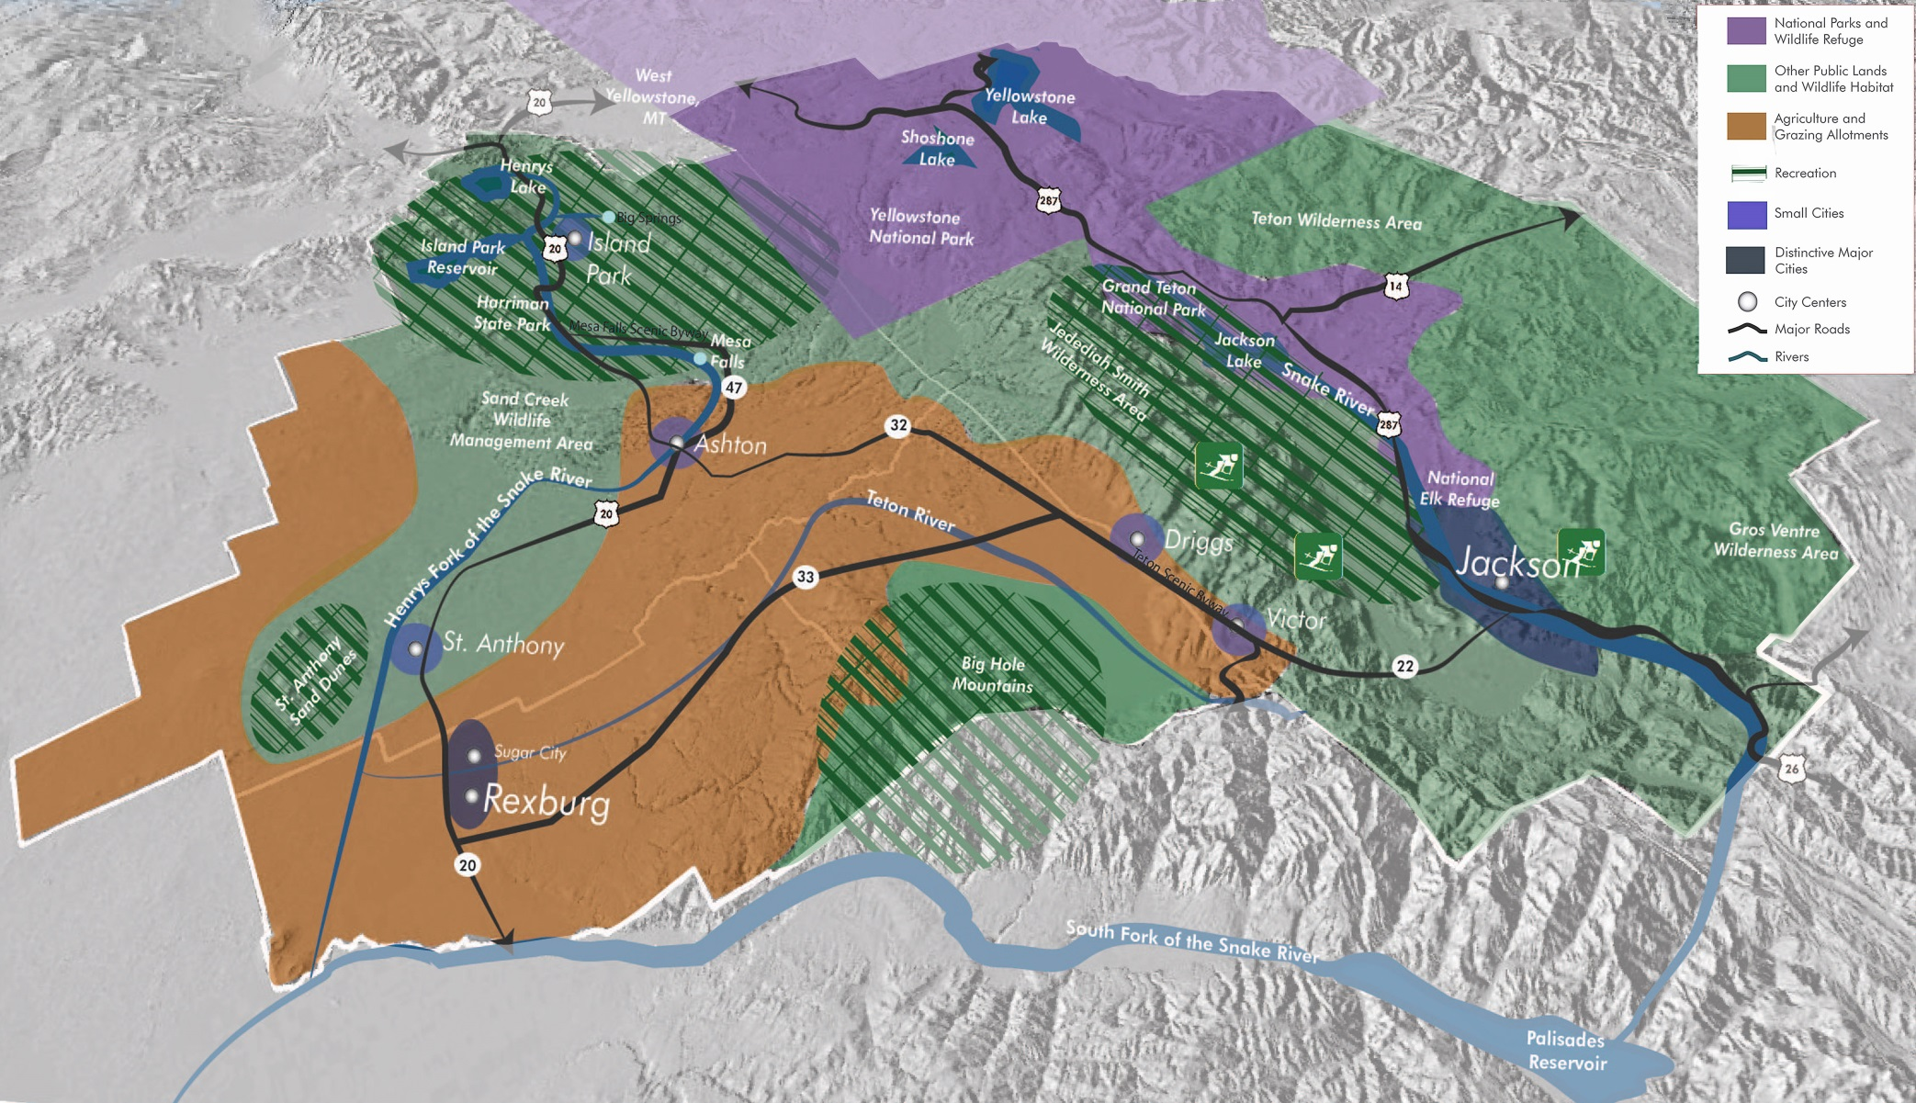
Plan Region

Slide 4
Regional Systems
Notes:
Agriculture, commerce, tourism, industry, transportation, government

Slide 5
Preservation of Character
Notes:
Just because work is being done on a regional scale doesn’t mean there has to be loss of identity

Slide 6
Opportunities on a Regional Scale
Notes:
Because so many of these places are small, resiliency and opportunity can happen only on a regional scale

Slide 7
Resiliency VS Sustainability
re·sil·ience rəˈzilyəns/
the capacity to recover quickly from difficulties; toughness.
sus·tain·a·ble səˈstānəb(ə)l/
able to be maintained at a certain rate or level.
Notes:
There are opportunities for resiliency and sustainability when looking regionally: Economic diversity and recovery, broadband, recycling etc

Slide 8
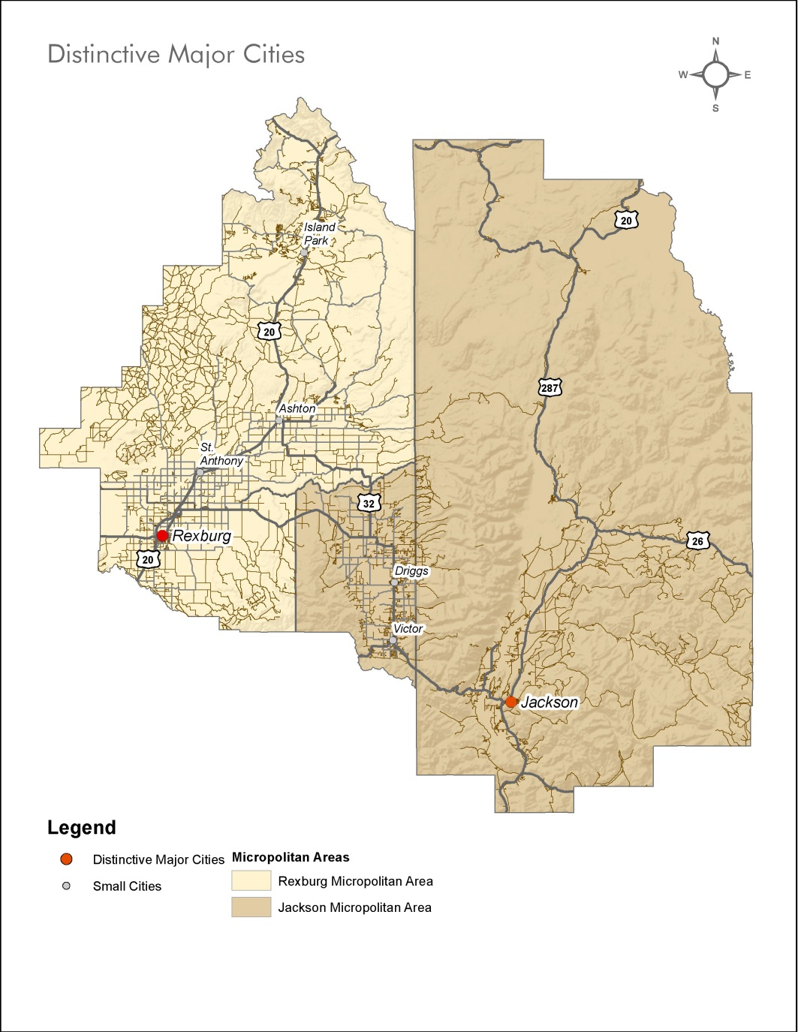
Major Cities
Rexburg ID: Pop 26,520
Jackson WY: POP 10,135

Slide 9
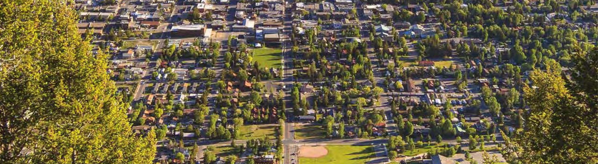
Major Cities
Theme 1.2: Encourage managed growth, access to services, and a healthy economy through sustainable land use planning.
Strategies
• Promote compact development in key infill areas where amenities and utilities are available to reduce cost of services.
• Coordinate city and county planning through joint planning processes, mutual agreements…
• Ensure compatible planning efforts and the application of consistent regulations in the areas adjacent to each city.
• Pursue local and inter-city transit options

Slide 10

Small Cities
Island Park ID: POP 286
Ashton ID: POP 1,084
St. Anthony ID: POP 3,465
Driggs ID: POP 1,657
Victor ID: POP 1,938

Slide 11
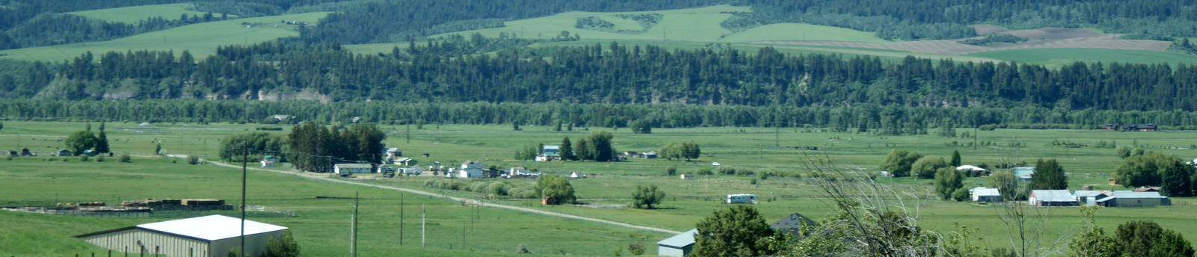
Small Cities
Theme 2.2: Promote a healthy economy by positioning communities for new
downtown investments.
Strategies
• Continue to revitalize our downtowns and create the appropriate environment and locations for new office and commercial businesses.
• Promote pedestrian activity in downtowns by improving the ability to access employment, shopping, and services through walking and biking.
• Seek dedicated funding sources for downtowns to support amenity improvements.
• Coordinate regional marketing campaigns with a focus on local businesses and small towns.

Slide 12
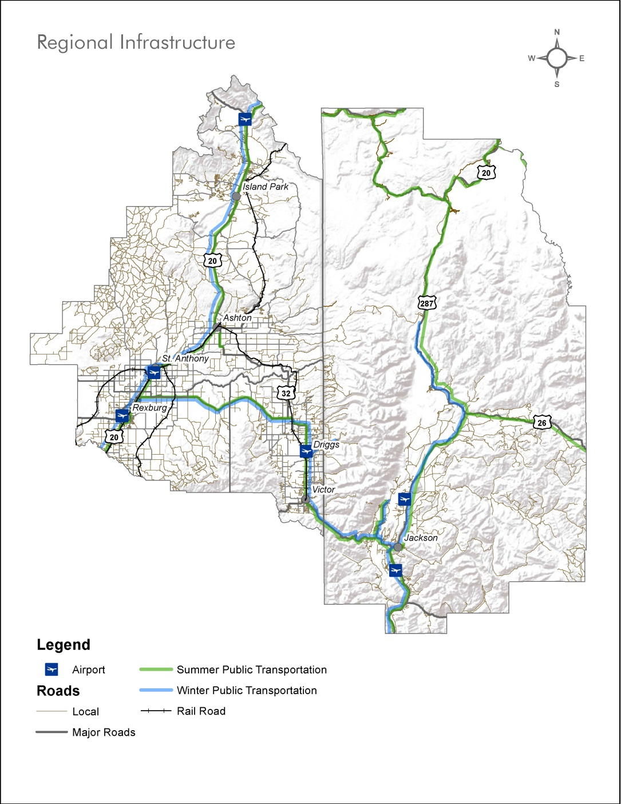


Vital Connections

Slide 13

Vital Connections
Theme 3.2: Encourage development of distributed, small-scale renewable energy
sources, and promote green energy purchasing by regional utilities.
Strategies
• Encourage and incentivize opportunities for residential and commercial projects to use state of the art construction techniques with energy efficient/renewable technologies.
• Encourage and incentivize the use of alternative energy sources to improve our resiliency.
• Encourage building types, features, and low impact storm water designs that reduce our per capita culinary and irrigation water use.

Slide 14
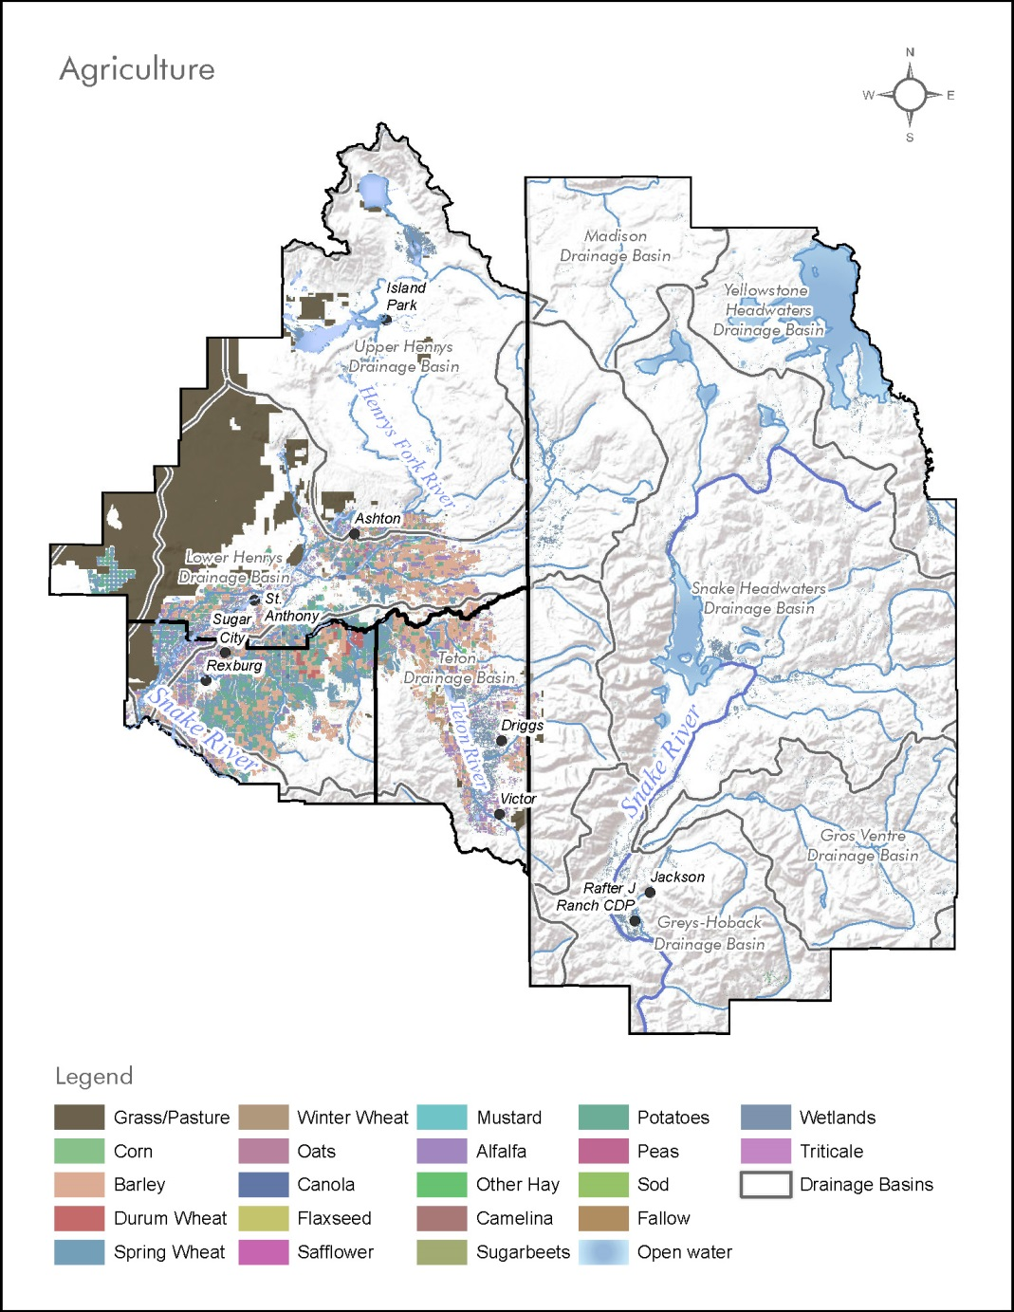

Agricultural Heritage

Slide 15

Agricultural Heritage
Theme 4.1: Support and enhance local agriculture, including crops and ranching/grazing.
Strategies
• Improve and maintain roads and other infrastructure important for agricultural production and transportation.
• Promote local agricultural industries and businesses and recruit agricultural entrepreneurs through local universities and education centers.
• Encourage land use policies and resources that enable farms to remain viable as circumstances and markets change.
• Return platted land to agricultural production where appropriate and viable.
• Provide a reasonable means for transfer of agricultural land to family members for the purpose of remaining in agricultural use.
• Encourage the launch of a “buy local” program that connects producers and consumers.

Slide 16
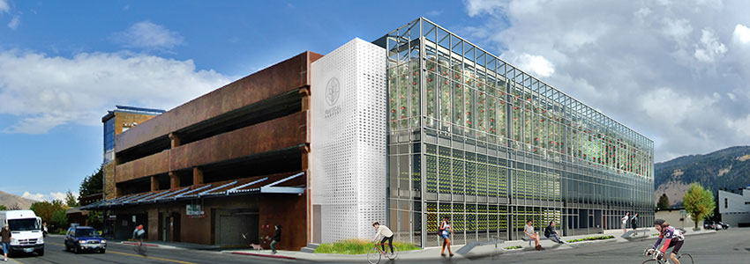
Very Cool

Slide 17
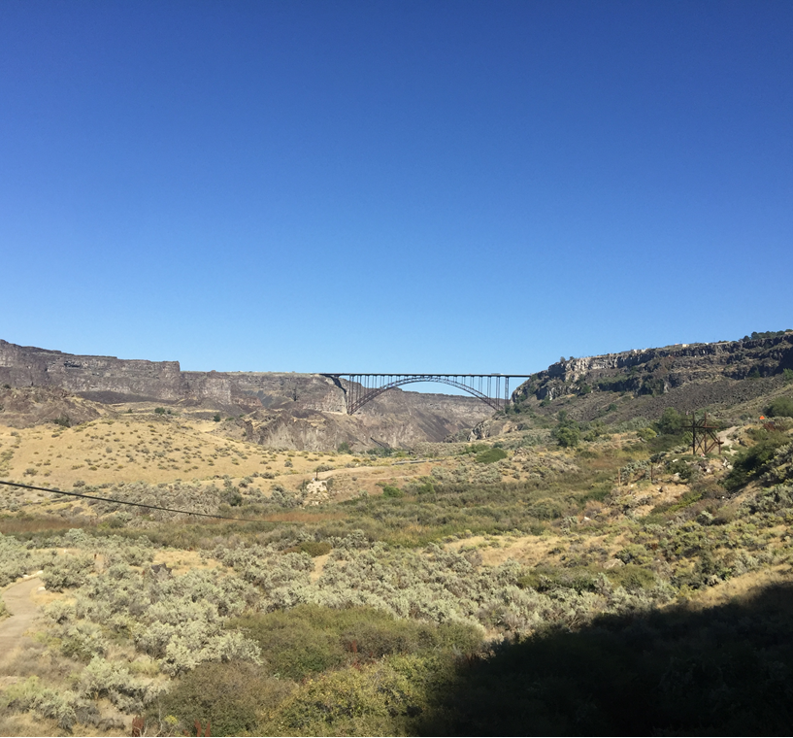
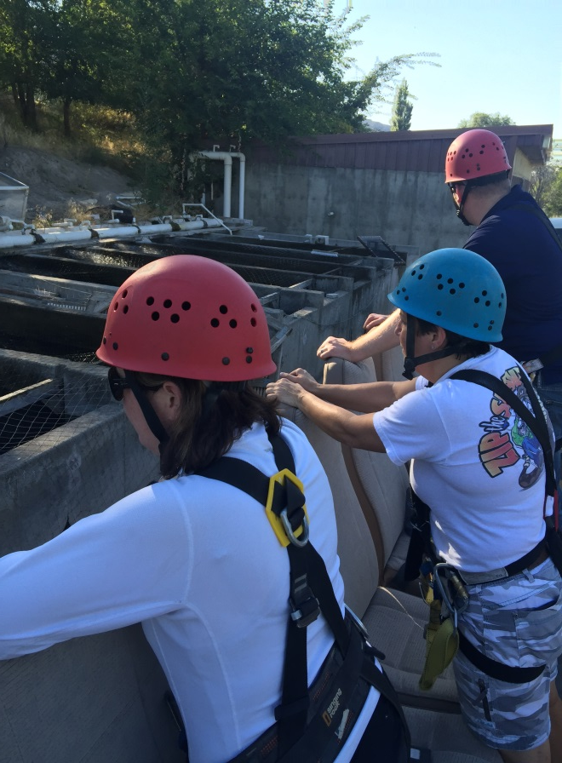
Very Cool

Slide 18
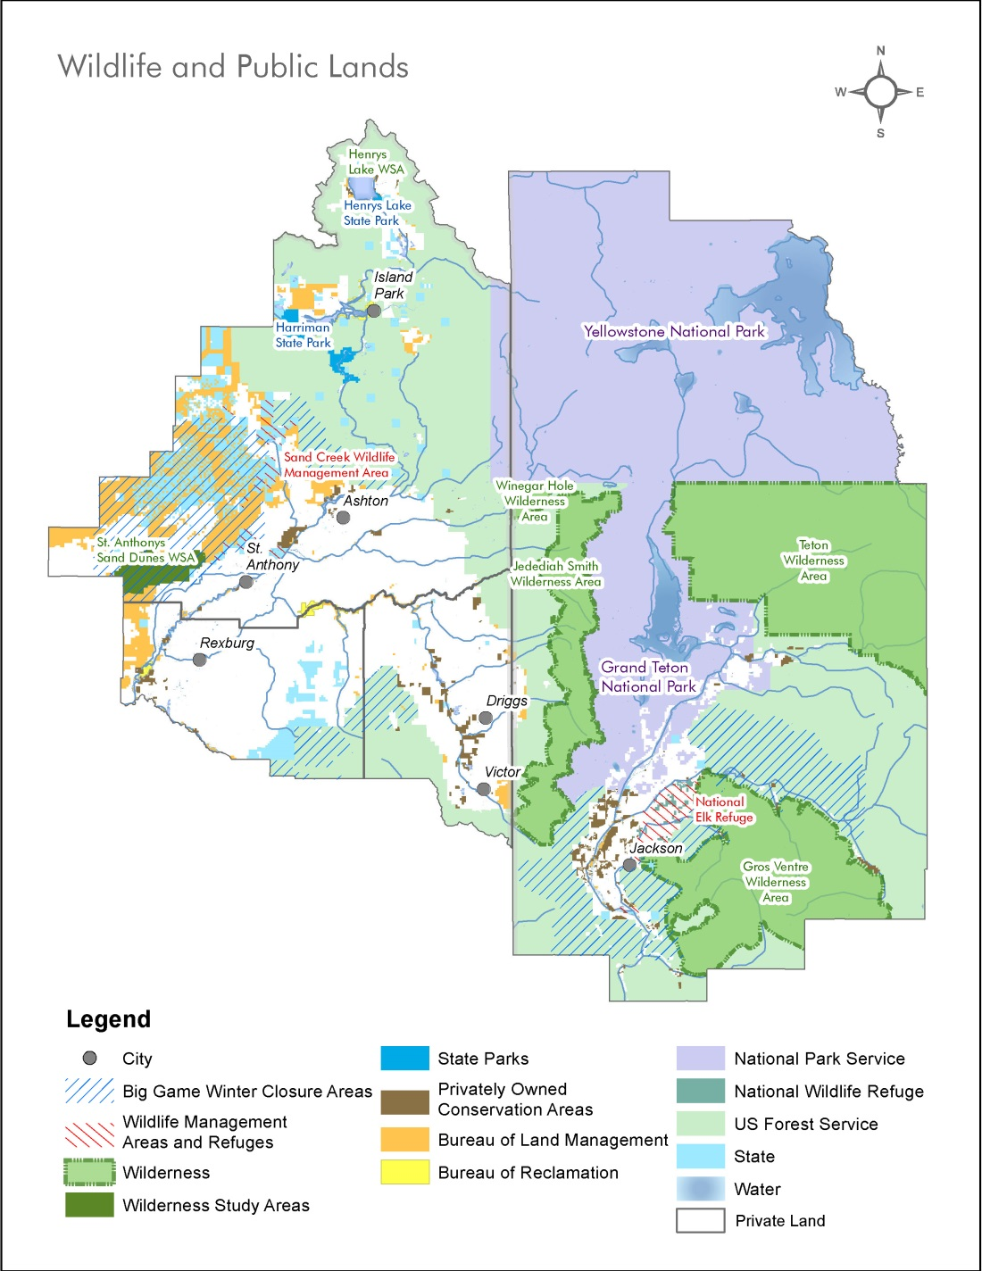
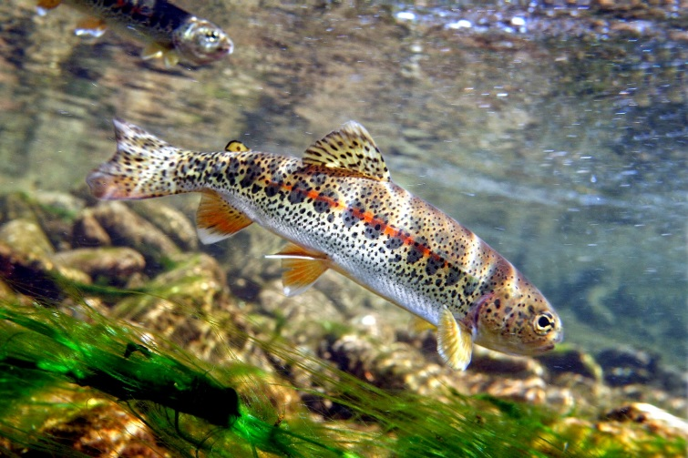
Wildlife and Public Lands

Slide 19
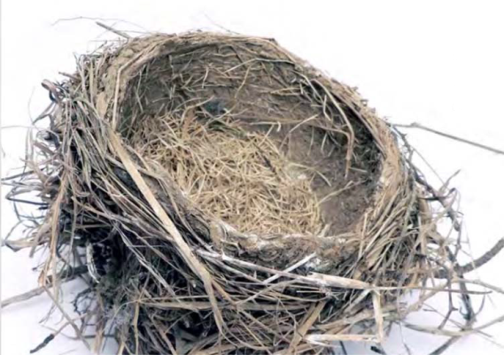
Wildlife and Public Lands
Theme 5.1: Ensure that development on state and federal lands within the Teton View Region is congruent with state habitat management objectives for species of critical concern.
Strategies
• Consider mutually agreeable land tenure adjustments/land exchanges to consolidate/connect wildlife habitats.
• Develop seasonal timing restrictions and buffer zones for sensitive wildlife species migration routes.
• Continue to designate winter ranges and prescription areas to emphasize big game security.
• Evaluate a range of possibilities of future climate conditions and bringing climate change adaptation into planning and management processes.
• Develop landscape level databases and the use of indicator species to fully understand the change in our environments due to development.

Slide 20
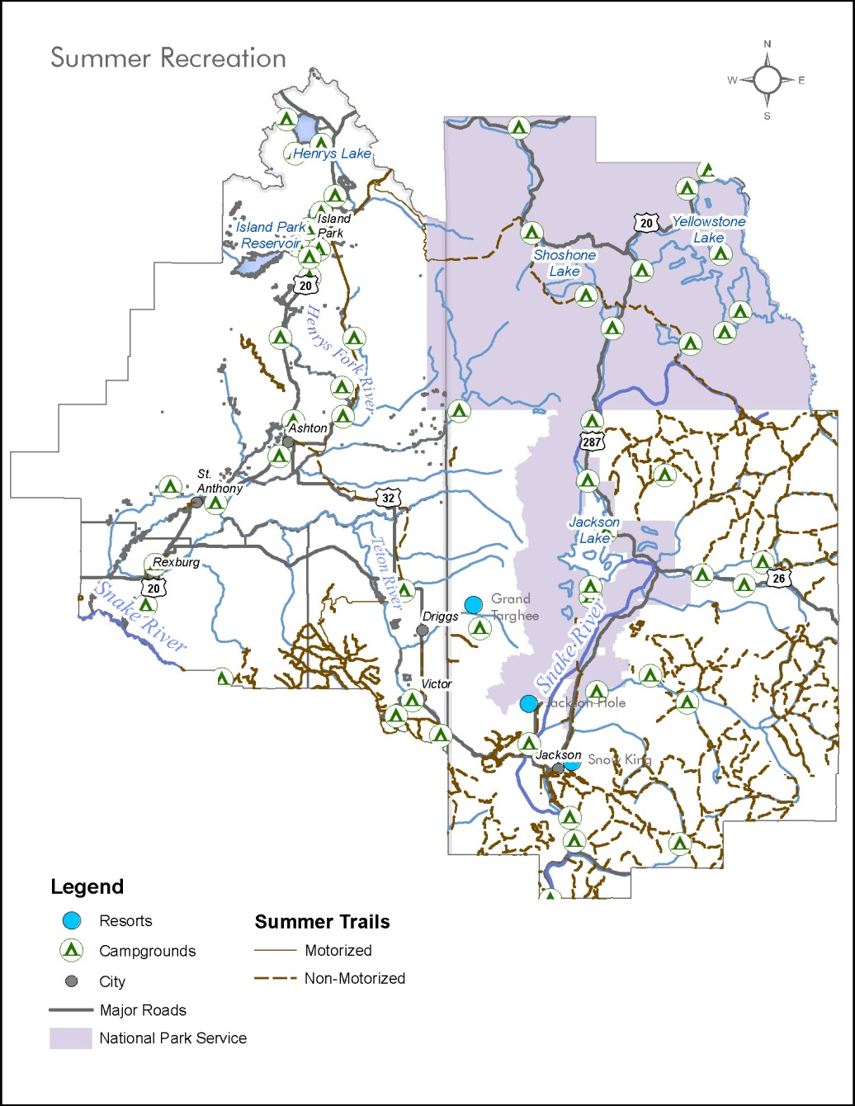
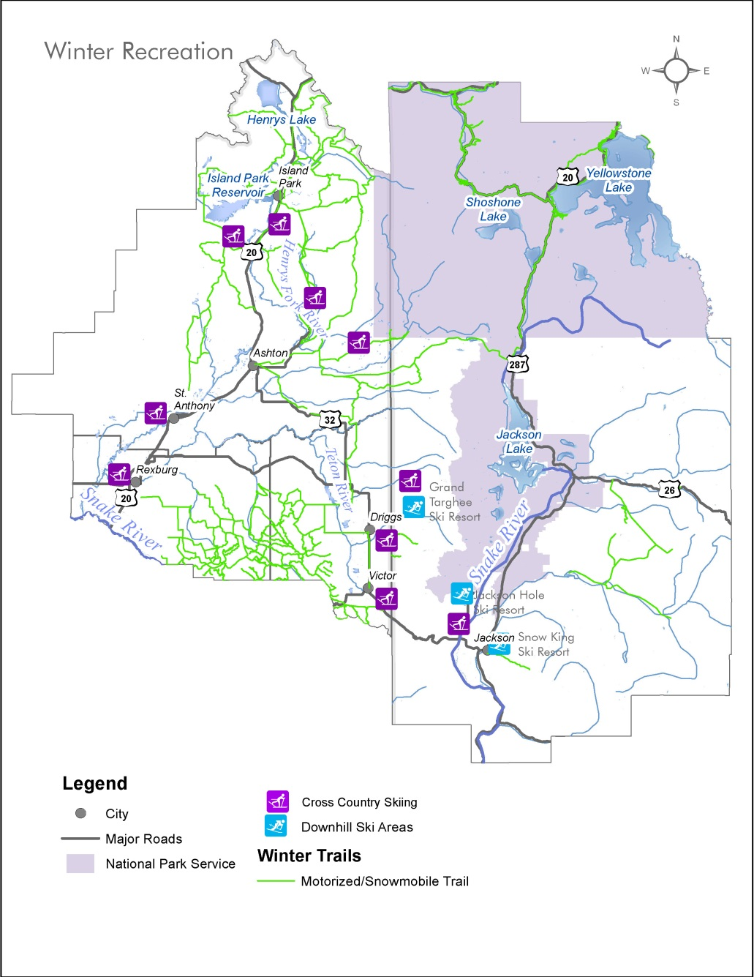
Four Season Recreation

Slide 21

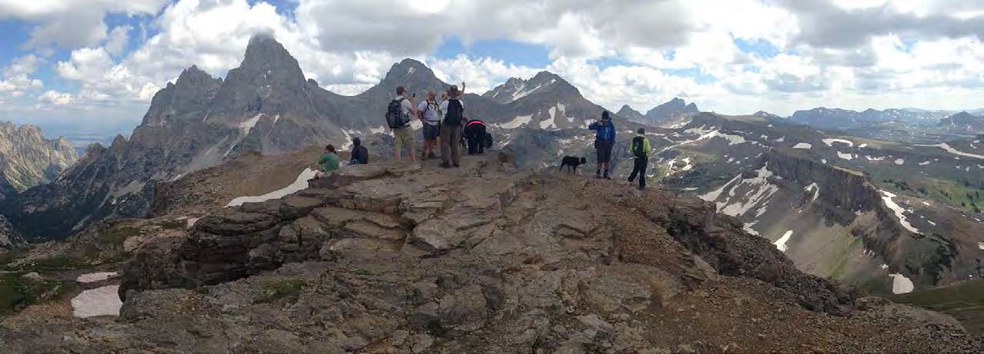
Four Season Recreation
Theme 6.1: Provide a diversity of recreation opportunities to match the diversity of
potential users.
Strategies
• Enhance and improve existing all-season access and support the development of new access to public lands and waterways, except where necessary to protect areas from environmental degradation, negative impact to wildlife habitat, or to protect public safety.
• Recognize the need to accommodate different user groups in a way that minimizes user conflicts and resource damage.
• Encourage “rights to hunt” and mitigate conflicts with other recreational uses.

Slide 22
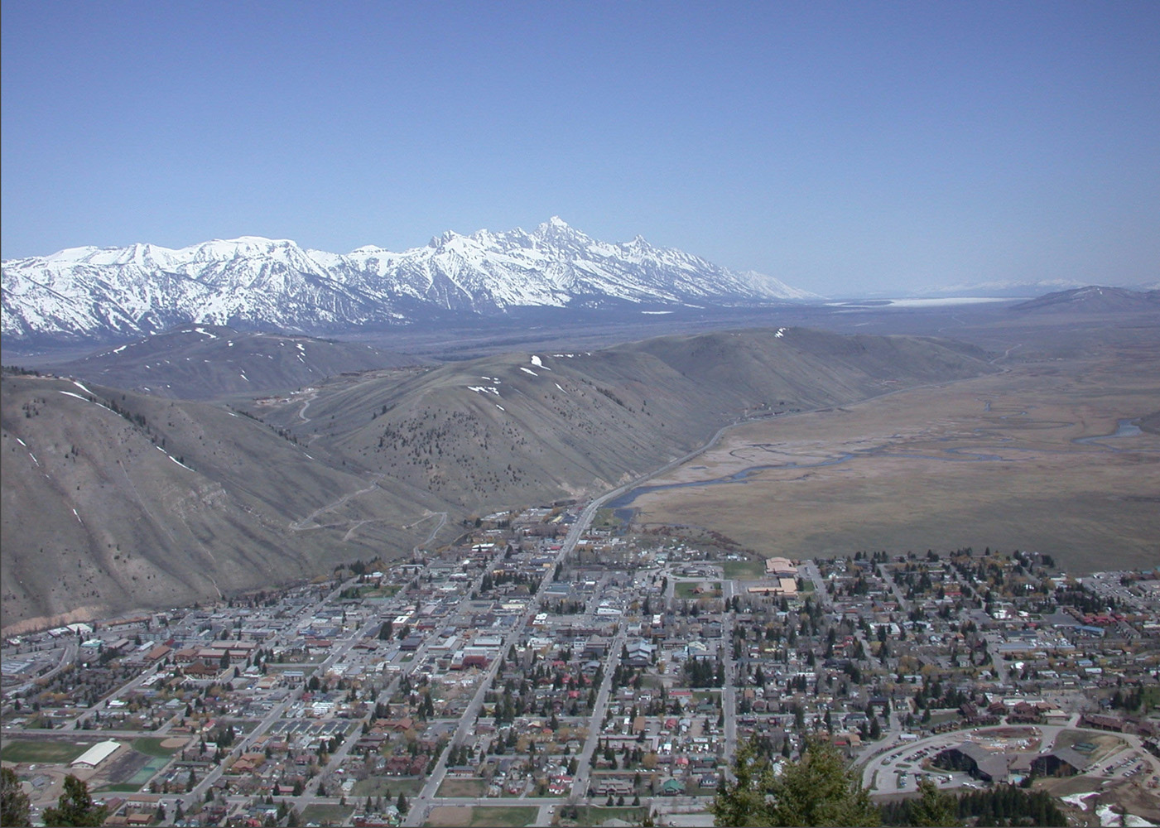
Jackson / Teton County Case Study
Notes:
Began in early 90s resulting in 1994 Plan
Late 90s, early 00s diversion
Reemphasis late 00s

Slide 23
Demographics
 | 1990 | 2000 | 2010
Town | 4,472 | 8,647 | 9,577
County | 6,700 | 9,604 | 11,717
Total | 11,172 | 18,251 | 21,294
Source: US Census
Population
 | 1990 | 2000 | 2010
Town | 40% | 47% | 45%
County | 60% | 53% | 55%
Total | 100% | 100% | 100%
Source: US Census
% of Growth

Slide 24
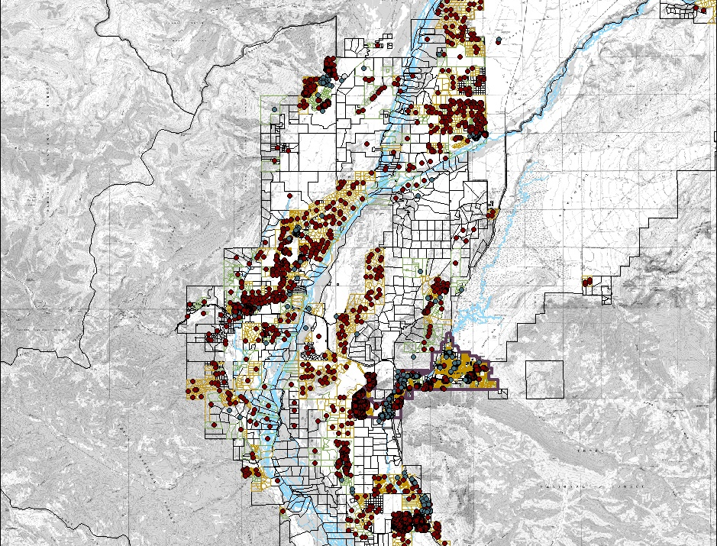
Before the Plan
Notes:
Rapid Growth pre-1994 plan
Few new lots created post 1994, lots of buildout of existing lots
Changes at the Resort
Led to:
Emphasis on Buildout: Desire for Quotas
Buildout as a desire but no
defined carrying capacity,
no defined inputs

Slide 25
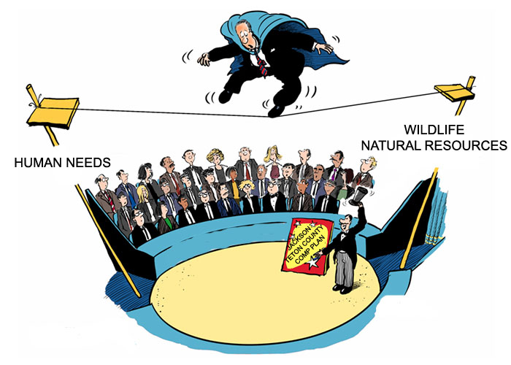

Slide 26
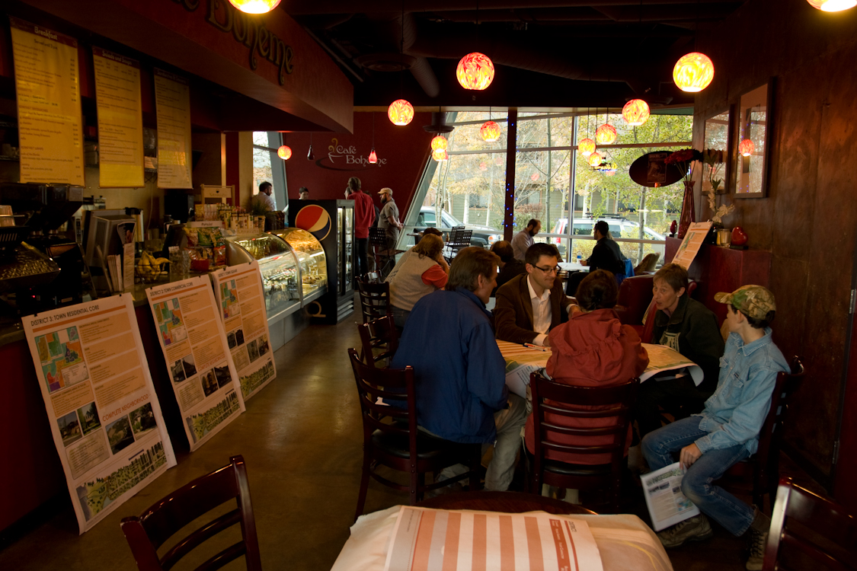
Notes:
Ultimately had broad support at adoption

Slide 27
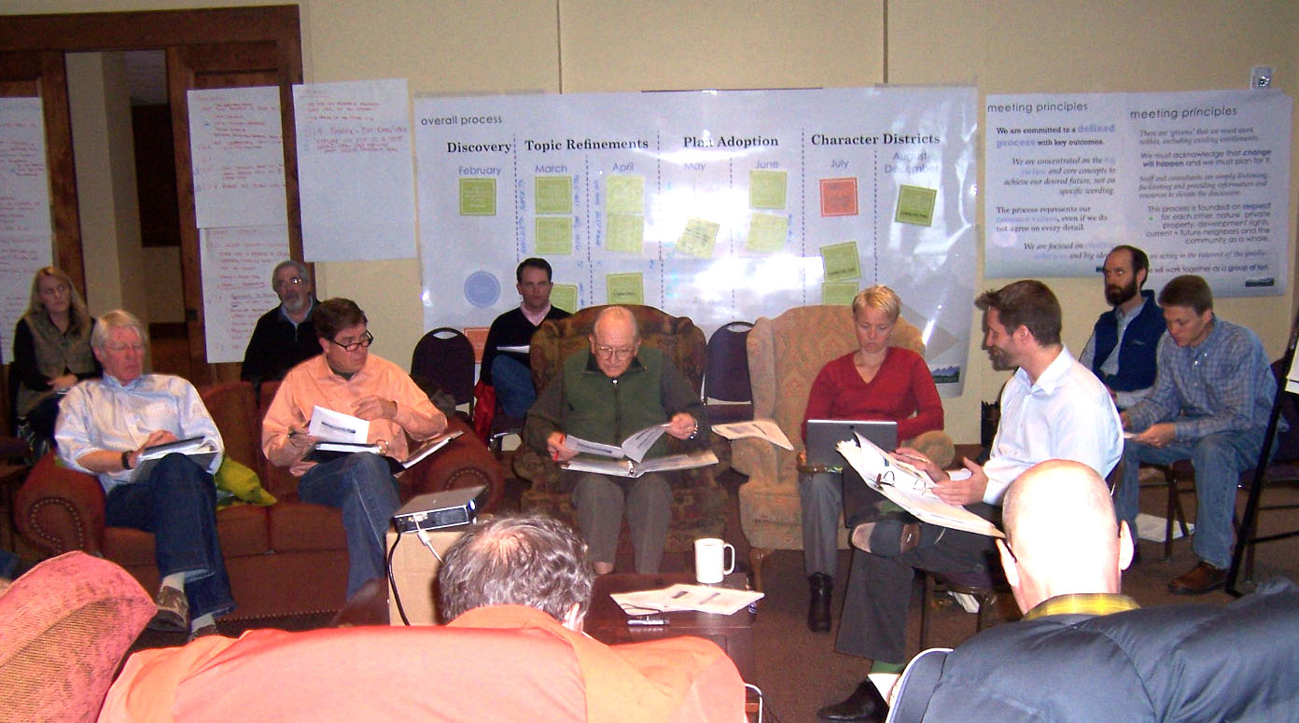
Notes:
Ultimately had broad support at adoption

Slide 28
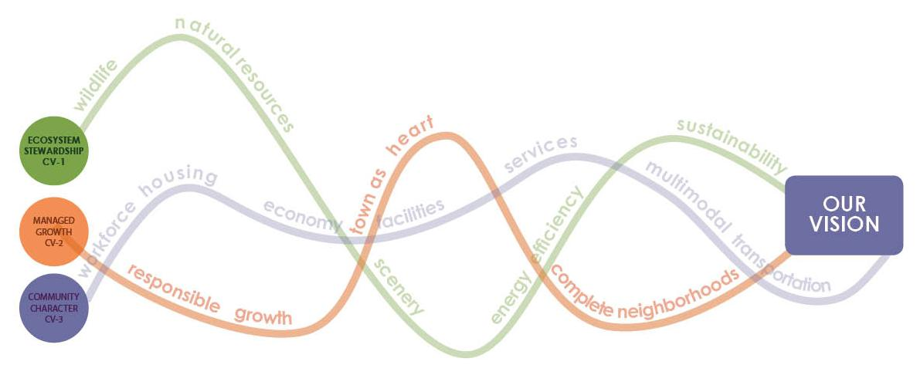
Vision
Preserve and protect the area’s ecosystem in order to ensure a healthy environment, community and economy for current and future generations

Slide 29
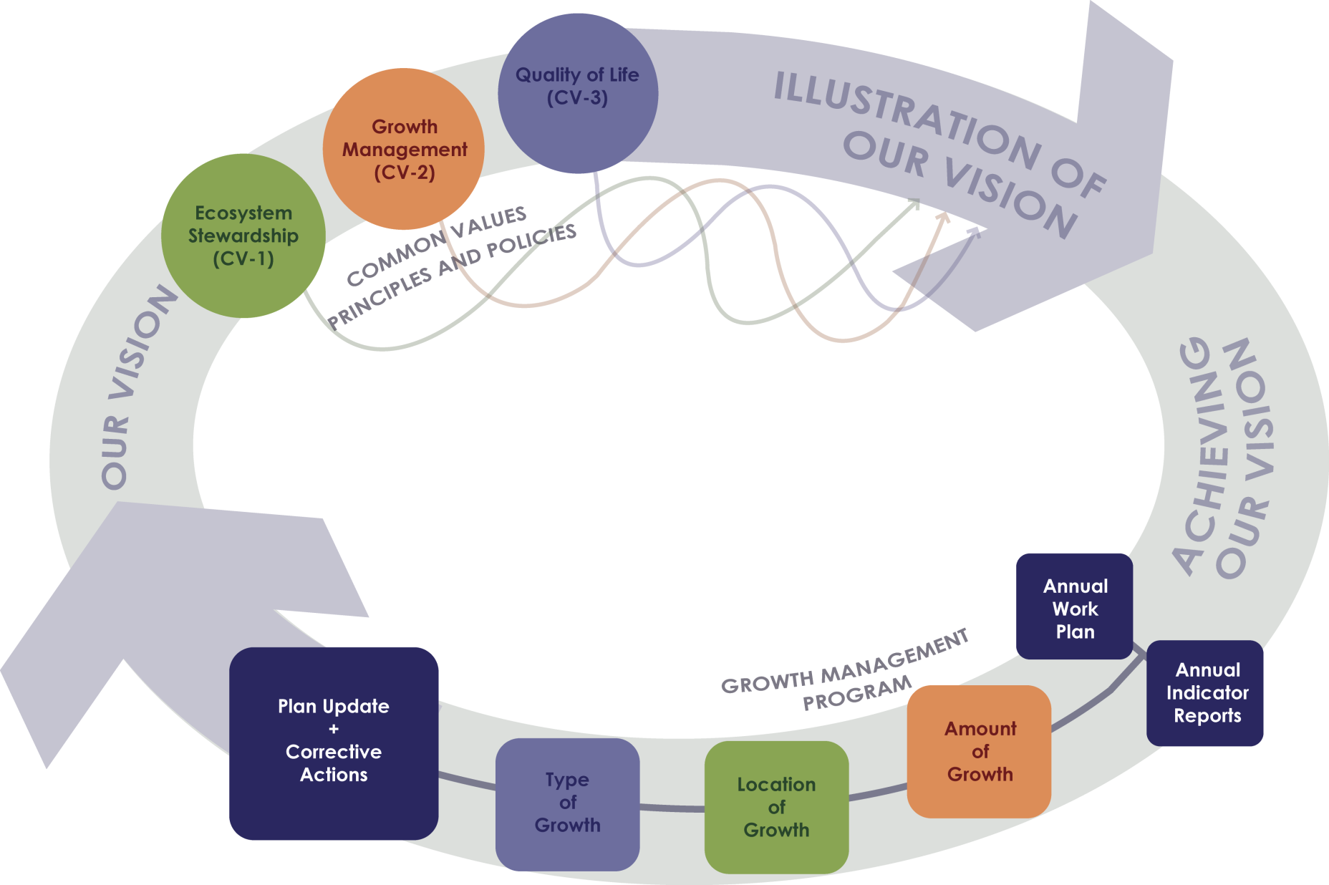
Plan Framework
Notes:
Overview of Plan Provide Details
Not repeat history with no check in and adaptation

Slide 30
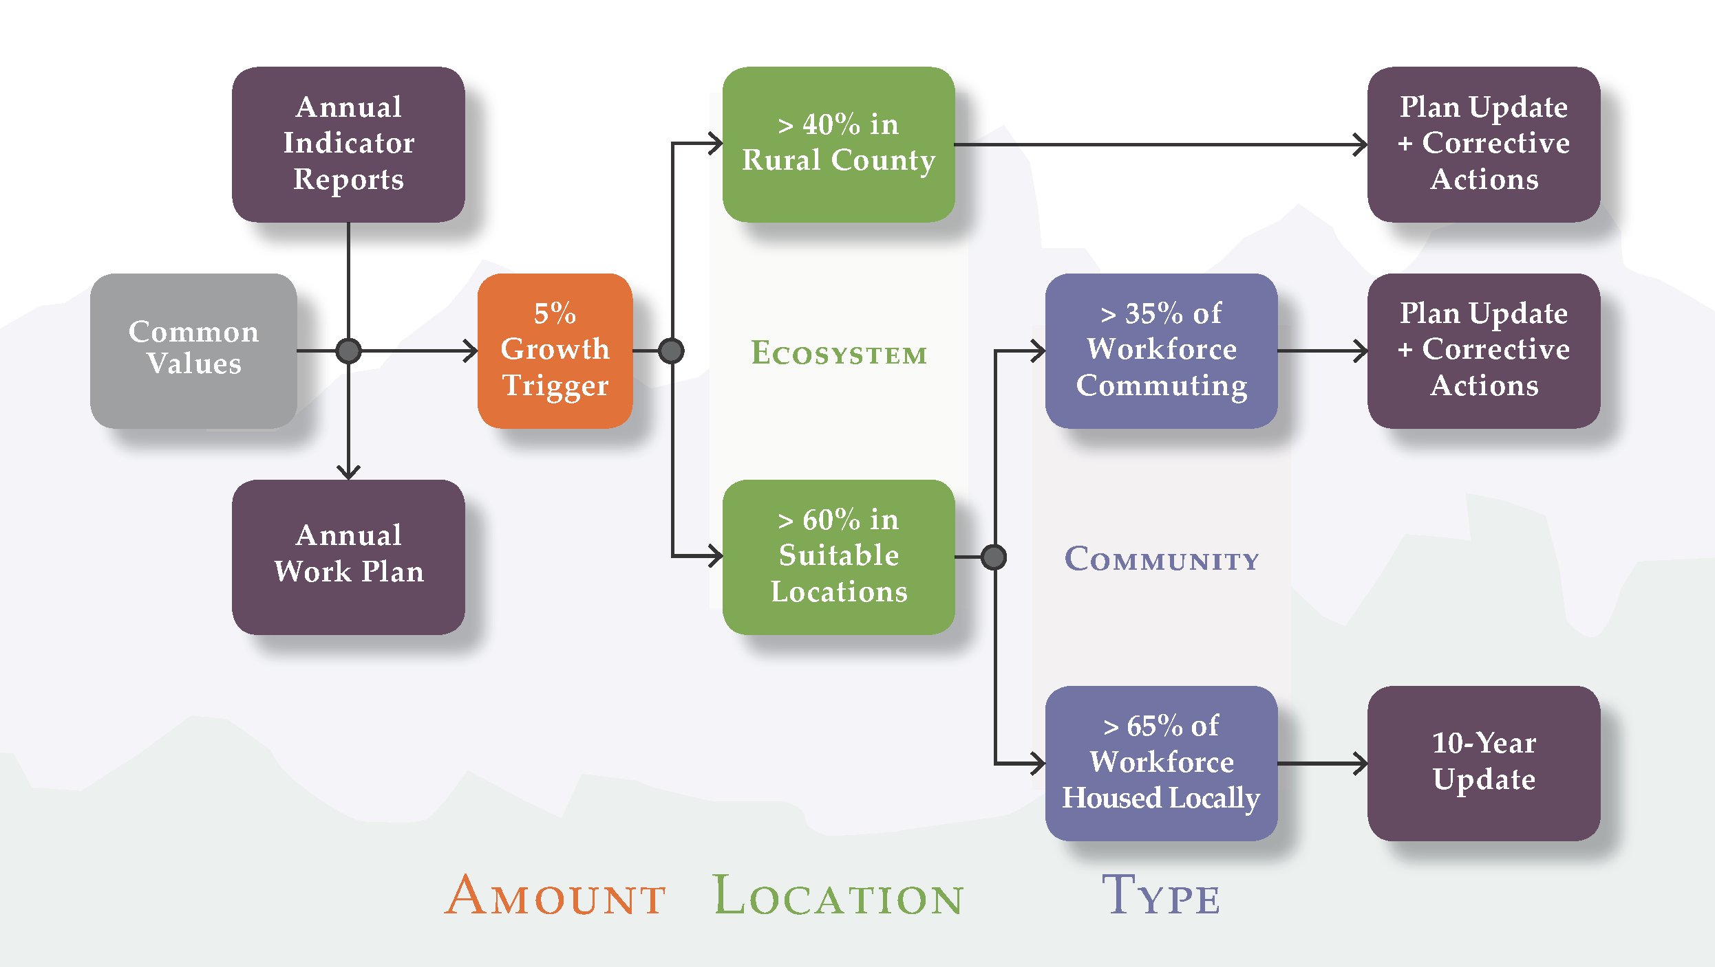
Growth Management Program
Notes:
Adaptive management philosophy
Monitor specific goals and take action
Benefits
Legal? Creates nexus, instead of requiring one
Addresses amount, location, character of growth
Indicators identified and prioritized
Process
Annual indicators/work program
5% trigger
Corrective Action
Goals
Maintain buildout
Shift from 40/60 to 60/40
Maintain 65%

Slide 31
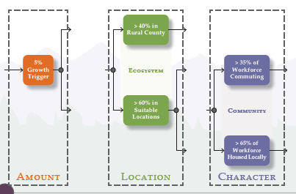
Components

Slide 32
Implications - Code

Slide 33
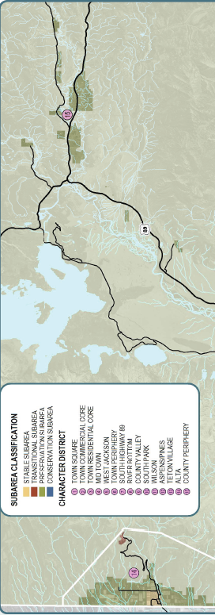
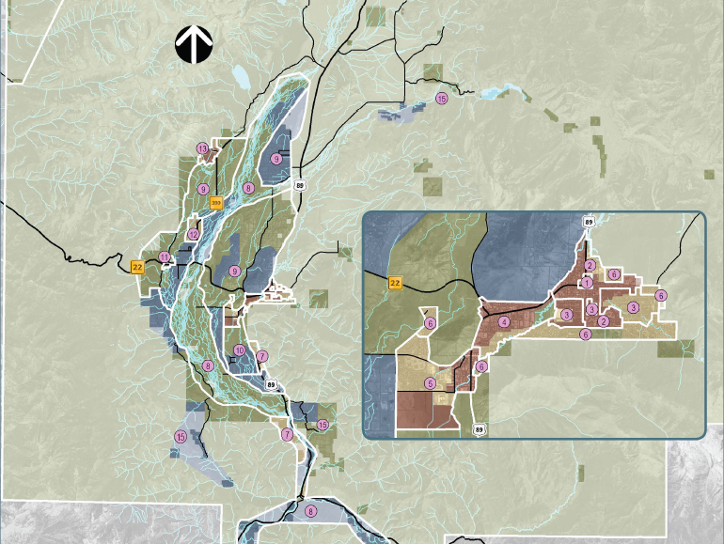

Slide 34
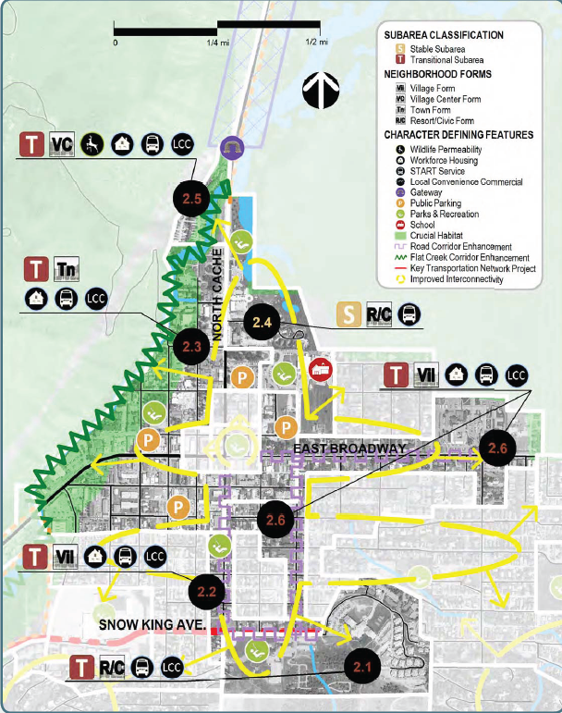
Character Districts – Rural or Complete
Depicts the characteristics each district and subarea
Characteristics are described through mapping or shown symbolically
Mapped features are illustrative of the character of an area and do not imply desired regulatory boundaries or specific locations of attributes

Slide 35
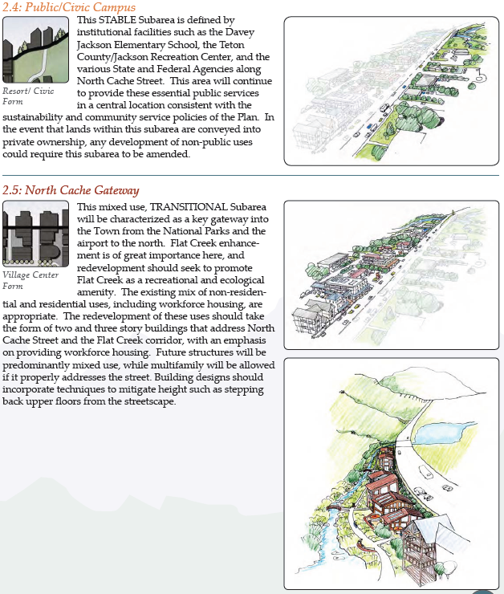
Character Defining Features
Describe each subarea through text, Neighborhood Forms, and photos and/or drawings
Neighborhood Form(s) depict the general pattern and intensity of development that meets the desired character
Illustrations and/or photos provide a more detailed illustration of the desired built form

Slide 36
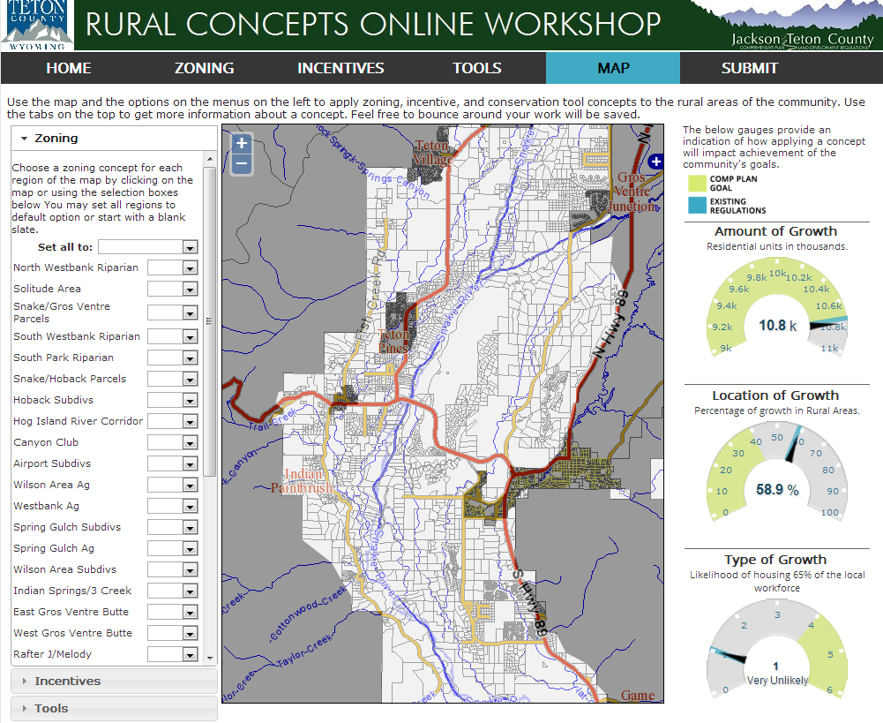

Slide 37
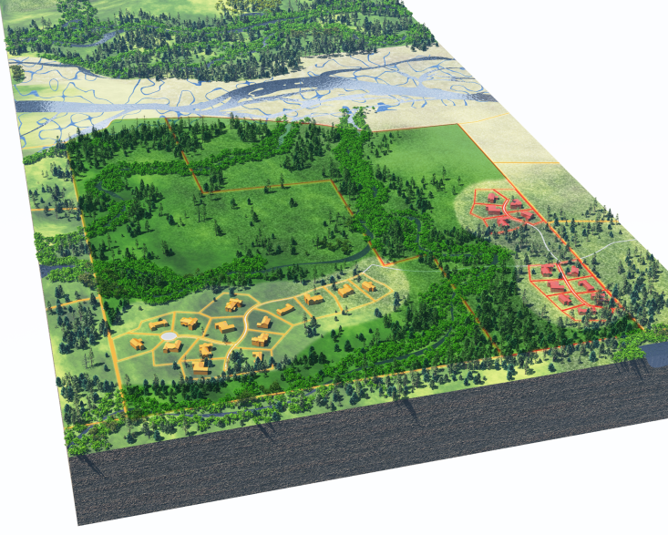
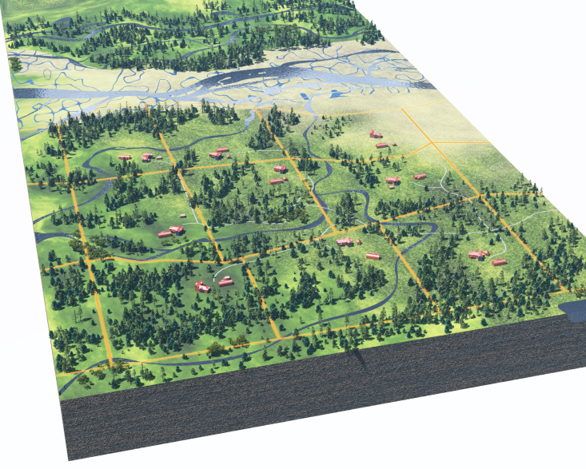
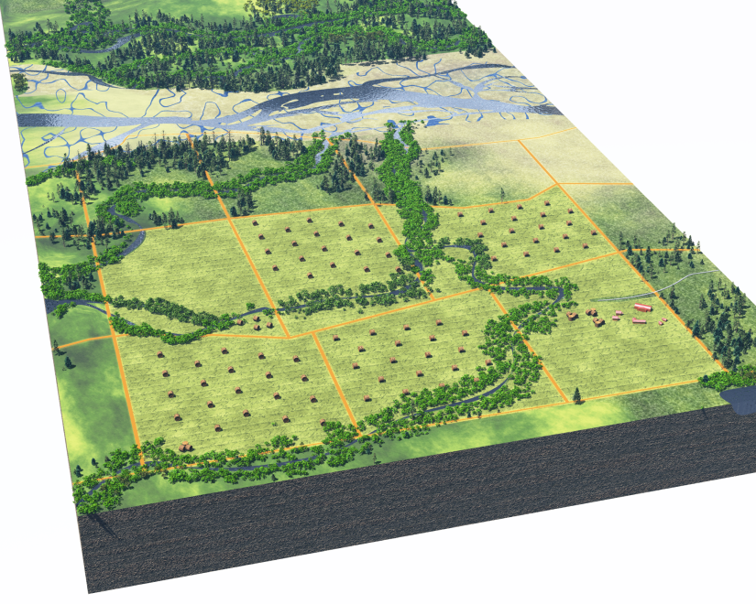
TDR to Conservation Tools

Slide 38
Implications - Workforce Housing

Slide 39

Tools and AMI Categories
< 50% AMI |  | 50-80% AMI |  | 80-120% AMI |  | 120-150% AMI |  | > 150% AMI
Rental | Owner | Rental | Owner | Rental | Owner | Rental | Owner | Rental | Owner

Slide 40
Housing Tools
Dedicated Sales Taxes
Stated Objectives & Metrics
Public/Private Partnership
Real Estate Transfer Tax
Preservation
Subsidize Housing Development
ARUs
Limiting Commercial Growth
Zone for Density
Land Acquisition
Density Bonus
Consistent Predictable Process
Tax Credits & Other Fed/State Funds
Flexible LDRs
Dedicated Property Taxes
Commercial Linkage
Residential Inclusionary
Residential Linkage
Potential Units Provided
Trailer Parks/
Microhousing
Rental Zoning
SPET Secondary Additional
Education
Rental Incentives
Bonus
Fee Waiver
No Net Loss
“Granting”
Expedited Project Approvals for Price Restricted Housing
Technical Assistance
Private Donations & Grants
Angel Fund
Cost/Complexity Per Unit

Slide 41
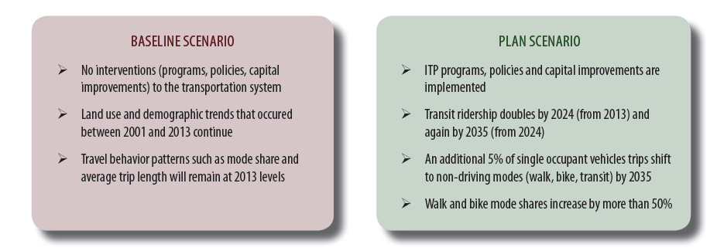
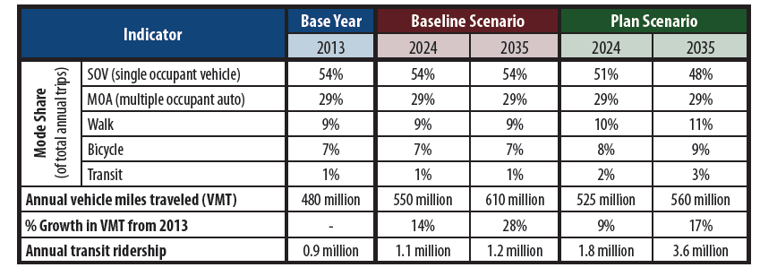
Other Benefits

Slide 42
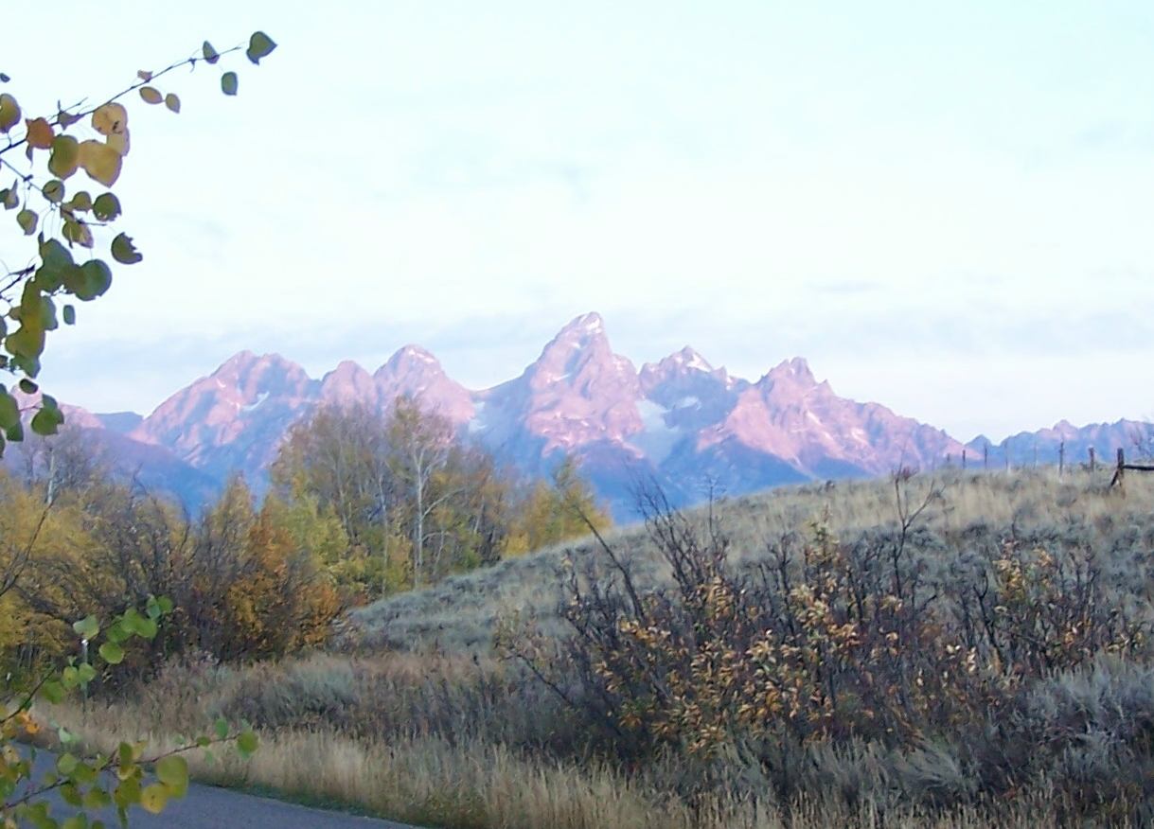
Paradise at the Price

Slide 43
Is Regionalism Worth It?

