Slide 1
Bicycle and Pedestrian Counting Methodologies and Strategies
8th Annual Idaho Planning Conference
Wednesday, October 7th
3:00-4:15pm

Slide 2
Goal for Today
Attendees will walk away with the following knowledge:
  Methods and strategies for manual and automated bike/ped counting programs
  What best practices are recommended for each counter technology
  How to interpret data received and how counter tech and be used to influence investment decisions
Notes:
This session is intended to start the discussion of planning for alternative modes of transportation.

Slide 3
Overview
Introductions
Manual Counts
  Margaret Havey, Valley Regional Transit
Automated Counts
  Kelly Lausten, Kittelson & Associates
Integration Example
  Tom Laws, COMPASS
Data Analysis
  Stephen McDaniel, WGM Group
Panel Discussion

Slide 4
Introductions
Margaret Havey
Regional Service Planner, Valley Regional Transit
Margaret is currently working as the Regional Service Planner for Valley Regional Transit in Meridian, Idaho where she works on a variety of public transit planning, mobility, and technology projects. Prior to that she worked for the Idaho Transportation Department in the Headquarters Roadway Data section, where for three years she coordinated the statewide portable traffic data collection program. For the past four years Margaret has had a volunteer pet project to recruit and train community volunteers to count bicycle traffic. The project deploys upwards of 70 volunteers around Ada County each May and September, and the data provided to local agencies.

Slide 5
Introductions
Kelly Laustsen
Transportation Engineer, Kittelson & Associates
Kelly is a Transportation engineer at Kittelson & Associates, a transportation consulting firm. Kittelson is based in Portland, Oregon with seventeen offices around the county. While Kelly lives in Portland, she has had the opportunity to also do work in Anchorage, Orlando, Boise, Baltimore, and a number of other locations across the country. She has worked on a variety of planning, development services, safety, and research projects. She recently worked on a research project to assess methods and technologies for collecting pedestrian and bicycle counts, resulting in NCHRP Report 797: Guidebook on Pedestrian and Bicycle Volume Data Collection. She is currently helping develop a multimodal data collection program for Bend, Oregon.

Slide 6
Introductions
Tom Laws
Bicycle and Pedestrian Coordinator, COMPASS
Tom is an Associate Planner at COMPASS in Meridian, Idaho with a primary focus in bicycle and pedestrian planning. Tom has worked on a variety of other projects at COMPASS including performance monitoring, development review, complete streets level of service, and demographics forecasts. Prior to joining COMPASS, Tom worked with the Department of the Interior and National Parks Service on visitor movement and transit shuttle planning in Sequoia and Kings Canyon National Parks. Tom holds a Master’s degree in Geography with emphasis in Transportation Planning from Western Washington University and Bachelor’s degrees with honors in Geography and Environmental Studies from the University of Oregon.

Slide 7
Introductions
Stephen McDaniel
Engineer Intern, WGM Group, Inc.
Stephen McDaniel is an Engineer Intern with a focus on transportation engineering at WGM Group, Inc. in Missoula, MT. His current areas of focus are geometric design and traffic engineering. Working in Missoula has enabled Stephen to be on the forefront of implementing bicycle friendly design and complete streets into urban settings. Stephen received his Bachelor’s and Master’s degrees in Civil Engineering from the University of Idaho. During his time as a graduate student, Stephen worked as a research assistant developing a new method of bicycle demand forecasting utilizing manual count data, GIS street networks, land use parcel data, and topographic characteristics.

Slide 8
Manual Bicycle and Pedestrian Counting
Manual Counts
Methodology
Site Selection
Volunteer recruiting
Training
Field sheets
resources

Slide 9
Manual Bicycle and Pedestrian Counting
Advantages
Turning Movements
Demographics
Behavior observation
Cheap
Flexible
Disadvantages
Small time window
Flaky volunteers

Slide 10

http://itd.idaho.gov/bike_ped/publications.htm

Slide 11
Selecting Locations
Establish baseline data
  Existing infrastructure
  Consistent locations year over year
Gaps in Network
  Behavior observation
Measure success of new infrastructure
  Before/after

Slide 12
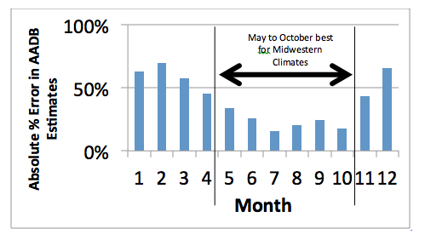
Standard Methodology
Adjust to your community/count purpose, but be consistent.
Months of the year
  May and September
  are most common
Day of the week
  Tuesday Wednesday Thursday
  Saturdays
https://www.pdx.edu/ibpi/schedule-and-count

Slide 13
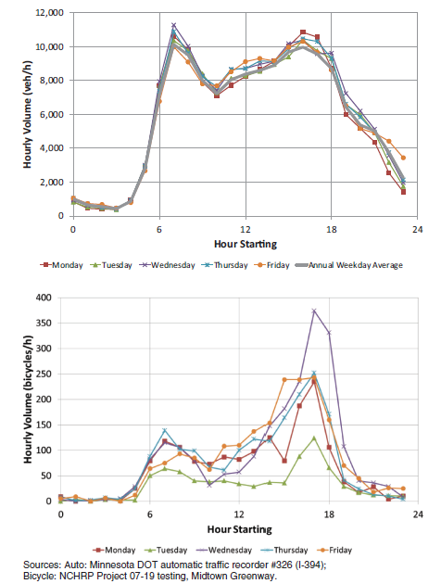
When to Count
Hours of the day
  7:00 AM to 9:00 AM
  4:00 PM to 6:00PM

Slide 14
Recruiting
Staff
Interns
Local High School or College Students
Parks Volunteers
Not for profit groups and clubs

Slide 15
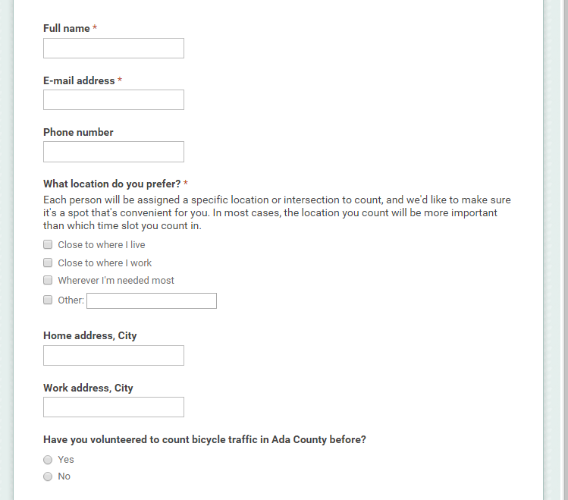
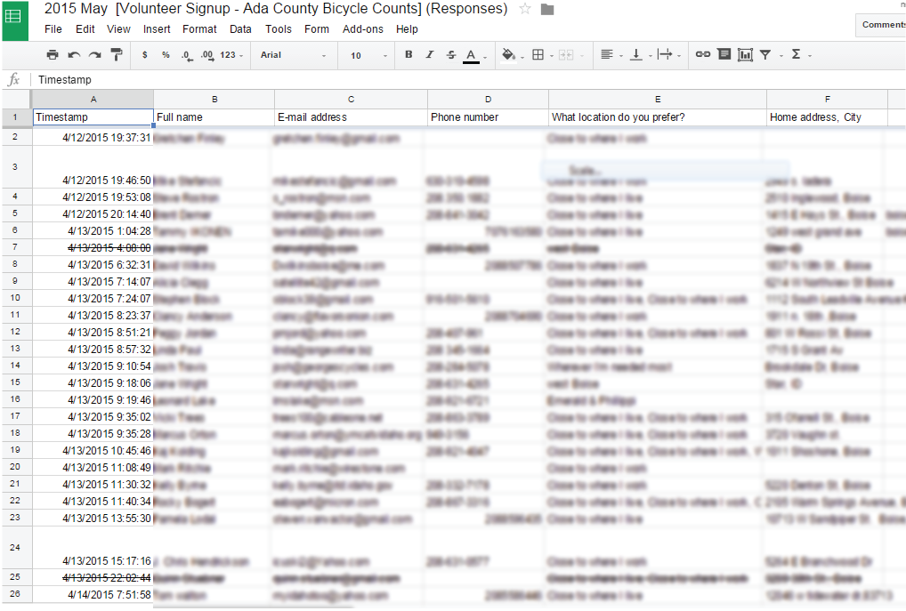
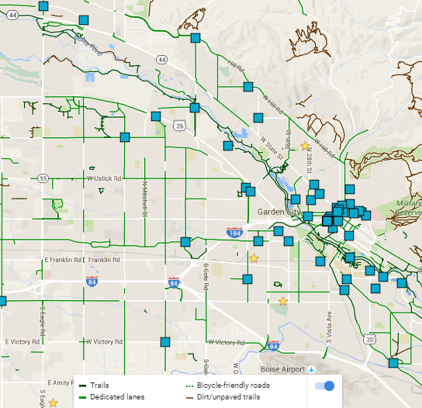
Volunteer Management
Google Docs Form (aka Drive)
Form Spreadsheet Map

Slide 16
Training
How to properly fill out the count forms.
What to count
What not to count
How to return forms
http://biketreasurevalley.org/resources/Documents/bikecounttraining2015.pdf

Slide 17
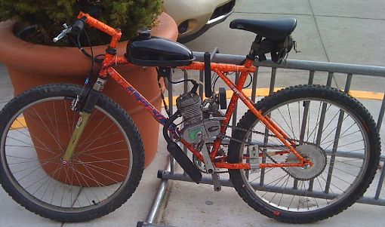
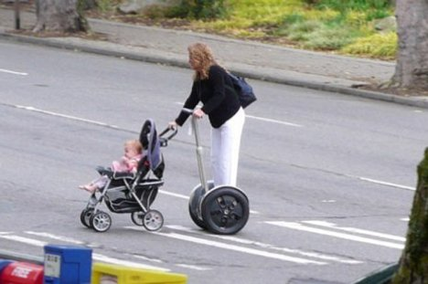
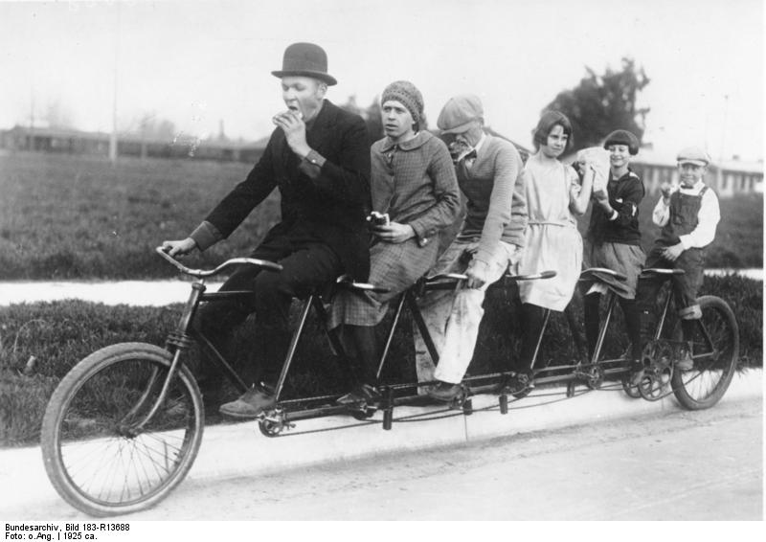
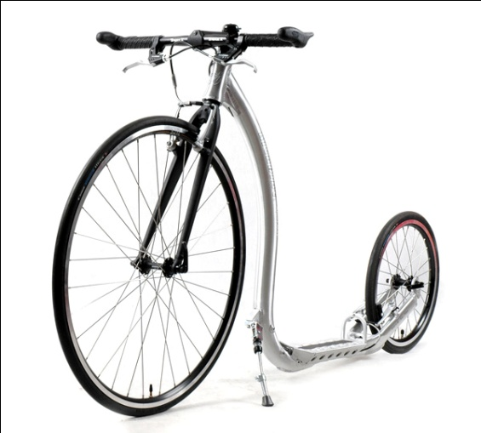
What counts as a bike?

Slide 18
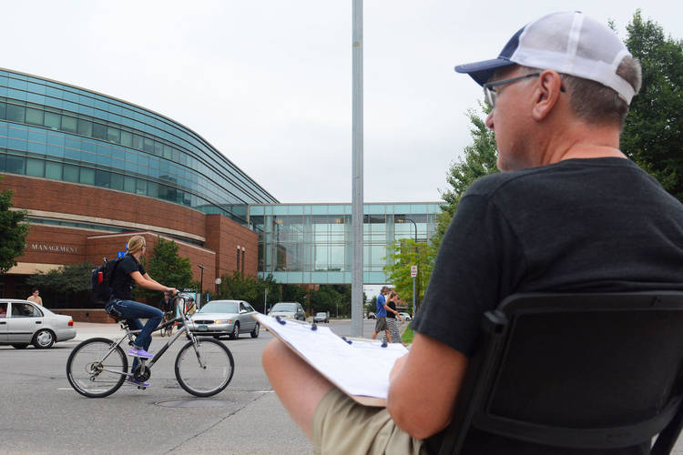
Counting Field Sheets
Can be tailored to community's need and still be standard
  Screenline
  Demographics
  Pedestrian

Slide 19

Screenline Field sheet
http://bikepeddocumentation.org/downloads/

Slide 20
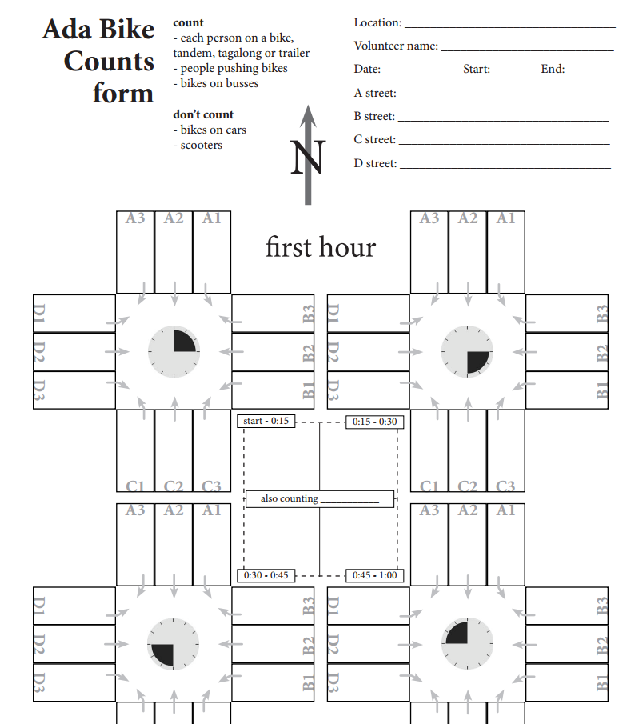
Demographic Field sheet
http://biketreasurevalley.org/resources/Documents/countingform.pdf

Slide 21
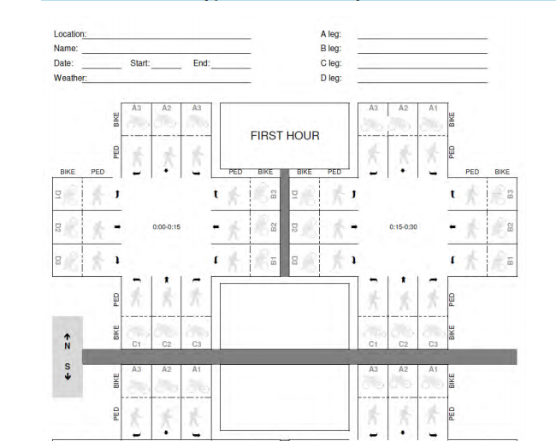
Pedestrian Field sheet

Slide 22

Smartphone apps
http://www.bikeandwalk.org/

Slide 23
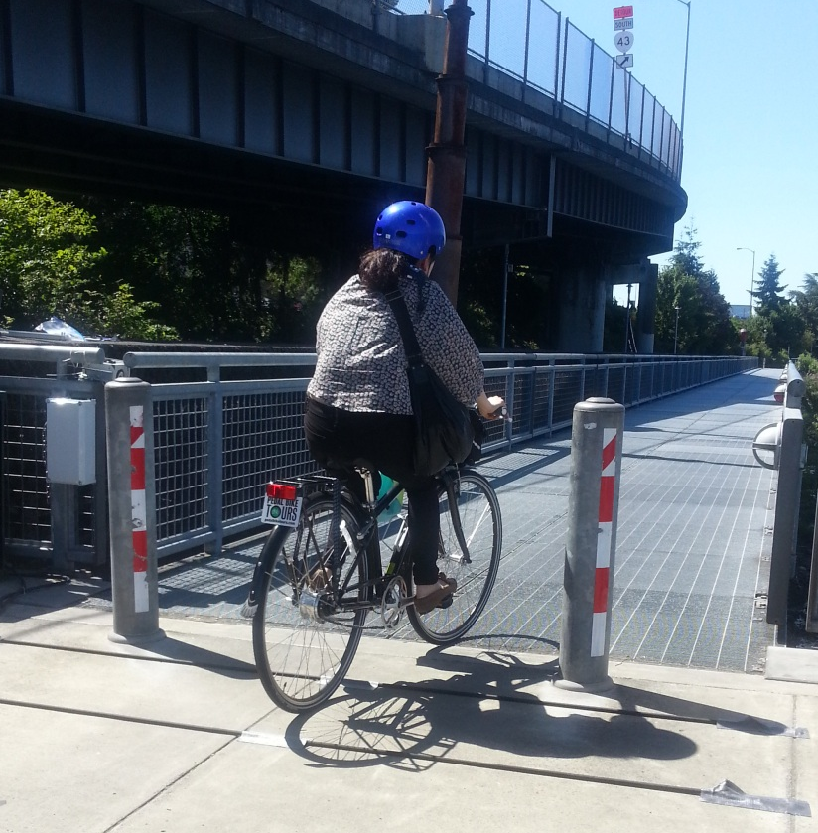
Methods & Technologies for Bicycles & Pedestrian Counting
NCHRP 797
October 7, 2015

Slide 24
Presentation Overview
Introduction
Project and guidebook overview
Automated count technologies

Slide 25
Project and Guidebook Overview

Slide 26
NCHRP 07-19 Research Team
Kittelson & Associates, Inc.
University of Wisconsin—Milwaukee
UC Berkeley, SafeTREC
Toole Design Group
McGill University
Quality Counts, LLC

Slide 27
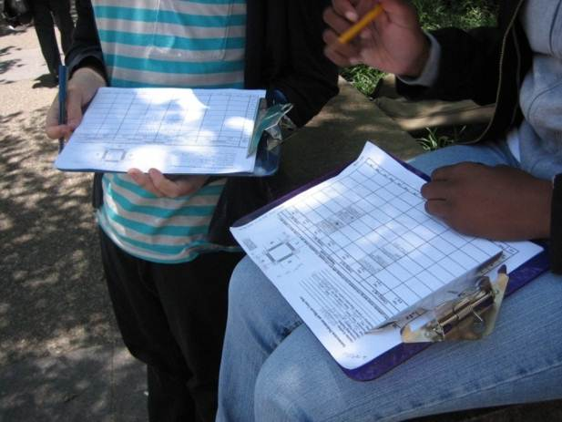
Project Purpose
Address lack of pedestrian and bicycle volume data
Assess data collection technologies and methods
Develop guidance for practitioners
Notes:
Why?
-Barrier to planning effective facilities
-Standard procedures for vehicular data collection

Slide 28

Guidebook (NCHRP Report 797) Contents
Quick Start Guide
Introduction
Non-Motorized Count Data Applications
Data Collection Planning and Implementation
Adjusting Count Data
Sensor Technology Toolbox
Case Studies
Manual Pedestrian and Bicyclist Counts:
Example Data Collector Instructions
Count Protocol Used for NCHRP Project
07-19
Day-of-Year Factoring Approach
Appendices

Slide 29

Related Work
FHWA Traffic Monitoring Guide (TMG)
  2013 edition includes chapter on non-motorized traffic
  Guidance on data reporting formats
  NCHRP research complements FHWA guide
Notes:
Provides more recent data and real-world examples

Slide 30
Automated Counting Technologies

Slide 31
Common Strategy: Manual & Automated
 |  | Geographic Coverage
 |  | A Few Locations | Many Locations
Count Duration | Continuous | Automated
 | Short-Term |  | Manual

Slide 32
NCHRP 07-19 Study: Field Testing
Focus on testing and evaluating commercially available automated technologies
Assess type of technology as opposed to a specific product
Cover a range of facility types, mix of traffic, and geographic locations
Evaluate accuracy through the use of manual count video data reduction

Slide 33
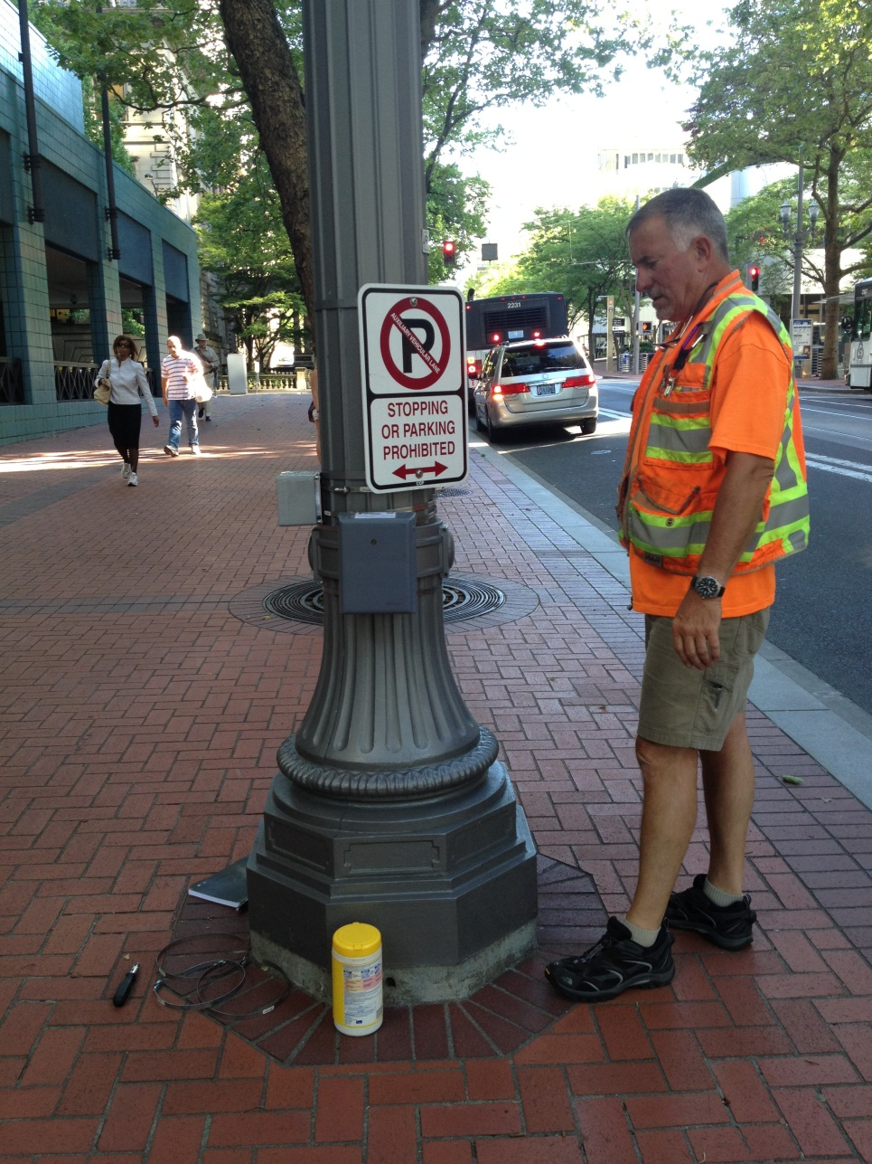
Portland, OR
5th Avenue (Downtown) Sidewalk
  Passive Infrared
  Radio Beam

Slide 34
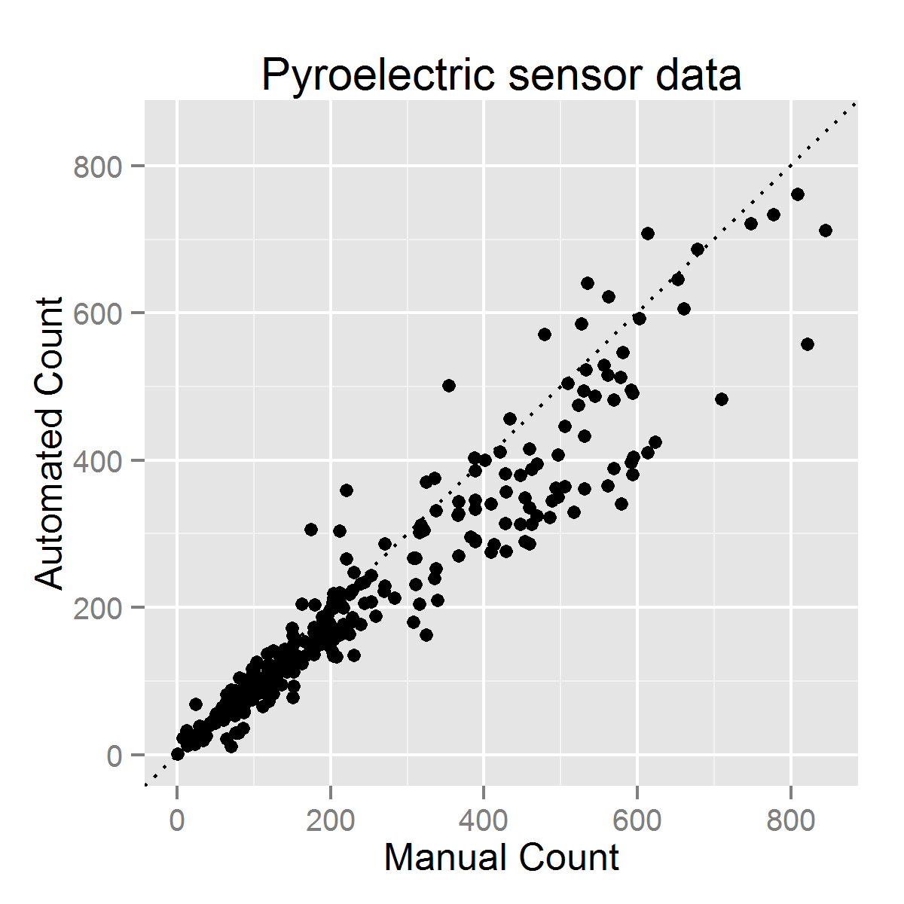
Graphical Analysis
Overcounting
“Perfect accuracy” line
Undercounting

Slide 35
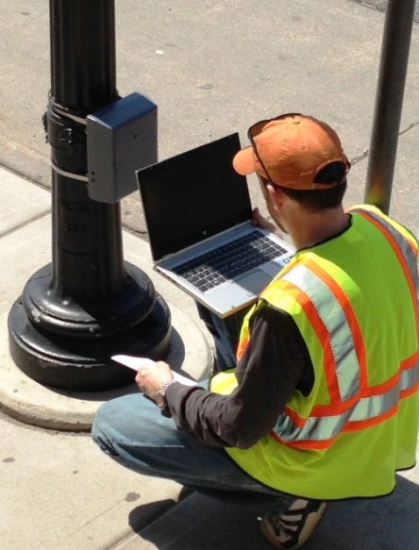
Passive Infrared (IR)
Detect pedestrians and cyclists by infrared radiation (heat) patterns them emit
Passive infrared sensor placed on one side of facility
Widely used and tested
Source: Toole Design Group

Slide 36
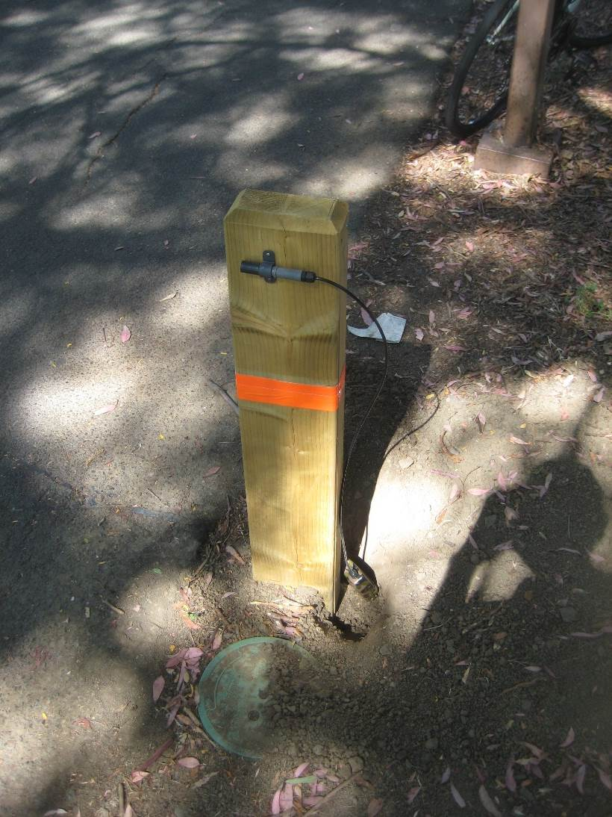
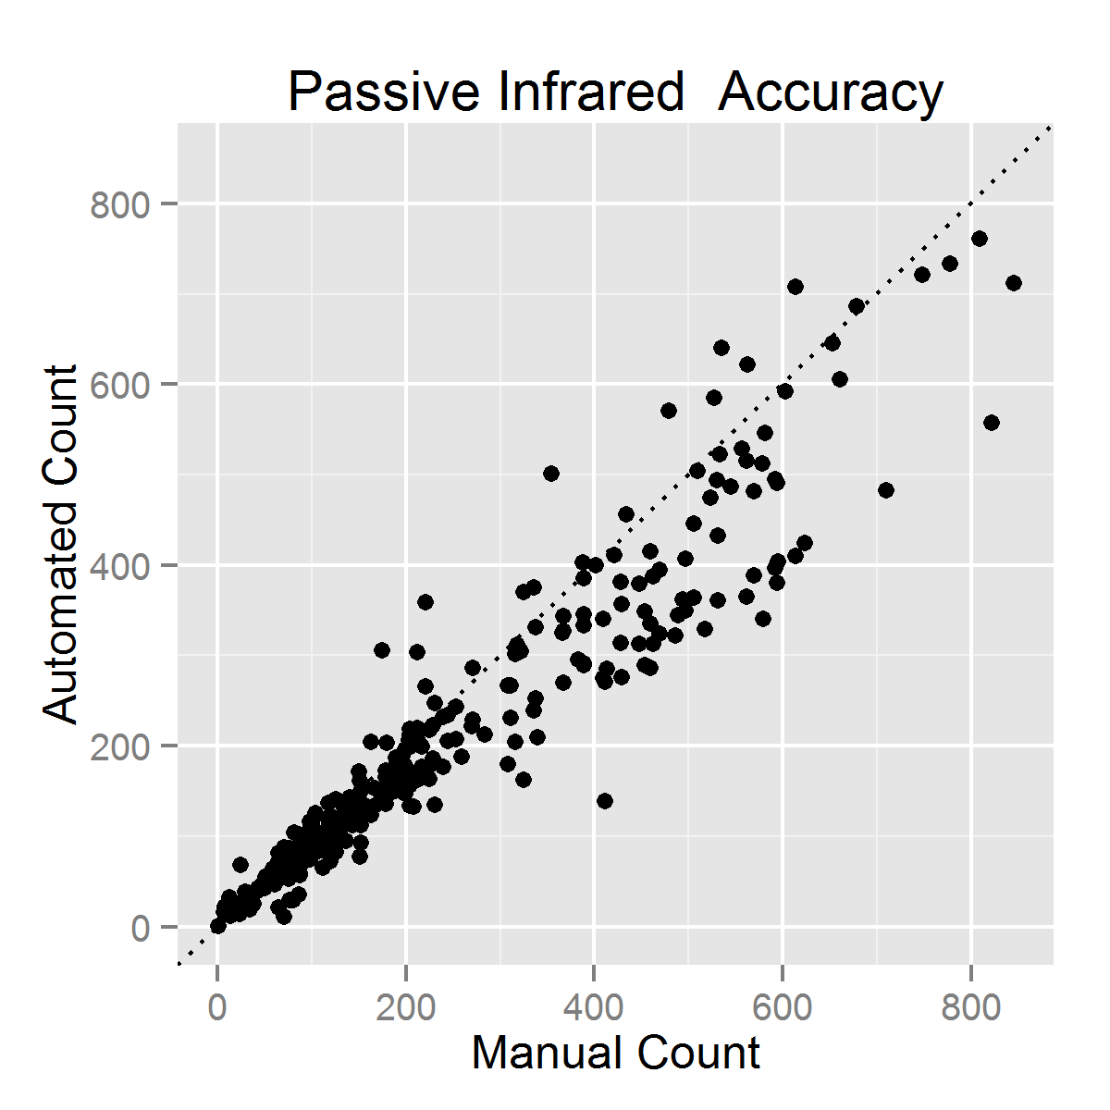
Passive Infrared (IR)
Easy installation
Mounts to existing pole/surface or in purpose-built pole
Potential false detections from background
Possible undercounting due to occlusion
Photo: Frank Proulx

Slide 37
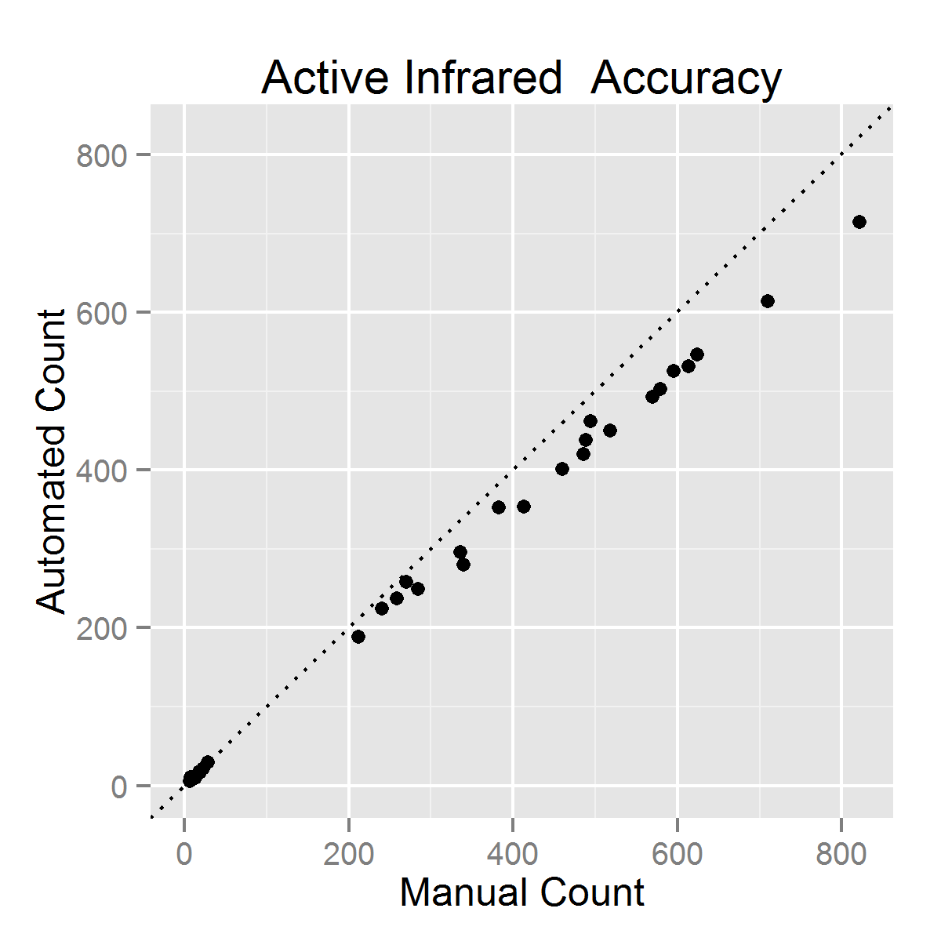
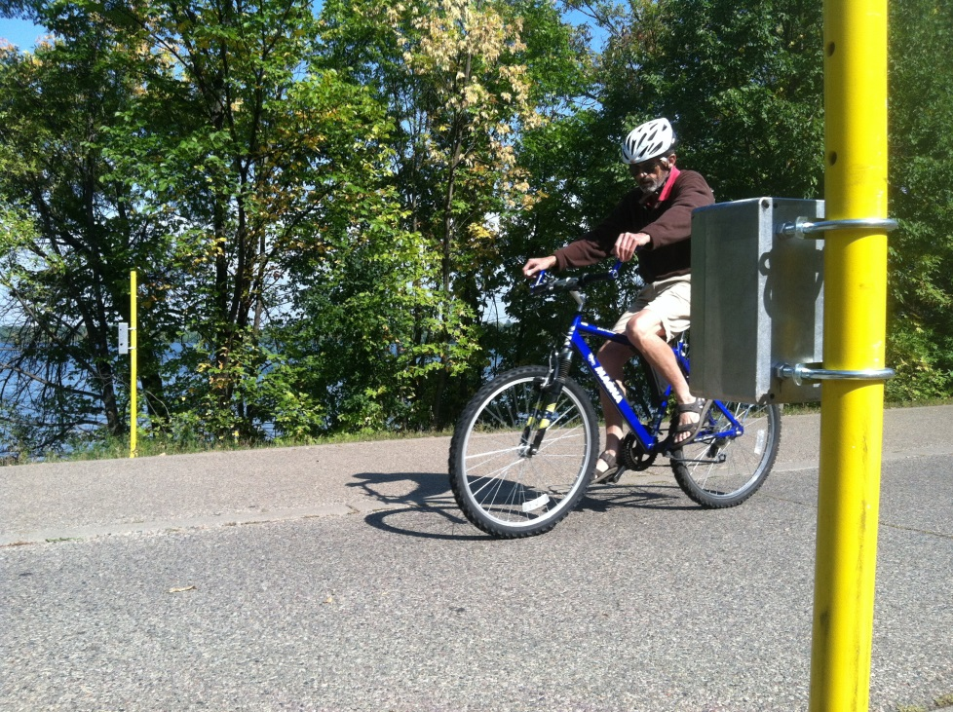
Active Infrared (IR)
Transmitter and receiver with IR beam
Counts caused by “breaking the beam”
Source: Steve Hankey, University of Minnesota

Slide 38
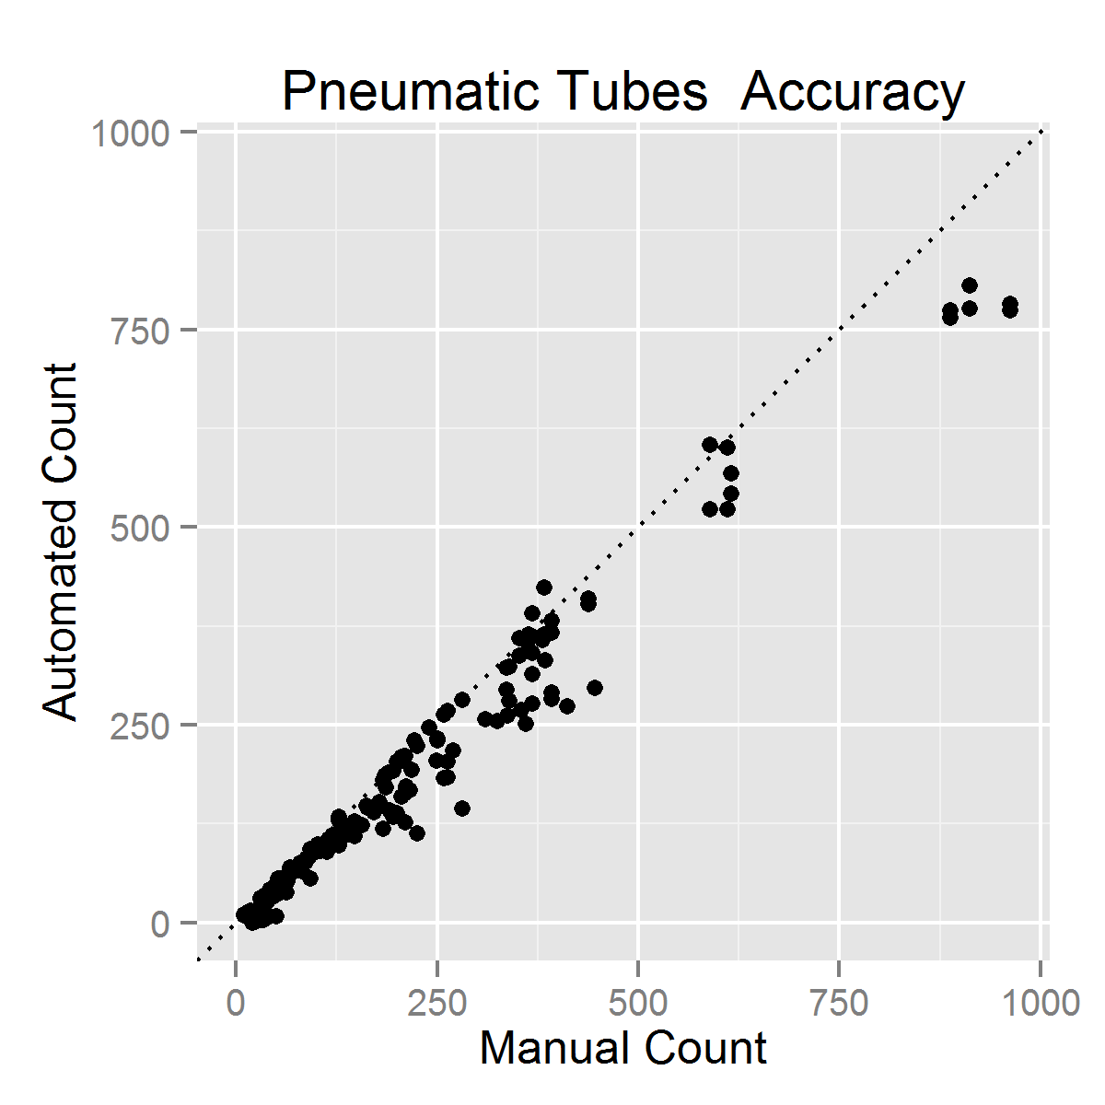
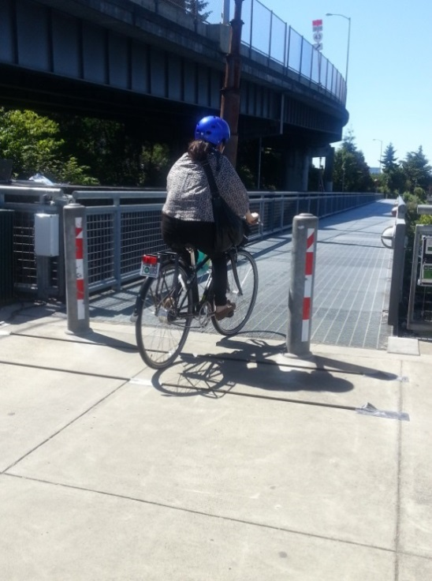
Pneumatic Tubes
One or more tubes are stretched across roadway or path
When a bicycle rides over tube, pulse of air passes through tube to detector
Tested BSCs – bicycle specific counters
Primarily tested tubes on multi-use paths and bicycle lanes
Source: Karla Kingsley, Kittelson & Associates, Inc.
Notes:
Tested BSCs – bicycle specific counters
Primarily tested tubes on multi-use paths and bicycle lanes
Issues with site on 15th Avenue in Minneapolis
Tube nails came out of ground
Severe undercounting and overcounting
Removed sensors from data set

Slide 39
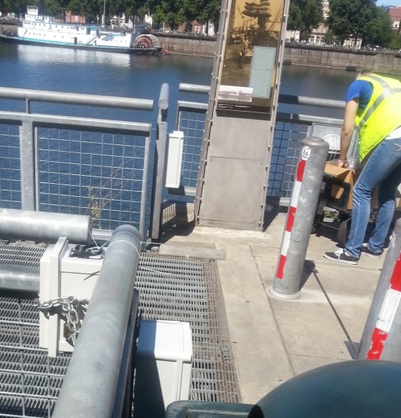
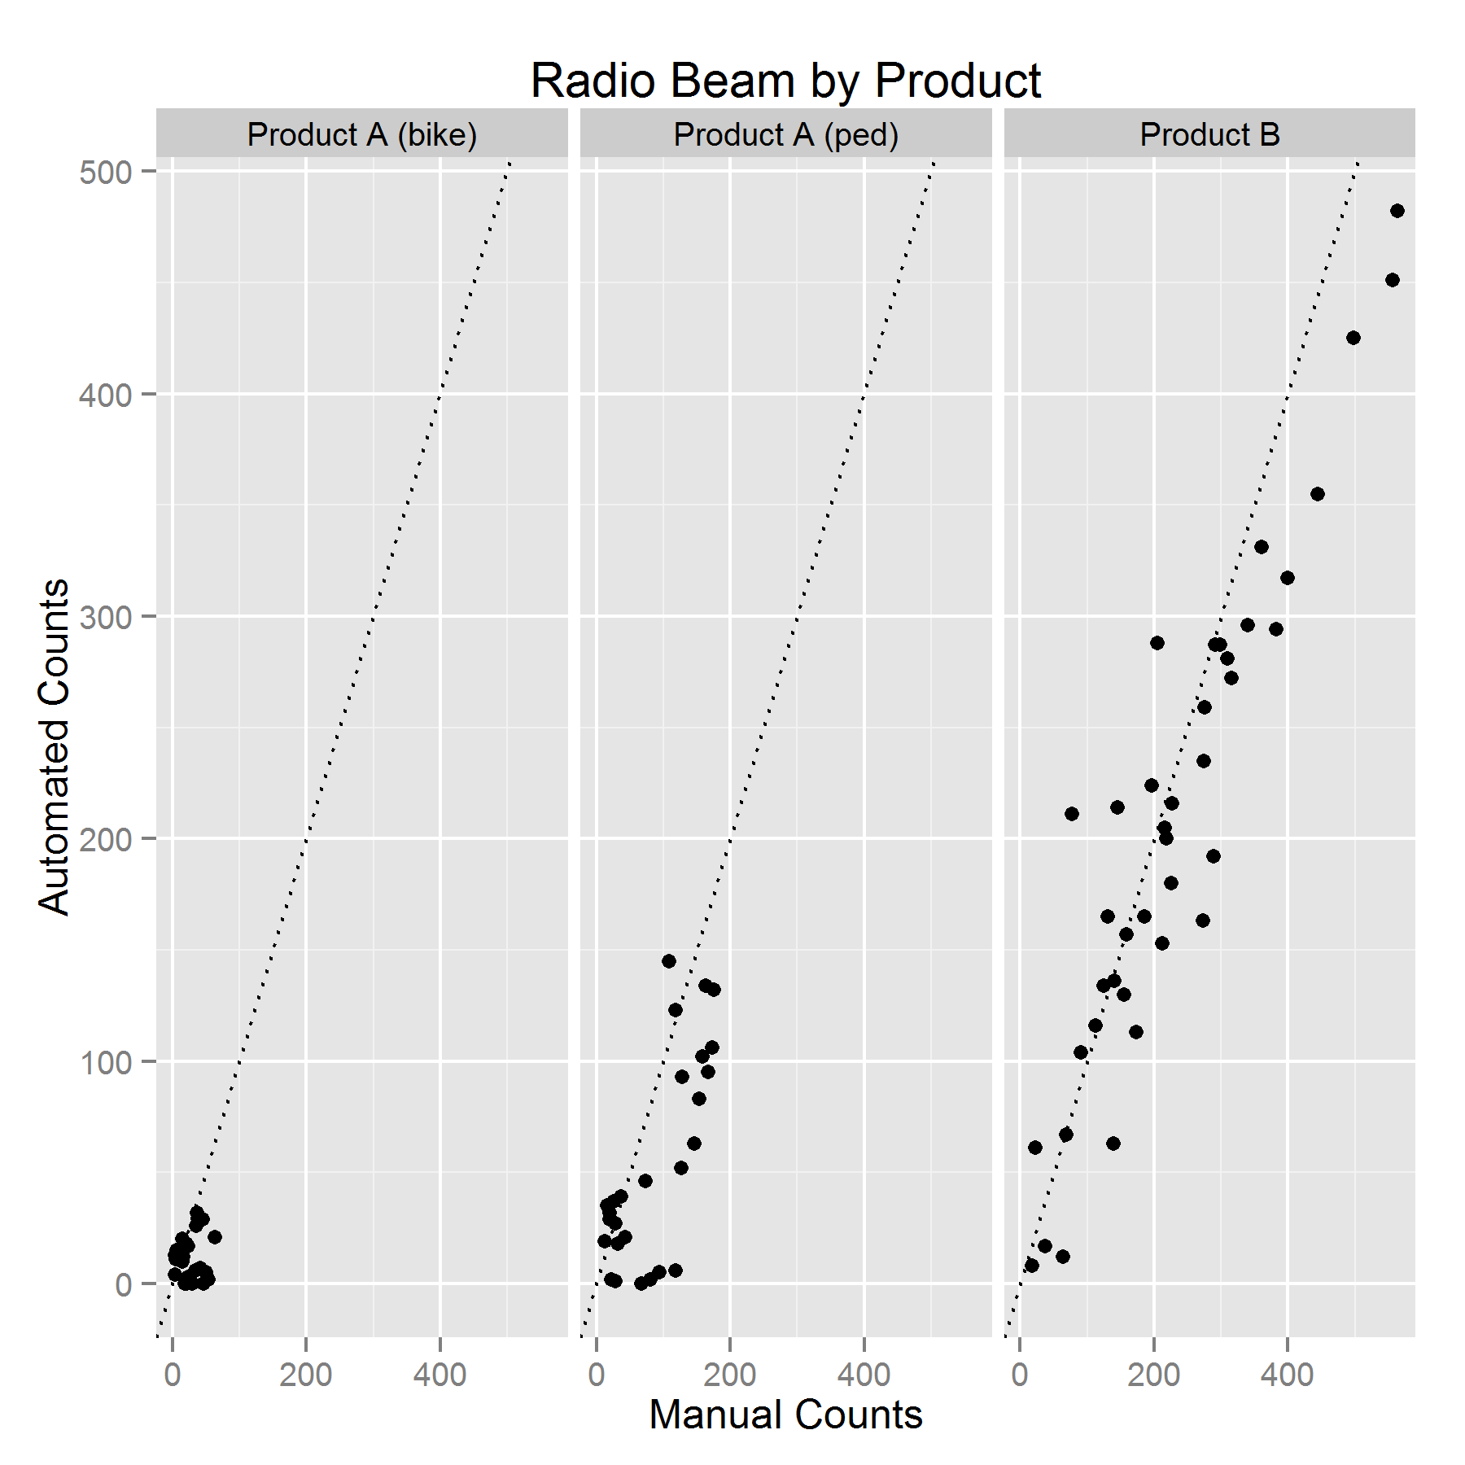
Radio Beam
Transmitter and receiver emit a radio signal that detect a user when the beam is broken
Not previously tested in literature
Some devices count bikes and peds separately
Tested two products, one that distinguished bicyclists and pedestrians (product A)
  Required mounting devices 10’ apart
Source: Karla Kingsley, Kittelson & Associates, Inc.

Slide 40
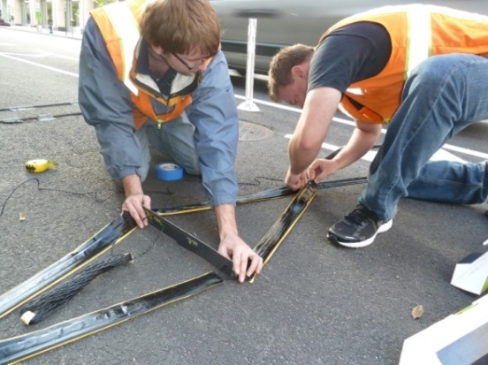
Inductive Loops
Generate a magnetic field that detect metal parts of bicycle passing over loop
In-pavement or temporary loops (on surface)
Source: Katie Mencarini, Toole Design Group
Source: Toole Design Group

Slide 41
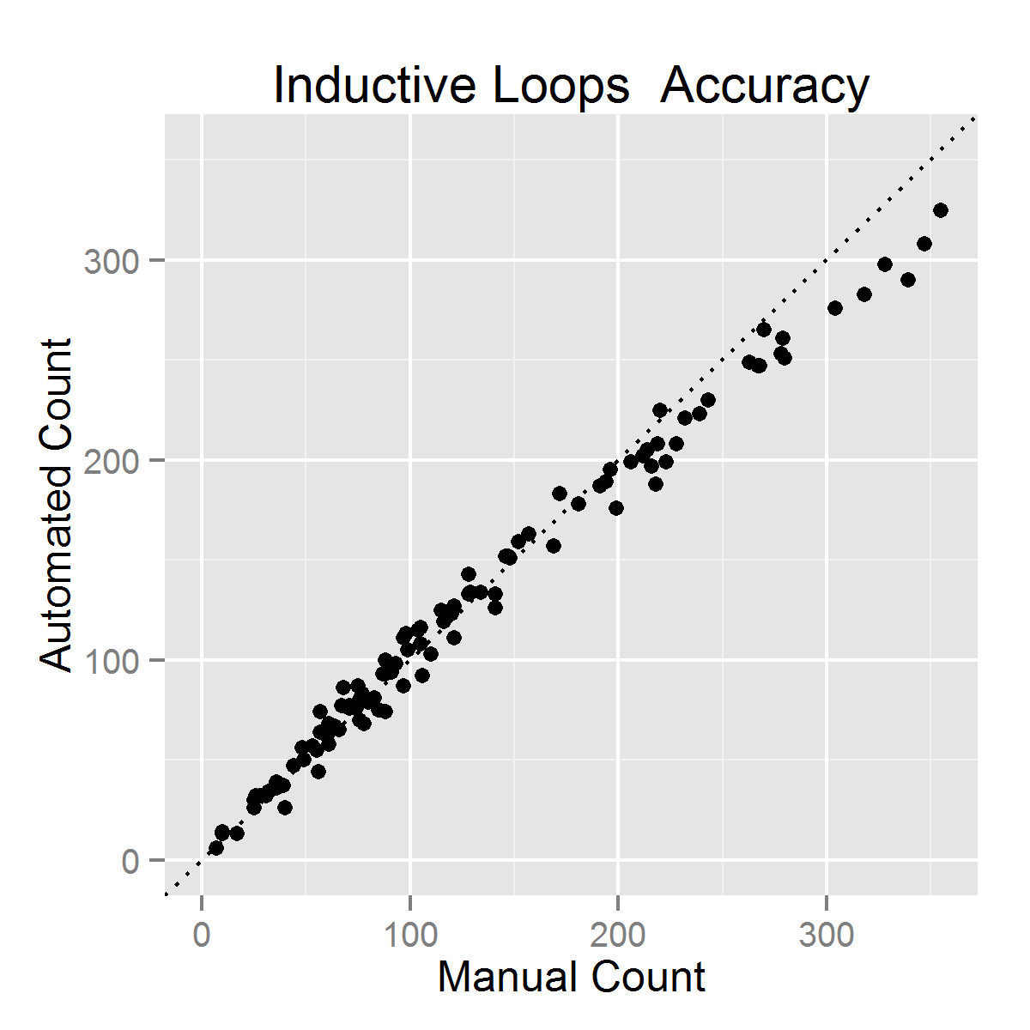
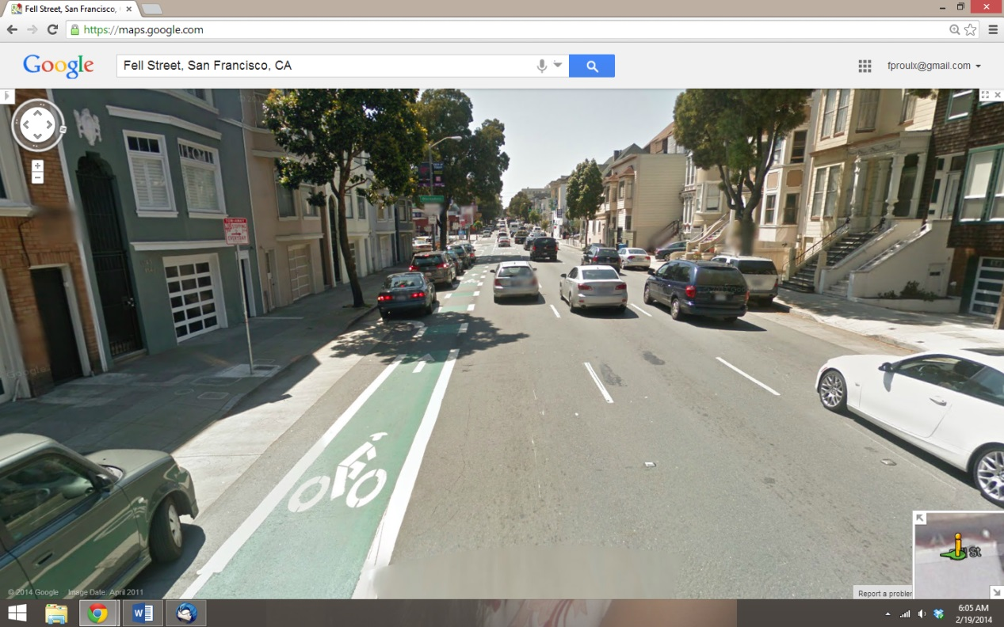
Inductive Loops
Bypass errors
  Cyclists passing outside bike lane
  Loops leaving gaps in detection zone
41

Slide 42
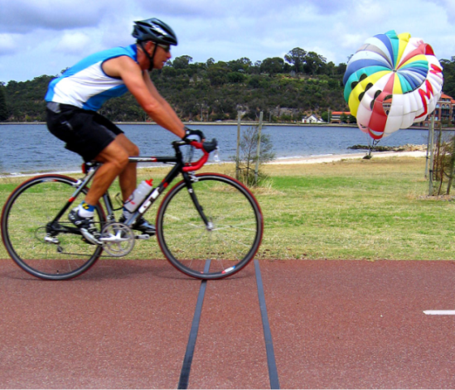
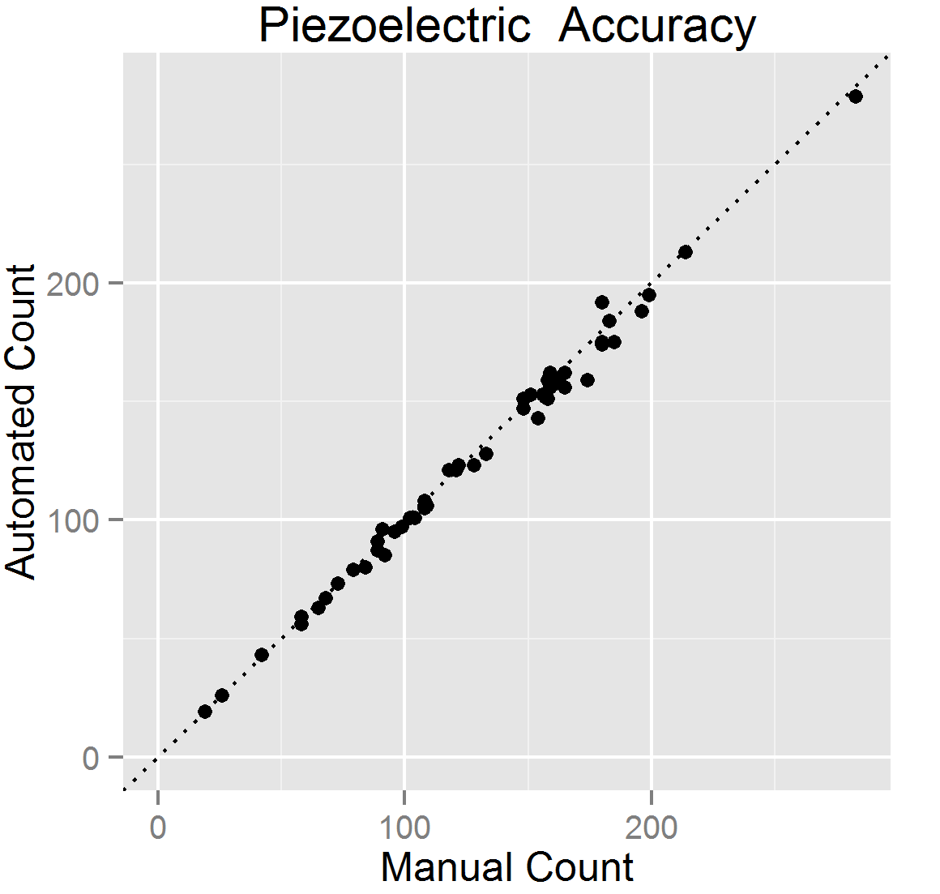
Piezoelectric Strips
Emit an electric signal when physically deformed to detect bicyclists
Typically embedded in pavement across travel way
Source: MetroCount

Slide 43
Research Conclusions
Factors influencing accuracy
  Proper calibration and installation
  Occlusion
  Vendor differences
Factors not found to influence accuracy
  Age of inductive loops or pneumatic tubes
  Temperature (except possibly active IR)
  Snow/rain (limited data)

Slide 44
Research Conclusions
Automated counter accuracy:
Untested technologies:
  Thermal
  Radar
Device | Undercounting Rate | Total Deviation
Passive Infrared (2 products) | 8.75% | 20.11%
Active Infrared | 9.11% | 11.61%
Pneumatic Tubes | 17.89% | 18.50%
Radio Beam | 18.18% | 48.15%
Inductive Loops | 0.55% | 8.87%
Piezoelectric Strips | 11.36% | 26.60%
1.46%
2.57%
  Laser scanners
  Pressure and acoustic sensors

Slide 45
Automated Counts
Calibrating a counter/count site prior to use is a worthwhile investment of time
  Site-specific differences
  Differences in vendor implementations of a particular counting technology
Count data from most counters tested could be readily corrected to produce good volume estimates

Slide 46
Bike/Ped Counting Integration
Tom Laws
Associate Planner
COMPASS

Slide 47
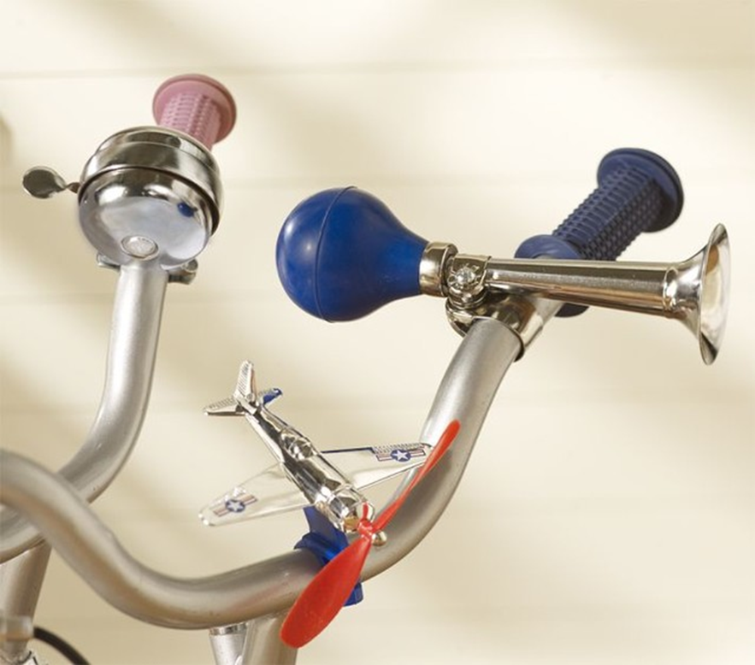
Background
COMPASS – Metropolitan Planning Association for Ada and Canyon Counties
Transitioning to four key elements:
  Automobiles
  Transit
  Freight
  Bike/Pedestrian
2014 FHWA Performance Review

Slide 48

Stakeholder Coordination
What are the needs in the Valley?
  Active Transportation
  Workgroup
  Foundation for Ada/Canyon
  Trails System (F.A.C.T.S.)
  Member Agency
  Bicycle/Pedestrian Committees
Notes:
Foundation for Ada Canyon Trail Systems, Inc. (F.A.C.T.S.): non-profit formed to promote greenbelt and pathways.
Active Transportation workgroup: COMPASS workgroup to develop regional ped/bike plan.
Regional Technical Advisory Committee: oversight in integration of ped/bike plan in CIM 2.040

Slide 49
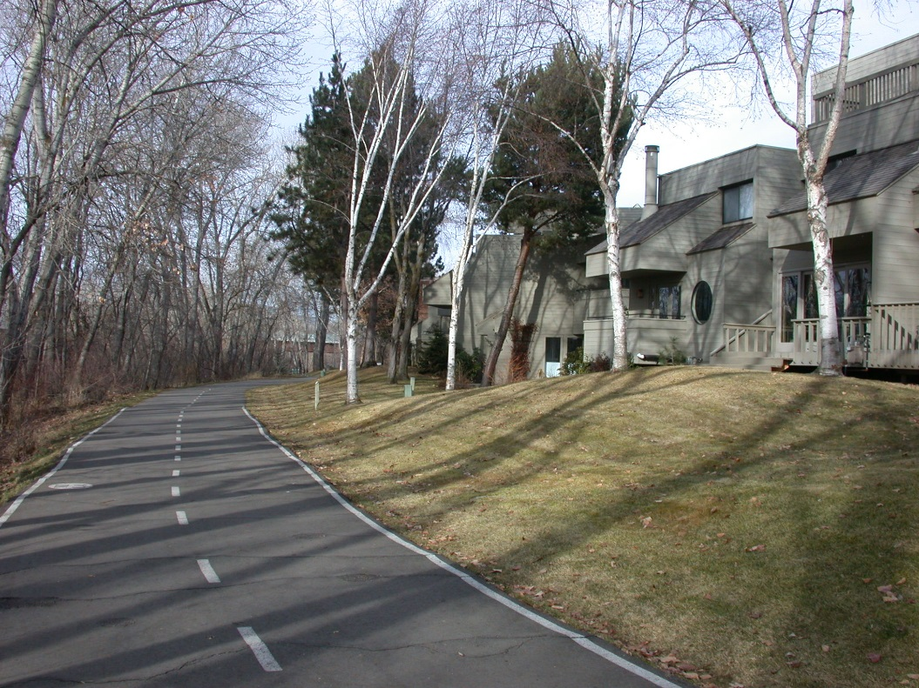
Agency Needs
  Where are users going?
  Where are they not?
  Why?

Slide 50

Approach
Two tiered Gap Analysis:
  1. Supply: Where is the existing bike/pedestrian infrastructure?
  2. Demand: Where are users traveling?

Slide 51
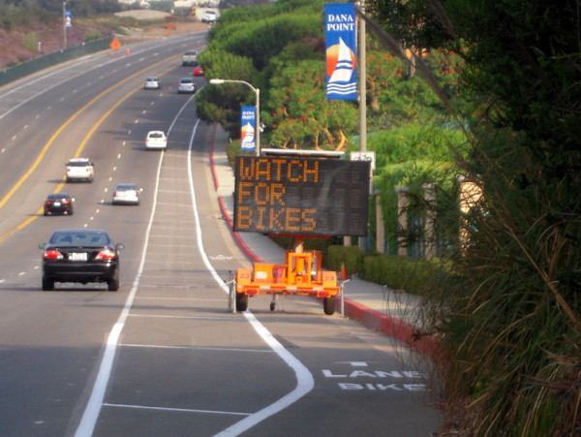
Agency Needs
Where are we seeing high use?
  Where not?

Slide 52
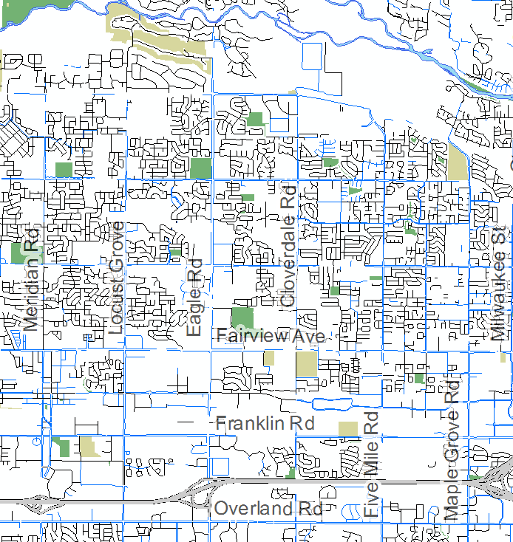
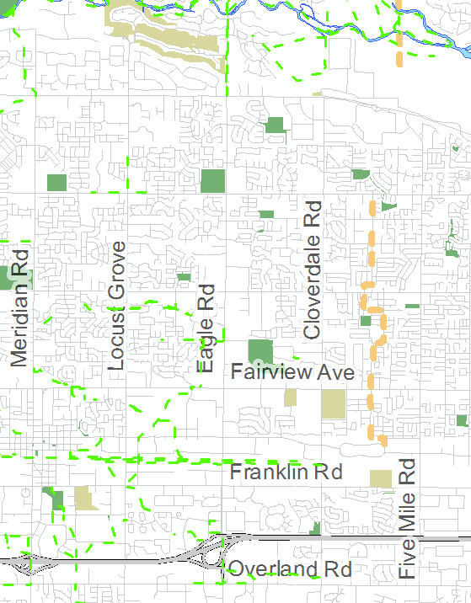
Bicycle and Pedestrian Supply
Existing Sidewalks
Future Pathways

Slide 53

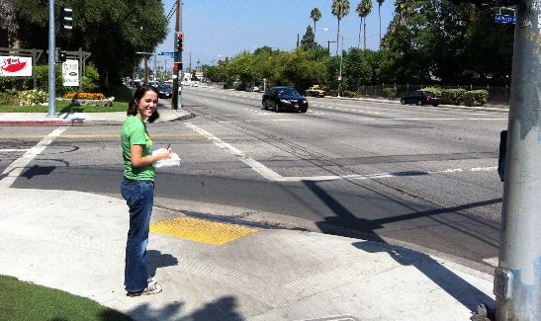



Bicycle and Pedestrian Demand
On-street counters
Manual counts
Vendor-supplied
counts
Other data sources
Off-street counters
Notes:
Talking Points:
The other half—demand data
Variety of sources—no one source is perfect, but the combination provides very credible results

Slide 54
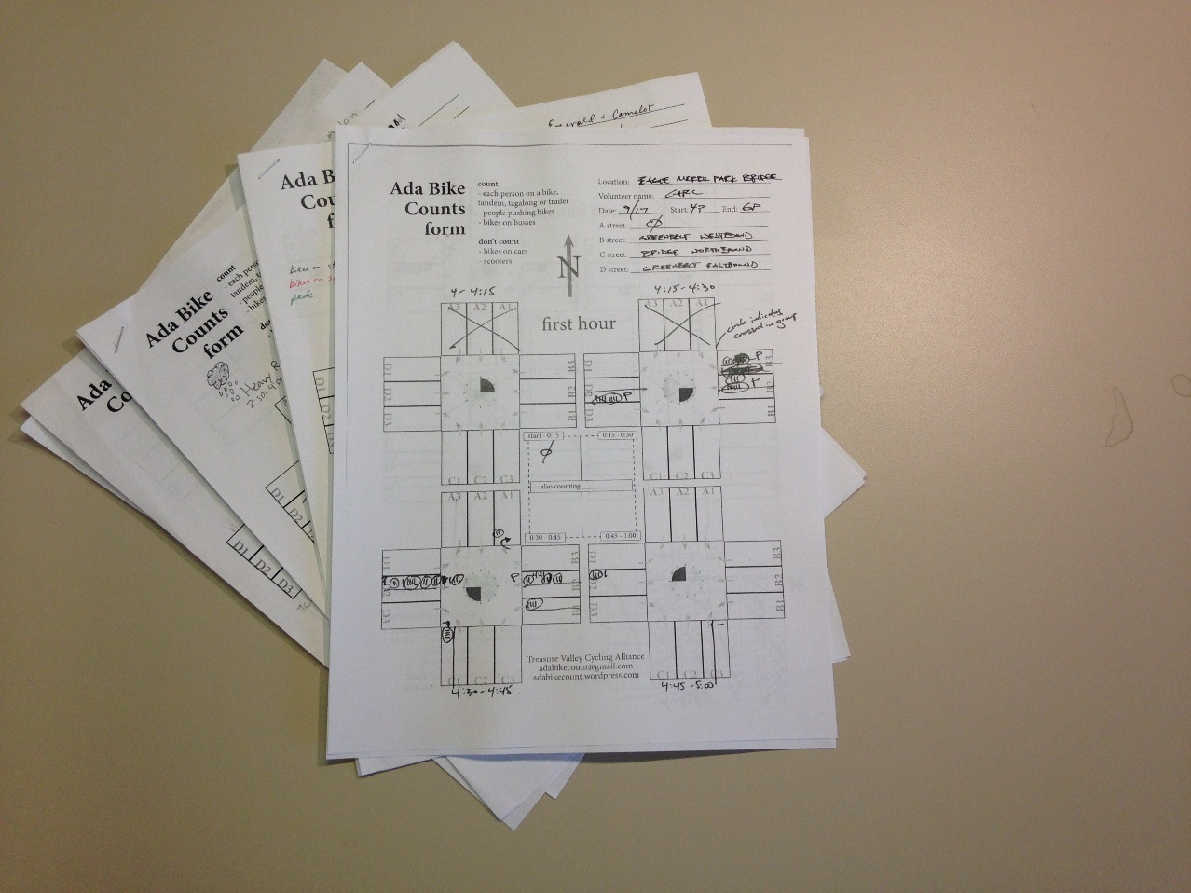
Manual Counts
Years of data
Varied locations
Ability to calibrate permanent counters

Slide 55
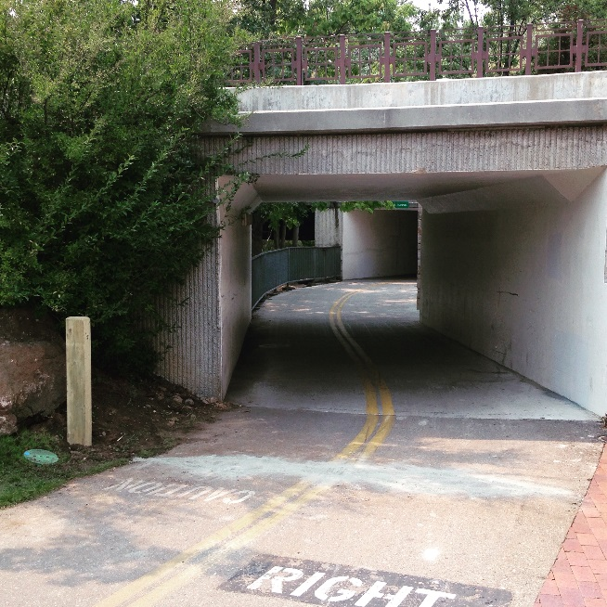
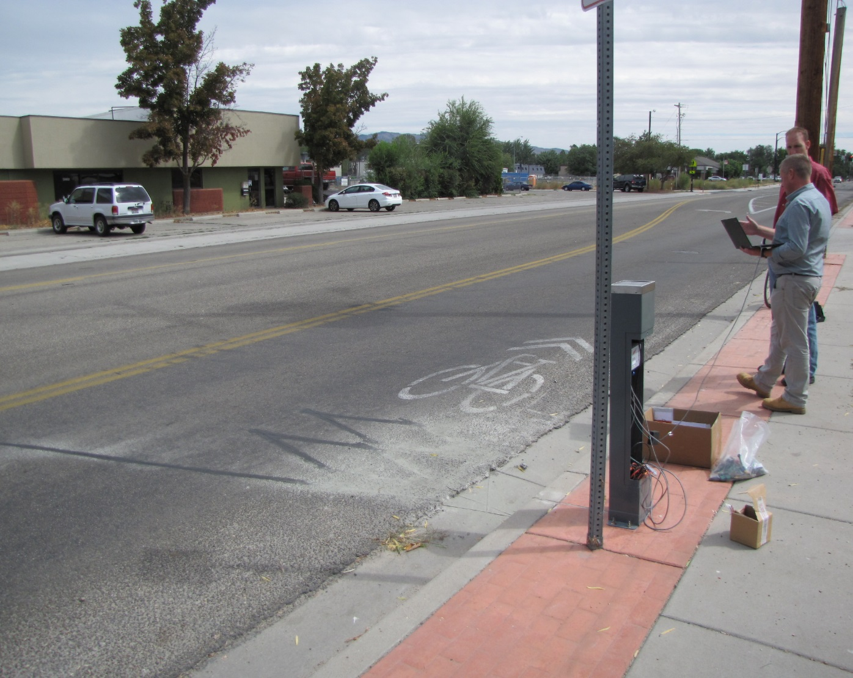
Permanent Counter Installation
Boise Greenbelt
Boise, Idaho
Adams Street
Garden City, Idaho
Notes:
Establish 24/7, 365 days/year data for constant demand estimations
Permanent counters (on and off street)
Pedestrian - passive infrared
Bicycle - inductive loop

Slide 56
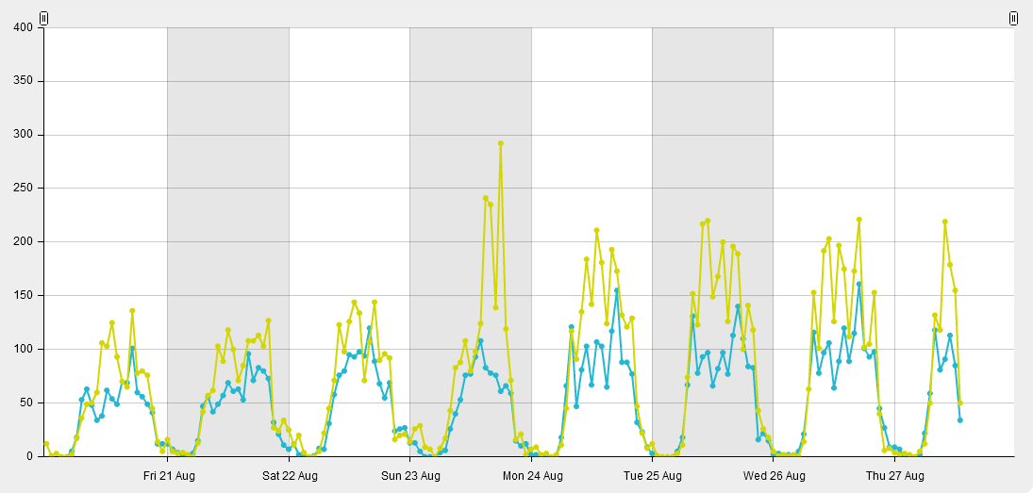
Data
Friendship Bridge, Boise

Slide 57
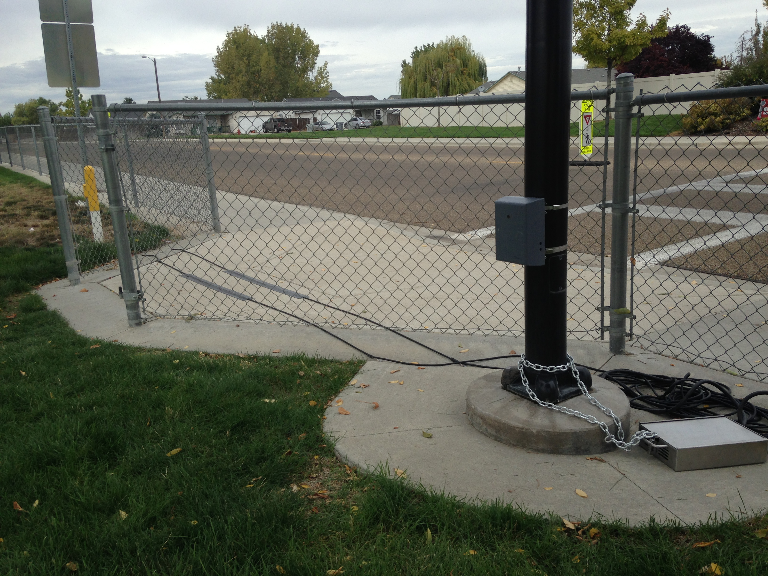
Portable Counter Installations
Passive Infrared and Pneumatic Tube Technology
Available to member agencies on request
Lewis and Clark Elementary School Caldwell, Idaho
Notes:
Develop counts from multiple urban locations to be used in regional examinations and member requests
Develop counts from multiple urban locations to be used in regional examinations and member requests

Slide 58
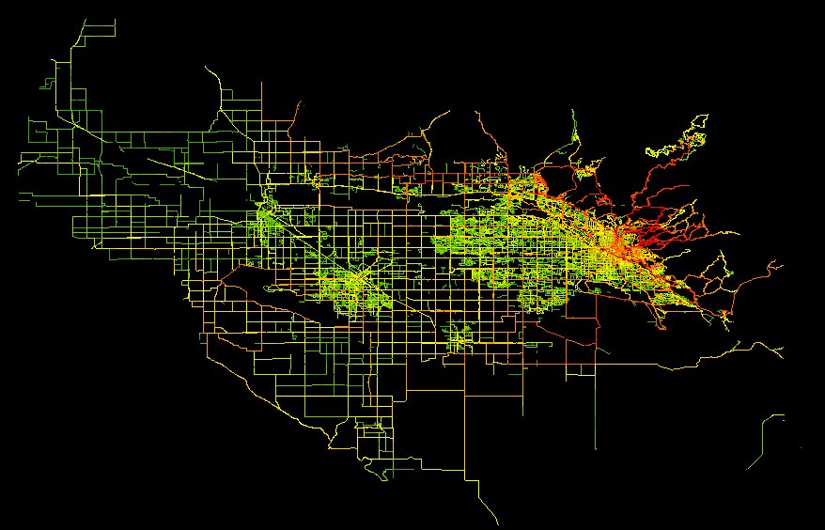
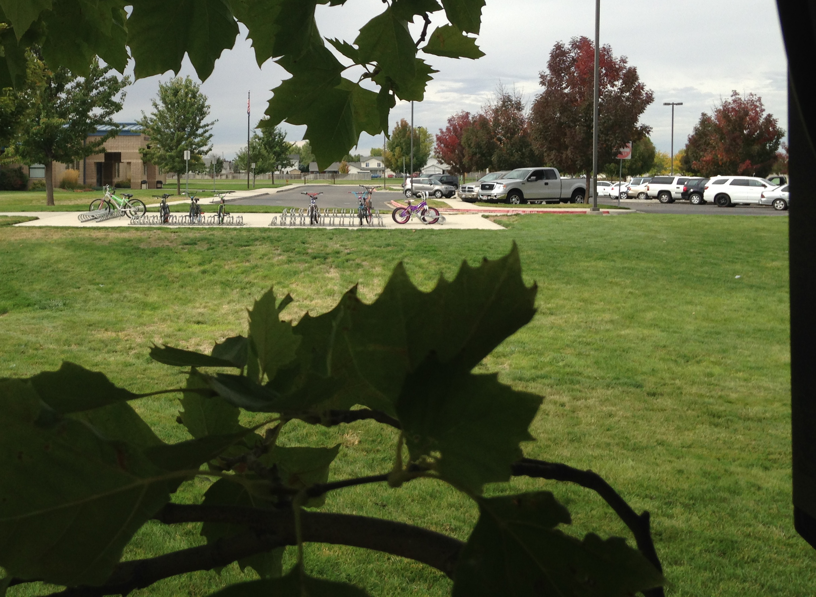
Additional Technologies
  Boise GreenBike
  Time Lapse Cameras
  Strava
Notes:
How they were chosen

Slide 59
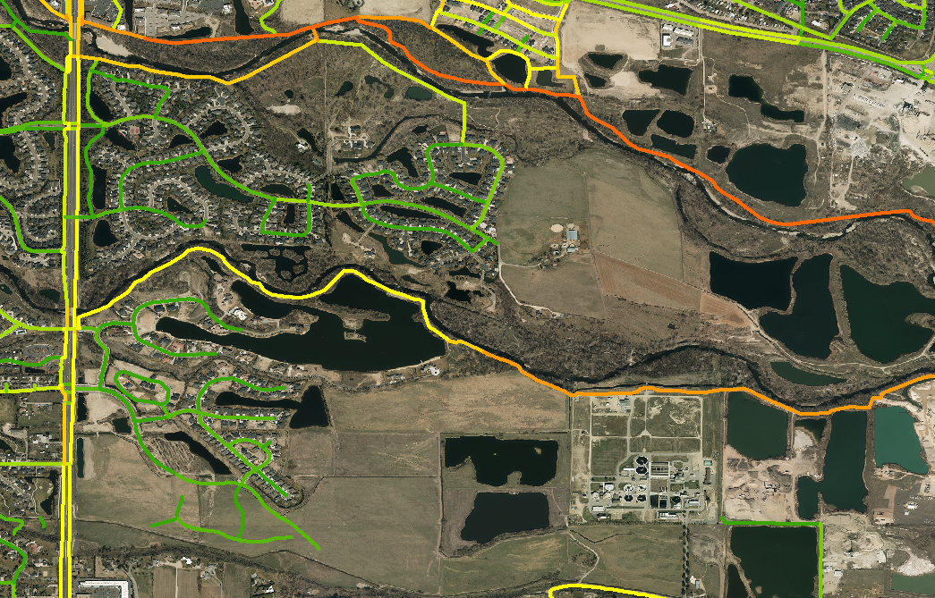
Additional Technologies

Slide 60
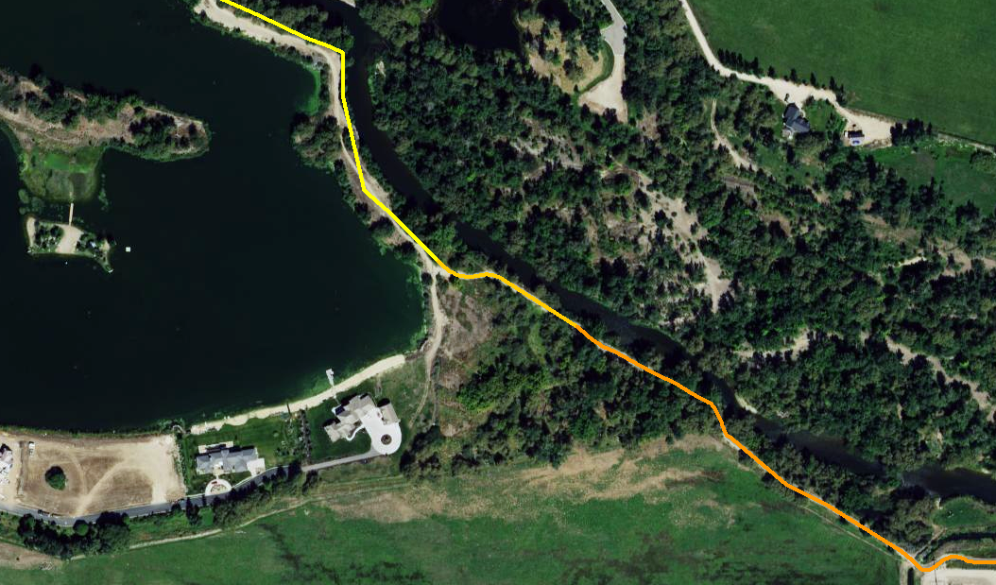
Additional Technologies

Slide 61
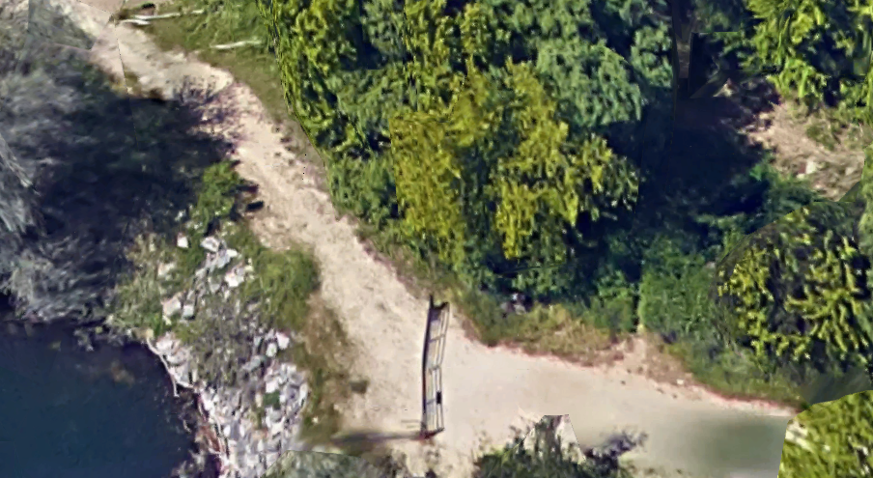
Additional Technologies

Slide 62

Outcomes
Permanent Counters +
Portable Counters +
Manual Counts +
Additional Data =
REGIONAL Supply/Demand Examination

Slide 63

Outcomes
Member Agencies can use results for:
  Project Justification
  Grant Applications
  Pre/Post project analysis

Slide 64
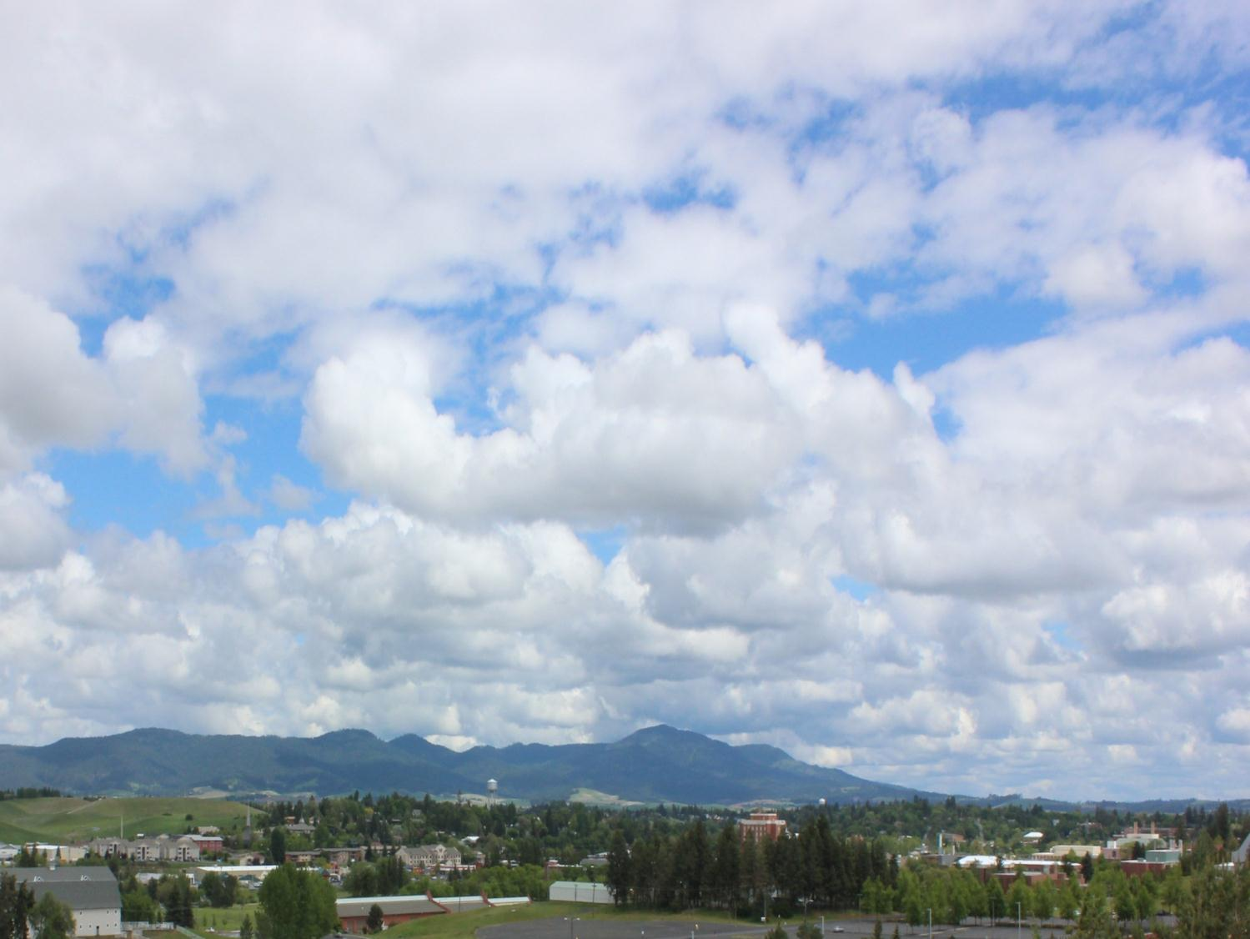
Estimating Directional Bicycle Volumes
Idaho APA Conference, October 7-9, 2015
Stephen McDaniel, WGM Group
Mike Lowry, University of Idaho

Slide 65
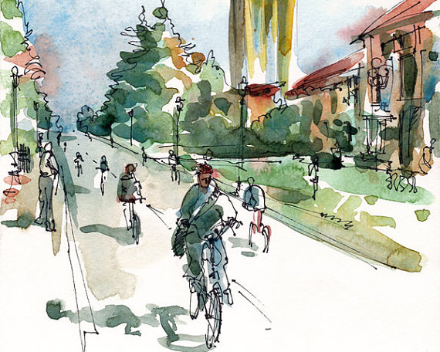
Estimate
Bicycle Volumes
GIS Tool

Slide 66
Background
Estimating
Bicycle Demand
Multistep Behavior Demand Models
Direct Demand Models
Trip generation
Trip distribution
Mode choice
Route assignment
Volume = β₀
+ β₁(Functional class)
+ β₂(Adjacent land use)
+ β₃(Distance to BART)
Notes:
Elaborate on explanatory variable thing.

Slide 67
Background
Estimating
Bicycle Demand
Multistep Behavior Demand Models
Direct Demand Models
-Data intensive
-Complicated
-Expensive
- Not very accurate
-Ignore origin and destination relationship
-Do not provide directional volumes
- Not very accurate
Notes:
Elaborate on explanatory variable thing.

Slide 68
Background
Estimating
Bicycle Demand
Multistep Behavior Demand Models
Direct Demand Models
Our New Method
Notes:
Elaborate on explanatory variable thing.

Slide 69
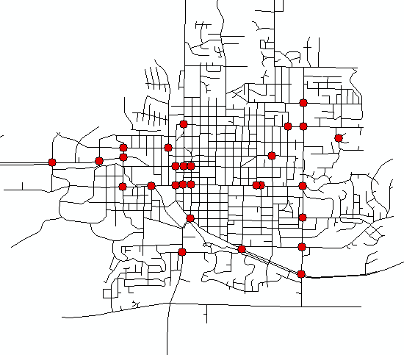
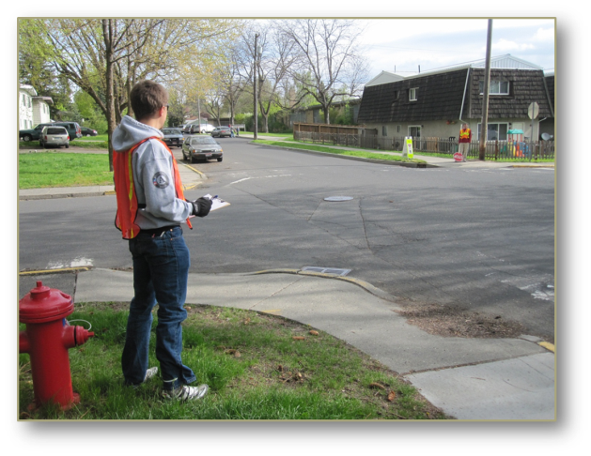
Snap shot of volumes
Notes:
The first step is to get a snap shot of bicycle volumes geographically dispersed around the city. We used for our case study manual 2 hour counts obtained from a community count program. This phenomena of volunteer community count programs is happening all over the country. For example Washington State DOT coordinates a community volunteer count program in over 50 cities every fall. In Idaho counts are periodically done in about 10 communities.

Slide 70


Quantifying Link Importance

Slide 71
Origin Destination Centrality
Limit Nodes as Only Origins and Destinations
Weight O-Ds with Trip Multipliers
Limit Reachable Destinations from each Origin

Slide 72

Origins & Destinations
Multiplier = # DU
Origin
Multiplier = Sq. Ft.
Destination

Slide 73

Network Flow
-Minimize distance
-Favor bike lanes
-Avoid slope (grade)
-Avoid car traffic
-Avoid turns
Notes:
The flow through the network is determined by street characteristics.

Slide 74

OD vs. Stress Centrality

Slide 75

Network Flow
Notes:
What emerges is a network flow from all the origins to all the destinations, The network flow is much like a stream and river system. The observed count locations are like river gauges that measure the flow.

Slide 76

Estimated Bike Volumes
Network-wide
2 Hour Volume
Observed Count Points
Notes:
The result is the ability extrapolate the observed counts throughout the network based on the network flow.

Slide 77

Regression Results

Slide 78

[Volume Estimation Demonstration video]
http://www.youtube.com/watch?v=dMp2XIQaykw

Slide 79



AM 2 Hour Volume
AADB
PM 2 Hour Volume
Notes:
The morning count and the evening count are then inflated using adjusted to get AADB (Annual Average Daily Bicyclists)

Slide 80




Scenario Planning
Notes:
As an example of how this can be used.

Slide 81
Scenario Planning
Third Street Bicycle Volumes Existing and Forecasted
Increase of about
200 bicyclists per day.
Increase of about
150 bicyclists per day.

Slide 82

Conclusions
New GIS tools are…
Inexpensive and easy to use,
Require commonly available GIS data, and
Can produce very good results.

Slide 83
Estimate Bicycle Volumes
McDaniel, S., Lowry, M., and Dixon, M. (2014). “Using Origin-Destination Centrality to Estimate Directional Bicycle Volumes.” Transportation Research Record: Journal of the Transportation Research Board.

Slide 84

Questions?

Slide 85
Thank You!
Margaret Havey
Valley Regional Transit
mhavey@valleyregionaltransit.org
Kelly Laustsen
Kittelson & Associates
klausten@kittleson.com
Tom Laws
COMPASS
tlaws@compassidaho.org
Steve McDaniel
WGM Group
smcdaniel@wgmgroup.com

