Slide 1
Bridging the Gap- Project Development
Planning to Implementation
Sabrina Minshall, Director of Planning
COMPASS
Tom Laws, Associate Planner
COMPASS
Brad Marshall, Senior Planner/Project Manager
JUB

Slide 2
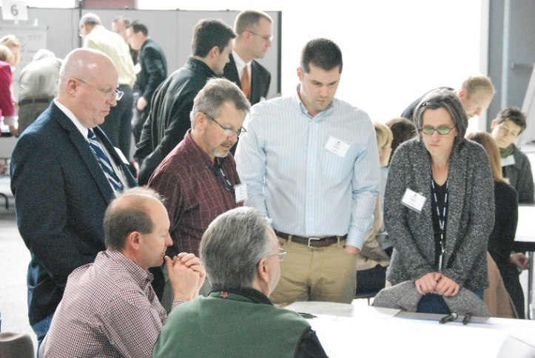
What is COMPASS?
The Community Planning Association of Southwest Idaho (COMPASS) is a forum for regional collaboration helping to maintain a healthy and economically vibrant region, offering people choices in how and where they live, work, play, and travel. COMPASS serves as the metropolitan planning organization (MPO) for Ada and Canyon Counties, Idaho.

Slide 3
Who is in the Room?
Name and employment
What is your interest in project development?
Any experience with project development?

Slide 4
“A vision without funding is a hallucination”

Slide 5
Questions to Ponder…
How does a project begin?
What information do you have?
What information do you not have?
What do you need to know before you can apply for money?
What time frame do most grants have?
What does a “planning” process do?
What does project “design or “preliminary engineering” do?

Slide 6
Project Development can be a missing link
between great plans and implementation

Slide 7
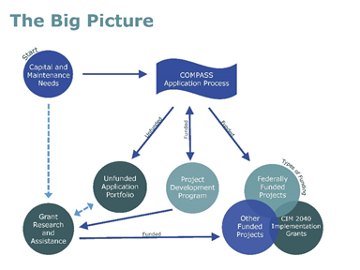
COMPASS and $$$$$$

Slide 8
Topics Today
Define project development
Key elements to effective project development
Illustrate connections between planning, engineering, and environmental analysis

Slide 9
COMPASS Project Development Program
Transforms member agency needs into well defined projects with:
  Purpose and need statements
  Environmental scans
  Defined scope
  Public involvement plan
  Cost estimate
  Typical schedule
  Visual drawings
  Funding sources

Slide 10
Application Process/Project Selection
Simple application
Describe the concept
Describe the status
Where is it in the process
Does the sponsor know what they want?
Can we help?
Is it ready?
Keep politics out if possible

Slide 11
Consultant On-Call
Do an on call process if you can
Know the procurement law
Be able to move quick
Pre qualify and know strengths
Use the expertise and partner
Don’t go too far before you have help on board
Set clear timeframes and expectations
Be clear who works for who

Slide 12
Important
Be Clear on Expectations
Ownership of project sponsor
Client is COMPASS
Budget and contracts
Be hands on
Keep elected officials and sponsors informed

Slide 13
2015 Experience
10 applications
4 projects selected
  1 roadway (sidewalk)
  1 pedestrian bridge
  1 greenbelt project/bridge
  1 sidewalk/stormwater
2 projects further developed for 2016
1 project on hold
3 projects not selected

Slide 14

2015 Example: Caldwell
Ustick Road, Montana to Indiana
Pre Concept Report
Widen from two to five lanes, addition of sidewalks and bike lanes

Slide 15
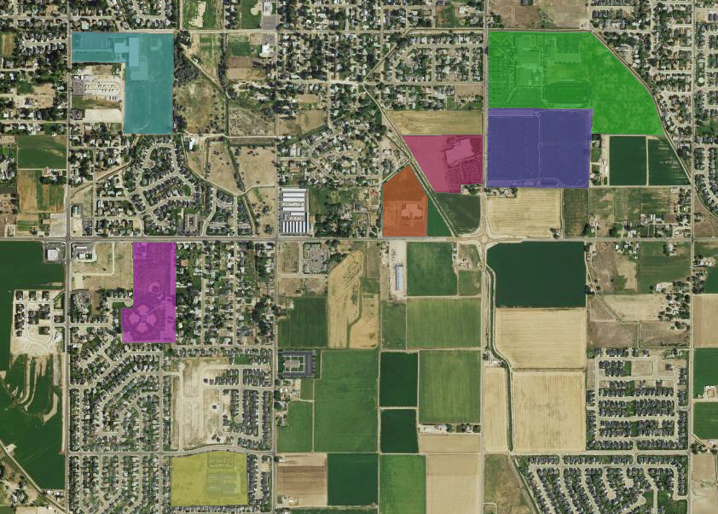
Ustick Road
Nearby Needs

Slide 16
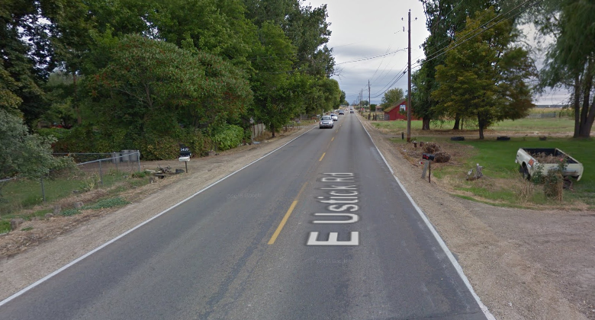
Ustick Road
Current Situation: Rural road, no shoulder

Slide 17
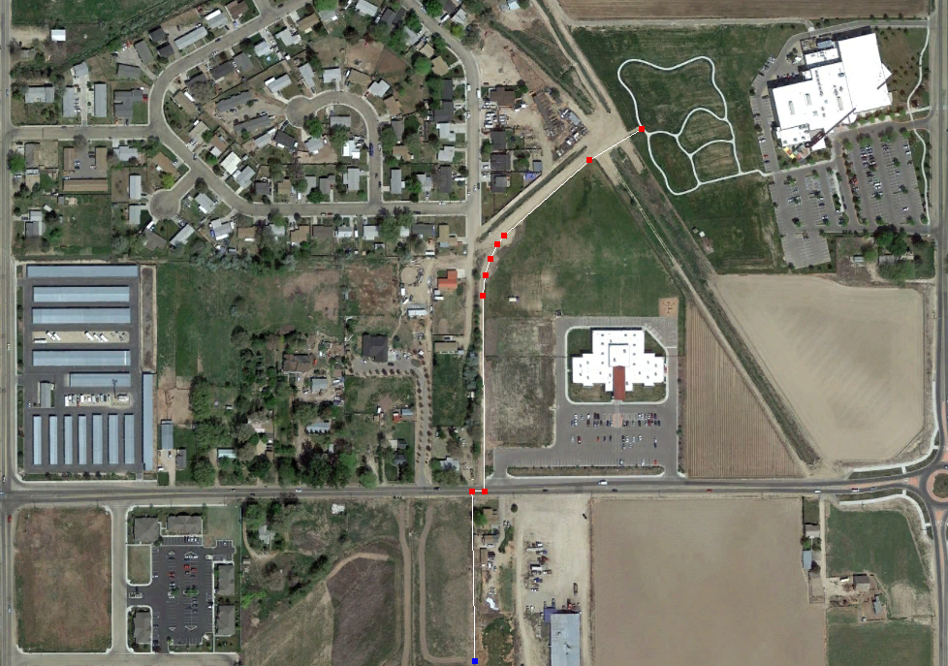
Ustick Road
Current Investment

Slide 18
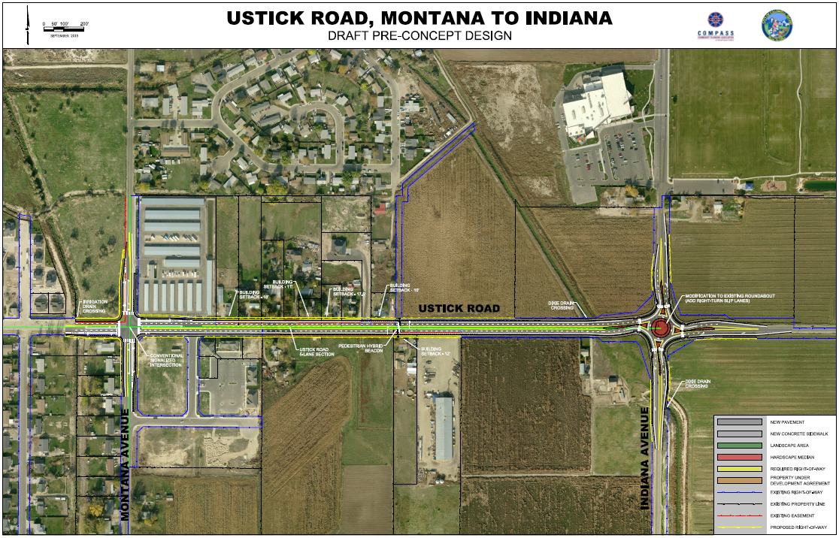
Ustick Road

Slide 19
Ustick Road
Deliverables:
Pre-concept report
Project schedule
Purpose and needs statement
Capacity and multimodal level of service analysis

Slide 20
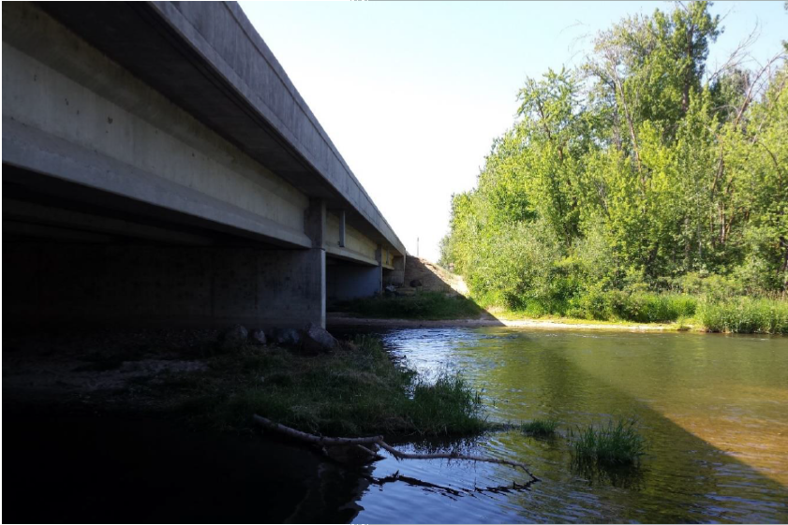
2015 Example: Eagle
Eagle Bridge Project Development
Examination of a bicycle and pedestrian bridge

Slide 21
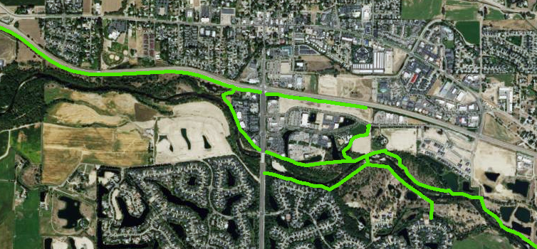
Eagle Bridge
Eagle, Idaho
  State Highway
  Boise River Greenbelt
Notes:
Key Route for alternative transportation modes

Slide 22
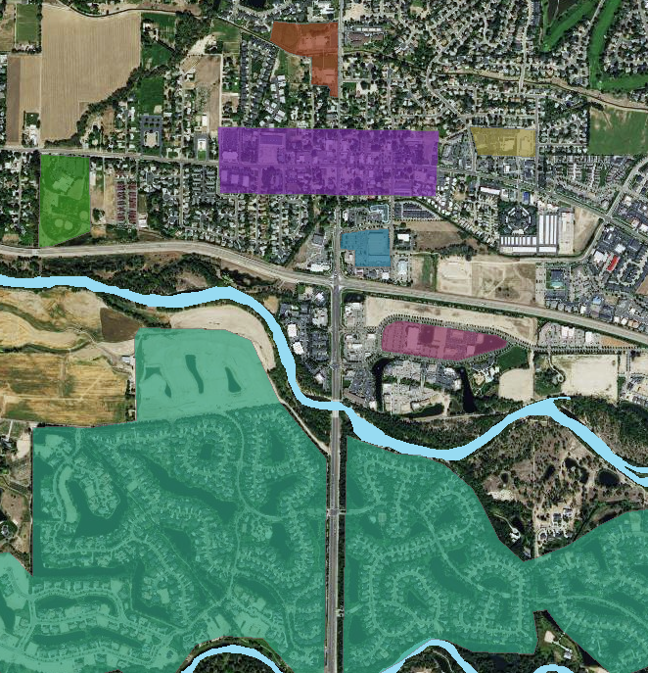
Eagle Bridge
Needs north of the river:

Slide 23
Eagle Bridge
Current Investment

Slide 24
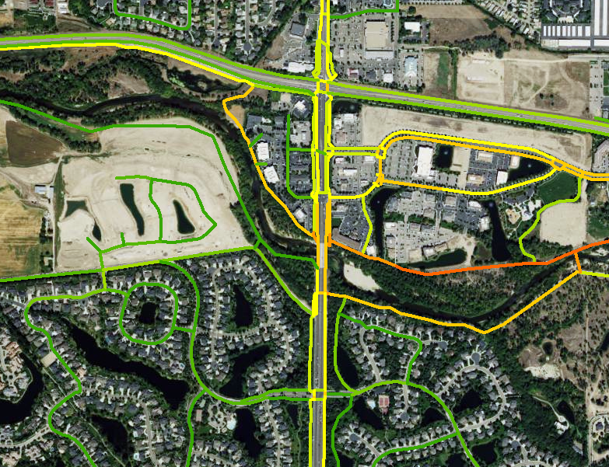
Eagle Bridge
High Potential for use, connectivity

Slide 25
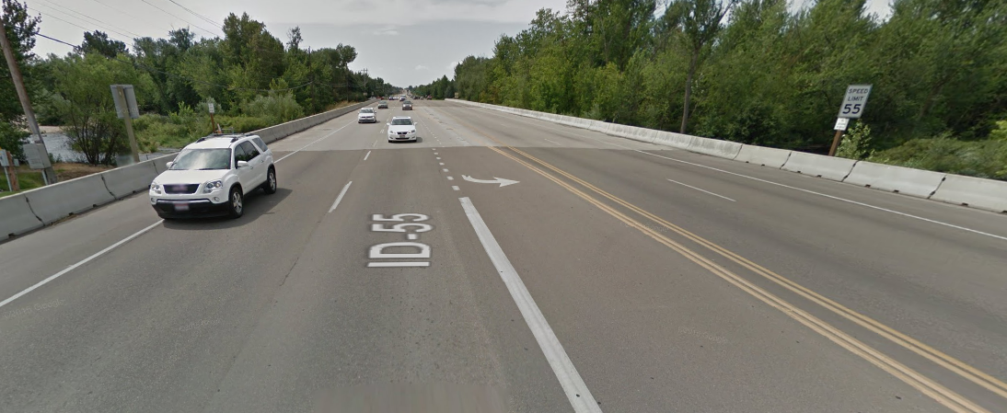
Eagle Bridge
Current Situation: High speeds, limited infrastructure

Slide 26
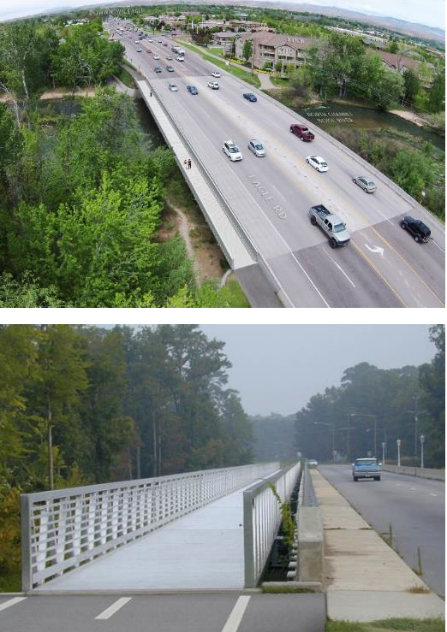
Eagle Bridge
Project Development Phase 1: Examining a bridge across the north channel of the Boise River
Aluminum Cantilever Bridge

Slide 27
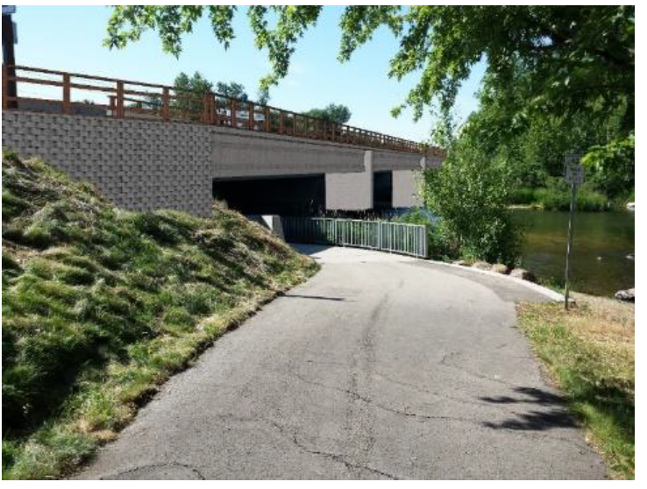
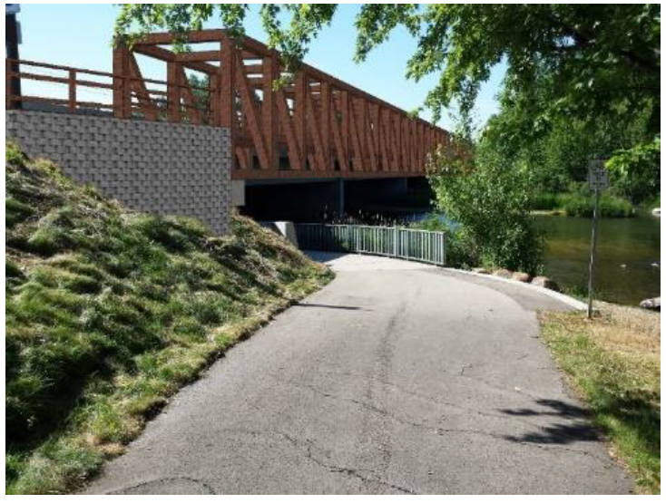
Eagle Bridge
Phase 1: Endorsement from ITD, Eagle City Council
Concrete Beams Attached to Existing Bridge
Steel Truss Clear-Span

Slide 28
Eagle Bridge
Phase 2 Deliverables:
Cost summary, budget, and Funding Strategy
Project Description, Environmental Scan, Public Involvement Plan

Slide 29
2016 Plans- Chinden Blvd (Garden City)
Chinden Blvd in Garden City

Slide 30
Chinden Blvd (Garden City)

Slide 31
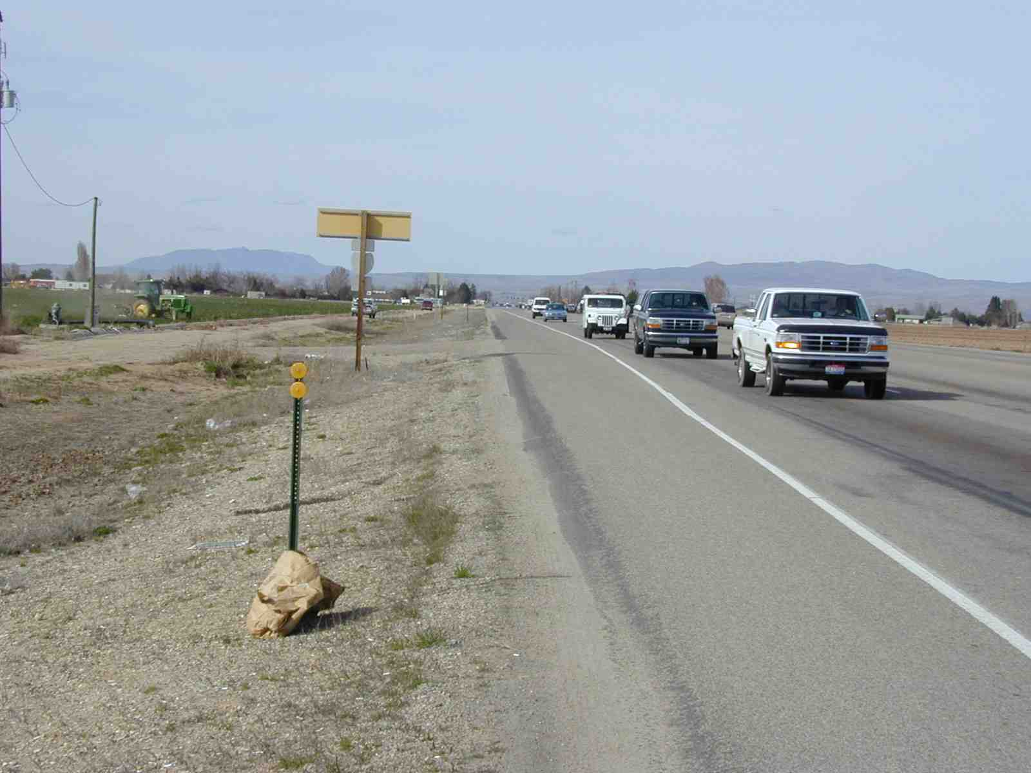
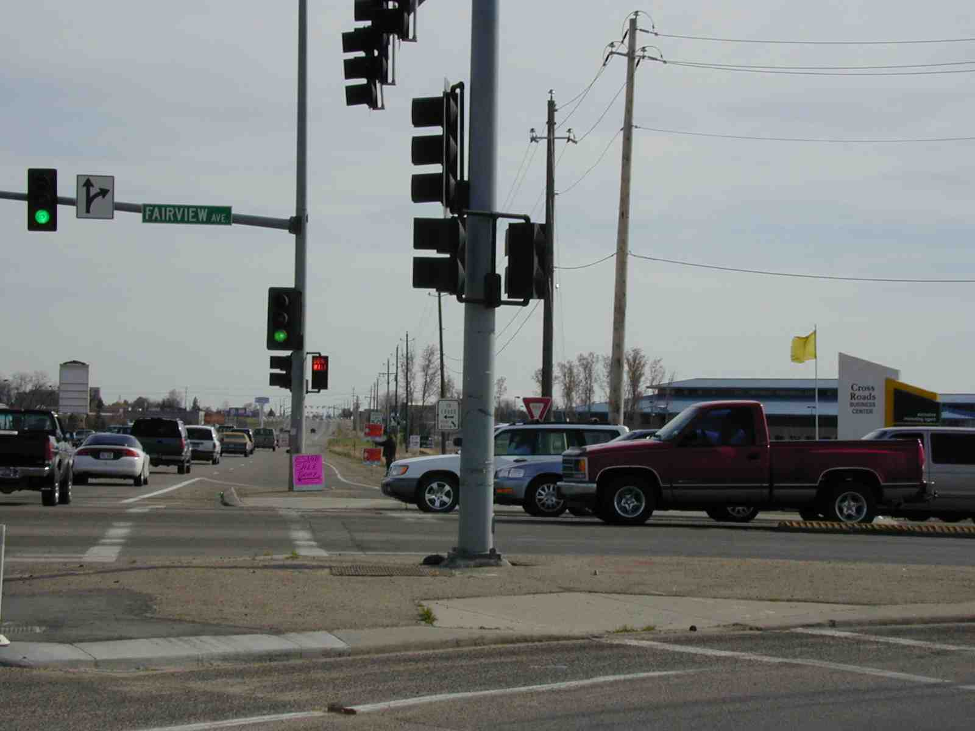
2016 Plans- Eagle Rd (Merdian)
Eagle Road in Meridian

Slide 32
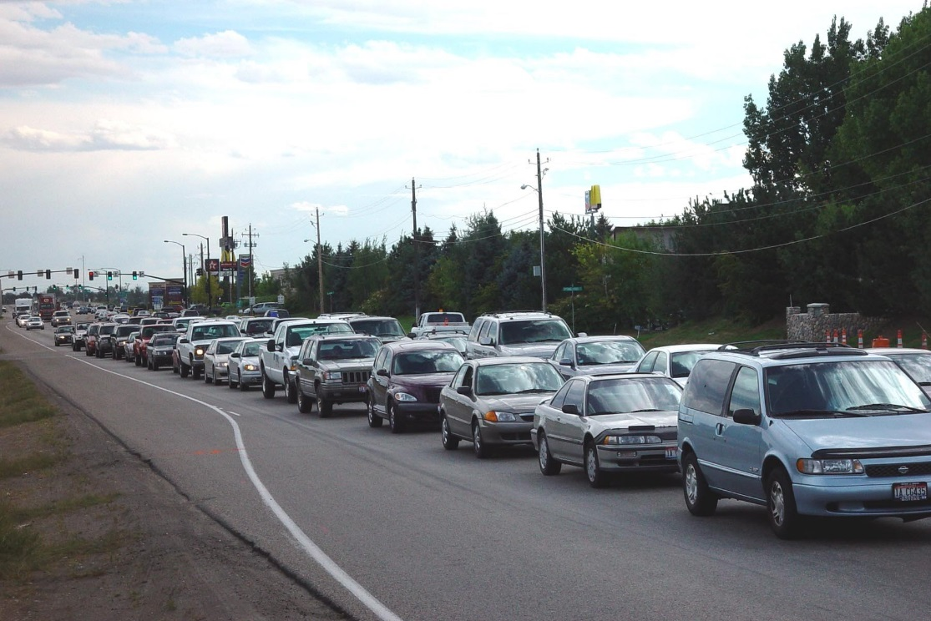
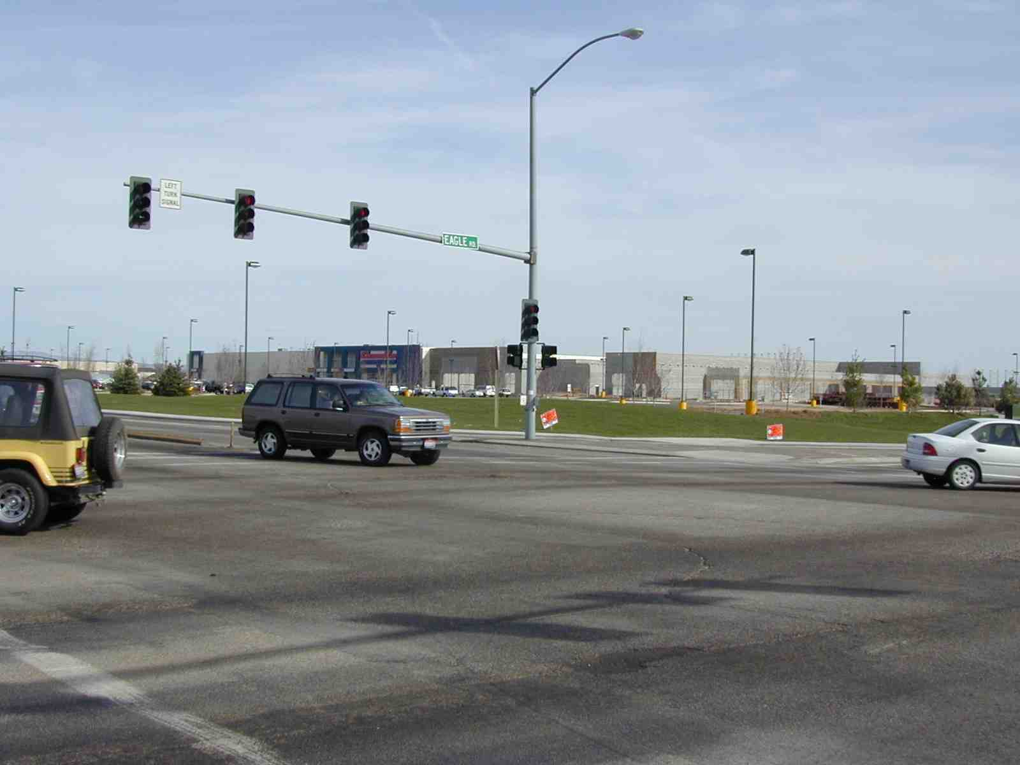
Eagle Rd. (Meridian)

Slide 33
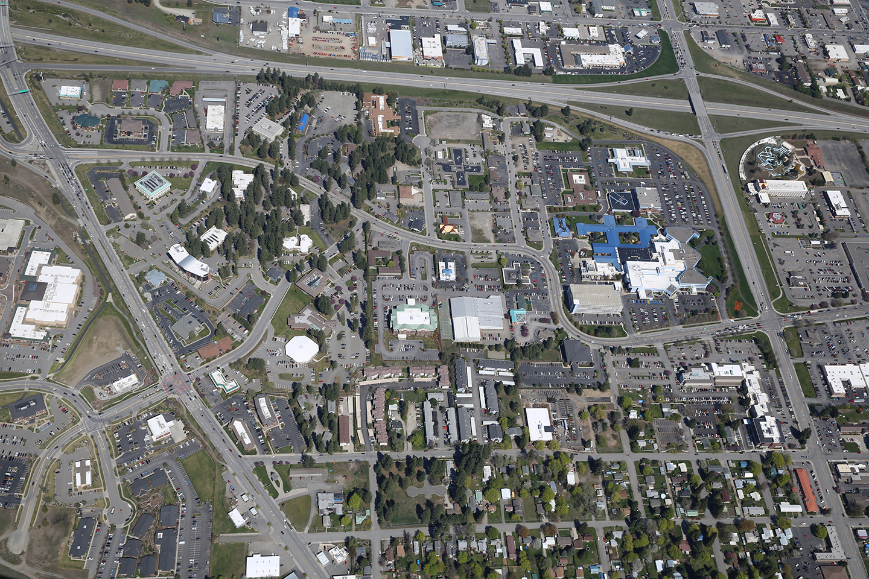







Medical Corridor
Traffic Improvement Plan
Coeur d’Alene City Council
April 7, 2015

Slide 35
Growth of the Medical Corridor
Regional Medical Center Growth
Offering expanded services to keep Idaho patients in Idaho
New physicians and specialties
New construction
Additional jobs
Economic development
Partnerships/Relationships

Slide 36
Medical Corridor - Access Challenges
Challenges:
Estimated 1.1 million patient, visitor, staff and vendor trips annually.
70-75% of the patients/visitors drive South (US95) or East (I90).
Medical corridor services are only accessible from Ironwood Drive.
Ironwood Drive is the busiest East/West arterial south of the freeway.
Congestion, vehicle stacking at intersections, lack of breaks in the traffic make entering/exiting campus difficult and dangerous.
Multi-jurisdictional roadway authority
Opportunity:
A collaborative approach to analyze the traffic data, develop solutions, and implement improvements.

Slide 37
A Collaborative Process
Kootenai Health
Parkwood Prop.
City of CDA
ITD
KMPO
NAC Architects
Traffic Counts
Wait/Delay Times
Stacking Queues
Crash Data
Future Projections
Stakeholder
Introduction
Traffic Engineer Selection
Traffic Data Analysis
Design and Implement
Identify Solutions
Stakeholder Support
Mar-Apr 2014
May-Jul 2014
Aug-Oct 2014
Nov-Feb 2015
Mar-Apr 2015
2015
RFQ Process
Collaborative Review
J-U-B Engineers, Inc .
Selected
Over 50 ideas vetted, tested
Narrowed to 10-12
Phasing plans
Budget estimates
Master Plan Developed

Slide 38
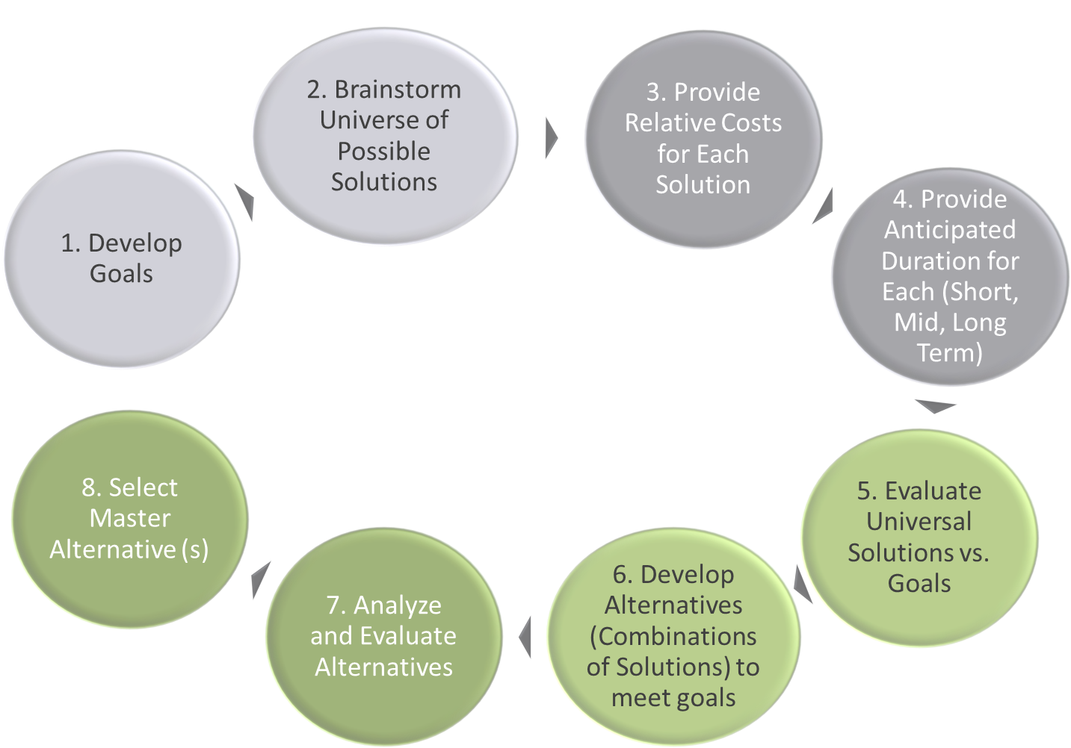
Identifying Solutions to Meet Goals
1. Develop Goals
2. Brainstorm Universe of Possible Solutions
3. Provide Relative Costs for Each Solution
4. Provide Anticipated Duration for Each (Short, Mid, Long Term)
5. Evaluate Universal Solutions vs. Goals
6. Develop Alternatives (Combinations of Solutions) to meet goals
7. Analyze and Evaluate Alternatives
8. Select Master Alternative (s)

Slide 39

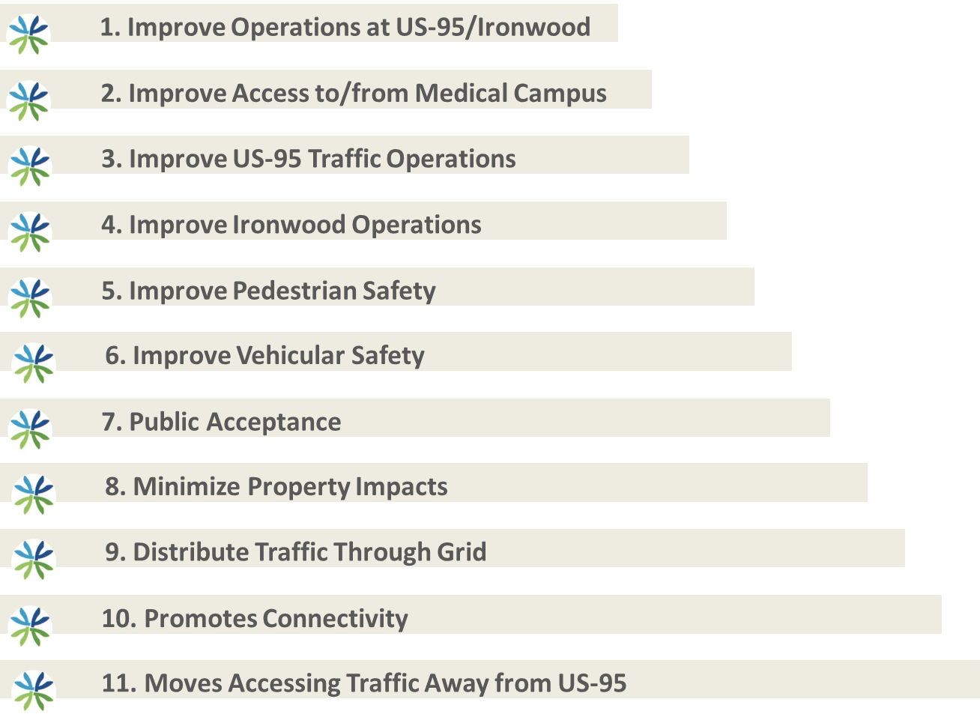
Goals
1. Improve Operations at US-95/Ironwood
2. Improve Access to/from Medical Campus
3. Improve US-95 Traffic Operations
4. Improve Ironwood Operations
5. Improve Pedestrian Safety
6. Improve Vehicular Safety
7. Public Acceptance
8. Minimize Property Impacts
9. Distribute Traffic Through Grid
10. Promotes Connectivity
11. Moves Accessing Traffic Away from US-95

Slide 40
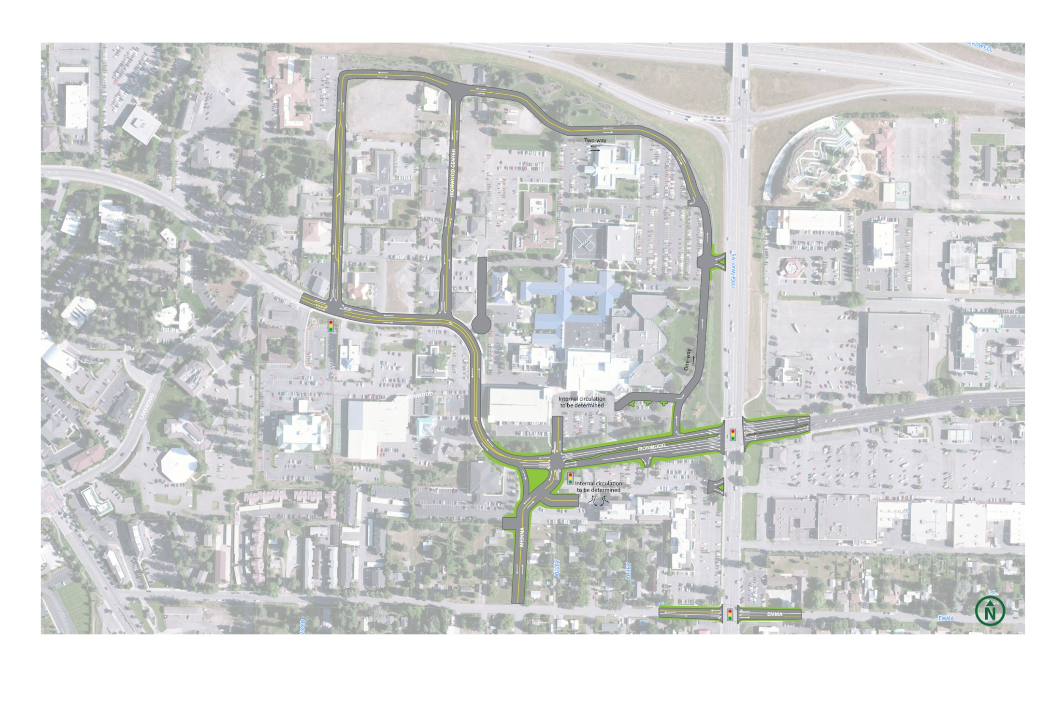
Master Plan Alternative

Slide 41
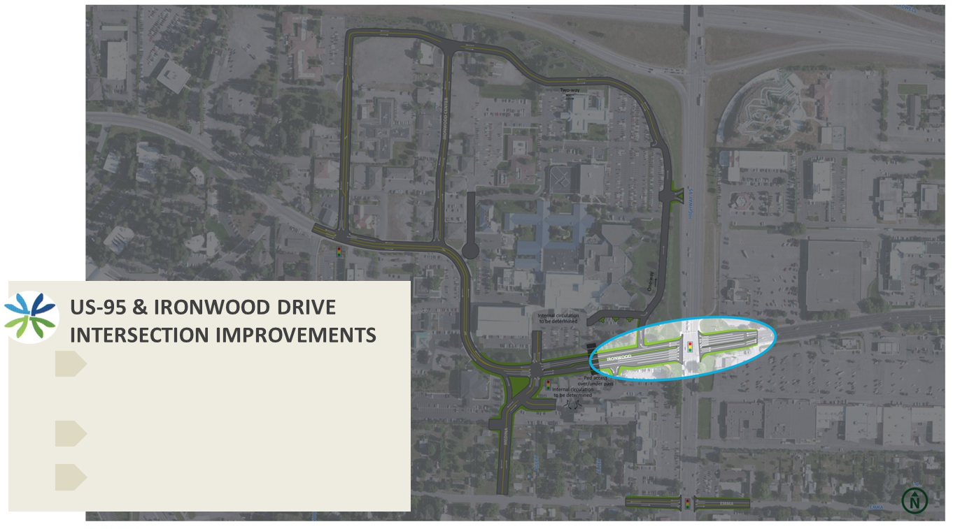
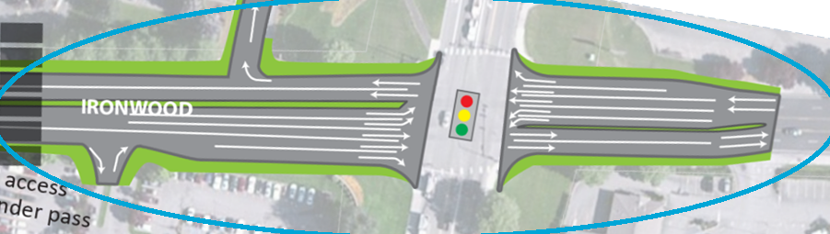
Master Plan Alternative
BENEFIT
Improves access to/from medical campus
Improves efficiency at signal
Improves operations on Ironwood
YEAR CONSTRUCTED/NEEDED
2015-2016
PRELIMINARY COST ESTIMATE
$1,000,000-$1,300,000

Slide 42
Master Plan Alternatives – Budget and Timing
 |  |  |  |  | Lead | Partnering
 | Project | Budget Estimate | Timing |  | Organization | Organizations
 | Phase 1:
1 | US95 & Ironwood Intersection | $1,854,000* | 2015-2016 |  | ITD/City | KH/Parkwood
2 | Right In/Out at Interlake (US95) | $170,000* | 2015-2016 |  | Parkwood | ITD/City
3 | Loop Road - Kootenai Health Way/Ironwood Place | $320,000* | 2015-2016 |  | KH | City
4 | Ironwood Place & Ironwood Dr. Intersection | $880,000* | 2015-2016 |  | City | KH
5 | Cul-de-sac Ironwood Court | $160,000* | 2015-2016 |  | City | KH
 |  | * Engineering Estimate
 | Phase 2:
6 | Kooteani Health and Interlake Intersection | $1,500,000 - $1,800,000** | 2017-2020 |  | City | KH/Parkwood
7 | Medina Connection to Emma | $250,000 - $600,000** | 2017-2020 |  | City | Parkwood
8 | US95 & Emma Intersection | $800,000 - $1,200,000** | 2017-2020 |  | ITD/City | KH/Parkwood
9 | Right In/Out at Kootenai Health (US95) | $100,000 - $170,000** | 2018-2022 |  | FHWA/ITD | KH
 |  | ** Conceptual Estimate

Slide 43
Potential Funding Opportunities
Funding Source | Program | Funding Amount | Implementation Time | Type of Work
Local Highway Technical Assistance Council | Local Highway Safety Improvement Program | $0-$250,000 | 2 years (construction) | Signals, Pedestrian Needs, Lane Widening, Turn Lanes, etc.
Idaho Department of Commerce | Community Development Block Grant | $400,000-$500,000 | Variable | Public Facilities and Job Creation (improvement that support companies who are expanding and creating new jobs).
Local Highway Technical Assistance Council | Urban Surface Transportation – Federal-Aid | $0-$2 million | 3-4 years | New construction, reconstruction or rehabilitation of urban collectors or arterials.
Idaho Department of Transportation | Community Choices | $0-$500,000 | 2 years | Pedestrian, bicycle, ADA, transit stop/pickups, traffic calming and safety related infrastructure.
Local Improvement District (LID) | N/A | Variable | Variable

Slide 44
Next Steps
Next step is to begin design of the early projects to refine our estimates and develop implementation plans.

Slide 45
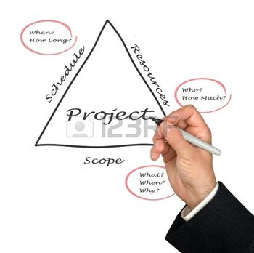
Questions???

Slide 46
Final Thoughts
Don’t stop at the Plan
Don’t rush to a grant without the project development
Don’t rush to preliminary engineering
Do try project development
Do make friends with engineers
Do learn creative financing
Don’t be afraid to try something new

