Slide 1
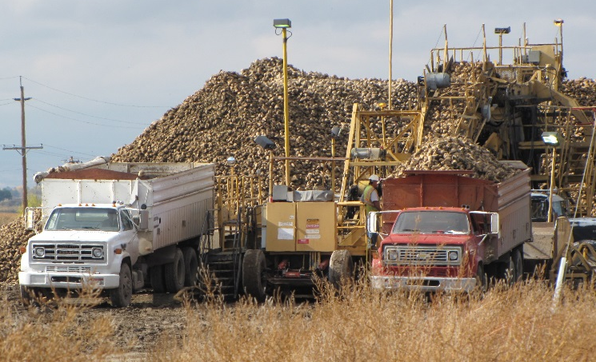
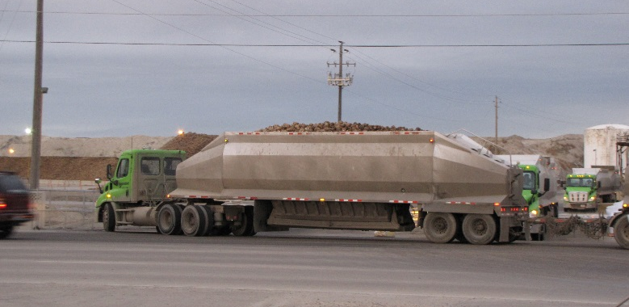
Agricultural Freight in Southwest Idaho
Tina Fuller
Assistant Planner
COMPASS
Notes:
Good morning/afternoon! My name is Tina Fuller and I am an Assistant Travel Demand Modeler for the Community Planning Association of Southwest Idaho or COMPASS, which is the MPO for Southwest Idaho. I’m here today to talk to you about the agricultural freight study that we recently undertook.

Slide 2
A little about COMPASS

Slide 3
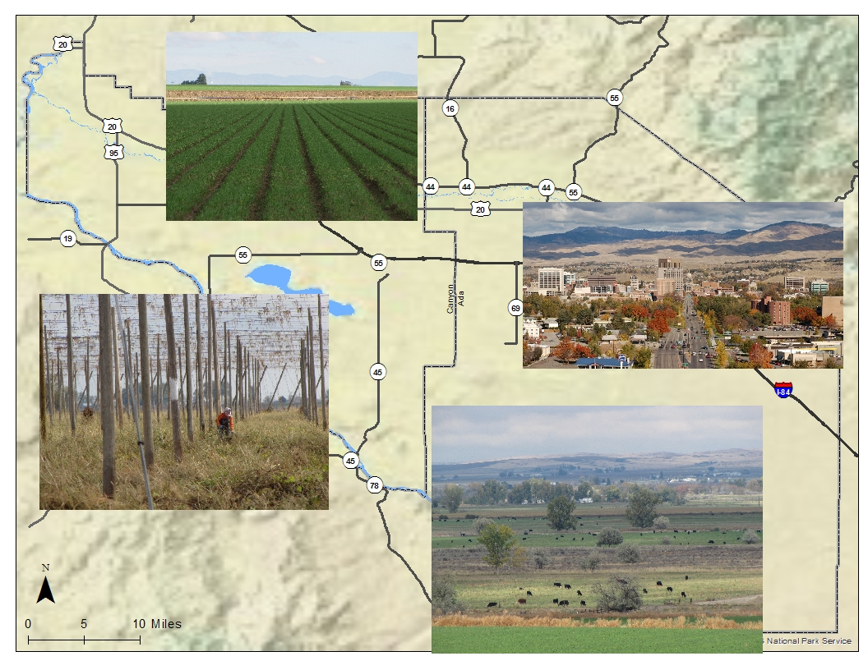
Ada and Canyon Counties
40% of the State’s population
Notes:
Ada and Canyon Counties are home to just under 40% of the population of Idaho
Only 1 interstate in Southern Idaho

Slide 4
Introduction
Agricultural Freight Study
Why agricultural freight is important
Methodology
Findings of the study
Lessons learned about agricultural freight
Lessons learned about rural and urban stakeholders
Next steps
SHRP2
Expanding the scope

Slide 5
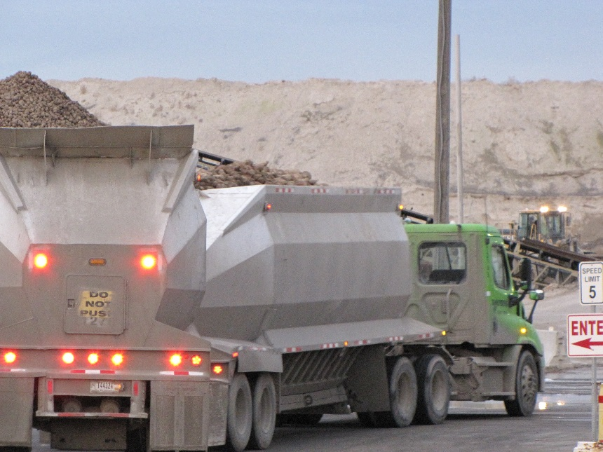
Why agricultural freight?

Slide 6
Agriculture is a critical component of the region’s economy
There are over 25,700 farms in Idaho, covering 11.5 million acres
Austrian Winter Peas
Potatoes
Barley
Trout!
Wrinkled Seed Peas
Sugar beets
Prunes & Plums
Mint
Hops
Cheese
Milk

Slide 7
Where is it going, and how is it getting there?
Goal: Efficient and safe movement of (agricultural) freight
What we need to reach our goal: information!
Corridors
Equipment
Volume
Problem areas/safety concerns
Conflicts
Opportunities
…and how do we find out?
Notes:
To plan and facilitate, we need to know:
Most frequently used corridors
Equipment being used
Volume of agricultural produce/goods
Problem areas/safety
Conflicts with other users

Slide 8
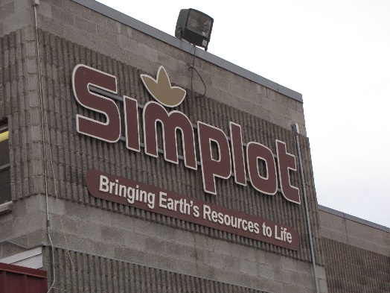
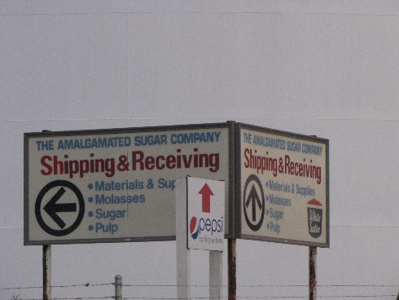
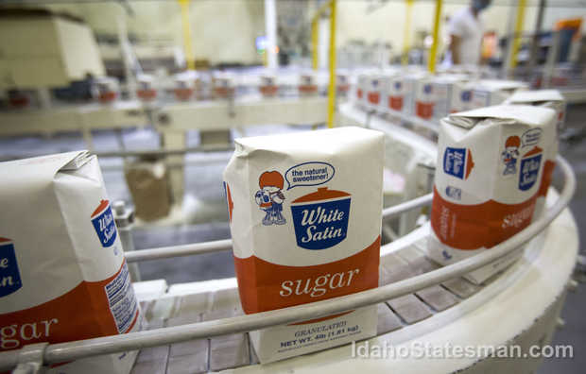
Methodology
Visited the offices of the biggest known producers/transporters
Notes:
Based on the recommendation from a local freight representative who participated in our last (and only other) freight study in 2008, we tackled the agricultural freight study by first reaching out to the three biggest producers in our area
Simplot for potatoes, Amalgamated Sugar for sugar beets and Ruan who is the primary transporter of dairy commodities
We went out to their offices, explained what we were trying to discover, and why, and asked for any information or data they had

Slide 9
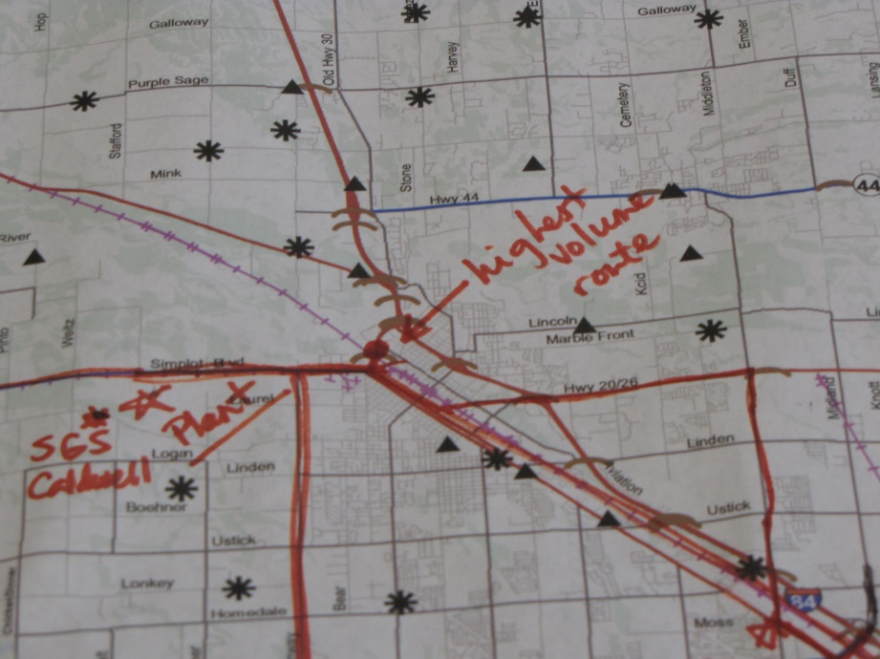
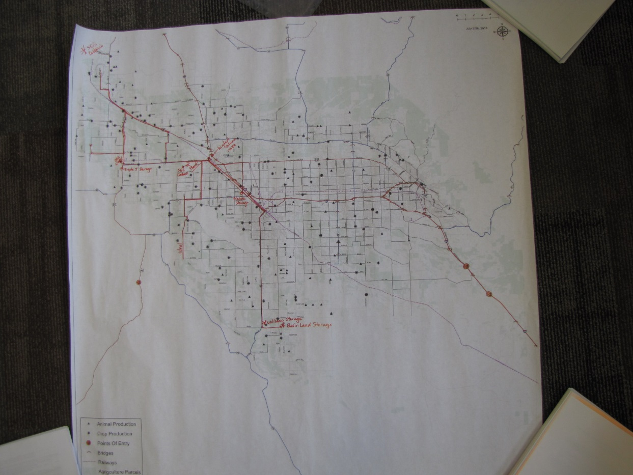
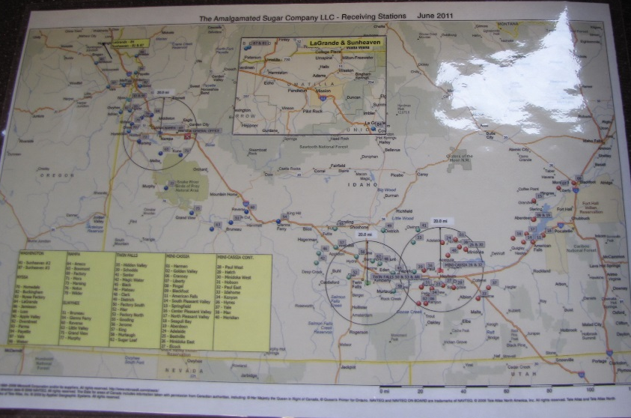
Methodology
Mapped the gathered information
Notes:
Using origins and destinations and the information on crop volume from our initial meetings, we mapped out the corridors and estimated the total volume moving along each route

Slide 10
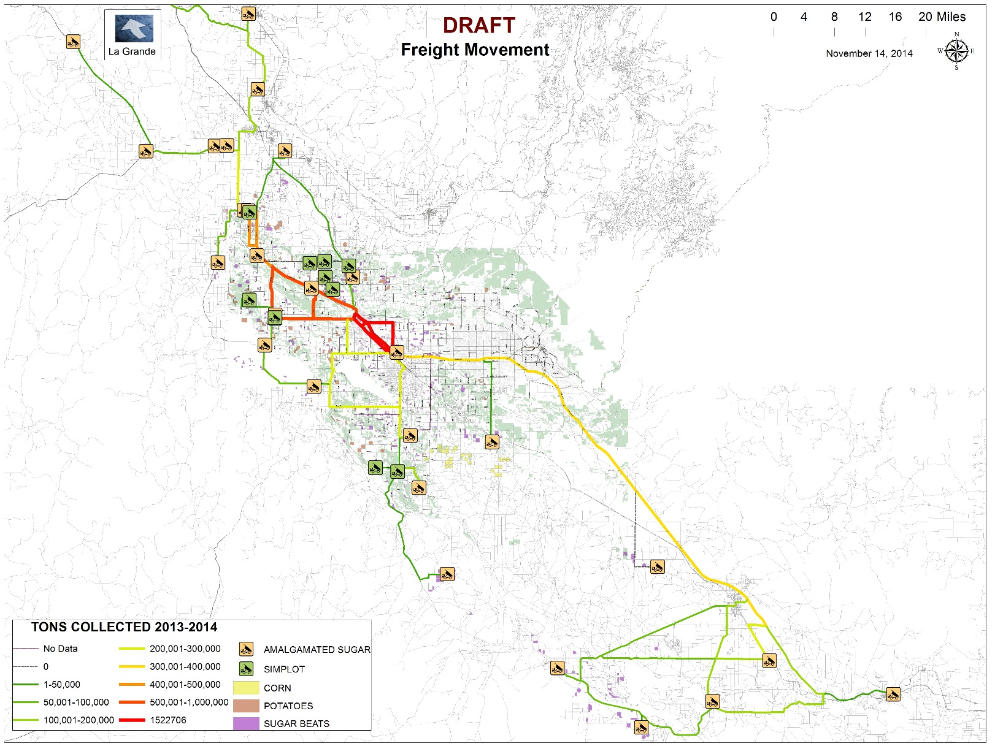
Methodology
Reviewed the information
Notes:
We invited all of the representatives that we had worked with from Simplot, Amalgamated and Ruan to come in to our office all together to look over what we had drafted. We gave them markers and asked them to mark anything that was missing, anything that way wrong – basically mark anything that needed to be changed to be more accurate
This also gave them a chance to network and just talk about common frustrations, and challenges

Slide 11
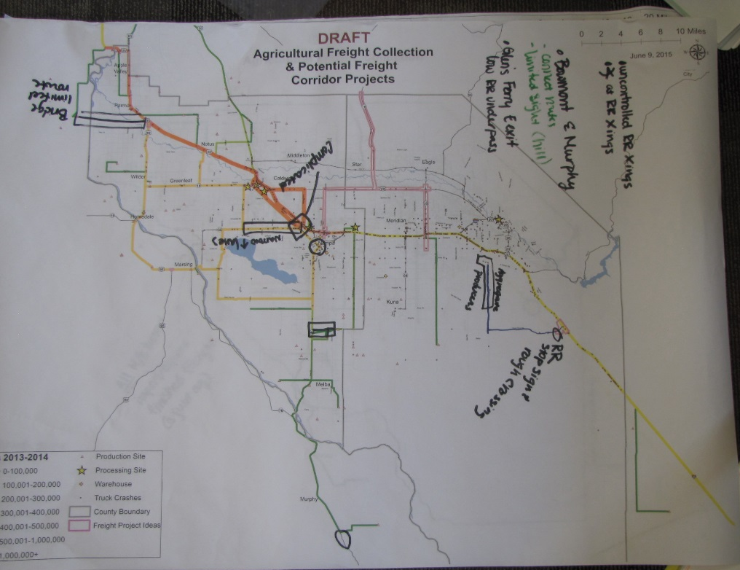
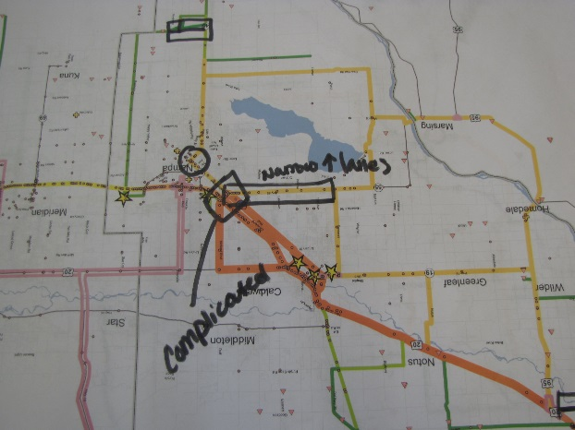
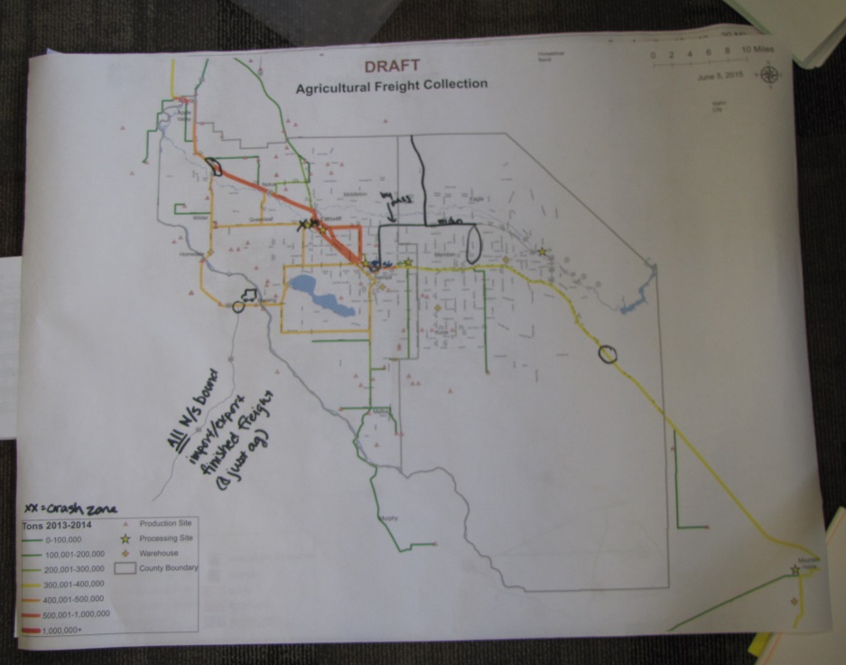
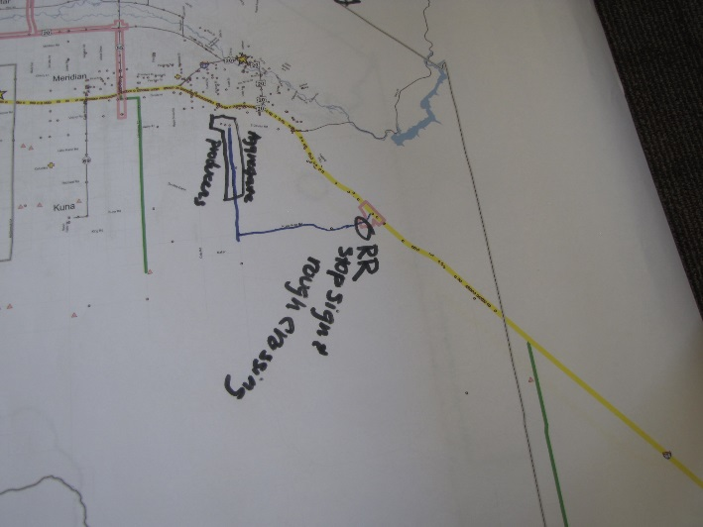
Methodology
Re-reviewed the information, and asked for more information
Notes:
We made the known corrections and asked the stakeholders back to once again review the information
This time we asked a few more questions about what their ‘perfect’ world might look like
We also asked them if there were corridors or routes that could be changed or improved to better meet the needs of their drivers

Slide 12
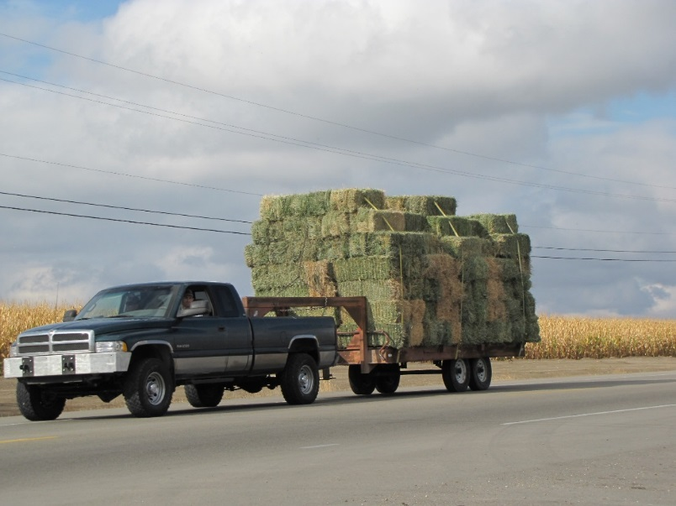
Methodology
Created a voluntary online survey to gather information from other smaller scale producers
19 questions
Sent to 190 producers
22 started the survey
11 completed the survey
But!
We learned from it
Notes:
This did not net us any useful information – but we had to try

Slide 13
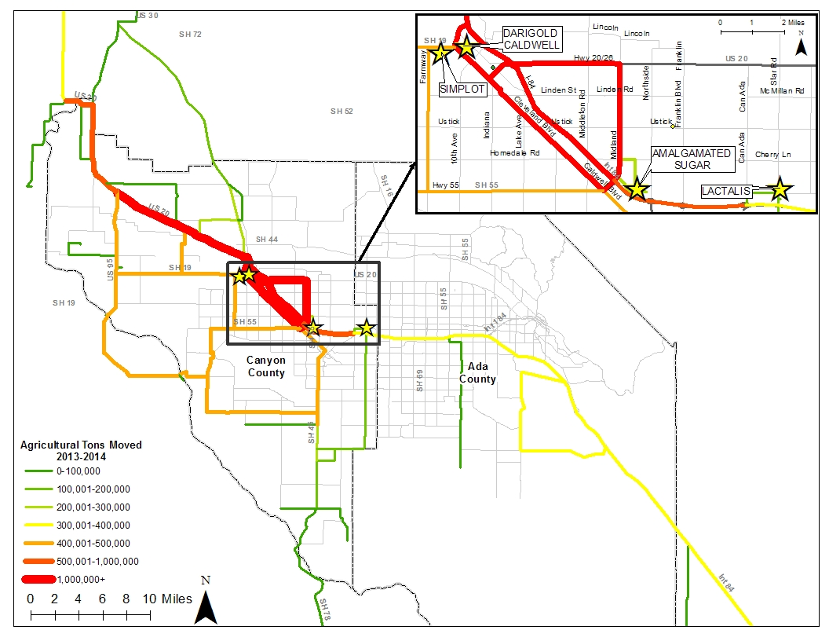
Findings
Most heavily used corridors
~2.2 million tons per year
Notes:
About 2.2 million tons moving in downtown Caldwell, which has about 47,000 as the population

Slide 14
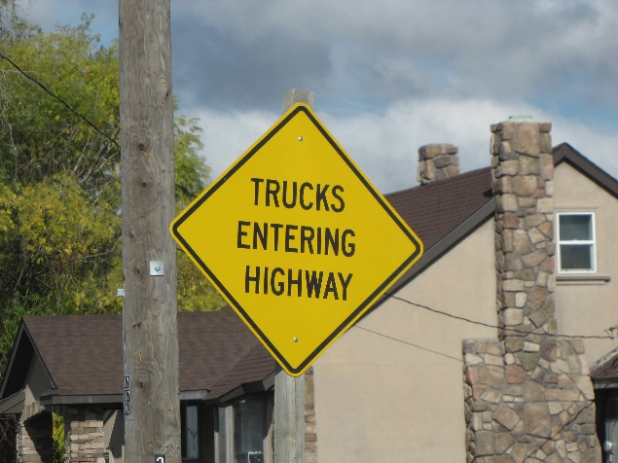
Findings
70,500 trips from production sites to processing and storage locations
~72,000 tons of potatoes
~1.5 million tons of sugar beets
~640,000 tons of dairy
Per year

Slide 15
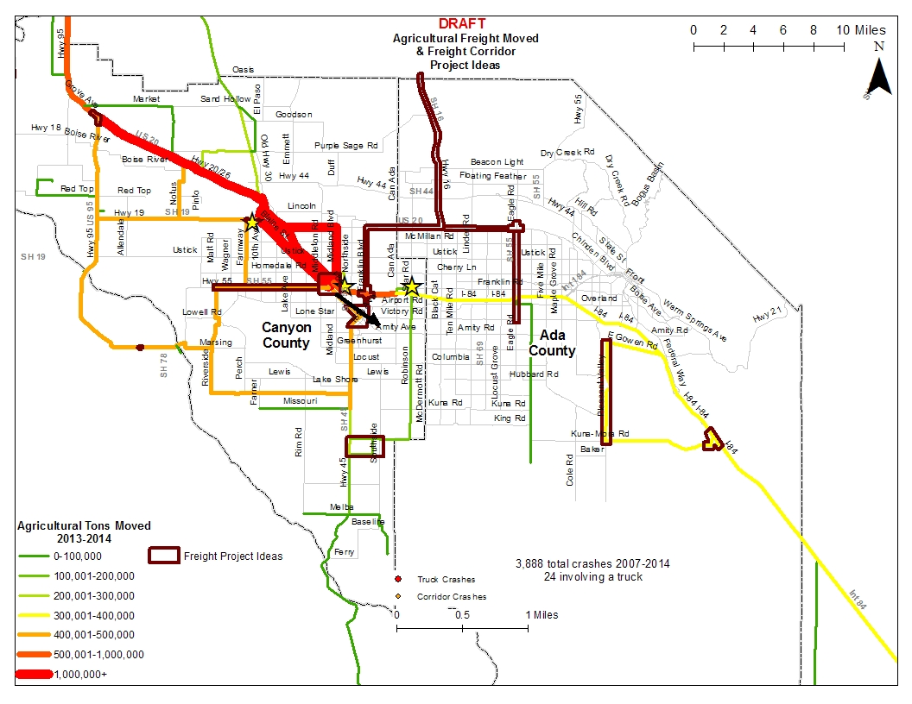
Priority corridors identified by stakeholders

Slide 16
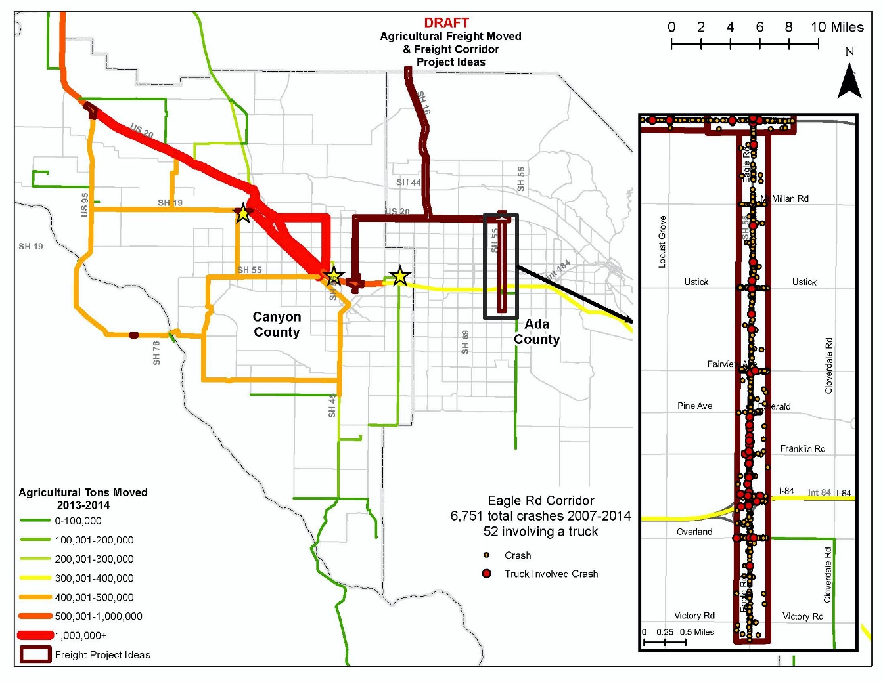
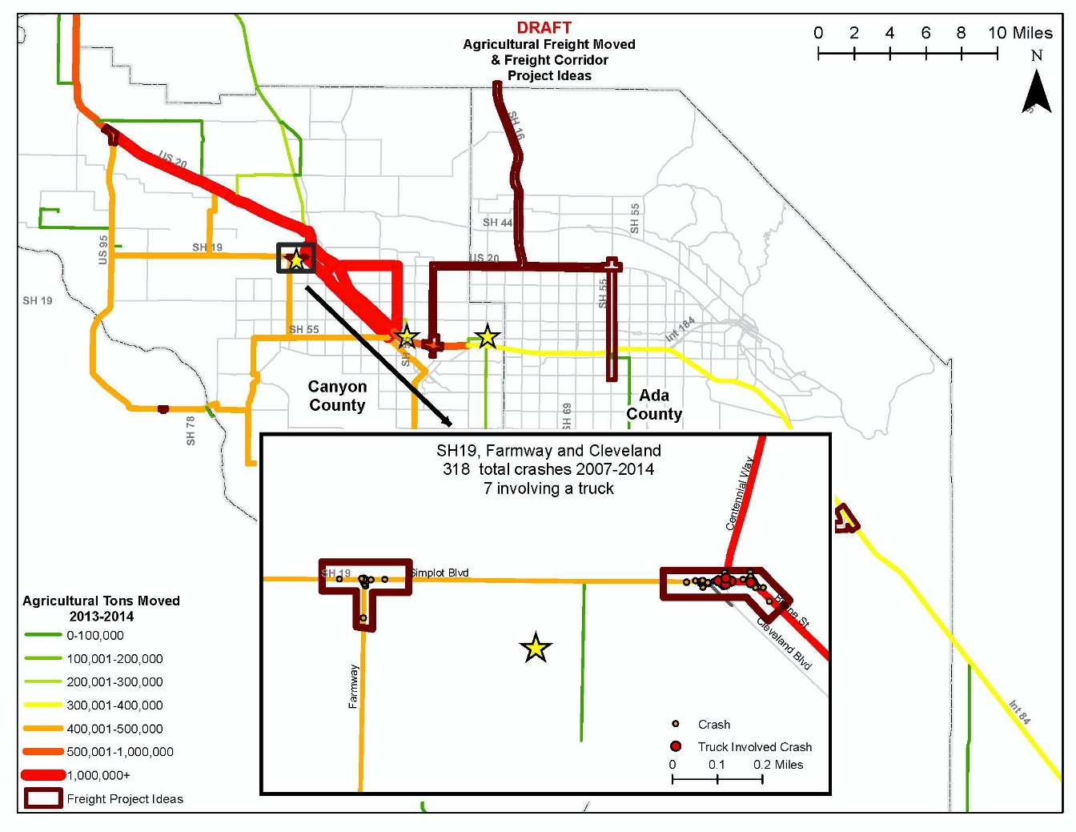
…detailed look…
Notes:
We also looked at crash data along these corridors of interest
While the overall crashes involving a truck were far lower than the total crashes, the other thing to consider is how all of the other crashes create congestion and hinder truck drivers

Slide 17
Findings
Issues and opportunities
Roundabouts and barns!

Slide 18
Findings – we need to ask more questions
Route variety
Rotating crops
Livestock, aquaculture, wheat, hops, barley, mint, fertilizers (in and out)
Internal to external movement
True stress added to the network
All the things we never knew we never knew

Slide 19
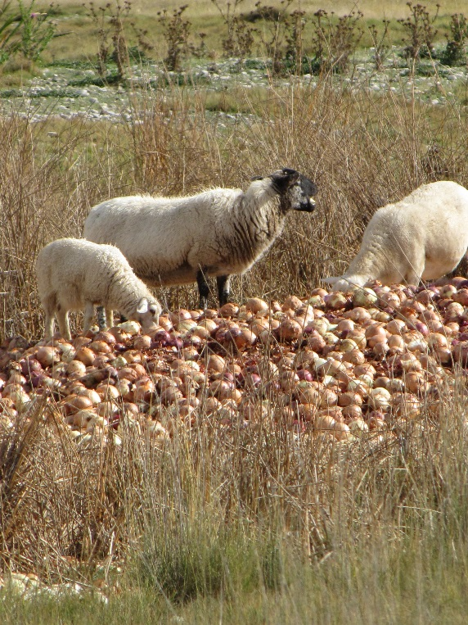
Lessons learned about agricultural freight
Importance of agricultural freight:
Rural to Urban movement
Sub-movements
Transportation system
Economy
Aggregate process

Slide 20
Lessons learned about stakeholders
Stakeholders are different in rural and urban areas
There is no easy way to reach all stakeholders
The interaction between rural and urban stakeholders is valuable
They want to participate
Creativity is key

Slide 21
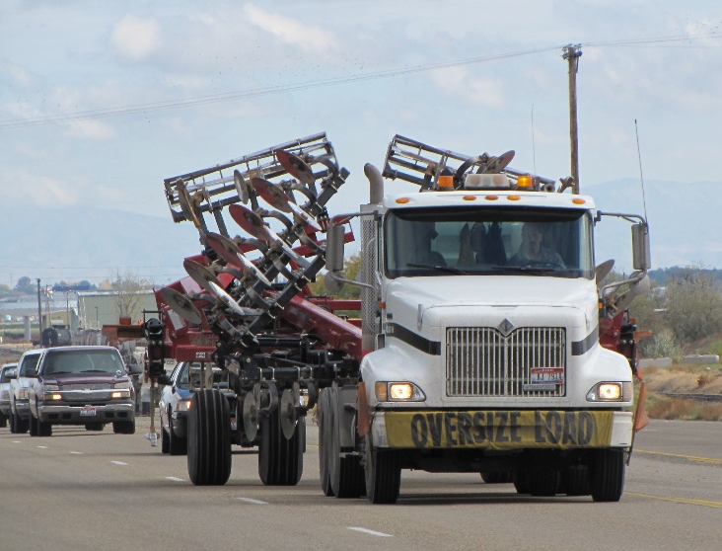
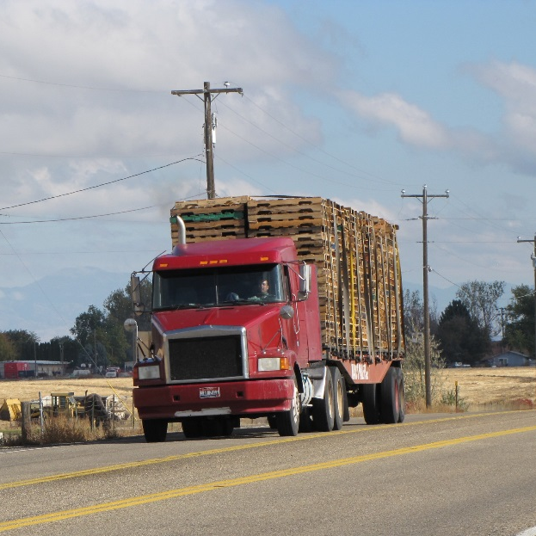
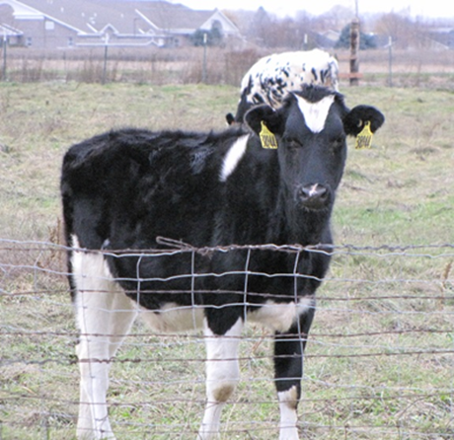
How can we use freight data?
Identify need for:
Preventative actions
More frequent maintenance
Expedited improvement/safety projects

Slide 22
The Big Picture
Notes:
How agricultural freight and really how all freight fit into the long range plan and the long range planning process

Slide 23
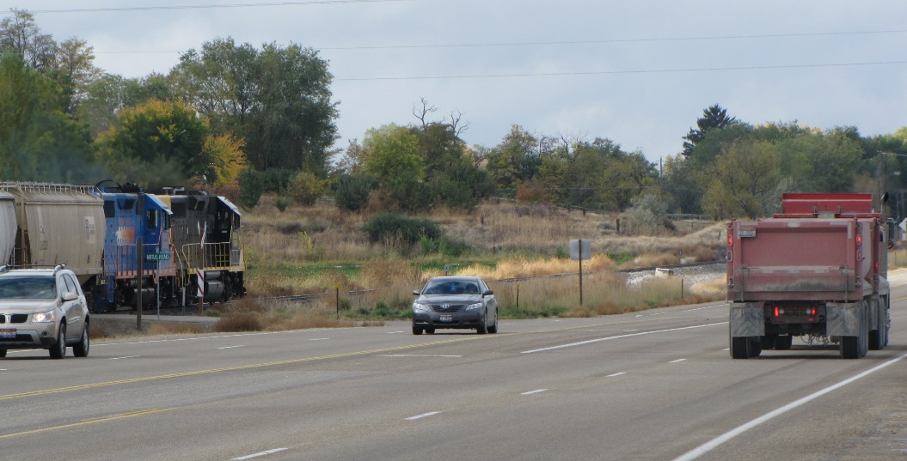
Communities in Motion 2040 2.0
Update to current plan
Same horizon year, same vision for growth
More detailed analysis of future transportation needs

Slide 24
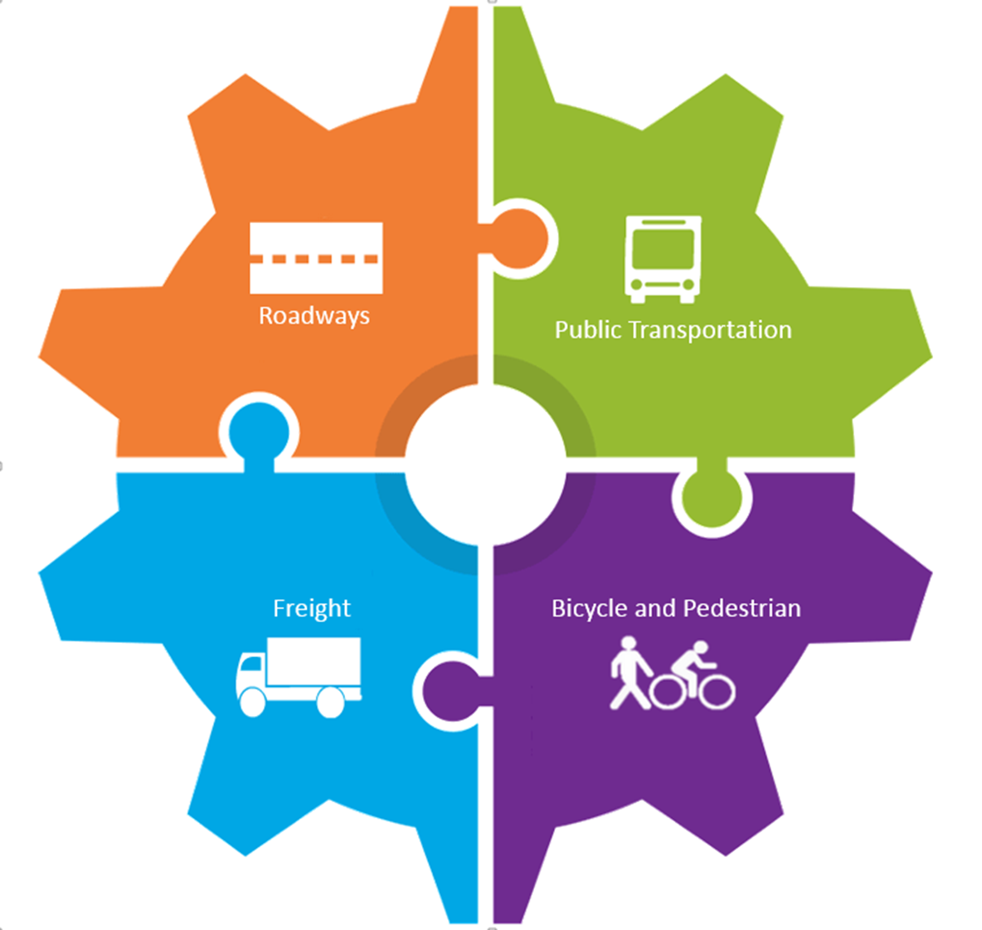
Four Components

Slide 25
Next steps
SHRP2 freight element and data collection
Freight advisory workgroup
Freight component for the long-range transportation plan
Notes:
COMPASS was awarded a SHRP 2 grant and part of this grant is a freight component.
This effort is similar to the out reach efforts to the agricultural community, we had our first meeting last Tuesday and it went really well. We sent out ____ invitations and had _____ participants and are hoping to get more through word of mouth.

Slide 26
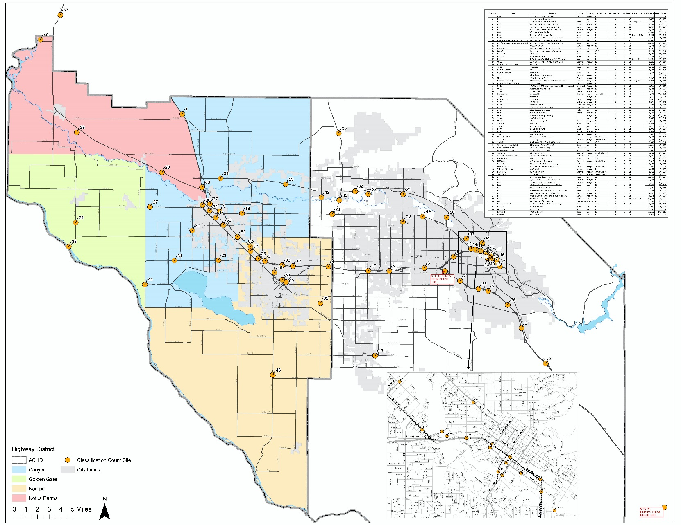
Next steps
Notes:
We’re preparing to collect vehicle classification counts at 70 locations between the two counties. This will help us get at some of those other questions like overall impact, or stress on the system, the internal and external trips – hopefully this will help us fill in some of the gaps that we now know exist

Slide 27
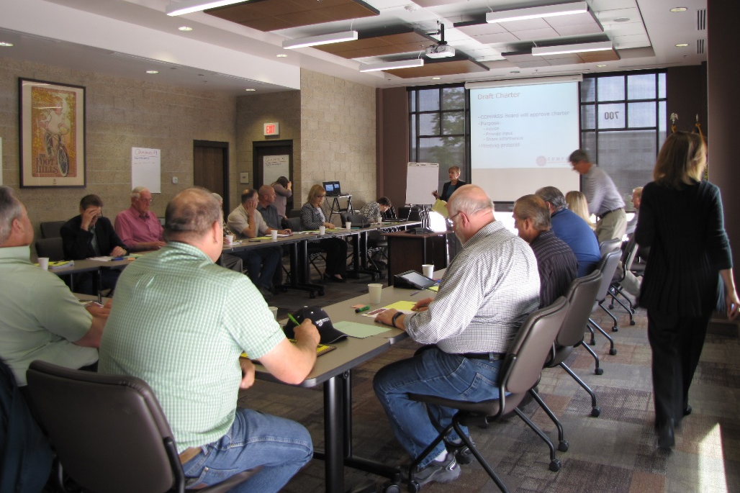
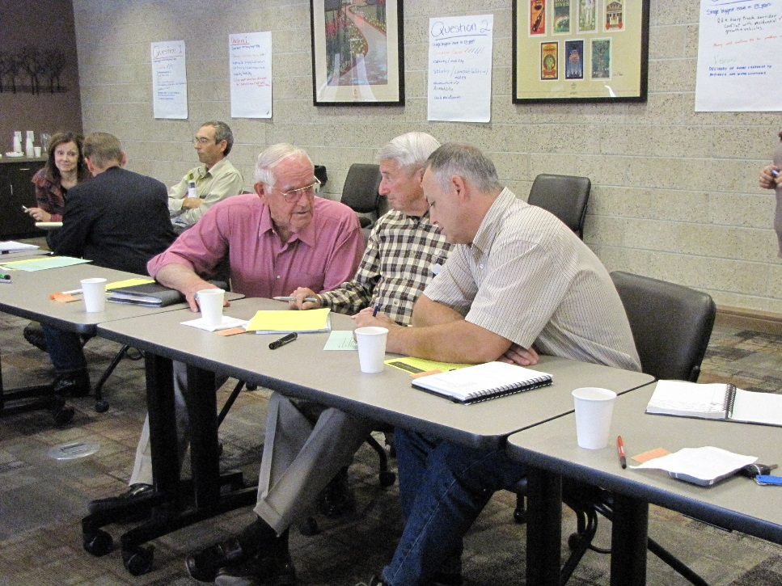
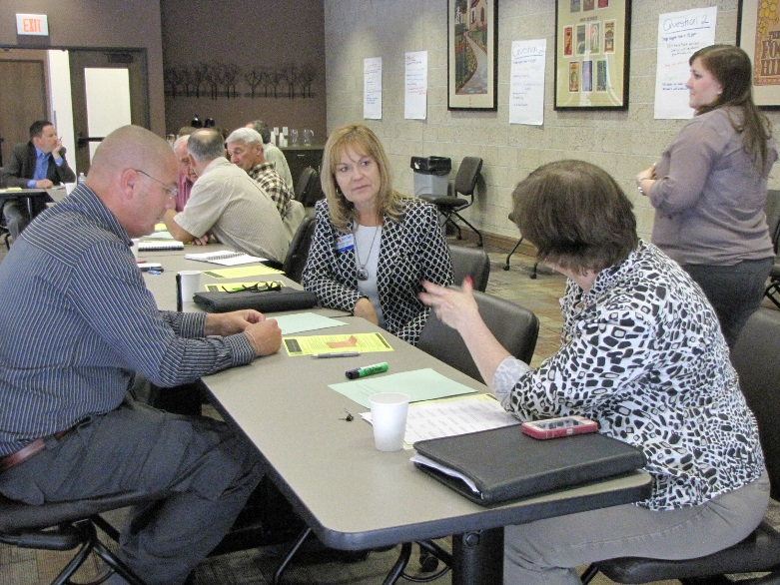
Next steps

Slide 28
How does this apply to you?

Slide 29
Couple of ideas
Consider freight in comprehensive plans and other planning documents
ITD will be reaching out for their upcoming freight study
Contact your MPO and find out what is in the long range plan about freight
Please ask questions about how to get started

Slide 30
Questions?
Tina Fuller
tfuller@compassidaho.org
208-475-2231

Slide 31
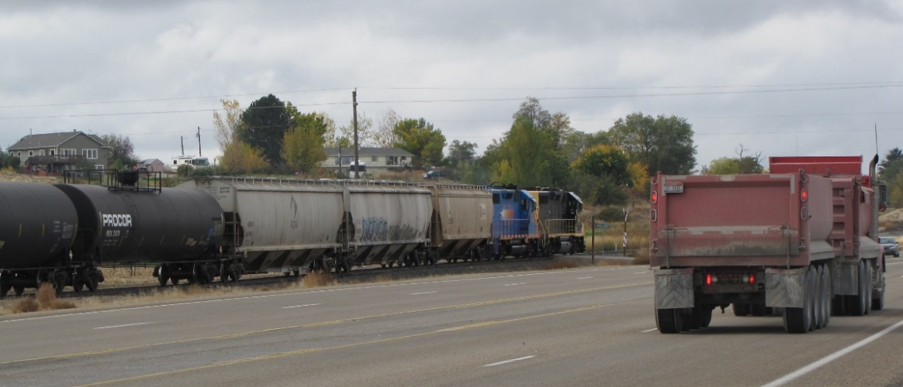
Conclusion
Driving home the importance of the different needs of different areas
Expanding scope to entire freight community
Freight component in the long range transportation plan
Continue building partnerships with and between stakeholders to make sure urban and rural needs are being addressed

Slide 32
References
http://beef2live.com/story-idaho-ag-facts-116-105018
http://farmflavor.com/us-ag/idaho/
http://www.visitidaho.org/idaho-trivia/

