Slide 1
Greenprint Development and Trail Planning in Bonner County and Sandpoint
Fred Gifford, Senior GIS Program Manager
Notes:
Short Presentation about the project and then a panel discussion.

Slide 2
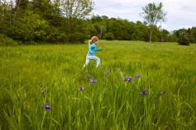
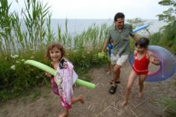
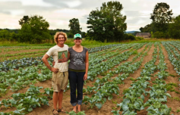
Our Mission
The Trust for Public Land conserves land for people to enjoy as parks, gardens, and other natural places, ensuring livable communities for generations to come.
Notes:
2
We are the land for people people.
We obviously do water and natural resource protection, but what distinguishes us from most other conservation organizations, is our focus on land for people. Because of our land for people focus, we’ve become national experts on land conservation for drinking water protection, creating successful and sustainable urban park systems, and the economic benefits of parks and conservation, among many other areas.

Slide 3
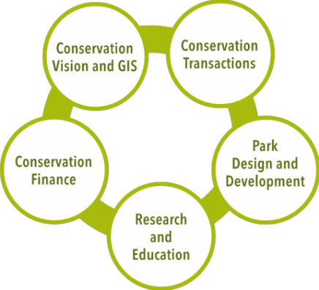
Conservation Service Areas
Notes:
The Trust for Public Land’s Vision and GIS service uses cutting-edge research and innovative mapping techniques to create parks, protect open space, and deliver community-driven conservation plans.
Conservations Transactions – The Trust for Public Land helps structure, negotiate, and complete land transactions that create parks, playgrounds, and protected natural areas. We buy land from willing landowners and then transfer it to public agencies, land trusts, or other groups for permanent protection. In some instances, we will protect land through conservation easements, which restrict development but permit traditional uses such as farming and ranching.
Park Design and Dev –
The Trust for Public Land collaborates with local governments and school districts to restore and create parks, playgrounds, and trails. We work on all aspects of the park design and build process, including:
Participatory design
Green Infrastructure
Creative Placemaking
Site restoration
Construction management
Park stewardship
Conservation Finance - The Trust for Public Land helps state and local governments design, pass, and implement legislation and ballot measures that create new public funds for parks and land conservation. We’ve helped pass more than 478 ballot measures—an 81 percent success—creating $57.9 billion in voter approved funding for parks, land conservation and restoration. Every $1 invested in this program has generated more than $2,000 in new public funds.
Research – Green Infrastructure, Park Analysis, - working with Georgia Tech on developing a new Heat Island model and Arizona State University on Co2 modeling to individual street and buildling level in LA

Slide 4
What we do—our two initiatives
Parks for People
initiatives
Our Land and Water
Notes:
The two organization-wide conservation initiatives of The Trust for Public Land are:
PARKS FOR PEOPLE: The Trust for Public Land works with communities to ensure that everyone has parks, gardens, playgrounds, trails and other natural places within a 10-minute walk from home.
OUR LAND AND WATER: The Trust for Public Land works with communities to protect the lands and waters that keep us healthy, inspired, and connected with nature and each other.

Slide 5
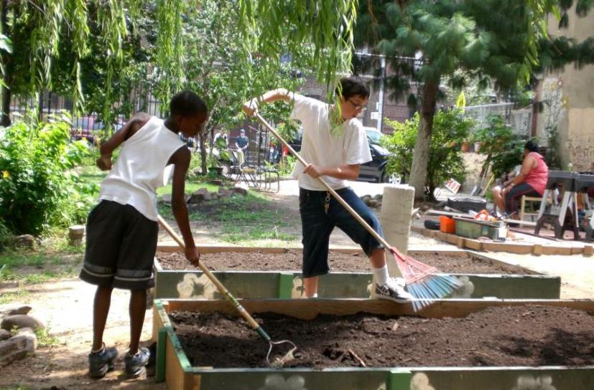
Community Gardens: NYC
Notes:
The Trust for Public Land now owns 69 community gardens throughout New York City. 64 gardens where saved from a city auction and eventual destruction, and an additional 5, the city subsequently donated to us for preservation. TPL works side by side with dedicated community gardeners to transform vacant lots into vibrant spaces where nature and community thrive. TPL, when necessary, purchases land to permanently protect it and then provides design and development assistance-including physical improvements such as watering systems, fences, and gathering spaces; organizing assistance; stewardship services; grants; environmental education; and programming.
In 2004, TPL created three new nonprofit organizations to ultimately own and manage the gardens. The Manhattan, The Bronx, and the Brooklyn-Queens Land Trust, together comprise the nation's largest land trust protecting community gardens.
Our goal is to work with the land trusts to ensure they become and remain a strong resource that protects the gardens and ensure they serve their surrounding communities and responds to its neighborhood needs.

Slide 6
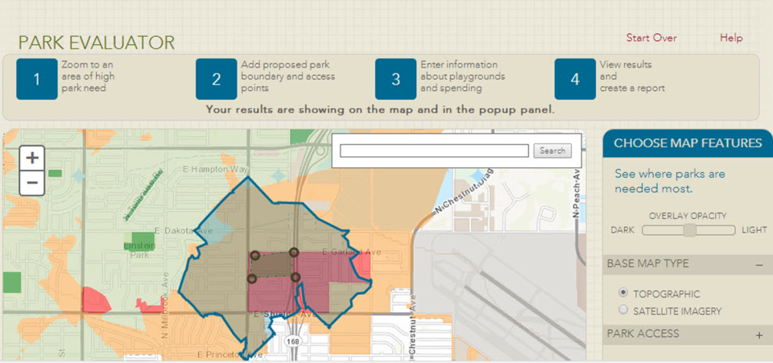

Slide 7
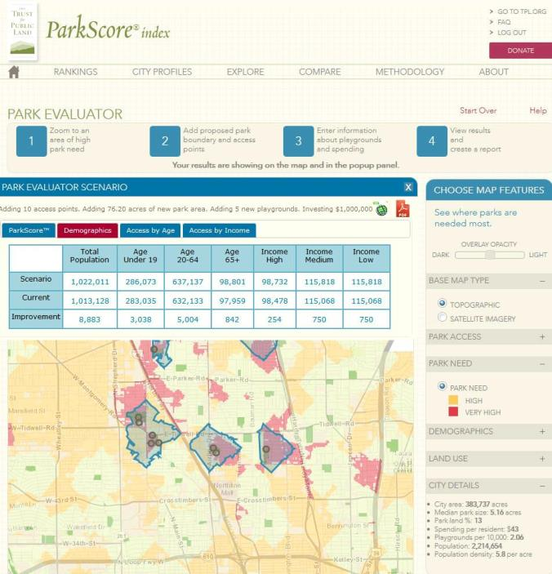

Slide 8
The Hoback Basin, Wyoming
Hoback Basin, Wyoming
Notes:
The Hoback Basin is the southern anchor of the Greater Yellowstone Ecosystem—the largest intact temperate ecosystem in the northern hemisphere—the Hoback Basin is home to magnificent mountains, vibrant forests, and the headwaters of the Wild and Scenic Hoback River.
In 2012 PXP Energy was pursuing plans to drill 136 gas wells and build 30 miles of roads at the headwaters of the Hoback River. If approved, it would have been the only instance in the United States of a major gas field at the headwaters of a Congressionally-designated Wild and Scenic river.
Oil and natural gas are important businesses in Wyoming, but local communities galvanized around a common belief that the Hoback is “too precious to drill.” In July 2012, The Trust for Public Land reached an agreement to purchase PXP’s 58,000 acres of oil and gas leases in the Hoback. TPL was successful because of the support we received from our partners and Wyoming communities of Rock Springs, Pinedale, Bondurant, Jackson, and Wilson.

Slide 9
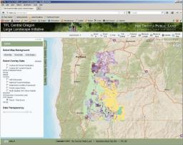
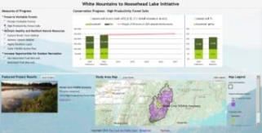
Leveraging GIS for Strategic Programmatic Efforts at the Landscape Scale
Frame Objectives & Metrics into GIS-Based Decision Support
Tell The Story
Track Progress
by Metrics

Slide 10
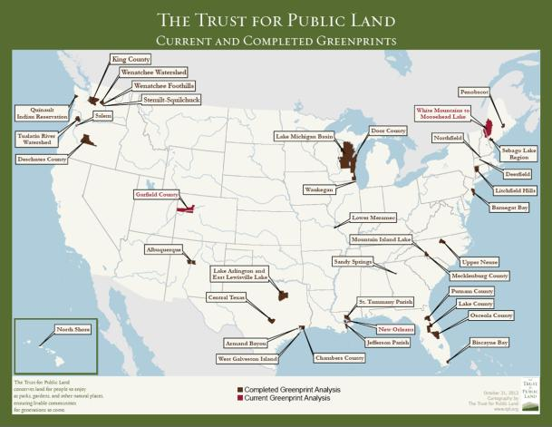
Greenprinting - Community Driven Land Conservation
TPL’s Greenprinting is an interactive, community modeling process that uses GIS to identify priorities for planning and conserving parks and natural resources based on local input.
Notes:
A large part of our visioning work is translating communities’ conservation and park creation goals into maps that identify lands that best meet those goals. We call this greenprinting.
This is a core service of ours and many of our projects build off of the tools and frameworks that we’ve developed under Greenprinting.

Slide 11
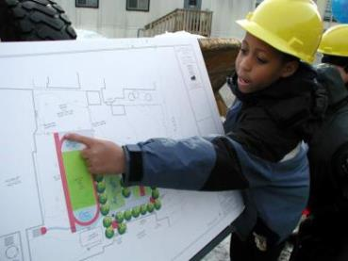
The Trust for Public Land Greenprinting Process
Constituency Building
Community-informed mapping (GIS)
Conservation Finance
Action
Planning
452 transactions from Greenprints since 2006
Notes:
Because our visioning work ranges from small towns or counties, to large, multi-jurisdictional watersheds, we’ve been getting smarter about how to get communities from vision to implementation through a four step process:
building strong community involvement and support,
using innovative tools to translate community goals into parcel prioritization maps,
identifying and creating new funding tools to finance implementation, and
Creating a short action plan that’s focused and doable.
We’ve created a structured, yet flexible process that is efficient, cost-effective and gets to results on the ground.

Slide 12
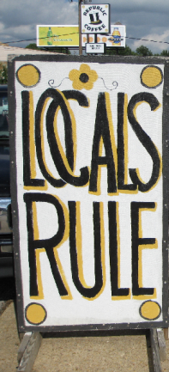
Technical Advisory Team
Notes:
Local experts
With expertise in Planning, Finance, GIS, Conservation, Land Acquisition, Water issues, Soil issues, etc.
From:
City and County Governments
Agriculture
Land Trusts
Universities
Council of Governments
Help in data identification
Review draft results
Participate in weighting exercise of individual criteria

Slide 13
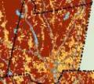
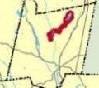
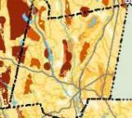
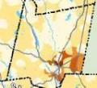
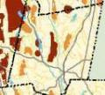
Greenprint Model
Water Quality
30%
Trail Connections
10%
Overall Priority (Stacked Benefits)
Park Equity
10%
Wildlife Protection
50%
Notes:
Community defines the goals and steering committee and TAT assign a weight to each of their goals. For example . . .
We combine all of their priority maps into one composite map that prioritizes land based on how well it meets the communities combined goals.
We can create alternative scenarios by modifying the weights of the various goals and allowing the community to see how various scenarios impact the final results.
In each of these maps, the redish areas represent high priority for conservation.
Locals and stakeholders identify goals and we assemble data.
Translate data into “priority maps” for each conservation goal.
Assign relative weightings that reflect community or regional priorities.
Create alternative scenarios by adding additional criteria or modifying relative importance of existing criteria.
Combine the building blocks into a composite conservation priority map.

Slide 14
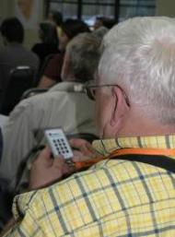
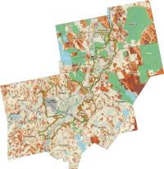
Innovation: Stakeholder Goal Weighting – Interactive Polling and Geoprocessing
Rank Greenprint goals in priority order
Use keypads to enter your personal ranking
System will compile all entries and display a summary graph
Entries feed into ArcGIS to create a sample map that reflects group weightings
Discussion and refinement of weights will follow
Notes:
14

Slide 15
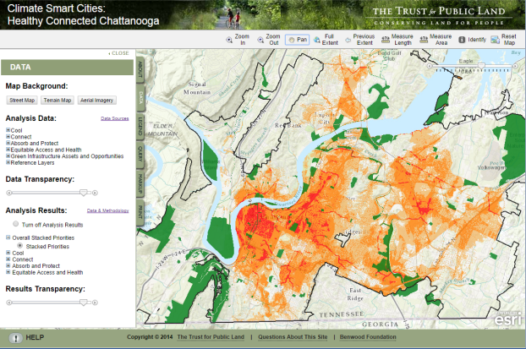
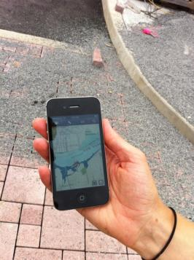
Web-based Decision Support Brings It All Together
Data Library
Priority Modeling
Notes:
We have developed unique and proprietary technology for providing web-based decision support tools on the Esri platform. Our custom JavaScript and parcel tagging tool enable us to create online portals where users can access the data and modeling that we have assembled, run queries to identify high priority parcels, and generate maps and parcel reports. Importantly, these web-based tools can be used on mobile devices such as a smart phone or tablet, making the assembled spatial information available on-site for project evaluation and development. These web-based tools can be kept password protected or made available to the public.

Slide 16
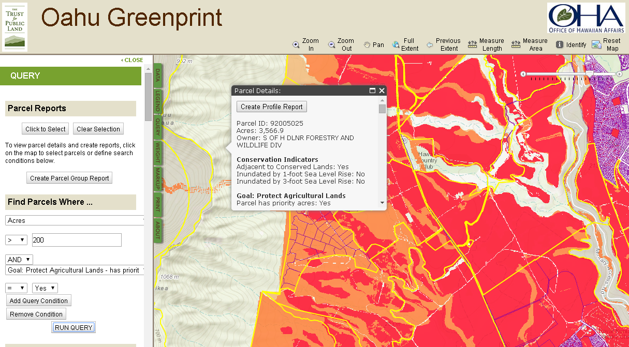
Advanced Query Tools for Targeted Prioritization

Slide 17
Reporting

Slide 18
Reporting

Slide 19
Greater Sandpoint Greenprint
Work To Date
Current Conditions Analysis
Public Outreach (8 Events) and Community Survey
Greenprint Goal Development
Preserve Water Quality
Provide Recreation
Protect Wildlife Habitat
Protect Working Lands
Draft Priority Map
Tasks To Come
Final Priority Map
Action Plan
Web Portal
Notes:
Current Conditions – history of the region, natural environment, demographics, current trends and issues, existing planning efforts and plans
Public
Outreach – community survey, speakout at county fair,
Speak outs
Santpoint Farmers Market 11-Oct 8:30am arrival Farmin Park (3rd ave and oak)
Oktoberfest 11-Oct Granary Arts District (524 Church)
Angels over Sandpoint 18-Oct Sandpoint Business and Event Center
Nordic Club Tap Night 22-Oct Idaho Pour Authority
Nordic Club Ski Swap 2-Nov
SARS Ski Swap 8-Nov 9am-2pm Bonner County Fairgrounds
Friends of Pend Oreille Bay Trail Event 13-Nov 5pm Pend Oreille Winery- 301 Cedar St, Sandpoint
Public Open House Priest River - Pend Oreille River Passage Trail 15-Nov Priest River
Open house
Bonner County Fair (Aug 11-15, 2015)

Slide 20
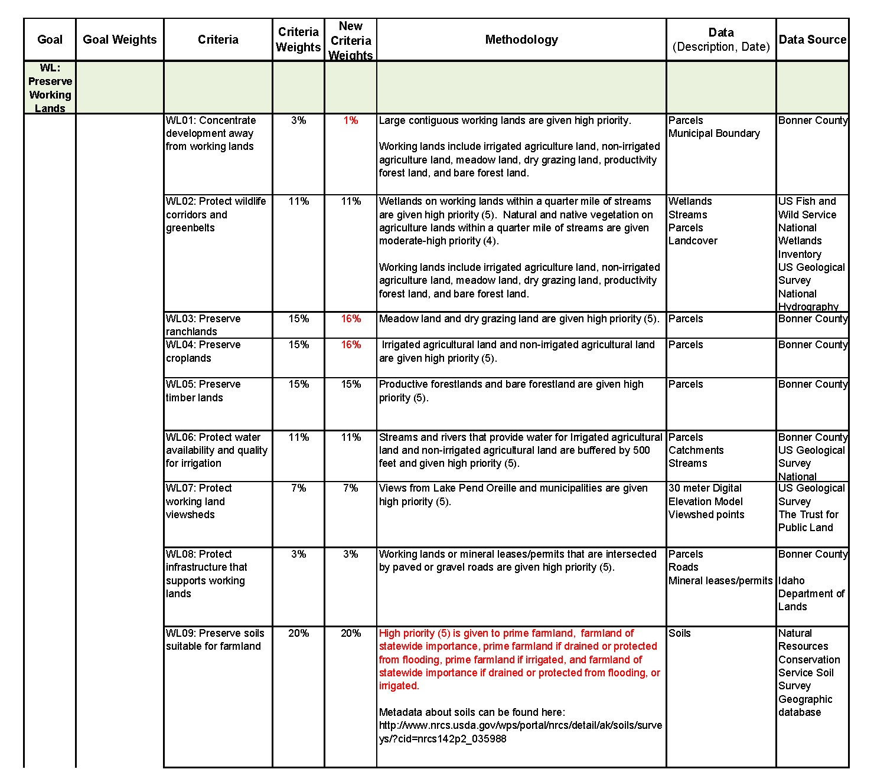
Preserve Working Lands Analysis Model

Slide 21
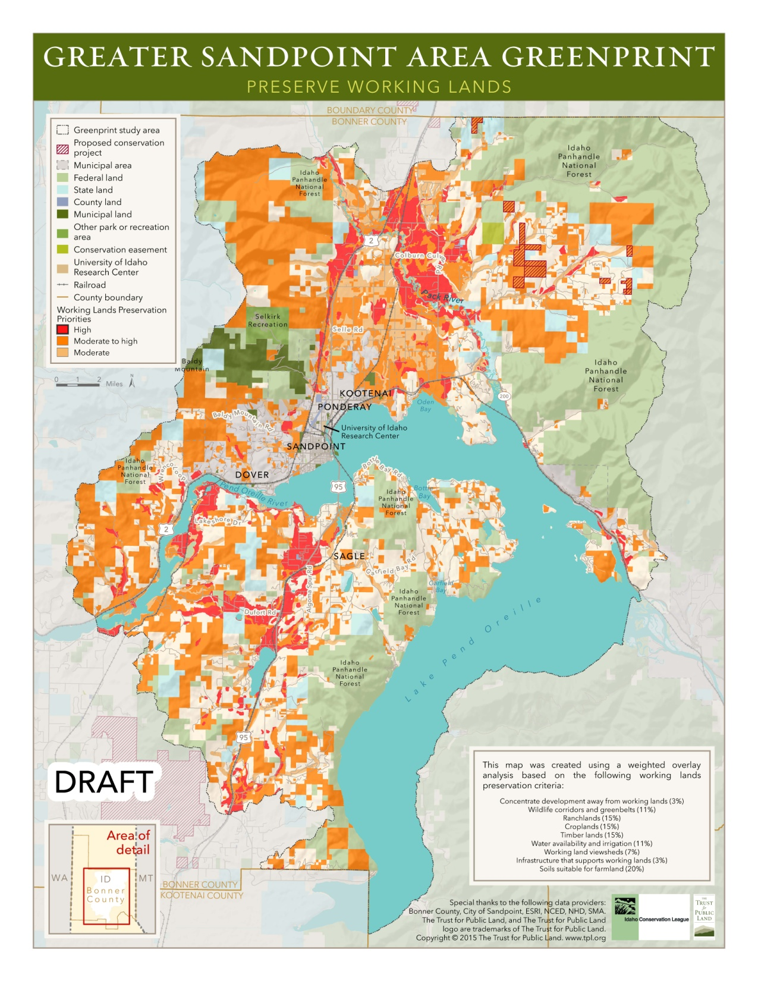

Slide 22
Trail Planning
TPL’s trail planning approach combines local knowledge with qualitative and quantitative analysis to help communities identify trails, rank their priority, and communicate benefits to stakeholders and potential funders.

Slide 23
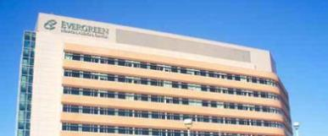
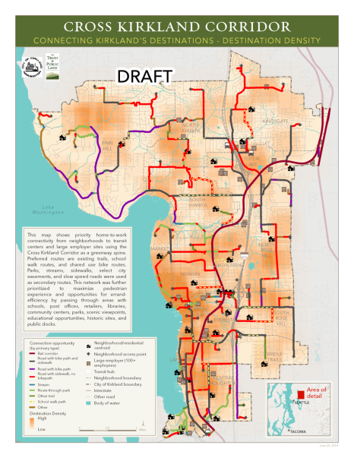
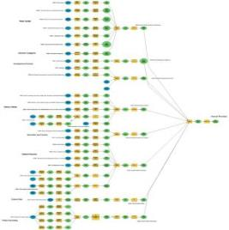
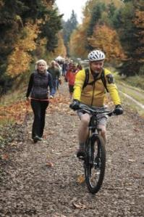
Modeling to Visualize “Hyper-Connectivity”
Destinations
Users
Notes:
Discuss GIS methodology
Identified the core routes from Kirkland’s existing non-motorized infrastructure as well as new connections that can be used to get people to common destinations throughout the city and demonstrates how the Kirkland Corridor can be used as a central route to connect these routes. The infrastructure on these core routes can be upgraded to allow both bike and pedestrian use where needed.
This model was developed by looking at connectivity from neighborhoods to primary work locations usging the Kirkland cooridor as a primary spine and taking advantage of opportunities to route through schools, parks retailers where possible.

Slide 24
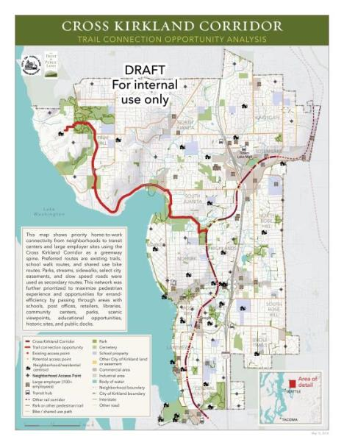
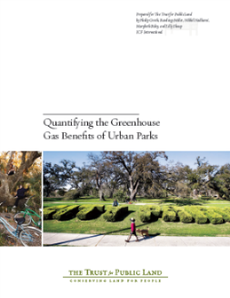
Quantifying CO2 Benefits for Connect Solutions
Finn Hill neighborhood to Google, Inc. | 0.38% Mode Shift | 2.07% Mode Shift | Units
Days¹ | 215 | 215 | days of use/year
Average length of bicycle trips² | 5.8 | 5.8 | miles
Annual average daily traffic³ | 650 | 650 | trips per day
Mode shift from driving to biking | 0.0038 | 0.0207
Credit for activity centers near the project⁴ | 0.002 | 0.002
Annual Auto Trips Reduced | 810.55 | 3172.33 | trips/year
Annual Auto VMT Reduced | 4701.19 | 18399.49 | miles/year
Annual Emission Reductions | 4280.09 | 16751.38 | lbs CO₂/year
CO₂ saving per VMT reduced | 0.91 | 0.91 | lbs CO₂/mile

Slide 25
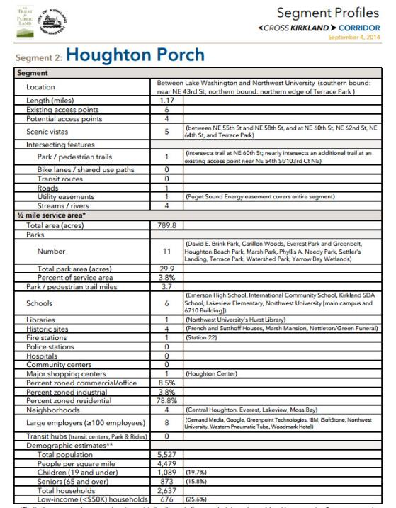
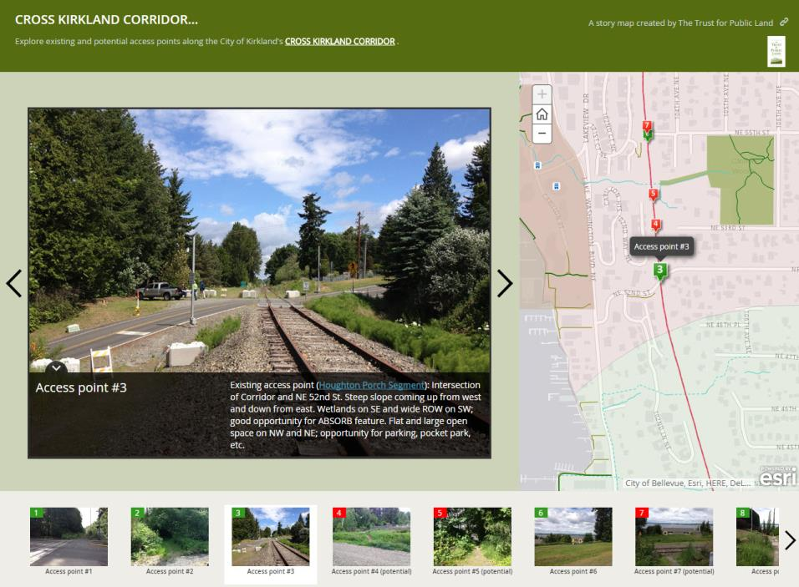

Slide 26
Bonner County Conceptual Trail Planning
Work To Date
Gather Data
Create New Data
Trail Verification
Analyze Crowd Sourced Data
Tasks To Come
Develop Metrics
Prioritize Trails

Slide 28
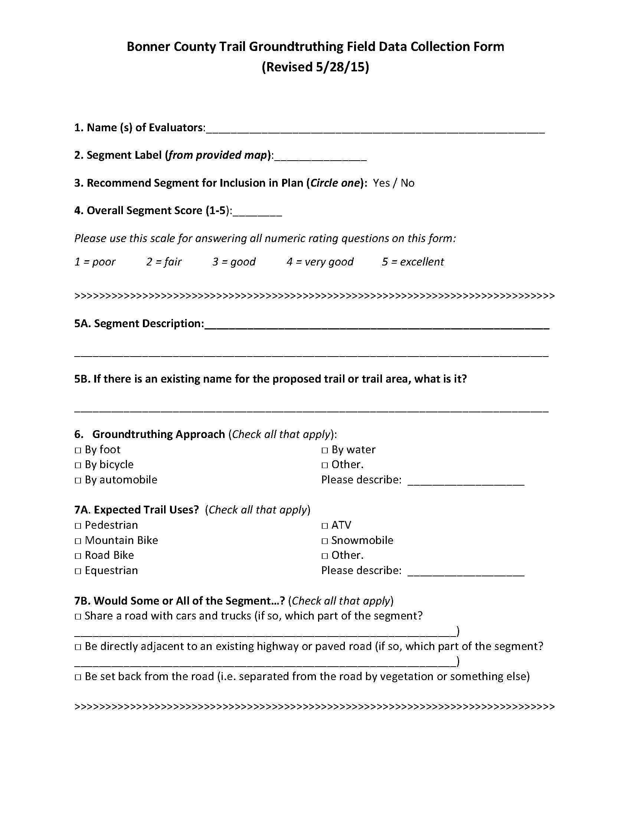
Notes:
Quality and viability

Slide 29
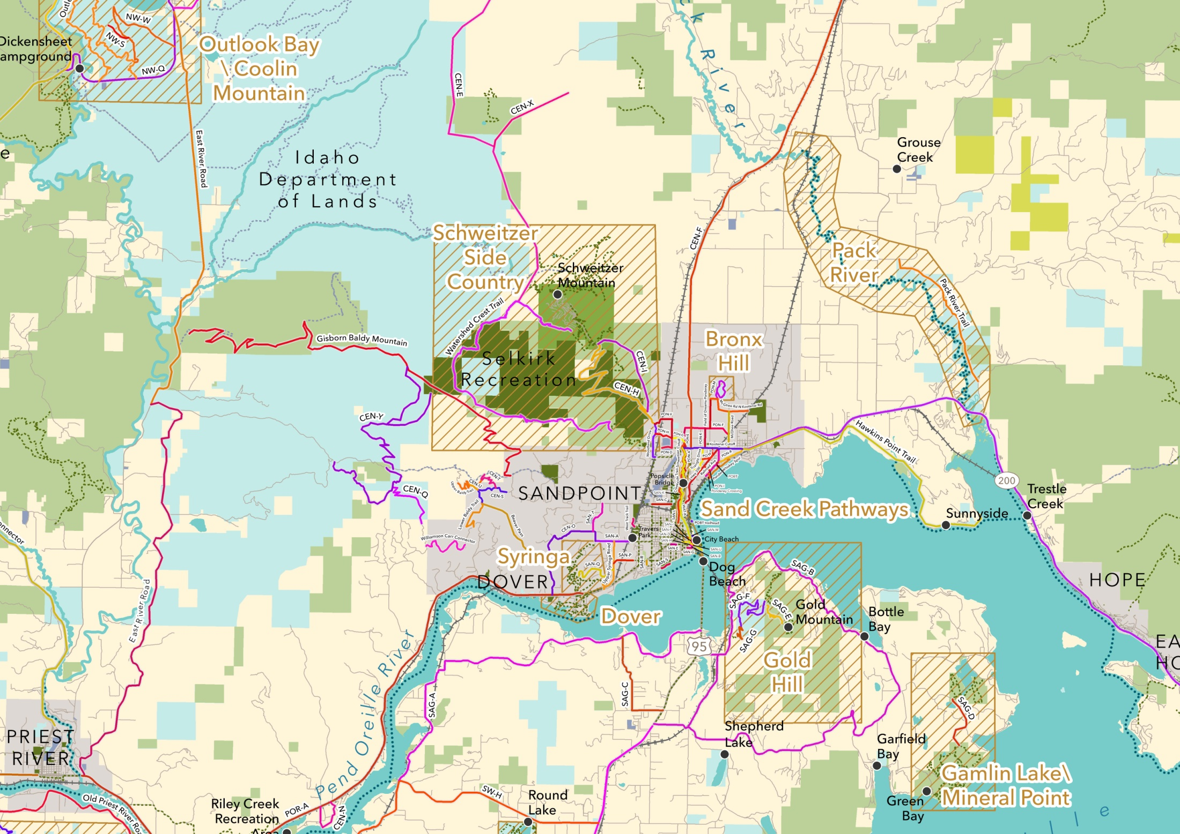

Slide 30
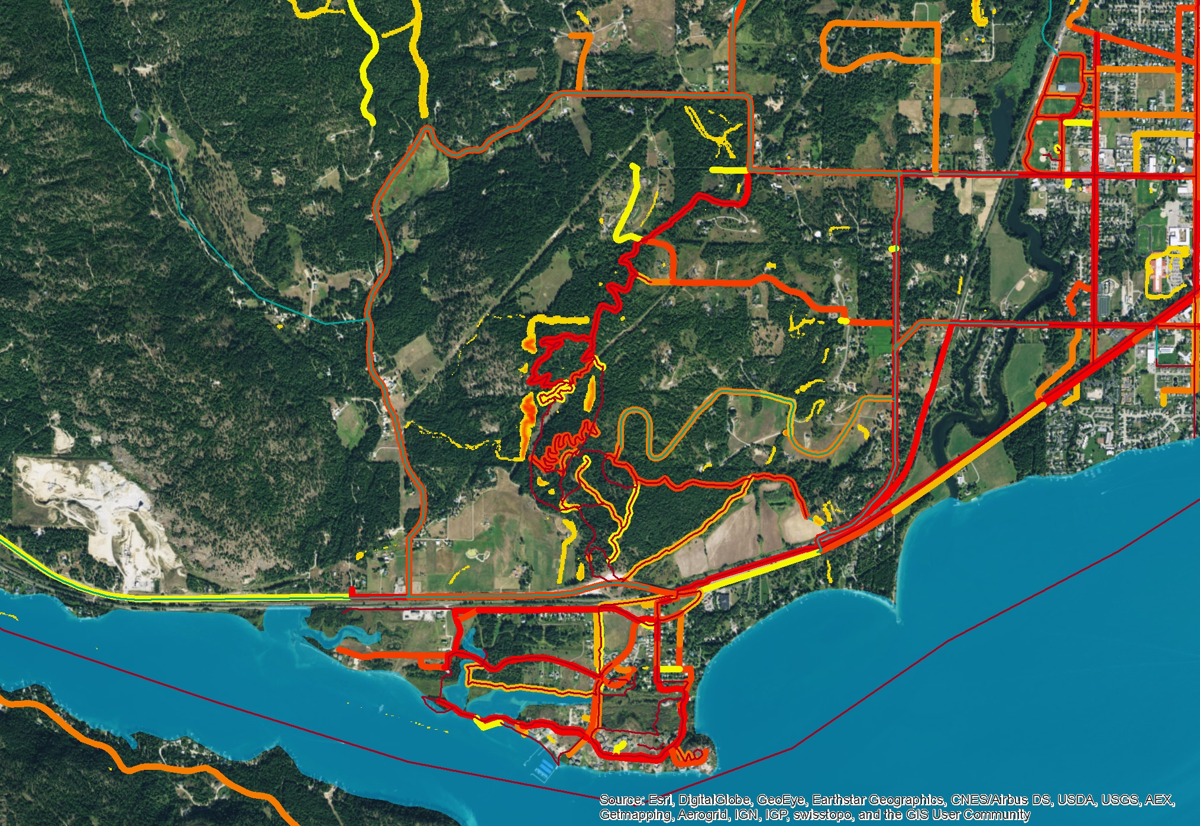
Use of Crowdsourced Data - Strava

Slide 31
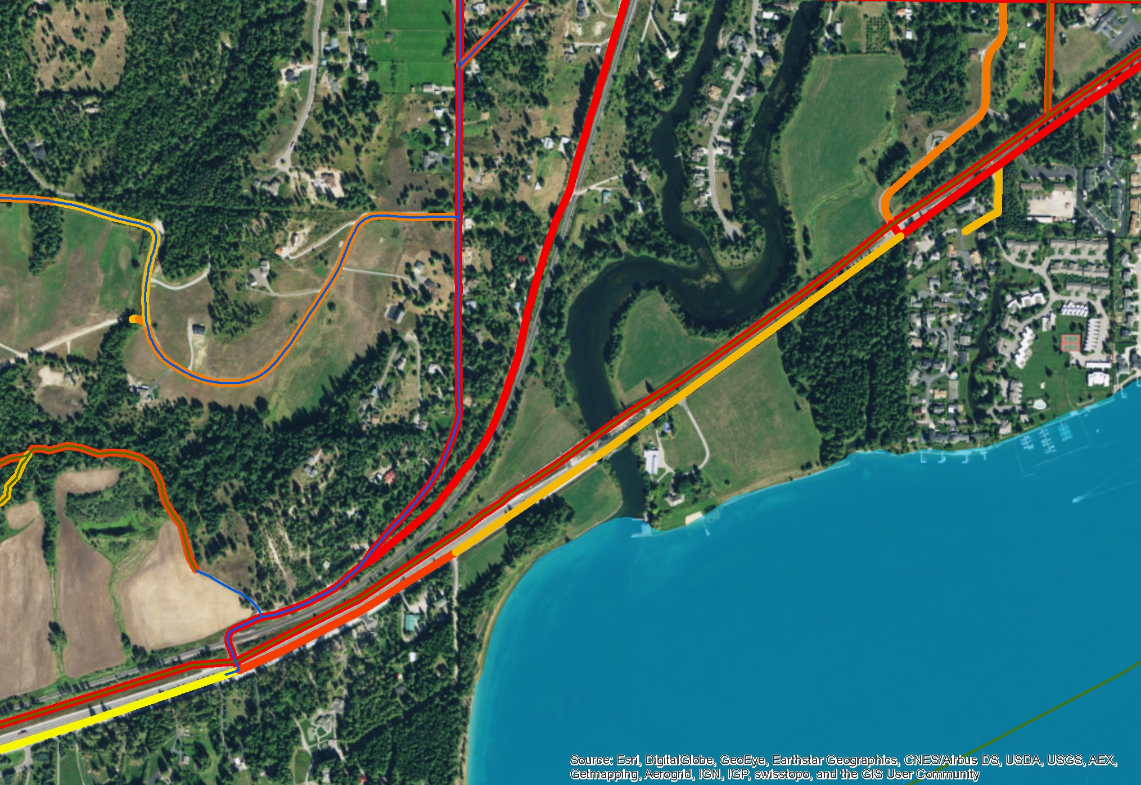
Use of Crowdsourced Data - Strava

