Slide 1
Charting a future for Rural Communities
American Planning Association-Idaho Chapter
Conference 2015

Slide 2
Introductions
Mayor Annie Shaha
Annie, her husband Kevin and two children have lived in northern Idaho for 20 years. In 1994 they purchased property in Laclede Idaho where they built their first home in Idaho.
Simultaneously they moved their business, Racor Home Storage Products, to Sandpoint Idaho. After 14 years of running this successful business, they sold Racor to Illinois Tool Works.

Slide 3
Introductions
Mayor Annie Shaha
In 2005 Annie and Kevin built a home in Dover Idaho, where they currently live.
Annie was asked to run for Dover City Council in 2013; this was her first foray into public life. Two short years later, the current Mayor resigned half way through his term. The City Council appointed Annie to fill this vacancy.
In her time on council and now as Mayor, with the help of a very active staff and city council, she has guided the city water and sewer systems to run more efficiently, enabling a decrease in water rates for most customers.

Slide 4
Introductions
Lisa M. Ailport, AICP
2012 Graduate from Washington State University with a B.S. in Natural Resource Planning
Began my planning career at Bonner County as an Assistant planner in February 2003
Started with Ruen-Yeager in February 2007.
Certified as a professional Planner with the American Institute of Certified Planners
Contract Planner for four communities in N. Idaho
Wife and Mother to a husband and two little girls, age 2 and 7.

Slide 5
Introductions
Elaine Clegg- began working on transportation/land use issues as a citizen advocate 30 years ago. She has worked at Idaho Smart Growth since 1998 providing community based solutions to smart growth challenges. Additionally she has served on the Boise City Council for 12 years concentrating on improving transportation and land use policies.
A professional artist by training, Elaine loves cities and loves helping people make the places they live into places they love (or love even more) Her art background helps her think creatively and holistically. Her experience as an advocate, nonprofit practitioner, policy expert and elected leader bridges diverse stakeholders.
Elaine and her husband Brett have been married for 39 years and they have 5 children and eight grandchildren.

Slide 6
An Overview
Mayor Shaha

Slide 7
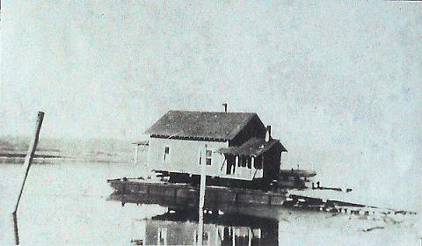
City of Dover
Historic Dover
Historic Dover was platted in 1908. Town was literally barged up stream to the current location when a fire in 1921 burnt down the main mill located in Laclede, Idaho. A new mill was established, known then as the Dover Lumber Company (DoverIdaho.org)

Slide 8
City of Dover
Dover incorporated in July 1989. Since that time, the city has seen tremendous change.
1990 Census suggest a population centered around 294;
According to 2010 Census Data population hovered around 550;
Bordered by the Pend Oreille River to the south; bisected by State Route 2

Slide 9
City of Dover

Slide 10
City of Dover
Dover has most of the same responsibilities as many larger cities:
State of the art sewer plant running that needs about 60% more users to become efficient.
Slow sand water filtration plan, also running around 30% capacity
Street Budget/maintenance
Public Transportation SPOT
Urban Renewal Agency
General fund which includes parks, law enforcement, planning and zoning

Slide 11
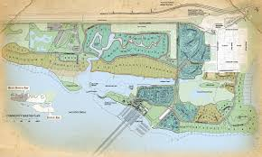
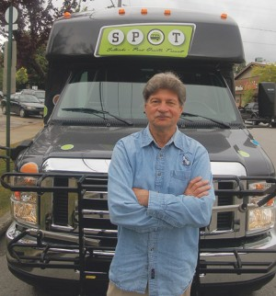
City of Dover

Slide 12
Updating an outdated Comprehensive plan
Most recent comprehensive planning effort was last completed in 2003
City Council directed staff and P/Z Commission to look at updating the 2003 plan in its entirety.
16 pages and tackles 14 of the required 17 components under Idaho Code §67-6508
Meets the statutory requirements (except for 3 components) but lacks depth to the plan and purpose.

Slide 13
Updating an outdated Comprehensive plan
The current comp plan was written before:
New state of the art sewer plant was installed;
Dover’s largest development, Dover Bay. Which includes a projected build out of 600 residences and condos, a private marina on the Pend Oreille River, health club, very active public city beach, etc;
Dover Bridge

Slide 14
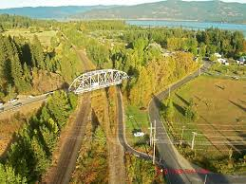
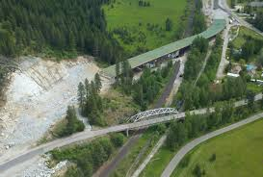
City of Dover

Slide 15
Tackling the Issue
Lisa Ailport, AICP

Slide 16
Taking the First Step:
So What’s Next?
Leveraging resources- Staff, working with the Mayor, is looking for opportunities within the state to leverage our resources.
A comprehensive plan is a very intensive public involvement plan that requires a strategic public outreach goal.

Slide 17
Tackling the Issue
How does a city of ±550 tackle a complete rewrite of an comprehensive plan?
City Council and the Mayor asked the City Planner to give the City options for answering the above question.

Slide 18
Tackling the Issue
Three Options were presented:
Option 1: Keep the work In-House and attempt to complete the update with the limited resources (budget and staffing) the city had;
Option 2: Hire outside assistance through a contract planner to complete the update
Option 3: Find a new option…

Slide 19
Tackling the Issue
Option 1 In-House:
Didn’t appear that the update would happen in a timely manner. The City wanted an update completed within a 1-year time frame;
Option 2 Contract Out:
City Planner Lisa Ailport’s experience with other city’s comp plans told us that it would be a starting cost of around $30,000.
Option 3 What Else is Out there:
Council and the Mayor requested feedback to other options that may be available.

Slide 20
Tackling the Issue
Staff searched the Globe for answers:
Results of the search found a favorable, but new options. Teaming with the non-profit, Idaho Smart Growth.
Risky- but worth it? Staff felt confident it was, council was more apprehensive.

Slide 21
Tackling the Issue
After reviewing a proposal from ISG, Council took the leap into entering a contract with the Non-profit.
The future will tell us how valuable this experience will be, but we at the City feel confident that it will a success.

Slide 22
Teaming with ISG
Elaine Clegg, Idaho Smart Growth

