Slide 1
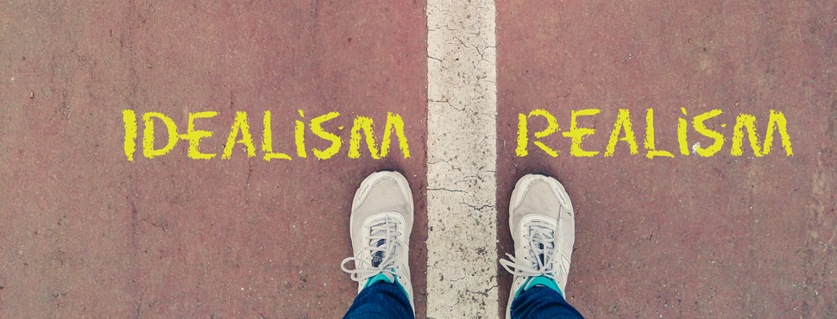
APA-ID October 2019
Idealism in Planning

Slide 2
Meet Your Panelists
Leon Letson – City of Boise
Aaron Mondada – Agnew :: Beck Consulting
Hilary Anderson – City of Coeur d’Alene
Additional acknowledgements:
Nicolette Womack – City of Boise
Kaite Justice – Downtown Mobility Collaborative

Slide 3
‘Principle Adaptability’ Blends Realism and Idealism at Work
By Richard Wilson, FAICP

Slide 4
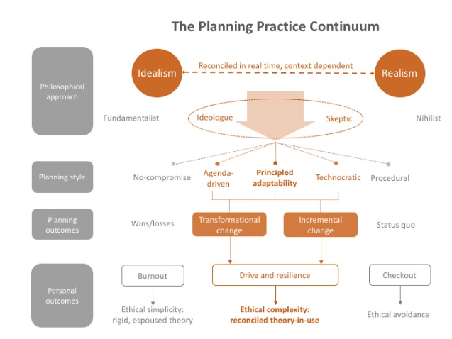
This post addresses the roles of idealism and realism in planning practice, arguing for a planning style called principled adaptability.

Slide 5
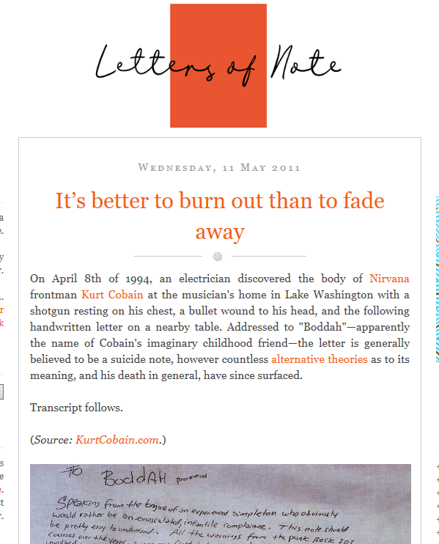
"A Guide for the Idealist" Articles
Burn Out VS.
Fade Out

Slide 6
Leon Letson

Slide 7
Aaron Mondada

Slide 8
Hilary Anderson

Slide 9
Discussion

Slide 10
The Role of Ideals in the Professional World
Can ideals be adapted to a regulatory, political and/or corporate environment?
What is the proper balance of idealism and professionalism?
Are there limitations to idealism in the workplace?

Slide 11
Disillusionment
What causes disillusionment in planning?
Do planners have to abandon ideals to avoid disillusionment?
How can you recover from disillusionment?

Slide 12
Refining Idealism
How can we evolve to develop ‘principled adaptability’?
How do we maintain ethics all while balancing idealism and professionalism?
How can you avoid misusing idealism/realism?
Is Idealism necessary for the planning profession?

Slide 13
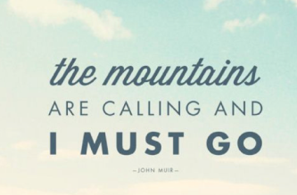
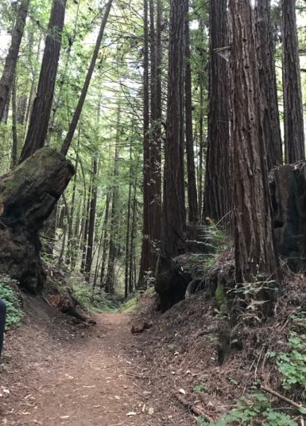
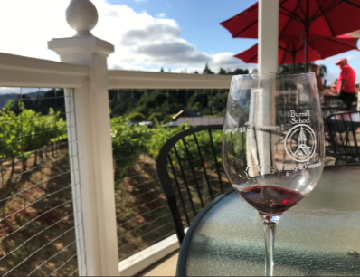
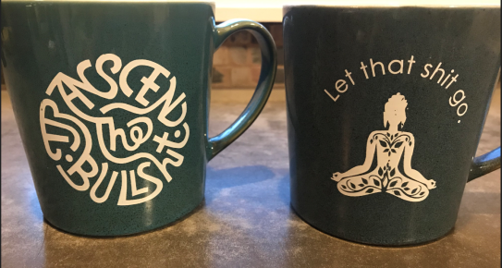
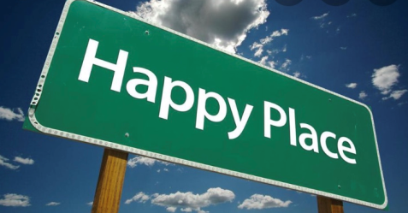
Helpful (& necessary) Coping Methods
Team Building
De-stress
Humor

Slide 14
Questions & Answers

