Slide 1
They Didn’t Teach You About Signs in School…
Presenter: Jonathan Spendlove, Planning & Zoning Director & Steve O’Connor, City Planner

Slide 2
History of Commercial Speech Regulation
Until 1976 the U.S. Supreme Court opinioned governments could regulate commercial speech as part of commerce regulation.
Several cases have since challenged that broad power starting with…
Virginia State Board of Pharmacy v Virginia Citizens Consumer Council, Inc. U.S. Supreme Court (1976)
Background: Acting on behalf of prescription drug consumers, the Virginia Citizens Consumer Council challenged a Virginia statute that declared it unprofessional conduct for licensed pharmacists to advertise their prescription drug prices.
This case concluded the 1st Amendment protects ones right to “receive information” in addition to freedom of speech, and that “state regulation must support a substantial interest.”
(Uni. Missouri-Kansas City - Law School n.d. & www.oyez.org)

Slide 3
History of Commercial Speech Regulation
Central Hudson Gas & Electric v Public Service Commission U.S. Supreme Court (1980)
Background: The Public Service Commission of New York (PSC), in the interest of conserving energy, enacted a regulation that prohibited electric utilities from promoting electricity use. The PSC's regulation distinguished promotional advertising from informational advertising, which was permitted. Central Hudson Gas and Electric challenged the regulation in a New York State Supreme Court
Established the “Central Hudson Test” regarding regulating advertisements and their messages.
This test has come under scrutiny and the legitimacy of it may be challenged in the future.
The Central Hudson test has four criteria on which it judges regulations to deem they do not violate the 1st Amendment; they are:
The regulated speech concerns an illegal activity, or
The speech is misleading, or
The government's interest in restricting the speech is substantial, if the regulation in question directly advances the government's interest, and
The regulation is narrowly tailored to serve the government's interest.
(Uni. Missouri-Kansas City - Law School n.d. & www.oyez.org)

Slide 4
History of Commercial Speech Regulation
City of Cincinnati v Discovery Network U.S. Supreme Court (1993)
Background: The city of Cincinnati had enacted regulations regarding the display of commercially oriented print ad publications such as real estate guides, preventing “news racks” from displaying or advertising them.
The court ruled this to be content based regulation
Non-commercial publications were just as obtrusive as the commercial publications
(Uni. Missouri-Kansas City - Law School n.d.)

Slide 5
Commercial Speech v Free Speech
“Commercial speech has been defined by the U.S. Supreme Court as speech where the speaker is more likely to be engaged in commerce, where the intended audience is commercial or actual or potential consumers, and where the content of the message is commercial in character.”
(Cornell Uni. - Law School n.d.)
What we have proposed:
Commercial Speech: The expression by a business or entity to convey a service or product, with any form of media, to actual or potential consumers, where the intent of the message is to draw attention to any product or service rendered.

Slide 6
Commercial Speech v Free Speech
In short...
“speech that proposes an economic transaction” or a service.
(Uni. Missouri-Kansas City - Law School n.d.)

Slide 7
Something A Little Closer to Home
Lamar Corporation v City of Twin Falls, ID (Idaho Supreme Court) (1999)
Background: In March 1995, Lamar Corp applied for an SUP for a billboard sign. P&Z Commission conditionally approved the sign. Through numerous appeals, the District Court remanded the case back to the PZ Commission and CC requiring new hearings.
In May 1996, a new SUP application was filed and both P&Z and CC denied the request based on “visual blight.” This decision was appealed again to the District court and it was once again reversed in favor of Lamar. The city appealed to the State Supreme Court who ruled in favor of the city and further opinioned…
Governments may regulate commercial speech to implement a substantial governmental interest if the regulation directly advances that interest and reaches no further than necessary to accomplish the given objective.
The regulations must be narrowly drawn so that zoning officials do not have “unbridled discretion” to permit or deny the exercise of First Amendment rights.
(www.findlaw.com)

Slide 8
So what’s the why?
What does this have to do with a sign code rewrite and why rewrite it anyway?
Reed v Town of Gilbert U.S. Supreme Court (2015)
Background: Good News Community Church utilized signs which directed attendees and the general public where service was going to be held that day since services were held in different venues each week. Gilbert’s sign code limited signs display size and duration. However, other temporary signs with political and ideological messages were permitted to larger and on display longer.
U.S. Supreme Court ruled Gilbert’s sign code was not content neutral and therefore regulated and infringed Good News Community Church’s 1st Amendment right.

Slide 9
What is Content Neutral?
Being content neutral means…
Looking not at what the message of the sign specifically, but at how the sign is constructed, where it is located, and the size of the sign itself. (Time, Place, Manner)
We, the City, can regulate duration and when a sign can be placed (Time), location or zone (Place), and size, height, or other physical characteristic (Manner) of signs. However, the same rules have to apply across the board with no differentiation of regulation due to message. We cannot regulate the message, within reason regarding offensive or obscene messages per State Statues.

Slide 10
Current Sign Code
41 allowed sign types:
Two (2) categories:
Permit required: Awning Signs, Banner Signs, Bench Signs, Canopy Signs, Civic Directional Signs, Community Event Signs, Freestanding Sign, Inflatable Signs, Internal Directional Signs, Marquee Signs, Menu Board Signs, Message Center Signs, Multi-Tenant Signs, Projecting Signs, Roof Signs, Sandwich Board Signs, Skylights and Searchlights, Subdivision Entry Signs, Subdivision Monuments, Wall Signs,
No permit required: Civic Signs, Cloud Buster Signs, Construction Identification Signs, Flags, Garage Sale Signs, Government Signs, Home Improvement Signs, Human Signs, Instructional Signs, Political Signs, Real Estate Signs, Residential Nameplate Signs, Scoreboards, Sponsor Signs, Vehicle Signs, Vending Machine Signs, Wind Device Signs, Window Signs, Yard Signs, Zoning Signs

Slide 11
Current Sign Code – Enforcement Issues
Banner Signs
$25 every 6 weeks for a maximum of 300 days/year
Allowed size is .75 x Linear ft/width of building or leased space, with max size of 100sq-ft
Cannot be in ROW or off site
Community Event Sign
$25; some instances require no fee
Displayed 10 days prior to event; must come down 3 days after event
Allowed off site but not in ROW
Sandwich Board Sign
$25 for 1 calendar year
Sandwich board signs shall be located not more than ten feet (10') from the door of the business
Allowed in ROW in the Downtown area; or on private property in a designated multi tenant development
Inflatable Sign
$25 for 15 days
Minimum setback from the road ROW shall be one and one-half (1 1/2) times the height of the sign
Real Estate Open House Sign
No Permit required
Can be place in the ROW, 1 hour before and 1 our after the open house
Real Estate Sign
No Permit required
Cannot be in ROW, must be 10’ from pavement, can be off site but only on private property
Projecting Sign
Sign Permit required
Can project into ROW

Slide 12
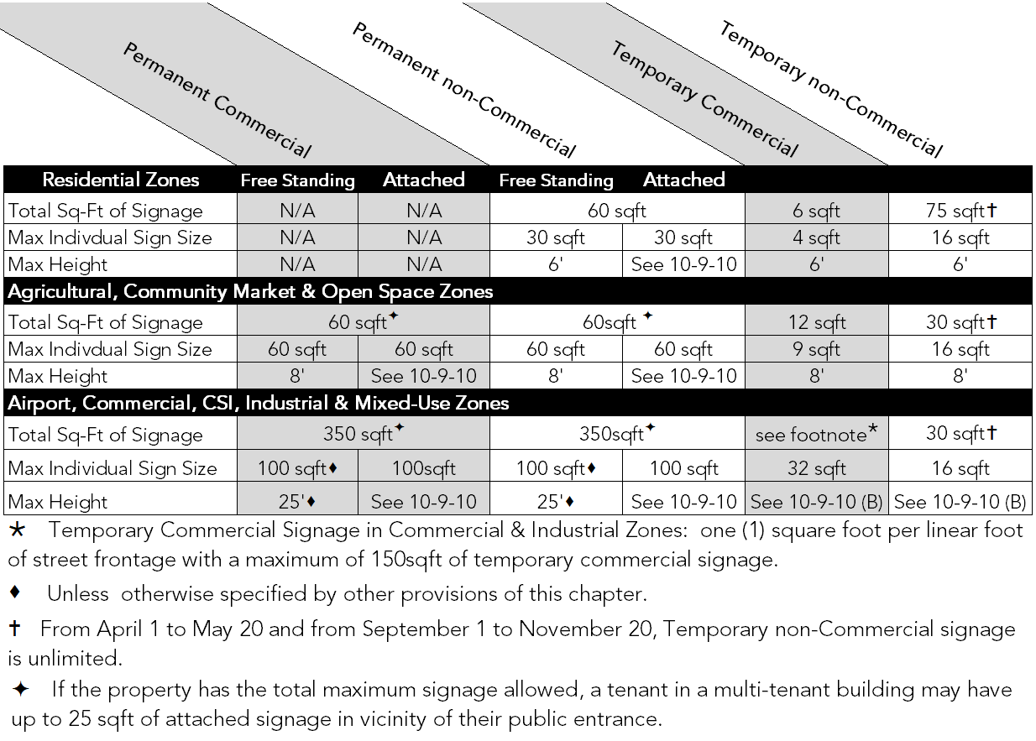
A Few Proposed Changes
Regulates Time, Place, and Manner based on Commercial vs non-Commercial speech
From 41 sign types to 16
4 classifications of signs
Permanent Commercial
Temporary Commercial
Permanent non-Commercial
Temporary non-Commercial
All Permanent Signs require a permit
All Temporary Signs are outright permitted within the bounds of the Time, Place, Manner regulations by zones

Slide 13
What About American Flags?
In 2005 the 11th Circuit Court invalidated the sign code of Neptune Beach, FL. The court ruled it was content based on the differentiation between “flags and insignia of any government, religious, charitable, fraternal, or other organization; religious displays;” and many other exemptions allowed an individual to fly the American flag but not a non-commercial speech, “Cut Taxes Now” flag.
What are we proposing?
Any form which displays the Standards or Colors for a country, state, county, city, other political subdivision, military, or religious entity is specifically exempt from this chapter.
We will no longer regulate the term flag and have clumped that form of media in the Temporary Signs as a “Wind Device.”
Anything that does not meet the provision above will be considered either commercial or non-commercial and shall meet the provisions of the chart shown before.

