Slide 1
Community Development Analysis
On overview of the process and findings

Slide 2
Today’s Topics
Health and Housing
Process Overview
Citywide Findings
Thematic Findings
Geographically Specific Findings
Next Steps

Slide 3
Health and Housing
U.S. Department of Housing and Urban Development
Housing Needs Analysis
Health Impact Assessment
Community Development Analysis

Slide 4
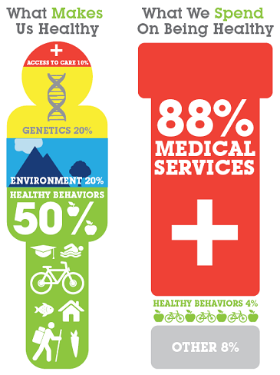
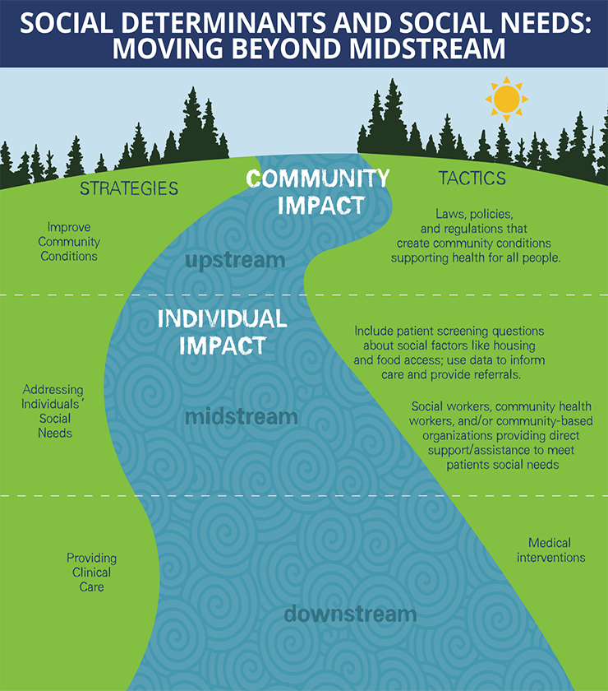
Health and Housing

Slide 5
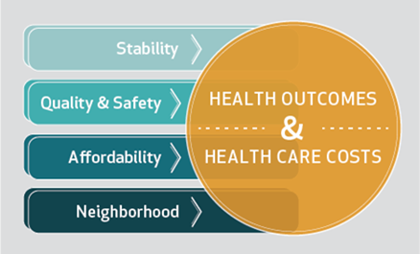

Health and Housing

Slide 6

Health and Housing

Slide 7
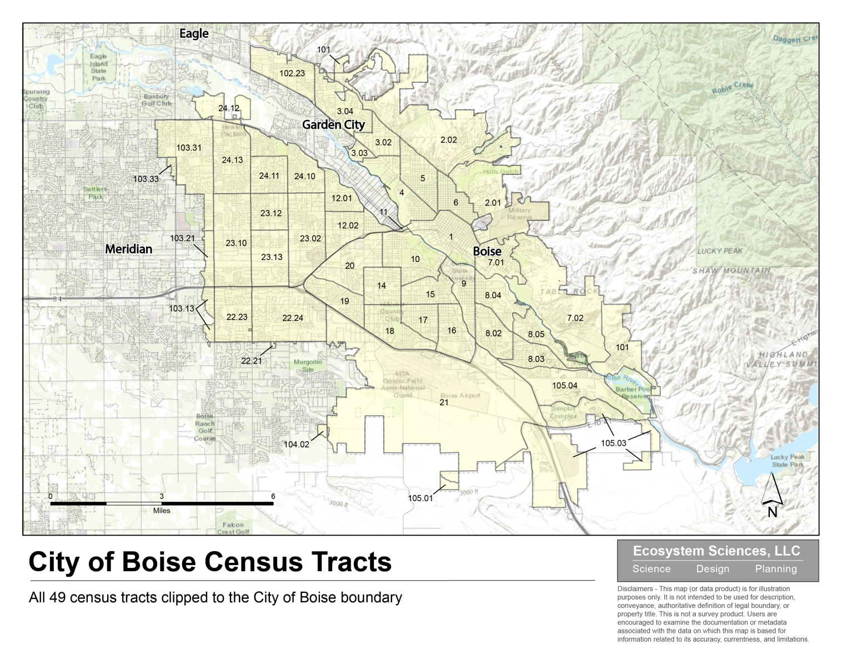
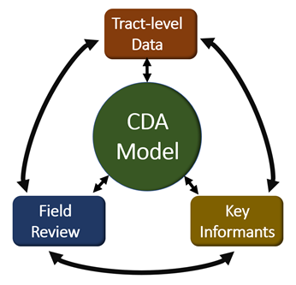
Process Overview

Slide 8
Process Overview
Demographic Information | Description
Over 65 Years Old | Total population over the age of 65.
Hispanic or Latino Origin | Total population of Hispanic or Latino origin.
Median Age | The median age of all residents living within the tract.
Percent Disabled | Percentage of population with any form of disability.
Life Expectancy | The number of years one could expect to live residing in a particular tract.
Limited English Proficiency | A person not fluent in English, and for who English is not their primary language.
Below Poverty Line | Households w/total annual income less than established poverty thresholds.
Housing | Description
Vacancy Rate | The number of residential units currently unoccupied.
Rent Cost Burdened | Percent of households paying greater than 30% of their income towards rental costs.
Owner Cost Burdened | Percent of households paying greater than 30% of their income towards mortgage costs.
Percent Tree Canopy | Percentage of a tract with current tree canopy coverage.
Physical Health | Description
Sidewalk Access | Sidewalk miles per tract divided by per 1000 people.
Bike Lane Access | Bike lane miles per tract divided by per 1000 people.
Heart Disease Rate | Current heart disease death rate per tract.
Asthma Rate | Current asthma death rate per tract.
Diabetes Rate | Current diabetes death rate per tract.
Cancer Rate | Current cancer death rate per tract.
Obesity Rate | Current obesity (greater than 30% BMI) rate per tract.
Physical Health Status | People over 18 with poor physical health in 14 of 30 recent days divided by total over 18.
Greater than Half Mile to Healthy Food | Percent of households farther than 1/2 mile from healthy grocery outlet.
Households without a Car | Percentage of households with no car access.
Environmental Health | Description
Insured Population | People w/healthcare insurance divided by total number of people.
Group A Crime Rate | Number of Class A (assault, robbery, murder) crimes per 1000 people.
Acres of Park Space | Acres managed by Boise Parks per 1000 people.
Acres of Impervious Surface | Acres of impervious surfaces per 1000 people.
Bus Stop Ratio | Number of bus stops per 1000 people.
Economic Health | Description
Access to Education Opportunities | People 3-19 years old enrolled in school divided by total age 3-19 years old.
Percent with Bachelors Degree | People age over 25 years old with Bachelor’s Degree divided by total over 25 years old.
Median Household Income | Median household income.
Households w/Under 18 Receiving SNAP | Households under 18 that received SNAP divided by total with under 18 years old.
Unemployment Rate | Rate of unemployment for percent of population over 16 years old.
Emotional Health | Description
Mental Health | People over 18 w/poor mental health 14 of 30 days divided by total over 18 years old.
Binge Drinking | People over 18 who had 4/5 drinks at one time over 30 days divided by total over 18.
Intellectual Health | Description
Households with Internet Access | Households with a computer and internet connection divided by total households.

Slide 9
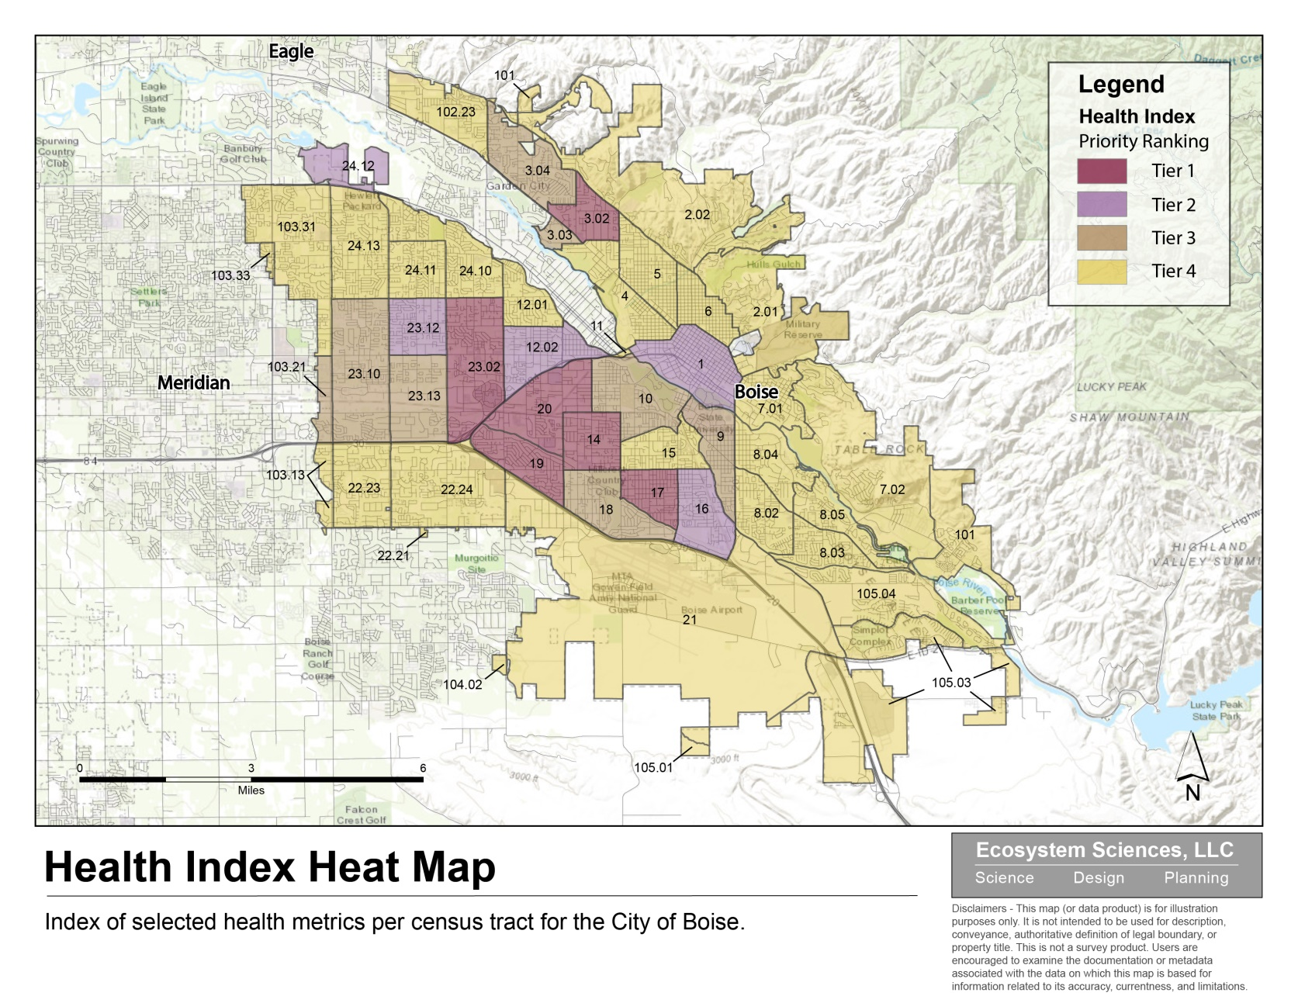
Process Overview

Slide 10
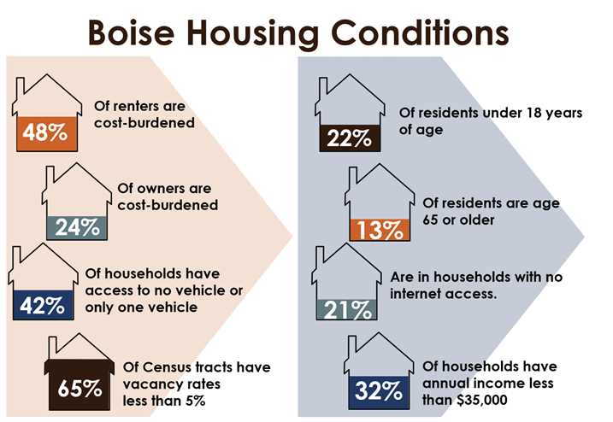
Citywide Findings

Slide 11
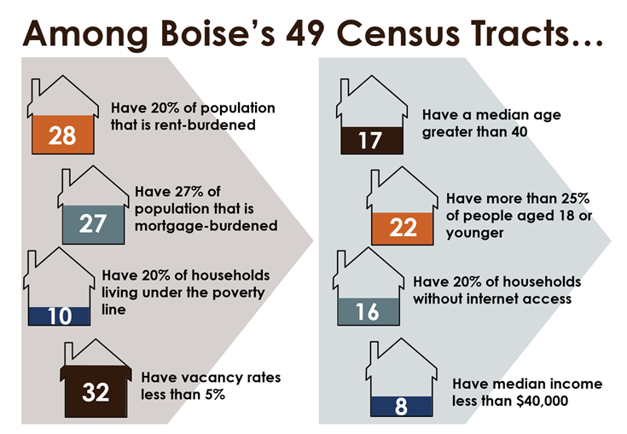
Citywide Findings

Slide 12
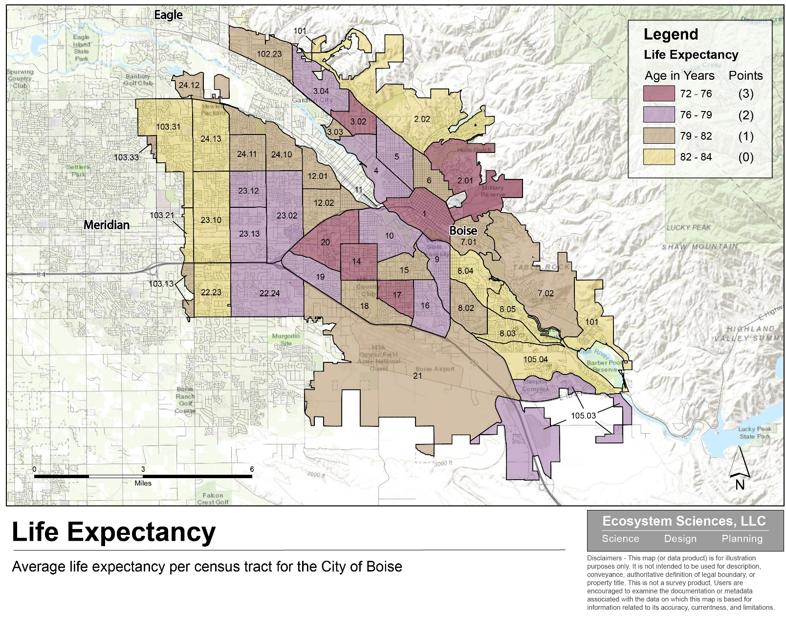
Citywide Findings

Slide 13
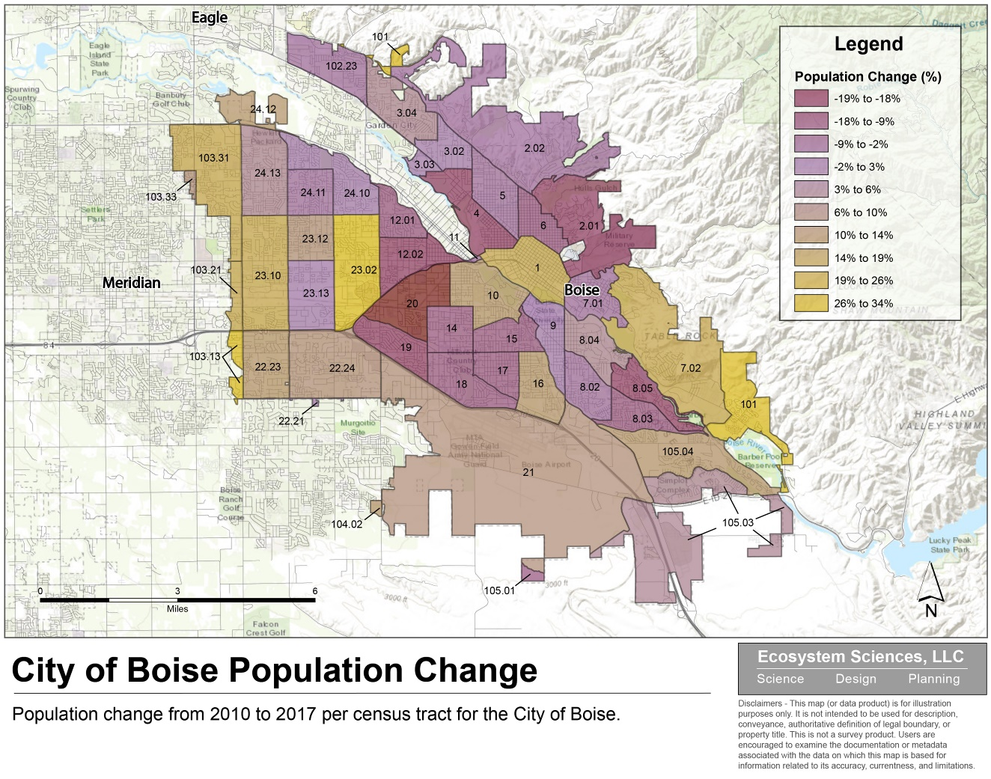
Citywide Findings

Slide 14
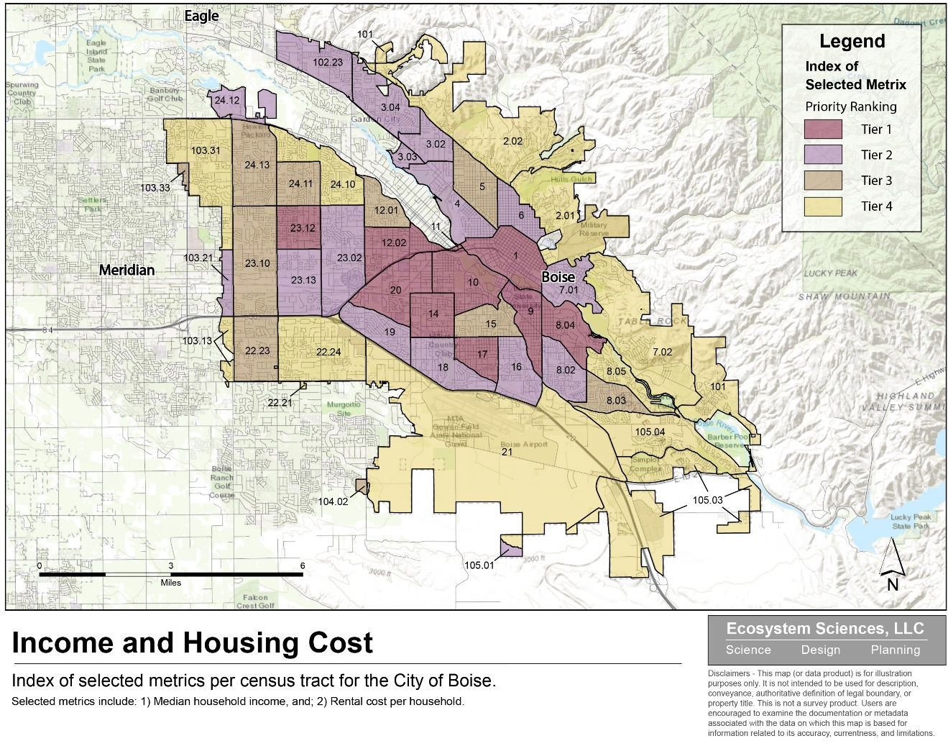
Citywide Findings

Slide 15
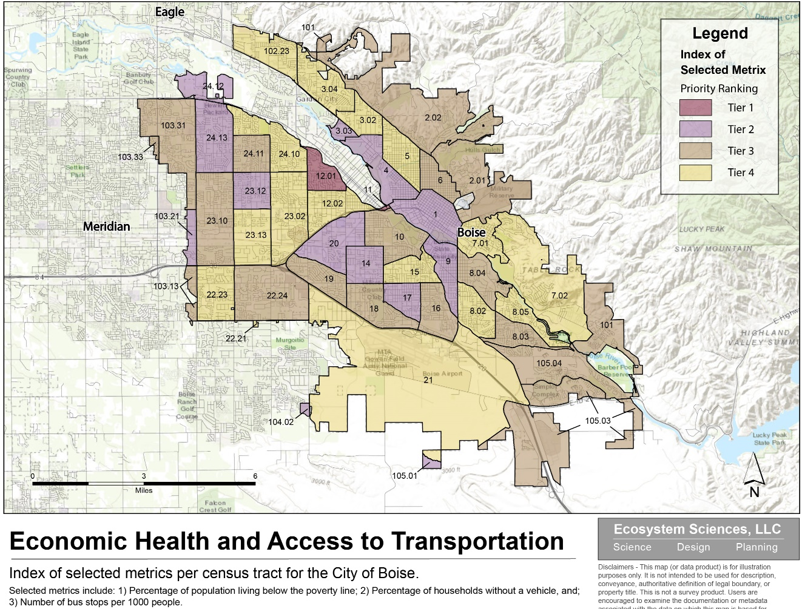
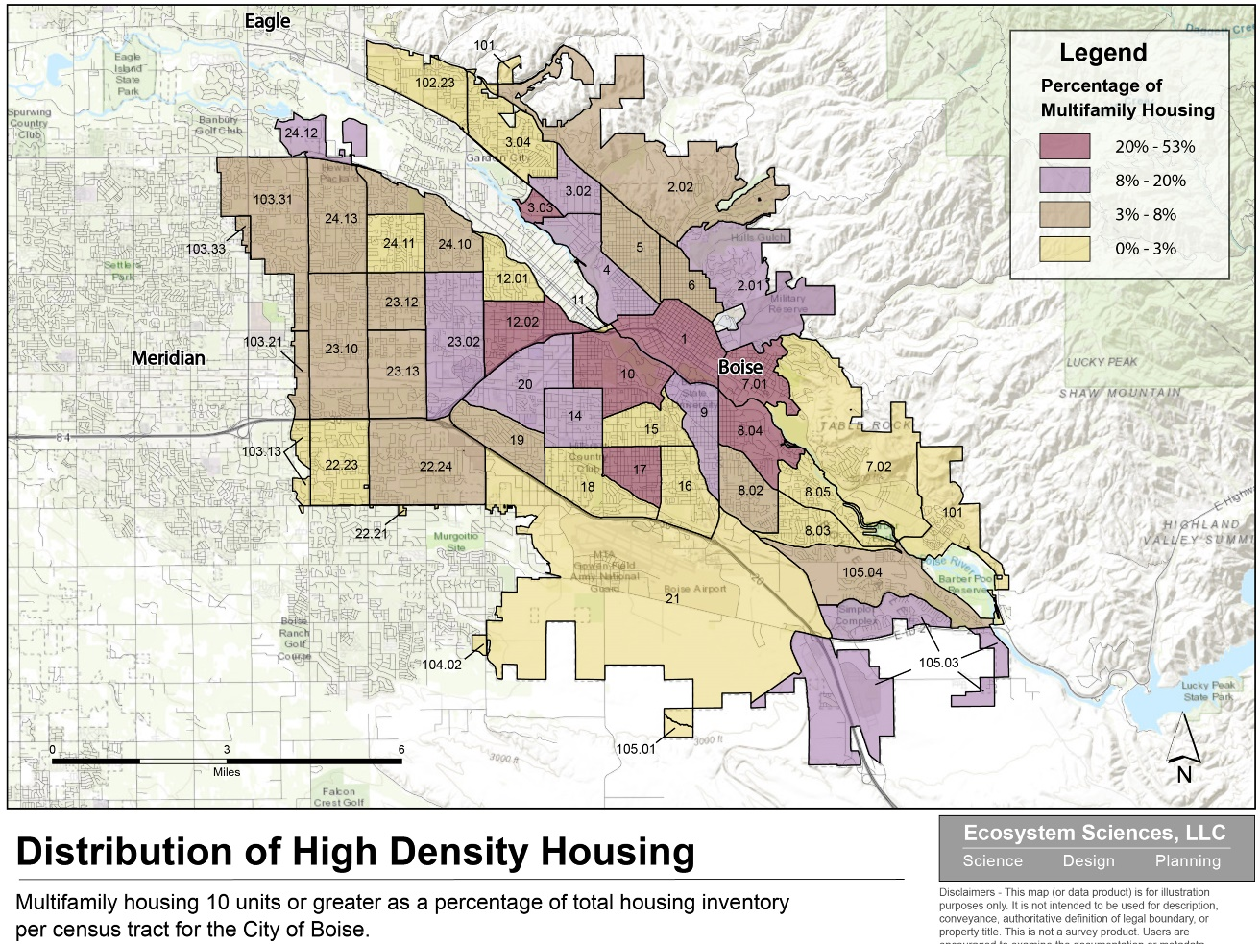
Citywide Findings

Slide 16
Thematic Findings
Trends
  Housing Costs are Relocating Residents
  Housing Costs Mean Vouchers Not as Effective
  Tenants Fearful of Reporting Unhealthy Issues
  Boise School District (BSD) Leadership
What is Working
  Housing Efforts
  Crime Control & Prevention
  School Support

Slide 17
Thematic Findings
Concerns
  City Outreach Methods
  Family Homelessness
Needs
  More Spectrum-Based Housing
  City-led Housing
  Mental Health Services
  Labor Shortage

Slide 18
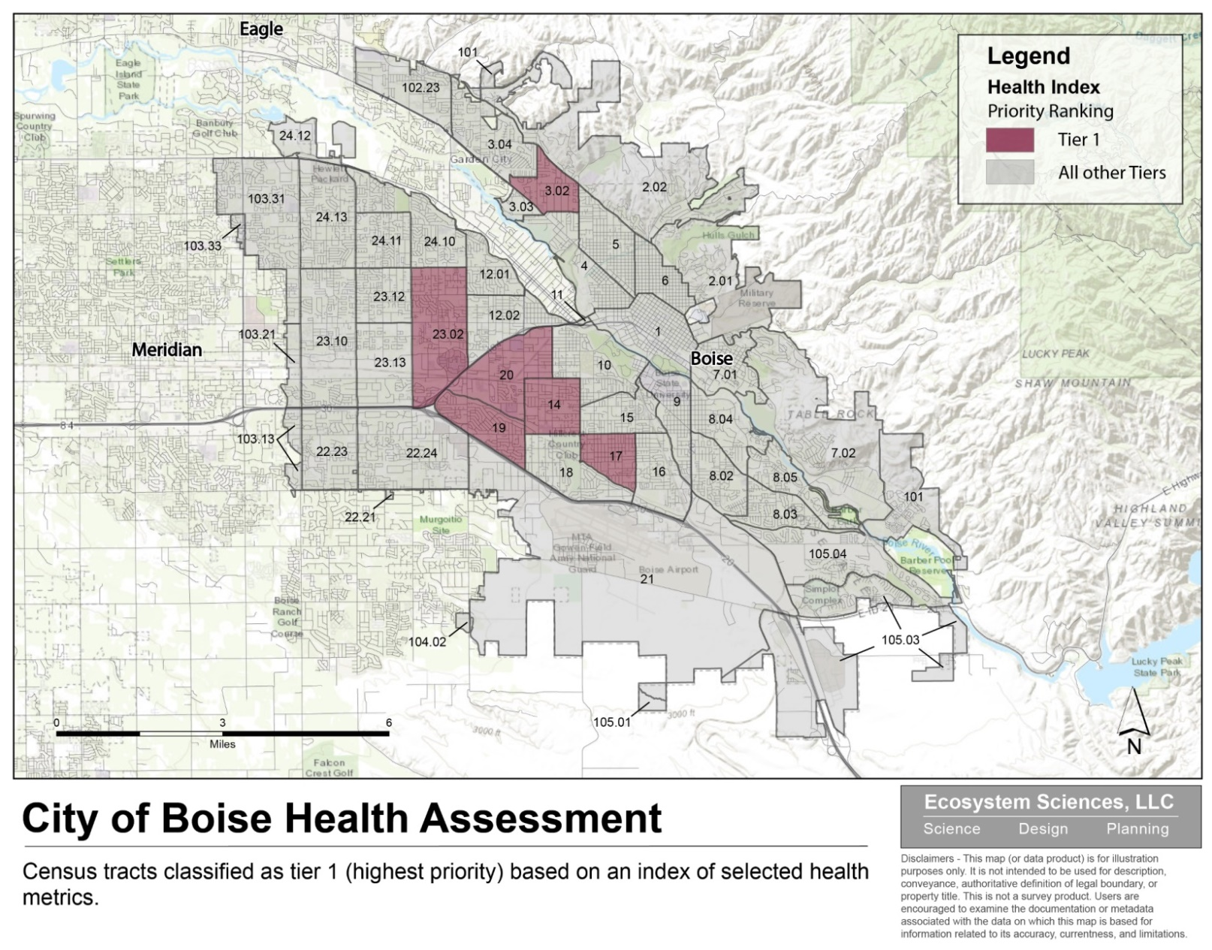
Geographically Specific Findings

Slide 19
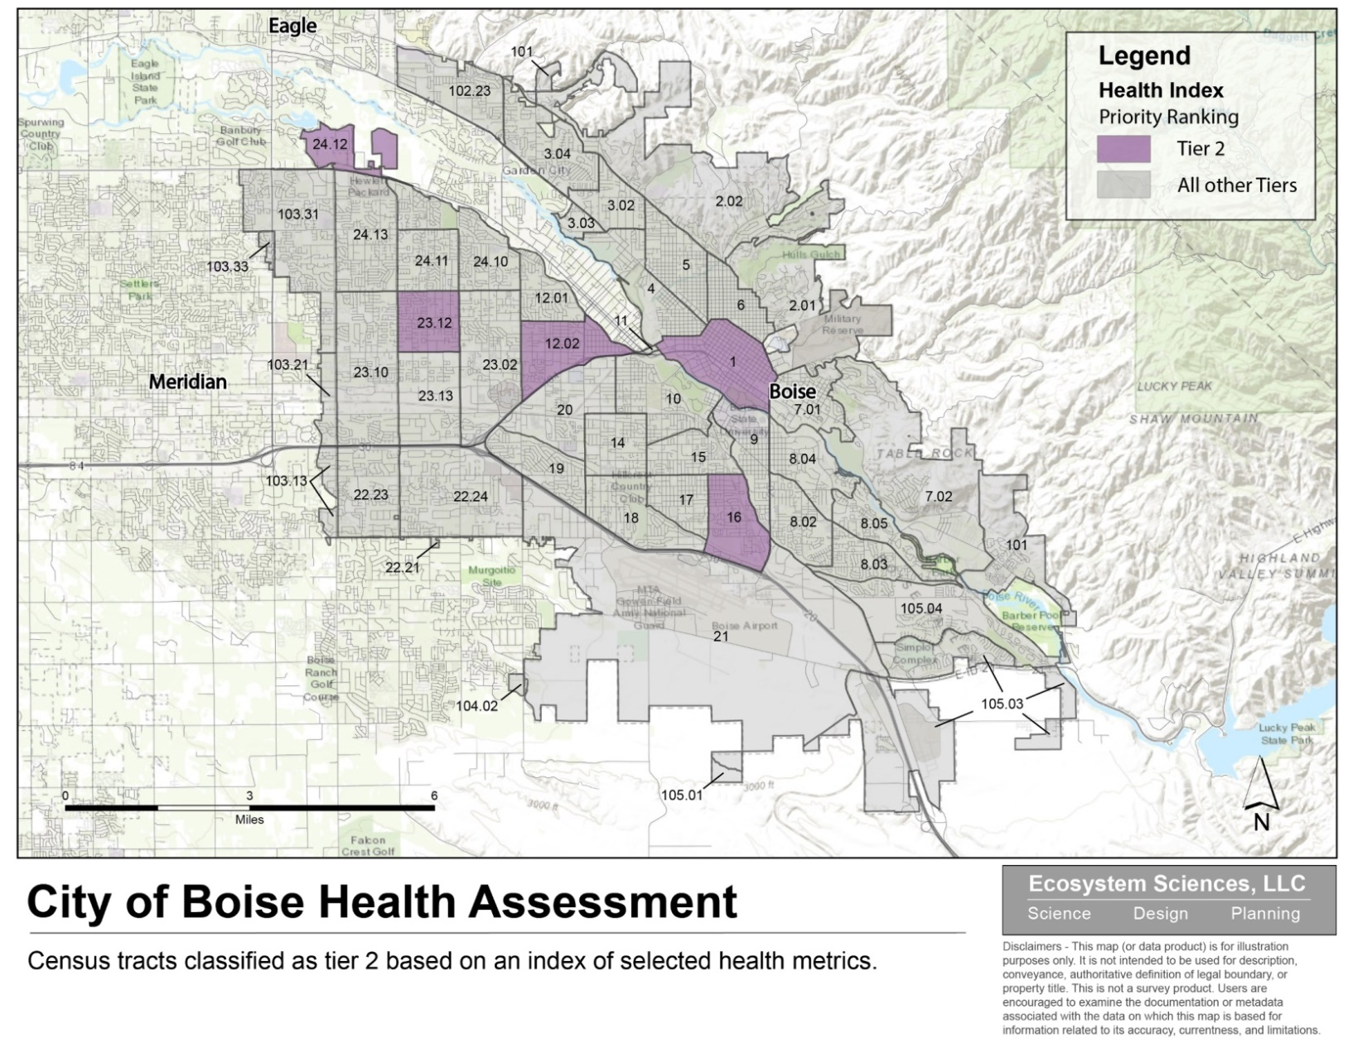
Geographically Specific Findings

Slide 20
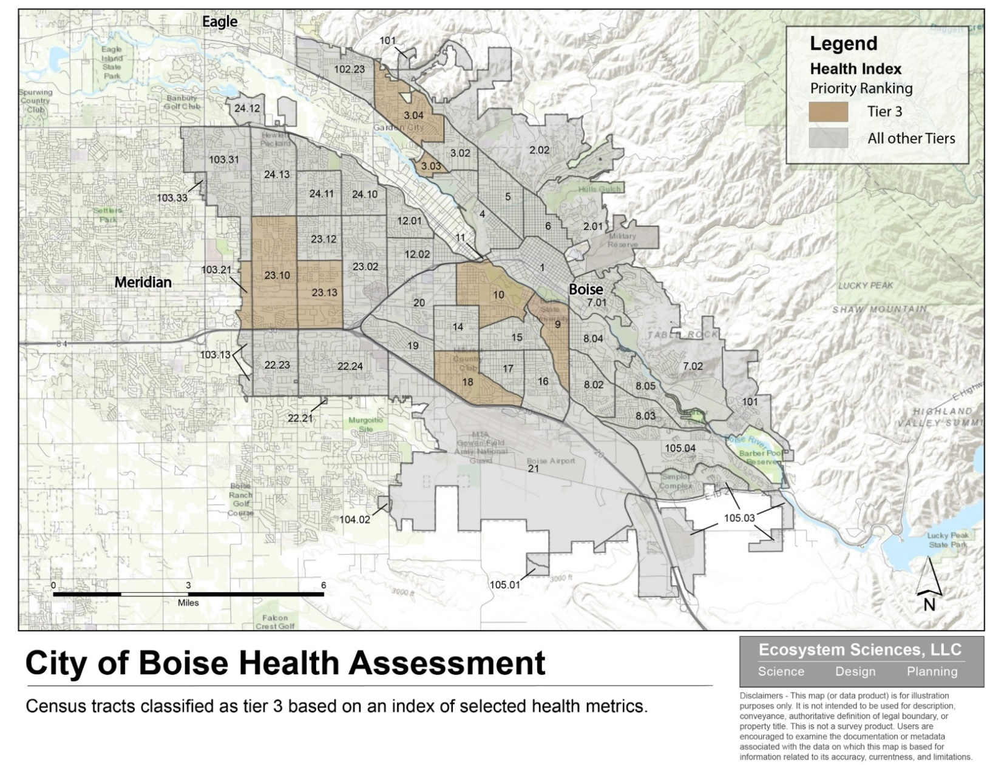
Geographically Specific Findings

Slide 21
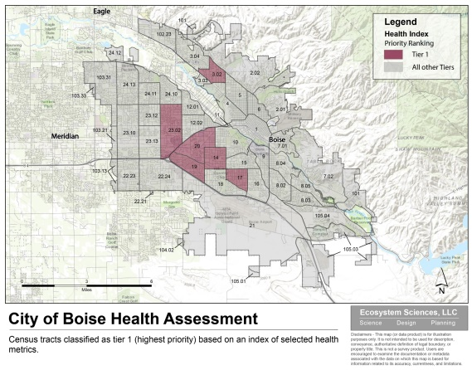
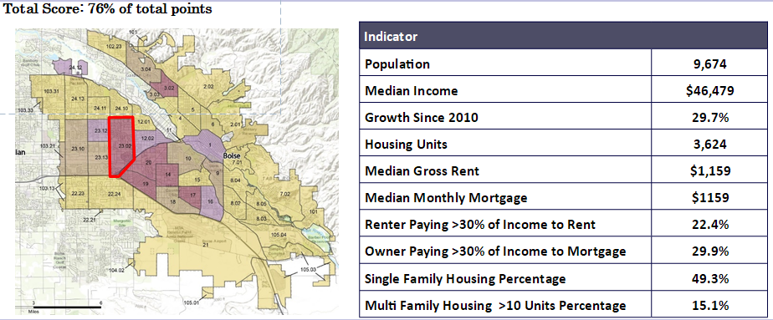
Geographically Specific Findings
Description
Strengths
Weaknesses
Opportunities
Threats

Slide 22
Potential Project Ideas
Adaptive reuse
Mobile home improvements
Support City zoning change efforts
Broader transportation investment
Tree planting investment
Strategically located housing development
Grow mental health services

Slide 23
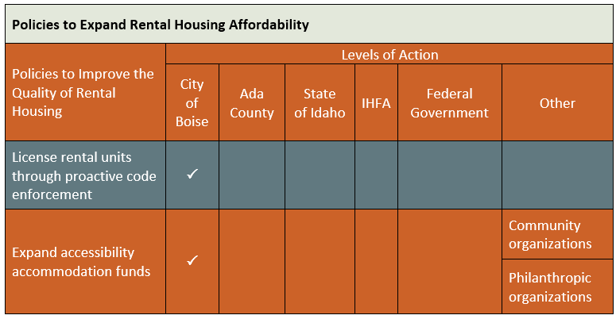
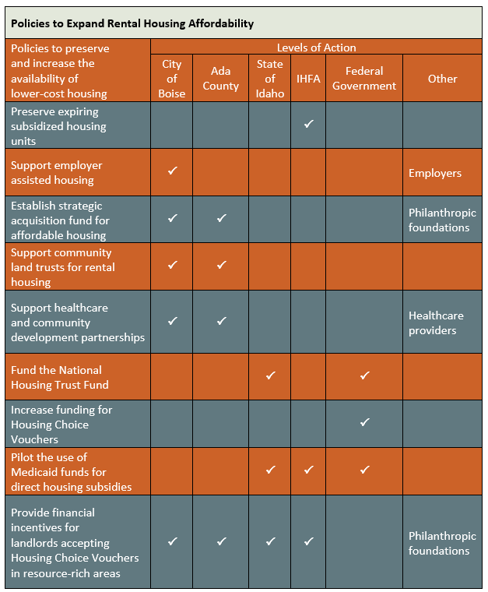
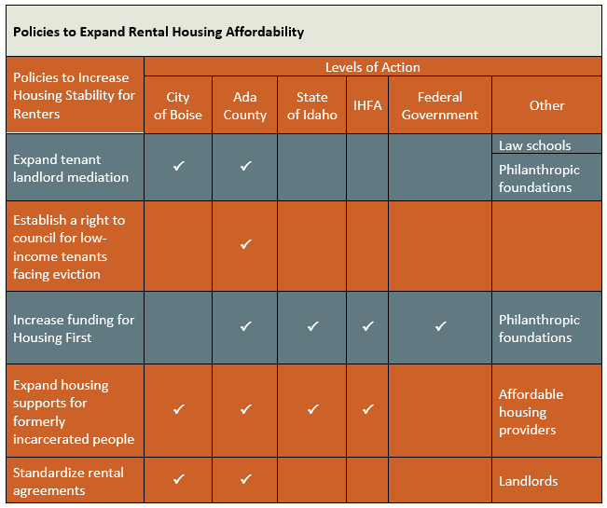
Next Steps

Slide 24
Next Steps
Complete Impediments to Fair Housing
Complete 5 Year Consolidated Action Plan
Derive Annual Action Plan

Slide 25
Questions?

Slide 26
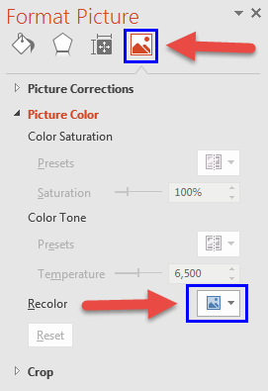

ICONS
Use icons to add visual interest to your presentations.
How to Recolor Icons
Select icon
Right click and select “Format Picture”

