Slide 1
Conflict, Change, and Neuroscience Oh My!

Slide 2
Two Change Stories

Slide 3
What Gets In The Way?

Slide 4
What Reactions Do You See?

Slide 5
An Experiment

Slide 7
Mirroring System

Slide 8
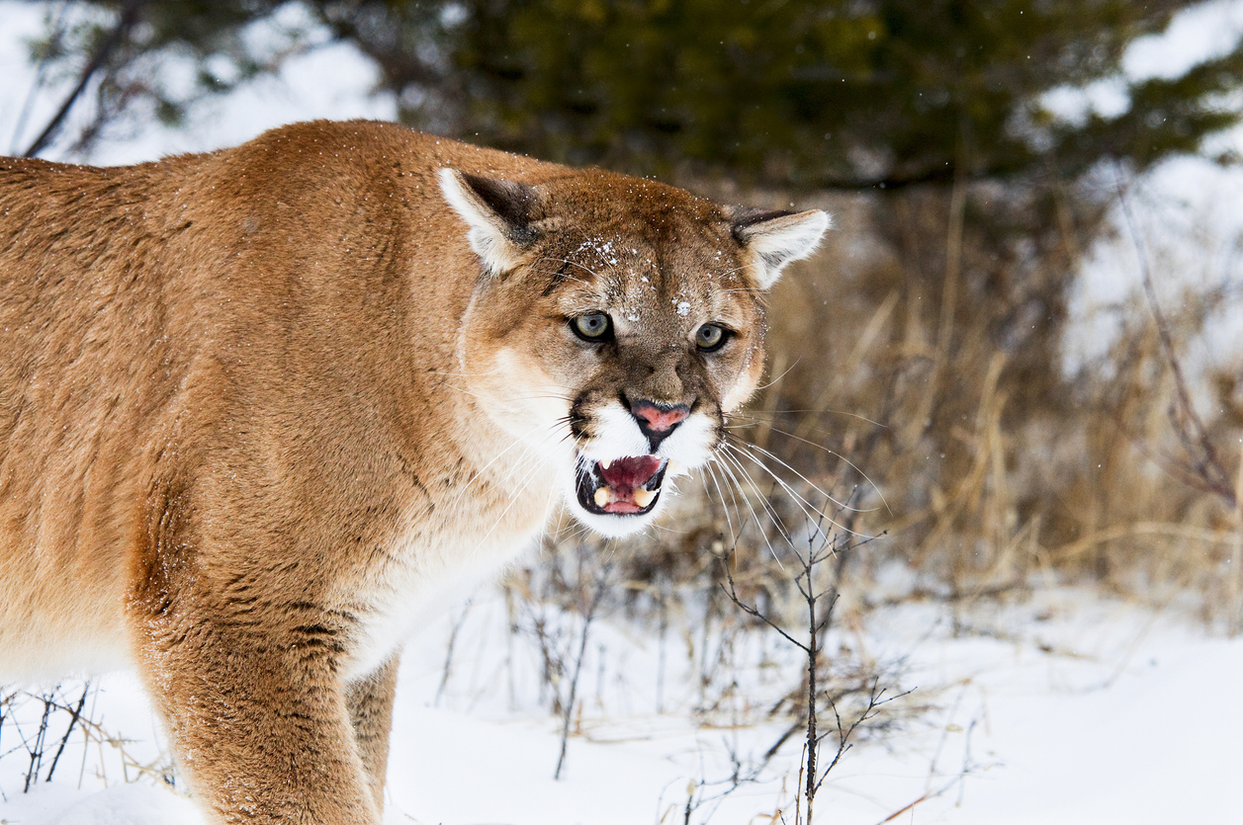
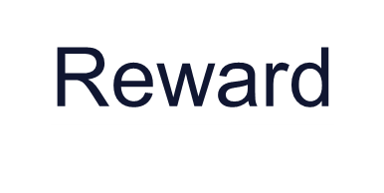
Our Survival System
Notes:
Amygdala is responsible for remembering if we should approach or avoid
The amygdala is not great at differentiating in subtle ways
The limbic systems processes before conscious awareness – subliminal threatening words study – 1/5 second response time
Negative correlation between threat response and resources available for the prefrontal cortex

Slide 9
The SCARF Model
SCARF
Status
Certainty
Autonomy
Relatedness
Fairness
- David Rock, 2008
Notes:
Describe & have them rank the social needs

Slide 10
Status
Notes:
Similar neural circuits that deal with processing numbers
Being left out of an activity lit up the same region that processes physical pain; Envy = physical pain
“can I offer you some feedback” triggers similar response to hearing footsteps behind you – performance evals….forget it
Increase status by paying attention to improvement – let them compete against themselves
About relative position – find something that makes them important

Slide 11
Certainty
Notes:
Brains are pattern recognition machines– we like patterns & predictability
Without patterns……which lead to prediction…the brain uses dramatically more resources
Our tolerance for ambiguous situations (Uncertainty) is different for people
Ambiguous social situations are stressful (more so for low esteem & low ambiguity tolerance)
Strategies:
Breaking a project into smaller steps increases certainty
Make the implicit explicit
Even if you don’t know, provide a date when you will circle back

Slide 12
Autonomy
Notes:
Inescapable stress is debilitating vs escapable stress much less so
Micromanaging = strong threat response
Teams create autonomy challenges
Build autonomy by providing organizational boundaries through policy then let employees choose -- -desk, hours, etc.
Anticipation of making a choice = reward

Slide 13
Relatedness
Notes:
In or out of tribe = friend or foe = greater trust and empathy for those perceived as similar to us
Information about people perceived as “like us” is processed using similar circuits for our own thoughts
Social time is not enough = share personal aspects of selves….pictures, stories….mentoring programs, “water cooler” talk
Gallup engagement poll = I have a best friend at work
Social support = life longevity

Slide 14
Fairness
Notes:
Fairness is intrinsically regarding = $10/50 vs $.50/$1.00 experiment
Unfair exchanges activate the part of brain for strong emotions, like disgust
Unfair exchanges lead us to have less empathy for persecutors, even feel reward when they are punished
Increase transparency to reduce threat to fairness
Let teams create their own rules

Slide 15
The SCARF Model
SCARF
Status
Certainty
Autonomy
Relatedness
Fairness
Questions?
- David Rock, 2008

Slide 16
Conflict Tools
Self-Awareness
Framing
Listening
Coalitions
Notes:
In or out of tribe = friend or foe = greater trust and empathy for those perceived as similar to us
Information about people perceived as “like us” is processed using similar circuits for our own thoughts
Social time is not enough = share personal aspects of selves….pictures, stories….mentoring programs, “water cooler” talk
Gallup engagement poll = I have a best friend at work
Social support = life longevity

Slide 17
Self-Awareness
The story I’m telling myself is…
Notes:
In or out of tribe = friend or foe = greater trust and empathy for those perceived as similar to us
Information about people perceived as “like us” is processed using similar circuits for our own thoughts
Social time is not enough = share personal aspects of selves….pictures, stories….mentoring programs, “water cooler” talk
Gallup engagement poll = I have a best friend at work
Social support = life longevity

Slide 18
Self-Awareness
You are asking others to change but what are you willing to change?
Notes:
In or out of tribe = friend or foe = greater trust and empathy for those perceived as similar to us
Information about people perceived as “like us” is processed using similar circuits for our own thoughts
Social time is not enough = share personal aspects of selves….pictures, stories….mentoring programs, “water cooler” talk
Gallup engagement poll = I have a best friend at work
Social support = life longevity

Slide 19
Framing
Notes:
In or out of tribe = friend or foe = greater trust and empathy for those perceived as similar to us
Information about people perceived as “like us” is processed using similar circuits for our own thoughts
Social time is not enough = share personal aspects of selves….pictures, stories….mentoring programs, “water cooler” talk
Gallup engagement poll = I have a best friend at work
Social support = life longevity

Slide 20
Framing & Self-awareness
“At heart, blame is about judging [and looking backward] and contribution is about understanding [and looking forward]”
- Difficult Conversations

Slide 21
Framing & Self-awareness
“At heart, blame is about judging [and looking backward] and contribution is about understanding [and looking forward]”
- Difficult Conversations

Slide 22
Framing & Self-awareness
“At heart, blame is about judging [and looking backward] and contribution is about understanding [and looking forward]”
- Difficult Conversations

Slide 23
Listening Mindset
Prepare
Attention
Empathize
Notes:
In or out of tribe = friend or foe = greater trust and empathy for those perceived as similar to us
Information about people perceived as “like us” is processed using similar circuits for our own thoughts
Social time is not enough = share personal aspects of selves….pictures, stories….mentoring programs, “water cooler” talk
Gallup engagement poll = I have a best friend at work
Social support = life longevity

Slide 24
Active Listening
Reflect
Ask Questions
Notes:
In or out of tribe = friend or foe = greater trust and empathy for those perceived as similar to us
Information about people perceived as “like us” is processed using similar circuits for our own thoughts
Social time is not enough = share personal aspects of selves….pictures, stories….mentoring programs, “water cooler” talk
Gallup engagement poll = I have a best friend at work
Social support = life longevity

Slide 25
Listening: For Bids
This can’t happen.
I don’t understand what that will look like.
Can I talk with you for a minute?
Notes:
In or out of tribe = friend or foe = greater trust and empathy for those perceived as similar to us
Information about people perceived as “like us” is processed using similar circuits for our own thoughts
Social time is not enough = share personal aspects of selves….pictures, stories….mentoring programs, “water cooler” talk
Gallup engagement poll = I have a best friend at work
Social support = life longevity

Slide 26
Listening: Conflict
Step Into Conflict
Get Curious
Reframe
Notes:
In or out of tribe = friend or foe = greater trust and empathy for those perceived as similar to us
Information about people perceived as “like us” is processed using similar circuits for our own thoughts
Social time is not enough = share personal aspects of selves….pictures, stories….mentoring programs, “water cooler” talk
Gallup engagement poll = I have a best friend at work
Social support = life longevity

Slide 27
From Conflict To
Problem Solving
Reframing
Notes:
In or out of tribe = friend or foe = greater trust and empathy for those perceived as similar to us
Information about people perceived as “like us” is processed using similar circuits for our own thoughts
Social time is not enough = share personal aspects of selves….pictures, stories….mentoring programs, “water cooler” talk
Gallup engagement poll = I have a best friend at work
Social support = life longevity

Slide 28
Reframing
Notes:
In or out of tribe = friend or foe = greater trust and empathy for those perceived as similar to us
Information about people perceived as “like us” is processed using similar circuits for our own thoughts
Social time is not enough = share personal aspects of selves….pictures, stories….mentoring programs, “water cooler” talk
Gallup engagement poll = I have a best friend at work
Social support = life longevity

Slide 29
Coalitions: Stakeholders
Notes:
In or out of tribe = friend or foe = greater trust and empathy for those perceived as similar to us
Information about people perceived as “like us” is processed using similar circuits for our own thoughts
Social time is not enough = share personal aspects of selves….pictures, stories….mentoring programs, “water cooler” talk
Gallup engagement poll = I have a best friend at work
Social support = life longevity

Slide 30
Coalitions
Find Mutual Interests
Notes:
In or out of tribe = friend or foe = greater trust and empathy for those perceived as similar to us
Information about people perceived as “like us” is processed using similar circuits for our own thoughts
Social time is not enough = share personal aspects of selves….pictures, stories….mentoring programs, “water cooler” talk
Gallup engagement poll = I have a best friend at work
Social support = life longevity

Slide 31
Your Tools
SCARF
Self-Awareness
Framing
Listening
Coalitions
Notes:
In or out of tribe = friend or foe = greater trust and empathy for those perceived as similar to us
Information about people perceived as “like us” is processed using similar circuits for our own thoughts
Social time is not enough = share personal aspects of selves….pictures, stories….mentoring programs, “water cooler” talk
Gallup engagement poll = I have a best friend at work
Social support = life longevity

