Slide 1
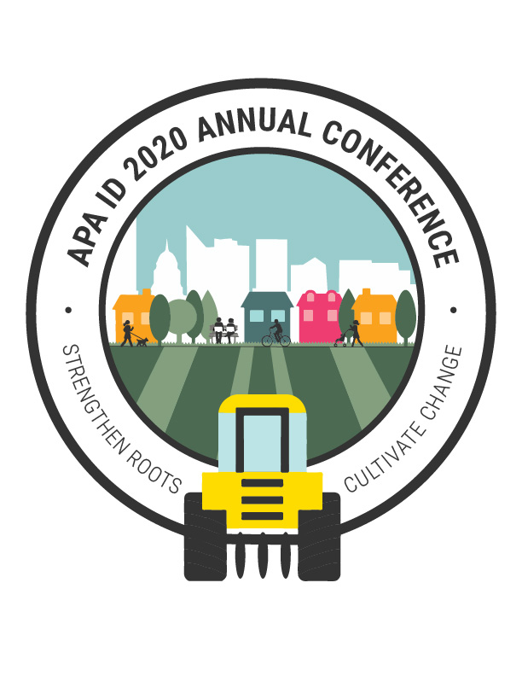
Cultural Planning for Diversity, Equity, and Inclusion: Cultivating Change in Communities
Dr. Amanda Ashley, Associate Professor, School of Public Service, Boise State University
Dr. Carolyn G. Loh, Associate Professor, Wayne State University
Karen Bubb, Cultural Planner, City of Boise & PhD Student, Boise State University
Dr. Leslie Durham, Interim Dean, College of Arts & Sciences, Boise State University
October 8
APA ID 2020 ANNUAL CONFERENCE

Slide 2
Presentation Overview
Background
What is Cultural Planning?
Planning Significance of Project
Project Question
Values of Project to Planning Field
Methodology
Findings
Recommendation
Questions/Discussion

Slide 3
What is a Cultural Planning?
“Cultural planning is a public process in which representatives of a community undertake a comprehensive community assessment and create a plan of implementation for future cultural programming and investment.”
Americans for the Arts
Topical plan (like transportation)
Often approved as part of comprehensive/general plan
No single approach

Slide 4
Cultural Planning is about:
Supporting Artists, Arts Organizations
Planning for Responsible use of Resources
Placemaking – making memorable and meaningful places
Historic Preservation
Fostering Equity
Community Engagement
Economic Development
Small Business Development
Work-force Development
Tourism

Slide 5
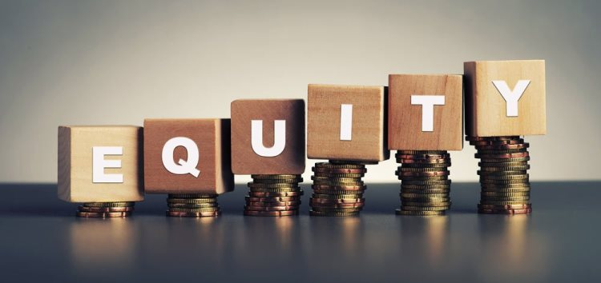
Planning Significance
This project bridges three content areas:

Slide 6
Project Question
How do municipal arts and cultural plans address/include equity, diversity, and inclusion?
To Answer:
Conducted content analysis of municipal arts and cultural master plans
Notes:
Our applied interdisciplinary research team of practitioners and faculty span arts and cultural planning, arts economic development, general planning practice, and art making.

Slide 7
Value to Planning Field
adds applied knowledge on how arts and cultural plans may shape diversity, inclusion, and equity policies and investments
gives practitioners and policymakers information on their efforts around diversity, inclusion, and equity so they can be more effective in their efforts
identifies strategies for fostering equity in planning practice

Slide 8
Why does Diversity, Equity, and Inclusion (DEI) matter?
“APA has made a focused commitment to Equity, Diversity, and Inclusion in all forms, as a means to achieving thriving communities in which everyone has equal opportunity to live a safe, healthy and prosperous life.”

Slide 9
Equity in Planning Practice
1. Diversity and inclusion have not always been core planning goals, and although they mostly are now, we still don’t do a great job.
2. It seems like when they do make an effort, planners largely try to address diversity and inclusion through the public participation process, although this is often not successful for various reasons.
3. Equity is harder to talk about and harder to incorporate in plans because it often involves redistribution and that is politically difficult.

Slide 10
Methodology
Quantitative Content Analysis
Plans selected from a national sample derived from Americans for the Arts database & Internet
Content survey of 64 municipal arts and cultural plans from 1998-2018
What is? How are these cities defining and looking at equity, diversity, and inclusion?
Notes:
Survey evaluating the extent to which the plan and its associated planning process used demographic references, public engagement processes, goals, and strategies that include or reference diversity, inclusion, social justice and equity concepts or words

Slide 11
Findings
Who is writing municipal cultural plans?
A combination of consultants, municipal staff, steering committees, volunteers, and in a few rare cases, artists (Bellevue, WA, Houston, TX)

Slide 12
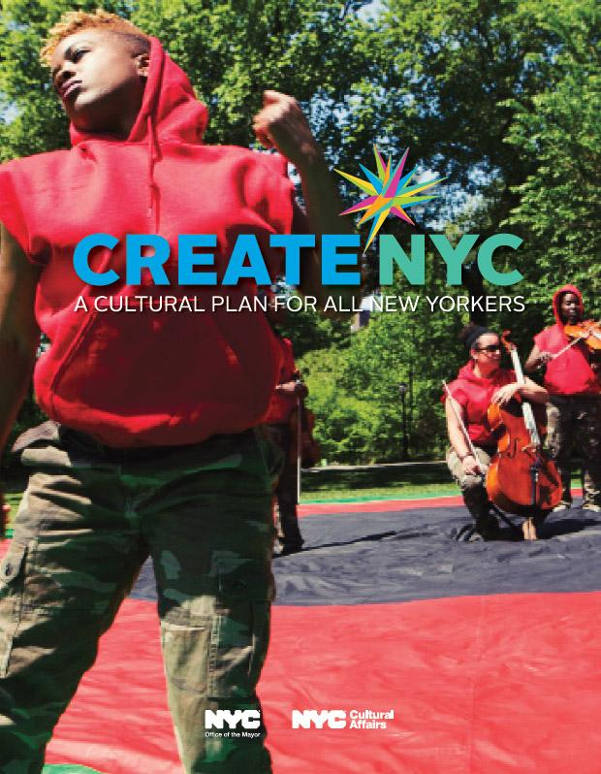
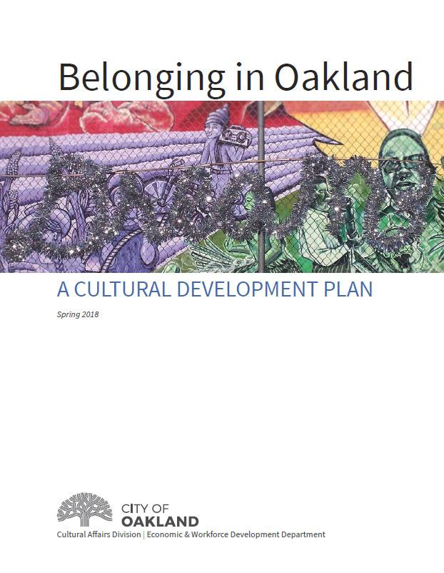
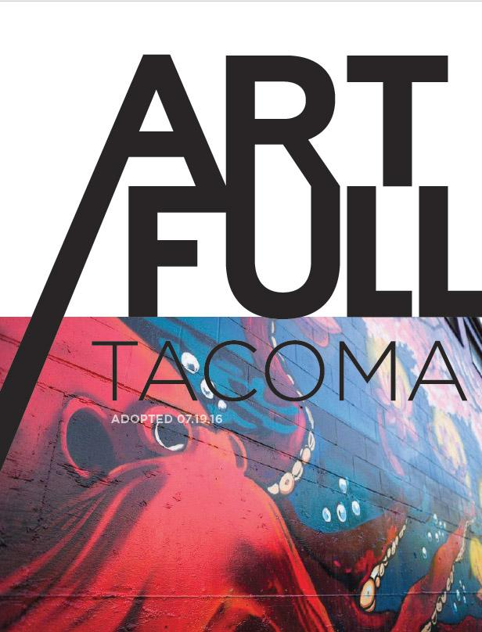
Findings
Definitions:
When used, words such as diversity are infrequently defined (diversity used in 94% of plans, defined by 22%).
When equity, inclusion, or diversity is defined, plans had a more comprehensive inclusion of equity principles in the planning process and resulting plan.
Notes:
NYC: “inclusive of communities representing categories of identity including but not limited to historically underrepresented communities”
Tacoma, WA: “a social good and the wellspring of free expression. Its support and protection require equitable distribution of public resources, particularly to correct past injustices and balance an excess of commercialization.”
Santa Clarita, California: diversity is “encompassing acceptance and respect. It means understanding that each individual is unique, and recognizing our individual differences. These can be along the dimensions of race, ethnicity, gender, sexual orientation, socio-economic status, age, physical abilities, religious beliefs, political beliefs, or other ideologies”

Slide 13
Diversity
New York City, NY
“inclusive of communities representing categories of identity including but not
limited to historically underrepresented communities, including individuals from ALAANA
racial and/or ethnic groups, people with disabilities, and LGBTQI populations, people with
disabilities, all genders, including transgender and gender non-conforming individuals,
Indigenous, immigrant, and refugee populations, ESL or non-English language speakers, all
ages, including older adults and youth, and low-income New Yorkers” (2017, p. 69)
Tacoma, Washington
“a social good and the wellspring of free expression. Its support and protection require equitable distribution of public resources, particularly to correct past injustices and balance an excess of commercialization” (2016, p. 46).
Santa Clarita, California
“encompassing acceptance and respect. It means understanding that each individual is unique, and recognizing our individual differences. These can be along the dimensions of race, ethnicity, gender, sexual orientation, socio-economic status, age, physical abilities, religious beliefs, political beliefs, or other ideologies” (2016, p. 75).

Slide 14
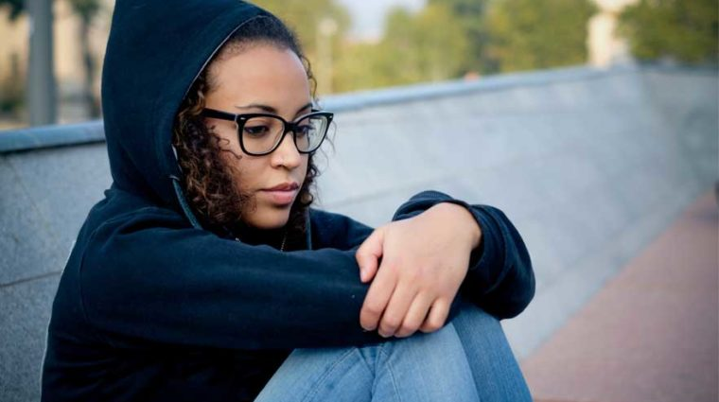
Findings
Who is identified as marginalized, underserved?
people of color/ethnically or racially diverse
young people
homeless youth
seniors/elders
low-income people
immigrants and refugees
people with disabilities
LGBTIQ
those in neighborhoods outside the downtown core

Slide 15
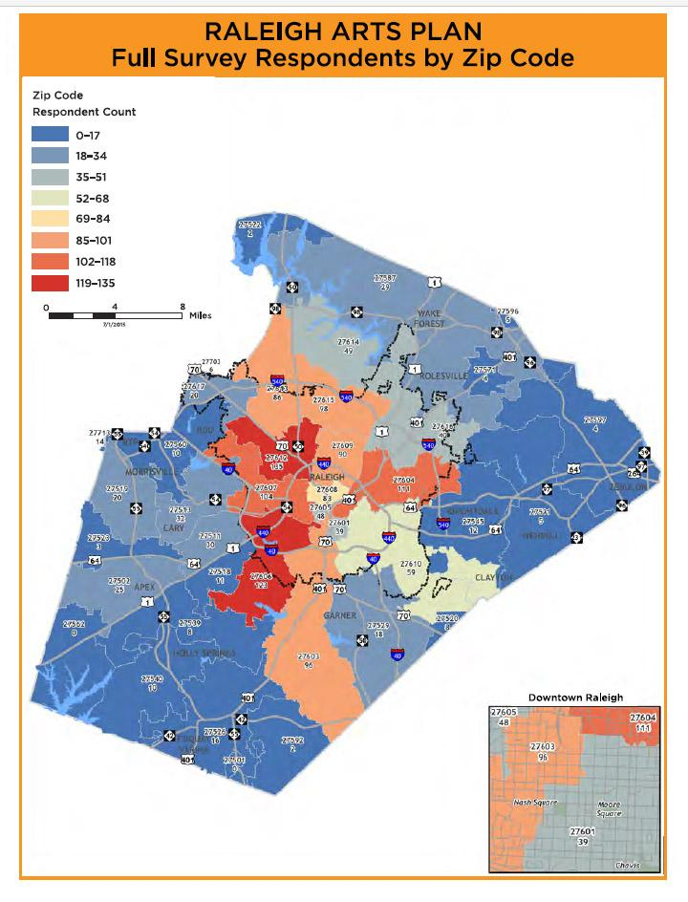
Findings
Who, from the public, is participating in the community engagement process and how does this participation represent historically marginalized communities?
Those identified as marginalized communities were mentioned to be part of the planning process in only 33% of the plans.
Statistics: Charlotte, NC Cultural Plan notes: “though this planning process was well-publicized and timed to provide ample opportunity for broad-based participation, the white/non-white assessment ratio of response was 81:19 in a community whose white/non-white composition is 49:51.” (p. 12)
Zip Code Maps of Respondents: Raleigh, NC
Notes:
Some planning processes identified specific tactics to involve and include the opinions of people of color, those with disabilities, or others targeted because they came from marginalized groups.
Other plans noted that themes emerged from their planning processes that pointed to the need to address gaps in services or resources to marginalized populations.

Slide 16
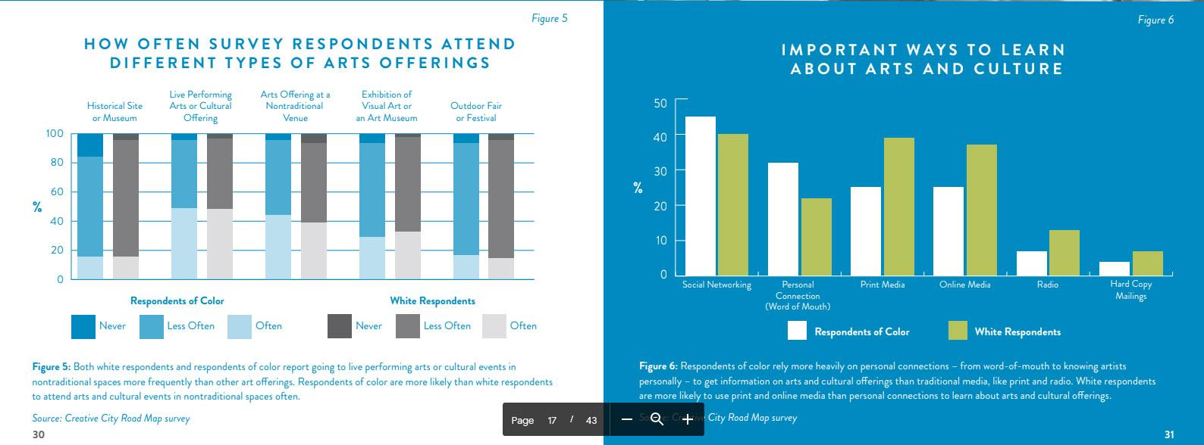
Side-by-Side Survey Responses
Minneapolis
Notes:
“Engagement Teams,” populated by artists whose jobs it was to build relationships and collect information specifically from communities who had typically been excluded in the past planning processes, people of color.
“The artists involved were hired for their community expertise, experience and ability to connect to diverse communities across the city...The staff team and Artist Engagement Teams worked with Voices for Racial Justice, a local community organization working to advance racial, cultural, social and economic justice, to learn how to infuse racial equity into data analysis” (p. 19).
This outreach process resulted in higher engagement levels from people of color and a more nuanced analysis of survey responses in the final plan which compared white people’s survey answers to those from people of color.

Slide 17
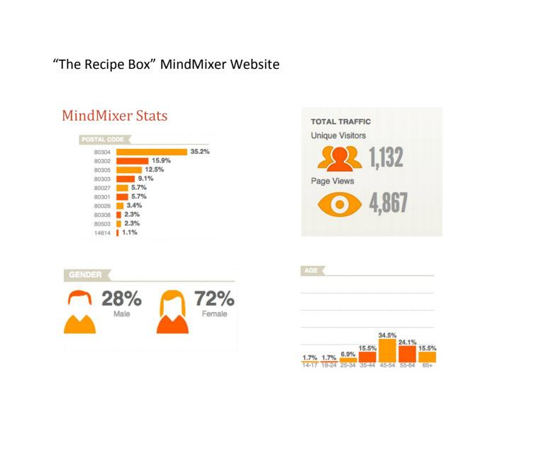
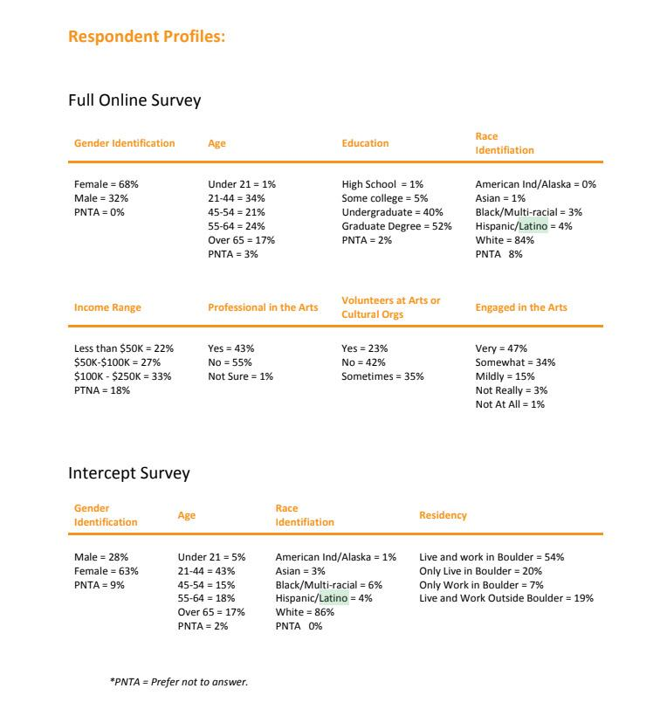
Use of Surveys/Targeted Outreach is Most Revealing: Boulder, CO

Slide 18
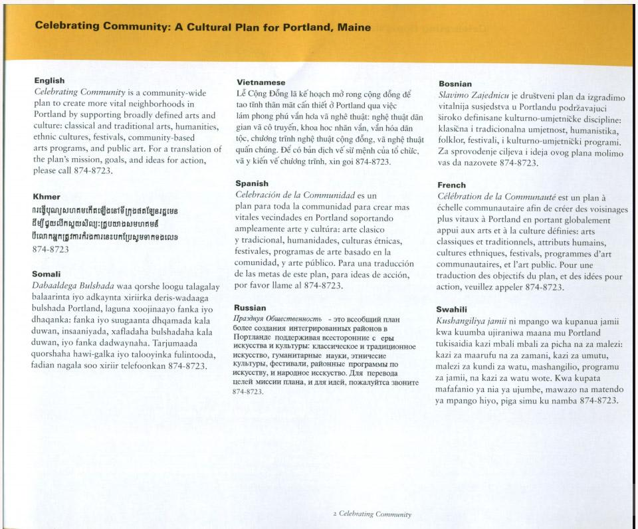
Findings
Use of a Language other than English:
Portland, Maine
Notes:
Denver was an impressive exception in the front-end engagement area. They used bilingual input tools to collect vision concepts and priorities during the planning process. They also conducted a survey targeting African Americans and Hispanics “to further understand commonalities and differences among key communities in their desire for, evaluation of and experience with arts, culture and creativity in Denver”

Slide 19
Findings
“Voice” of plans often as “other” than plan authors. represents presumed white majority; “Diversity” is typically positioned
Oklahoma City, Oklahoma
“The cultural momentum of our City is influencing economic growth, opportunities for tourism, the revitalization of neighborhoods, and a deeper
appreciation of ethnic diversity” (2009, p. 3).
But no mention in the plan of what ethnic diversity the authors were referring to, nor any indication that people of color were participants in the process.
Notes:
Diverse populations are identified as the other who needs to be included, understood, or appreciated, but frequently the populations who are called diverse are not identified with specific demographic information.
For example, Oklahoma City’s plan notes “The cultural momentum of our City is influencing economic growth, opportunities for tourism, the revitalization of neighborhoods, and a deeper appreciation of ethnic diversity” (2009, p. 3). There is no mention in the plan of what ethnic diversity the authors are referring to, nor any indication that those of ethnic diversity were participants in the cultural planning process.
When discussing board leadership, Reno’s plan notes that while about 30-35% of the Reno’s population is non-Caucasian, and that most cultural organizations have made an effort to establish relationships with minority groups, “overall diversity is still not present in the arts to a great degree” (2012, p. 13-14). The only other mentions in the plan regarding diversity were about encouraging “diversity awareness,” with no indication that the engagement of actual people of color was a goal.

Slide 20
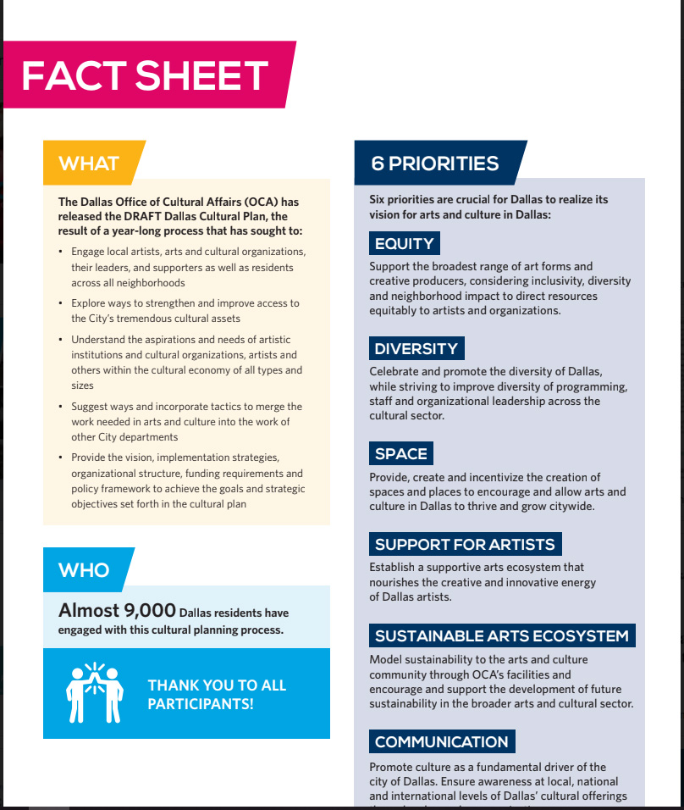
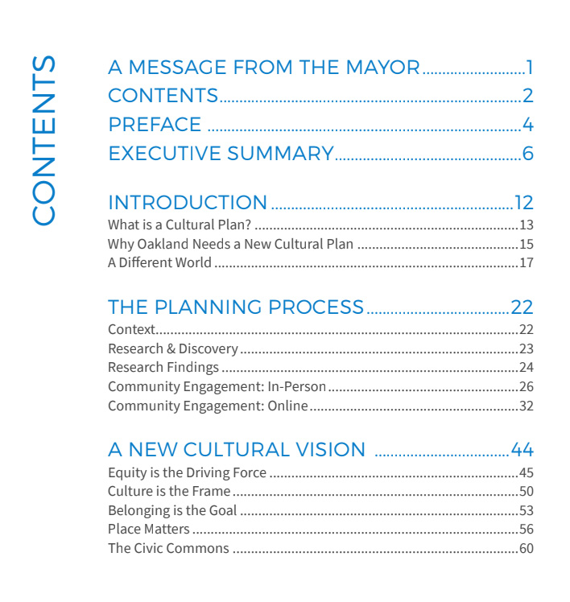
Strong
Dallas
Oakland
Equity and Access Prioritized in
Planning Process
Goals & Strategies

Slide 21
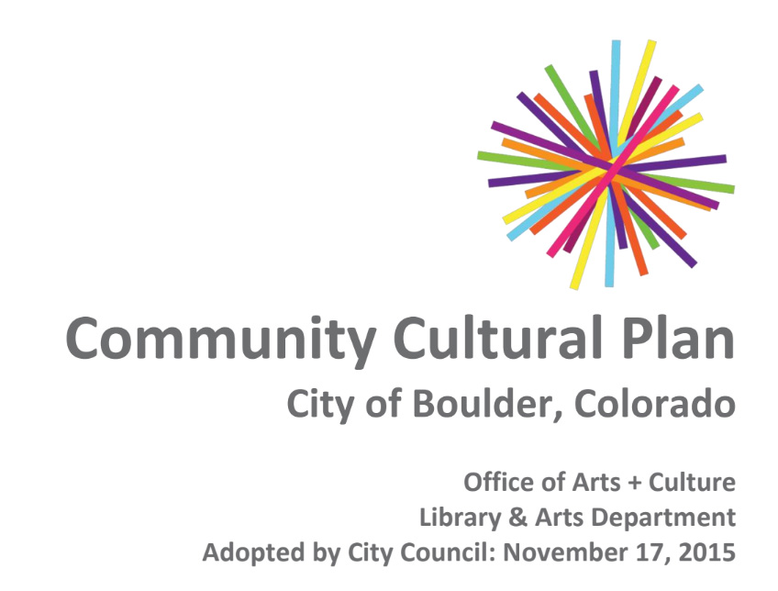
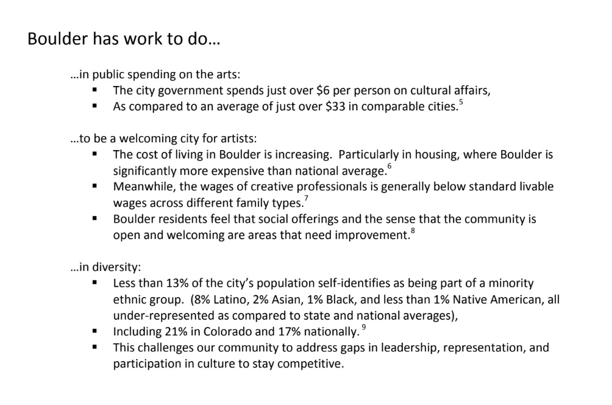
Mediocre
No mention of EDI in:
Community Priorities
Vision
Equity and Access Identified in:
Where they have work to do
Under Strategies only in “Strengthen Culture in our Neighborhoods and Communities”

Slide 22
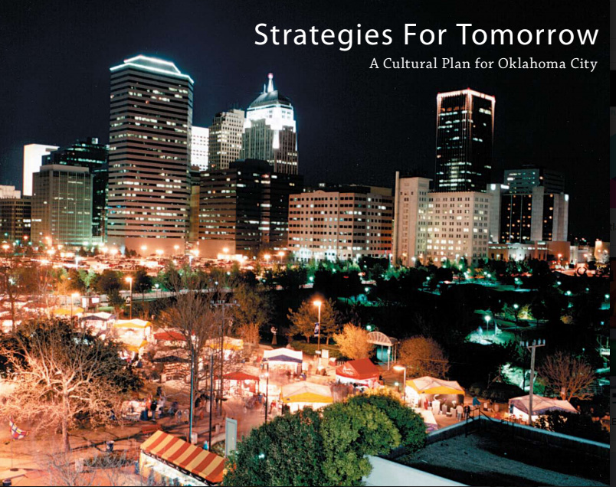
Weak
Done in 2009
African American, Hispanic and Asian cultures mentioned under Creative Strategy 1: Entice, Attract, Entertain as cultural destination
Diversity used 3 times
0 use of equity
0 use of inclusive
No demographics shared (Population 2018 649,021, 68% white, 19% Latino, 14% Black, 5% Asian, 3% Native American)

Slide 23
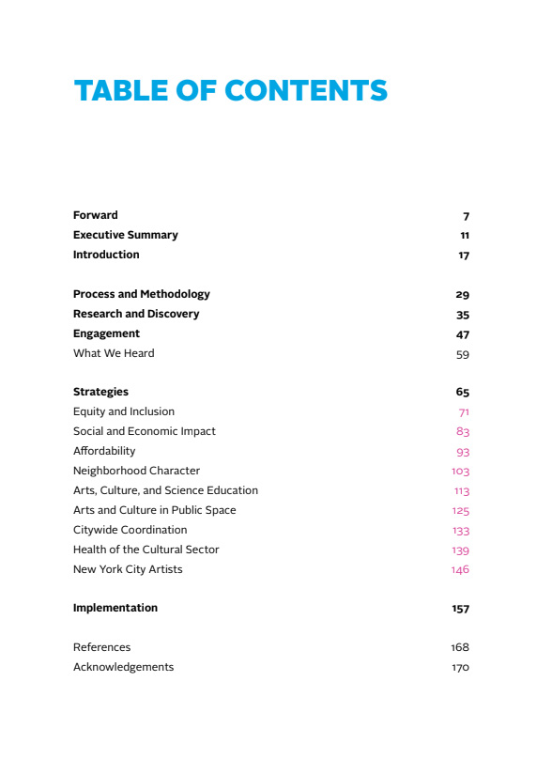
Recommendations
NYC
Make equity a guiding principle that frames the engagement process, data collection, and community conversation.
Equity-based planning processes and practices are increasingly being engaged but are unevenly applied.
How might we identify equity best practices and apply them consistently across comprehensive and topical planning?
Notes:
There is evidence that equity is being advanced with increasing prioritization in recent plans, however there is still much work to be done in understanding and identifying more robust best practices in this arena.

Slide 24
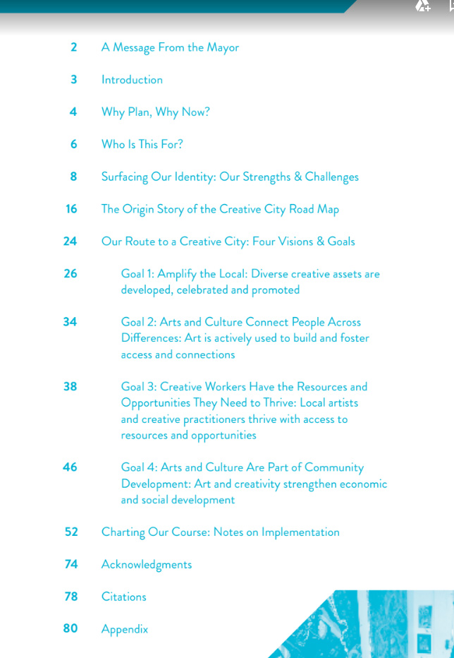
Recommendations
Minneapolis
Engage marginalized populations in the writing of plans.
Practitioners need to be more inclusive in the process, content, and tone of arts and cultural plans to ensure that they are inclusive of the many communities within the planning area.
Notes:
There is evidence that equity is being advanced with increasing prioritization in recent plans, however there is still much work to be done in understanding and identifying more robust best practices in this arena.

Slide 25
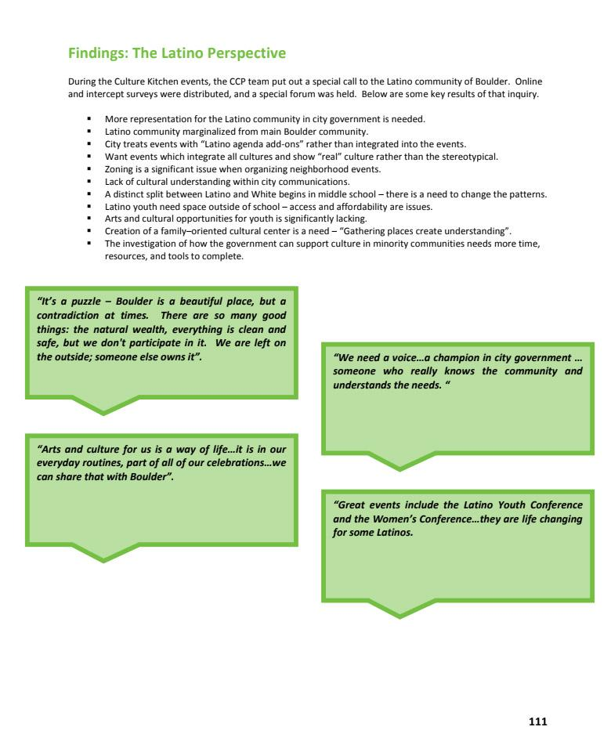
Recommendations
Use targeted outreach to engage various populations and show their feedback in the plan.
Notes:
There is evidence that equity is being advanced with increasing prioritization in recent plans, however there is still much work to be done in understanding and identifying more robust best practices in this arena.

Slide 26
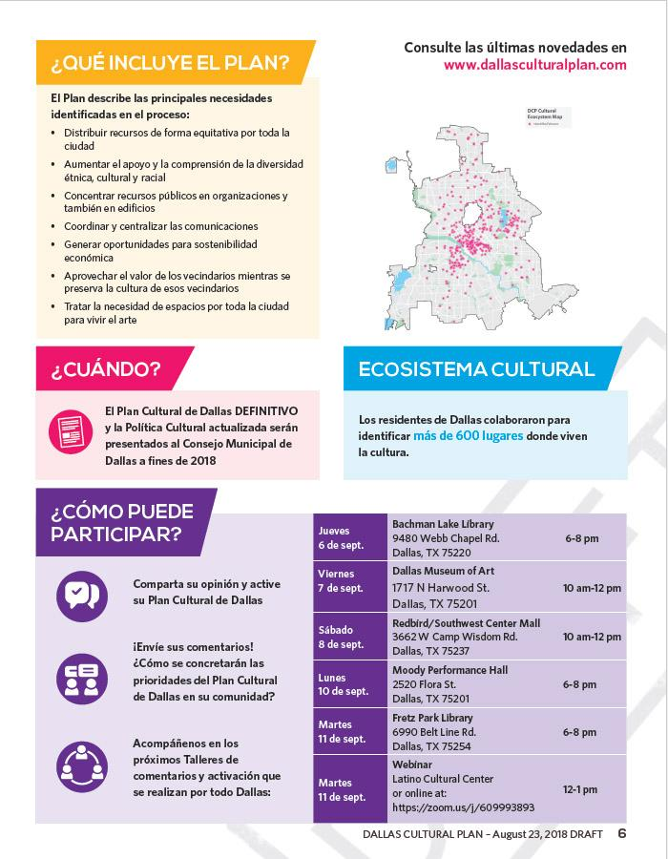
Recommendations
Consider use of languages other than English in outreach materials and the final plan.
Notes:
There is evidence that equity is being advanced with increasing prioritization in recent plans, however there is still much work to be done in understanding and identifying more robust best practices in this arena.

Slide 27
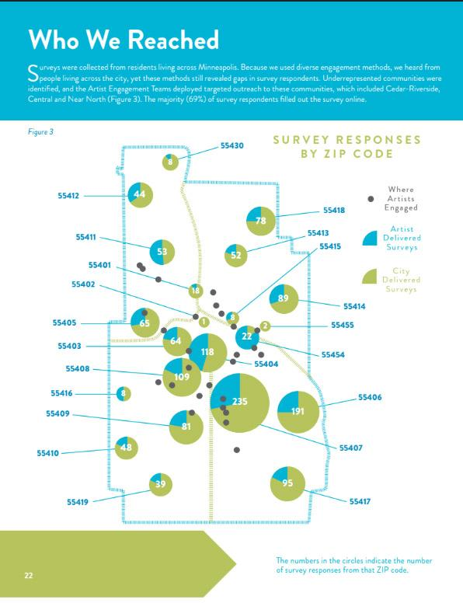
Recommendations
Minneapolis, MN
Collect and provide detailed demographic analysis of planning process participants and the community’s overall population so that place-based diversity is clearly defined and reflected in the final document.
Consider using mapping to visualize respondent and community diversity using race and socio-economic data.
Notes:
There is evidence that equity is being advanced with increasing prioritization in recent plans, however there is still much work to be done in understanding and identifying more robust best practices in this arena.

Slide 28
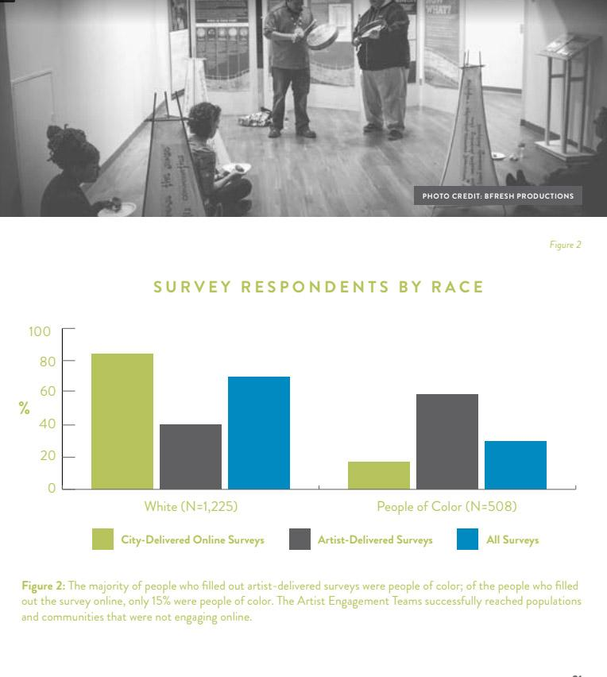
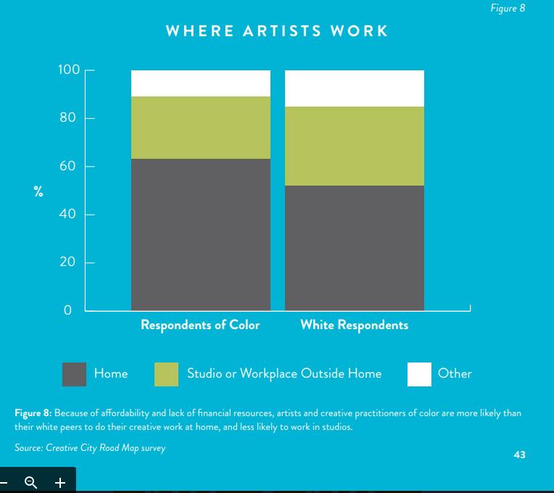

Slide 29
Further Research
a survey of arts and cultural planners on planning process and implementation
interview analysis with identified planners to gain more in-depth insight
a comparative case study of different municipal approaches to diversity and inclusion using an arts & culture lens

Slide 30
Further Research
Does the impetus to include diversity, equity, and inclusion process or content in a cultural plan come from the commissioning agent (usually the City or Arts Commission), the hired consultants, or the community?

Slide 31
Further Research
When there is little about diversity, equity, and inclusion, is that omittance from the commissioning agent, hired consultants, or the community?

Slide 32
Further Research
Have the diversity initiatives been implemented?
Are there concrete actions or changes that have come from goals and strategies relating to what was outlined in cultural plans such as funding, new or expanded programs, facilities, studies, or partnerships?

Slide 33
Further Research
Native Americans are absent from all plans but Boise, ID, Rapid City, South Dakota, and Santa Fe, New Mexico.
What are the cultural relationships between Native Americans and municipalities nationally and how might they be more integrated?

Slide 34
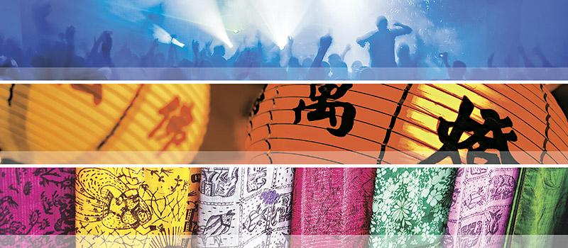
Discussion

