Slide 1
Development 101 presented by

Slide 2
Presenters Ryan Armbruster, Elam & Burke Shellan Rodriguez, PMP, SMR Development Patricia Nilsson, AICP, Canyon County Development Services

Slide 3
About ULI
Mission: to provide leadership in the responsible use of land and in creating and sustaining thriving communities worldwide.
ULI–the Urban Land Institute is a 501(c) (3) nonprofit research and education organization supported by its members. Founded in 1936, the institute now has more than 40,000 members in over 90 countries representing the entire spectrum of land use and real estate development disciplines, working in private enterprise and public service.
As the preeminent, multidisciplinary real estate forum, ULI facilitates the open exchange of ideas, information and experience among local, national and international industry leaders and policy makers dedicated to creating better places.

Slide 4
Presentation Topics
● Public & Private Objectives for Development  Public & Private Steps in the Development Process  The Business of Real Estate  The Importance of an Integrated Planning Process  How to Work More Effectively Together

Slide 5
Idaho Land Use
Local Comprehensive Plan
Local Land Use Planning Act
Zoning
Local Government
Idaho Legislature
Local Government

Slide 6
Public
● Transparency  Feasibility  Cost effectiveness
Common
● Certainty/ No surprises  Honesty
● Fairness
● Resources (Policies, regulations and staff) that support good development
● No public controversy
Private
● Simplicity  Flexibility  Efficiency

Slide 7
PRIVATE PROCESS
PUBLIC PROCESS
Business Concept
Site Selection /Market Study
Secure Financing
Due Diligence/real estate purchase
Comprehensive plan
Zoning entitlement
Subdivision plat
Infrastructure
Site engineering
Architectural design
Building plan review
Preliminary Bids
Pre-sales/leasing
Inspections
Construction Management
Certificate of Occupancy

Slide 8
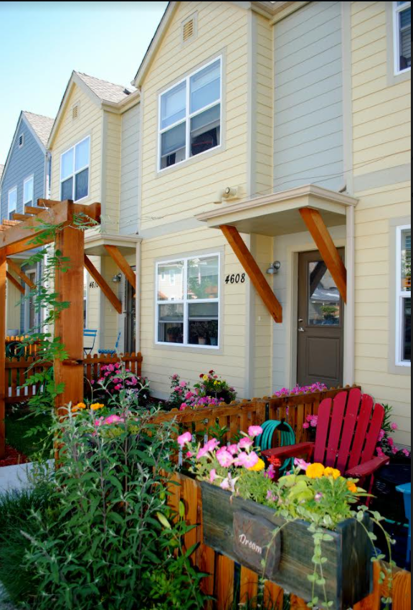
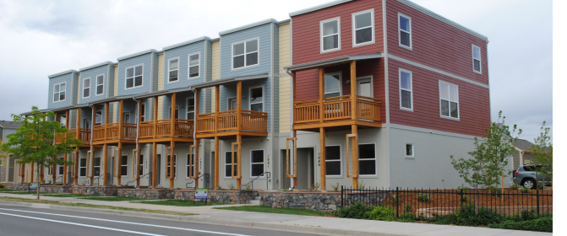
The “Back of the Napkin” Real Estate Deal

Slide 9
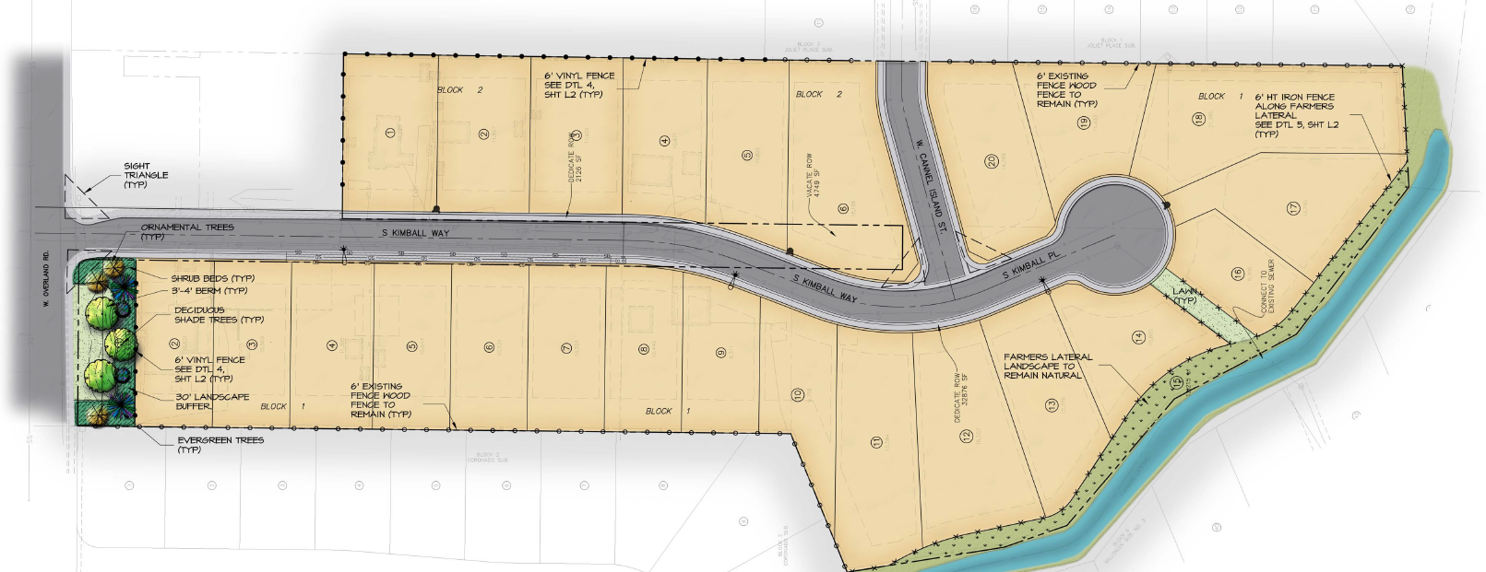
Conceptual Development

Slide 10
Project Assumptions
Property Size: 7.95 acres
Price: $85,000/ acre - $$ / lot
Development Assumption: 24 lots, 3.0 du/ acre
Price Assumption:
Home Price = $$
Lot Sale Price= 25% of home price

Slide 11
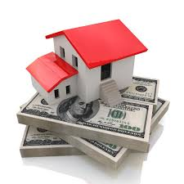
Project Cost Assumptions
Planning, A & E and Entitlement Costs = $$$/lot
Soft Costs
General & Administration Marketing
Closing Costs Legal Costs
Taxes Financing Costs
Site Development Costs = $$$/lot
Off-site Costs = $$$

Slide 12
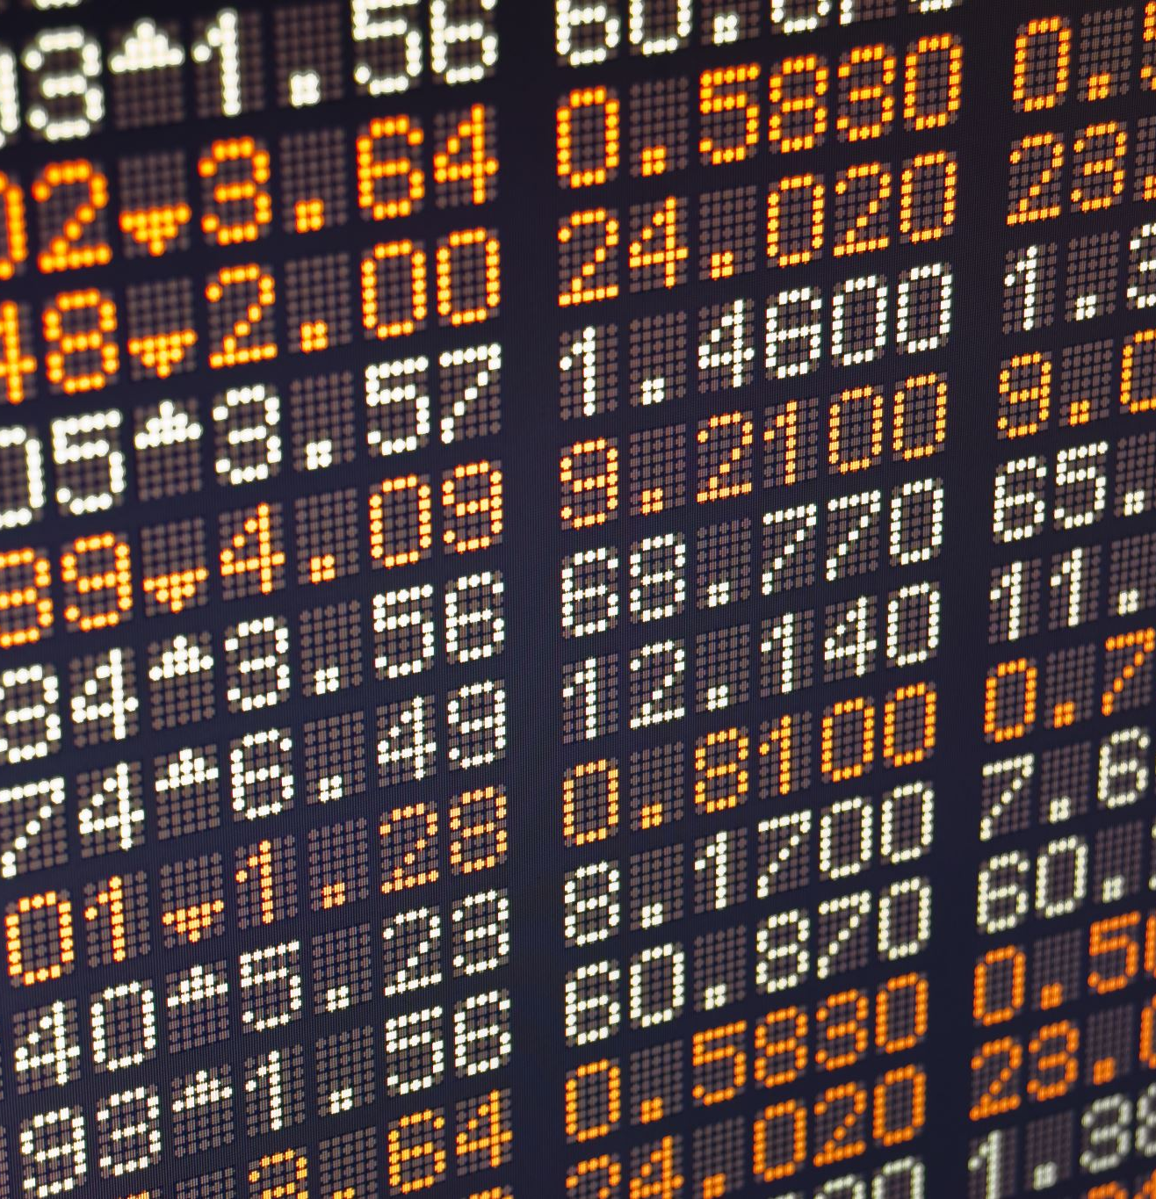
Pro Forma
Set of calculations that project the likely financial return that a proposed real estate deal is likely to create over time
BEST GUESS, NOT MAGIC

Slide 13
Base Pro forma
 | Yr1 Q1, Q2 | Yr1 Q3, Q4 | Yr 2 Q1, Q2 | Yr 2 Q3, Q4 | Total
Lot Sales (2/Mo.) | - | - | 10 | 14 | 24
Total Revenue (Sources) | - | - | $$ | $$ | $$
Planning, Engineering Entitlement Costs | $$ | - | - | - | $$
Site Development | - | $$ | $$ | - | $$
Offsite Costs | - | $$ | - | - | $$
Land Acquisition | $$ | - | - | - | $$
Operating Costs | $$ | $$ | $$ | $$ | $$
Total Costs (Uses) | $$ | $$ | $$ | $$ | $$
Net Cash Flow | ($$) | ($$) | $$ | $$ | $$
Cumulative | ($$) | ($$) | ($$) | $$ | $$
Internal Rate of Return = 16.24%

Slide 14
Analyzing Returns
Internal Rates of Return (IRR)
Equivalent to the interest rate paid on a bank account with the same up-front money (total costs) in order to get the same return (net cash) in the same amount of time.
Example: $1 million invested at 10%/year for 5 years will return the investor’s money plus $100,000 per year for a total of $1.5 million returned at the end of 5 years
The TOTAL RETURNS to the investor are $1.5 million (50% on his/her money) BUT IT IS ONLY EQUIVALENT TO A 10% INTEREST RATE
Time
Up-Front Costs

Slide 15
What is the “Right” Return?
HIGHER RISK = HIGHER IRR Required
Real Estate Development =
HIGHEST RISK investment class
10-Year Treasury Bills are paying ~0.68%
Virtually NO risk
(Backed by the US Government)
Home Mortgage Rates ~2.75%
Developer of Project Requires 15%+ IRR
Every developer will require a different return depending on the risk associated with the project
Difference is Risk

Slide 16
Impacts on Returns Developer requires 15% IRR to move forward
Proforma calculation
IRR 16.24%
Passed
Reduce lot density from 3.0 to 2.75 du/ac
IRR 13.38%
Failed
Increase site costs by 10%
IRR 12.70%
Failed
Reduce finished lot prices by 10%
IRR 11.02%
Failed
Add 6 months to entitlement
IRR 11.45%
Failed

Slide 17
Overall Risks
Absorption Period
Entitlements
Rate Environment
Construction Process
Market Demand & Conditions

Slide 18
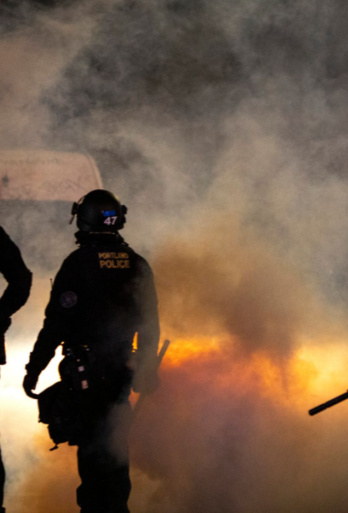
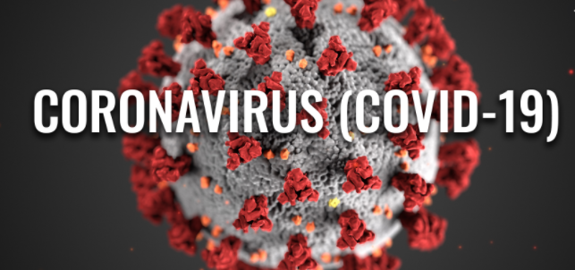
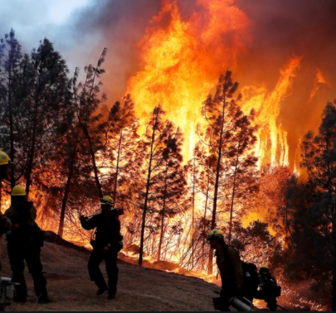
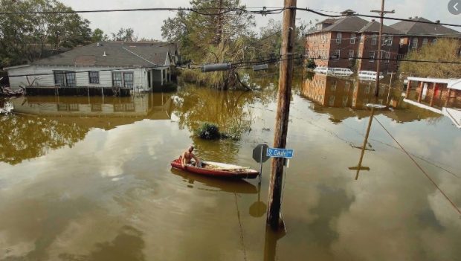
Market Demand & Conditions

Slide 19
Such a risky business requires…
Large profit margins
Vast experience by all professions
Available capital
Significant liquidity for “what if” scenarios

Slide 20
The Building Blocks of the Planning Process
Zoning
Comprehensive Plan
Site Plan and Design
Subdivision

Slide 21
Steps in the Development Process
Zoning
Sets framework for development
First regulatory step
Use permit
Creates the way for property to be bought and sold
Ensures adequate public facilities and buildable area
Sub-division
Allow for review of certain uses that may have impacts on surrounding uses
Ensures compliance with specific development standards
Site & design
Less Discretion

Slide 22
Zoning
Issues decided at previous step
Comprehensive Plan land use and policies
Issues on the Table
Consistency with Comprehensive Plan
Existing zoning
Zoning of other properties in the area
Site suitability/compatibility
Impact on services
Zoning category proposed

Slide 23
Special Use Permits
Issues decided at previous step
Consistency with the Comprehensive Plan
Issues on the Table
Use allowed by zoning ordinance
Allowance for use in the District
Standards to be used in evaluating the use
Density
Setbacks
Height limits
Parking requirements
Landscaping requirements
Compliance with specific standards for use
Suitability of property for use
Conditions

Slide 24
Subdivision
Issues decided at previous step
Consistency with the Comprehensive Plan
Issues on the Table
Compliance with the zoning regulations
Land use
Density
Setbacks
Height limits
Parking requirements
Landscaping requirements
Impacts from land use
Compatibility with adjacent uses
Balance of uses city-wide
Market for use
Adequacy of infrastructure and services
Subdivision design
Title to property
Compliance with plat requirements

Slide 25
Site and Design Plans
Issues decided at previous step
Consistency with the Comprehensive Plan
Issues on the Table
Compliance with zoning
Allowance for use in the District
Balance of uses city-wide
Market for use
Compatibility with adjacent land uses
Development standards
Density
Setbacks
Height limits
Parking requirements
Landscaping requirements
Availability of services
Traffic impacts
Drainage impacts
Building layout and orientation
Landscaping
Site triangle
Drainage
Buffer areas
Screening
Walkways and pedestrian ways
Access points and internal circulation
Public improvements
Architectural treatment
On site circulation and parking
Building scale and design
Open space
Vicinity considerations

Slide 26
Factors that impact development beyond the control of the developer
Controlled by the public agency
Process timing
Application fees
Other factors
Local and national economy
Public agency resources
Policies and regulations
Market for development
Financing
Labor
Public resistance

Slide 27
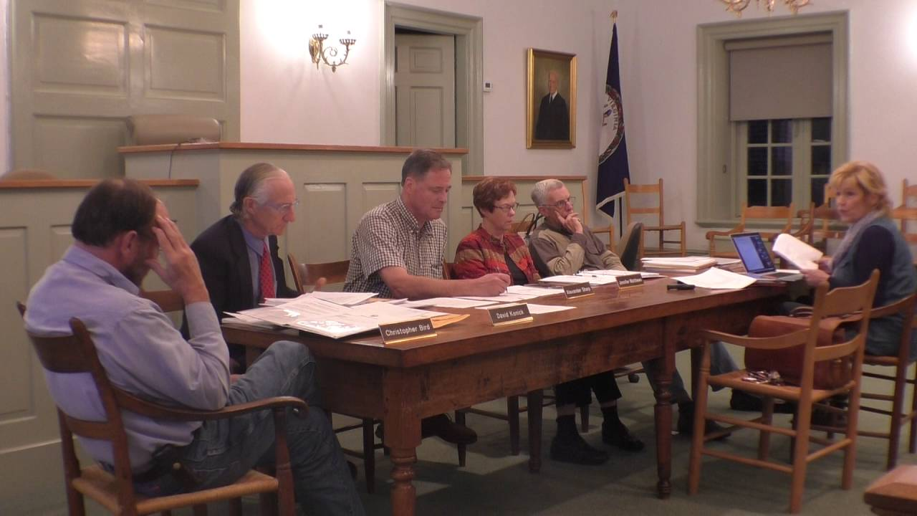
How to Work Effectively Together
Maintain respect
Be clear
Recognize mutual needs
Keep the long view-vision
Understand the risks
Understand the regulations
Identify shared goals

Slide 28
Questions

Slide 29
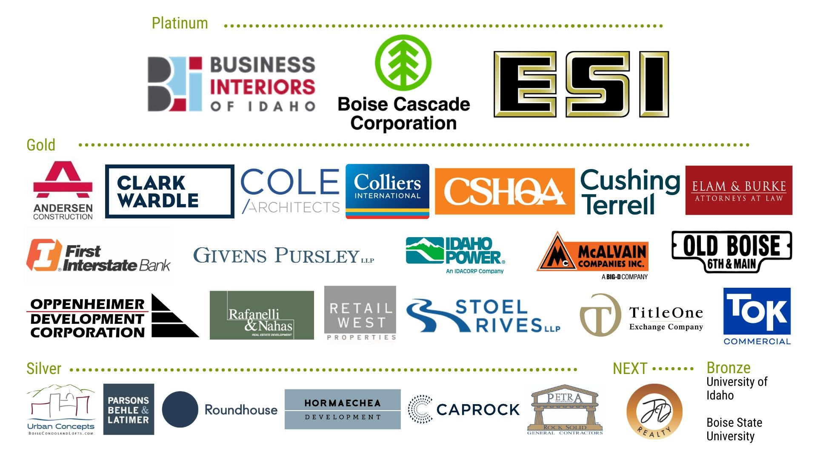

Slide 30
About ULI
http://idaho.uli.org/
https://www.facebook.com/OfficialULIIdaho/
https://twitter.com/ULIIdaho

Slide 31
