Slide 1

Local Green House Gas Emissions and Climate Action Planning in Idaho Communities
Idaho APA Conference
October 9, 2020
10-11:30 am

Slide 2




Michelle Groenevelt, AICP, is the Community and Economic Development Director from the City of McCall.
Sharon Grant, CSBA and LEED AP, providing sustainability consulting since 2006 when she founded her company Eco Edge.
Kelli Cooper is the Environmental Education and Sustainability Specialist from the City of Moscow.
Jami Goldman is the Climate and Sustainability Coordinator and Amy Parrish is the Climate and Energy Analyst from City of Boise.

Slide 3

Overview of Session
Overview of climate change and impacts in Idaho
Why this topic is important to Planners
What is happening in other Idaho communities
Resources available to conduct a greenhouse gas emissions inventory, the basis for a climate action plan or sustainability plan

Slide 4

Overview of Climate Change and Impacts in Idaho
Changes in plant productivity
Increase areas burned by wildfires
More precipitation falling as rain instead of snow
Drought

Slide 5
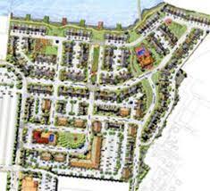


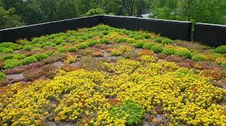
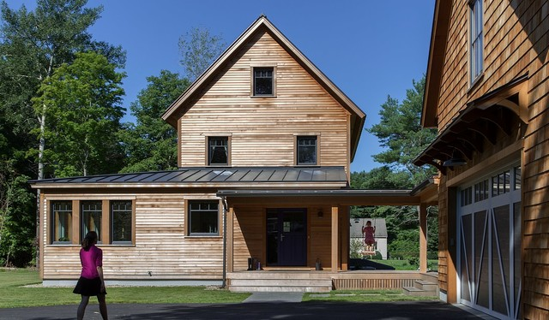
Why this topic is important to Planners?

Slide 6
City of McCall Greenhouse Gas Inventory

Slide 8




Wood River GHG Inventory and Ketchum Sustainability
Leading by Example
October 9, 2020
Notes:
The purpose of today is to share the experience we had with doing a GHG emission inventory as a collaborative group in the Wood River Valley and how that ties into the goals and actions of one of the jurisdictions in the Valley: Ketchum.

Slide 9
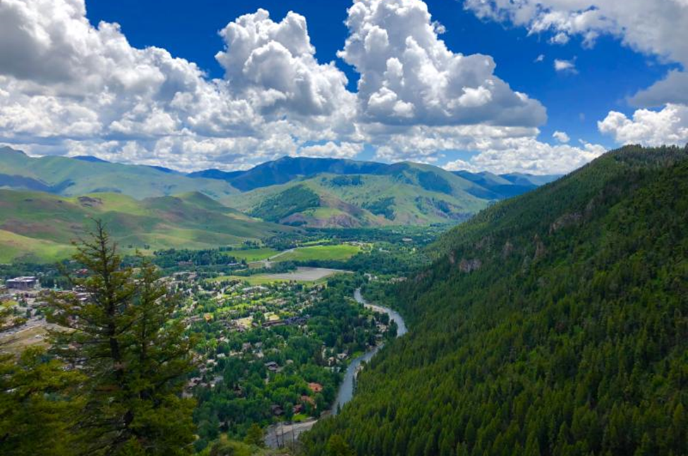
Agenda
Goals & Inspiration
Challenges
Collaborative Approach
Process
Progress
Next Steps

Slide 10
Inspiration
Previous work with Boise, Eugene, Tacoma, Missoula, Providence and Grand Rapids; Ada and Pierce County; school districts; etc.
KEAC expanded to KSAC and reinvigorated
HCAC then NVCAC now WRCAC
How much water and energy does snowmaking use?!
MT2030
Notes:
Describe my background: USGBC, SEM, LEED (e.g. ND), energy codes, sustainability planning, Smart Growth – all rooted in and Ecological Design degree. Reference Boise counterparts and my foundation working with them. Describe my role as advisory to Ketchum and with valley collaborations. Describe evolution of KEAC to KSAC and HCAC to WRCAC. From the outside, it would seem snowmaking is the elephant in the room for emissions. However, Sun Valley Co has invested in significant improvements in snowmaking efficiency. What is the elephant in the room?! A Ketchum City Council member attended MT2030, which established a network of similar size/type jurisdictions that share a passion for reducing emissions and led to the collaborative effort on conducting GHG inventories with ICLEI.

Slide 11
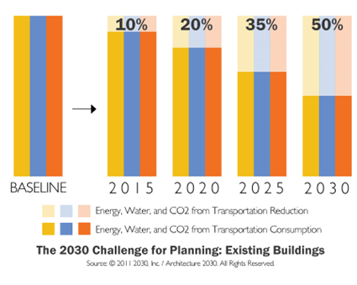
Ketchum Energy Goals
Align with the 2030 Challenge and upgrade existing municipal buildings towards a 50% reduction in energy use by 2030 compared to a 2007 baseline and ensure new buildings are carbon neutral by 2030
Ensure critical loads are met with resilient sources of energy by 2030
Eliminate emissions from municipal vehicles by 2030
Notes:
Describe 2030 Challenge as median. Not vanguard, not lagging. Note that Idaho Power has committed to clean power by 2045 so these 2030 goals are 15 years prior. Boise adopted 2030 Challenge-based goals then expanded to commit to 100% clean energy for the community by 2035. For reference, Aspen’s community GHG reduction goals (30% reduction by 2020, 80% reduction by 2050, based on 2004 levels).

Slide 12

Ketchum Water Goals
Complete upgrades to the spring line network by 2022
Reduce municipal water use by 40% by 2025
Reduce community water use by 40% by 2030
Notes:
Applaud the upgrades to the spring line network and the impressive savings that are expected from that. For reference, LEED has typically started awarding credit with 20% reduction and then 30% and 40%. Hence, we believe 40% is a stretch but still feasible by 2025 and 2030.

Slide 13

Ketchum Waste Goals
Analyze converting all wastewater sludge to beneficial use by 2022
Eliminate single-use plastic in the community by 2025
Become a zero-waste community by 2050
Notes:
We believe strongly in striving to eliminate single use plastic in our community over time and have already enacted new policies based on the plastic industry’s impact on emissions. There is global momentum for this and we want Ketchum at the table. It is ambitious to strive for zero-waste but cities like San Fran are already doing it so we would have 30 years to learn from them. Or, we could a shorter-term reduction target similar to water. For reference, Aspen has more urgency to waste reduction due to the estimated landfill life of 10—11 years as of 2017. A waste audit is currently being conducted of the SISW landfill, preliminary results indicate a significant opportunity to divert approximately 30% by addressing compostable waste. As a comparison, Teton County voted for 60% reduction in community waste by 2030.

Slide 14
Challenges
Too many cooks in the kitchen – is methodology consistent?
The pros and cons of interns
Acquiring natural gas data is a challenge
The airport declined to participate using the ICLEI methodology and prefers to use an industry standard if their data is to be included in the inventory
Large proportion of second homeowners
$
Notes:
Limited resources! Budget is an issue!

Slide 15
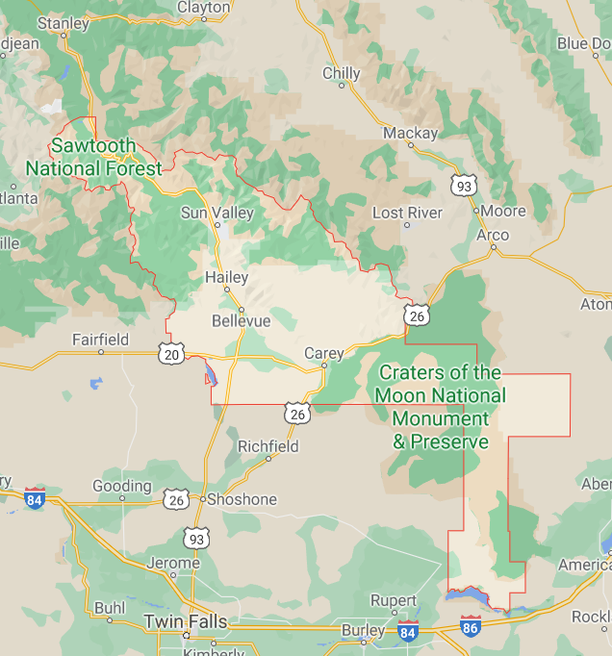
Collaborative Approach – ICLEI GHG Inventory Goals
Regional collaboration between governments
Share resources
Establish a baseline
Benchmark performance over time
Data-driven decision making
Notes:
Explain that 2007 inventory may not be apples to apples. 2018 inventory establishes a new baseline.

Slide 16
GHG Inventory Process
Webinars with great resources
ClearPath tool
Community and/or municipal?
Role of staff – reach out to utilities and other data sources
Role of interns – collect and enter data
Record and share methodology
Analyze and compare results
Report template
Notes:
Surprised how much effect the methane capture had!

Slide 17
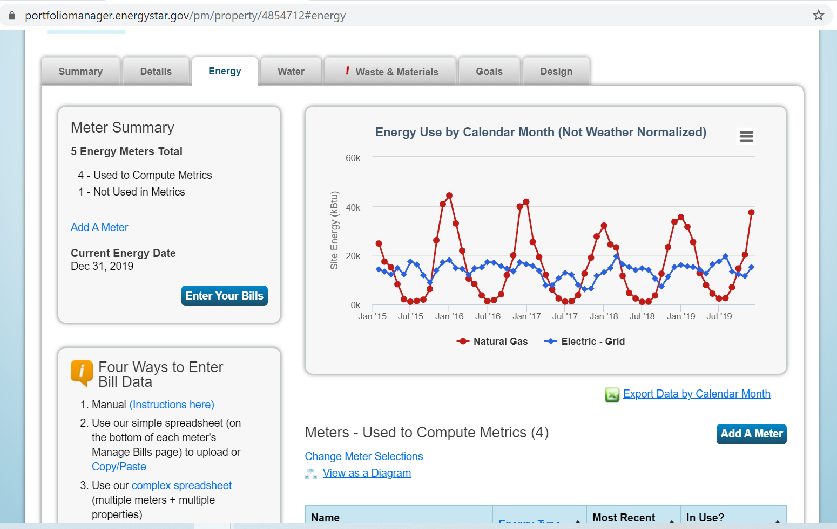
Benchmarking Municipal Energy Use and Emissions
Notes:
Describe the value of benchmarking energy, water and waste in a platform like Portfolio Manager.

Slide 18

WRCAC
Hailey City Council Candidates
Hailey Mayor
100% Clean Energy Resolution
Partner with students
Letter writing campaigns for
    Budget for Sustainability and Climate Change
    Regional Sustainability Director
    Street Closures
Notes:
Talk about the value, impact and actions of a citizens group.

Slide 19
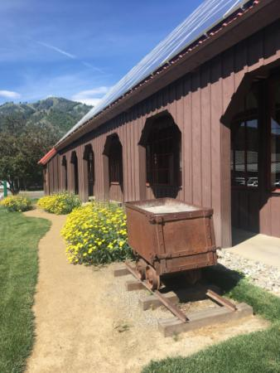
Ketchum Progress on Reducing Energy and Emissions –
Energy audits by IDL
Energy saving upgrades – especially WWTF
Lighting audit and upgrades
Back-up power analysis by IAC
OEMR grants
Sustainability standards for fire station
IDL analysis for new City Hall
GHG inventory
Abandoning spring water line (energy water nexus)
Installation of solar array at Ore Wagon
EV charging station
Photo credit: City of Ketchum
Notes:
Explain the OEMR Leading by Example grant for audits in rural communities. Describe a few upgrades. Explain the IAC as a resource. Share the grants available. Emphasize the significant opportunity that new construction and major renovations offer and how to take advantage of it. Describe the value of doing an inventory to establish a baseline and provide a trajectory for benchmarking performance over time.

Slide 20
Next Steps
Climate Action Plan!?
Pursuing impact investing
Sustainability goals for new Ketchum City Hall
Continue regional collaboration, possibly a regional office of sustainability
Continue to engage across regions and across mountain towns
Continue to engage with citizen climate action coalitions
Research and apply for grants

Slide 21
Thank You!
Sharon Grant
KSAC
Sharon@buildingecoedge.com
Notes:
Thank you for your time today and your interest in GHG emissions and sustainability! Happy to take questions the end.

Slide 22
City of Moscow
Kelli Cooper, Environmental Education and Sustainability Specialist

Slide 23
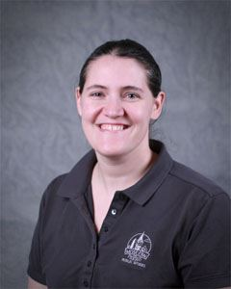
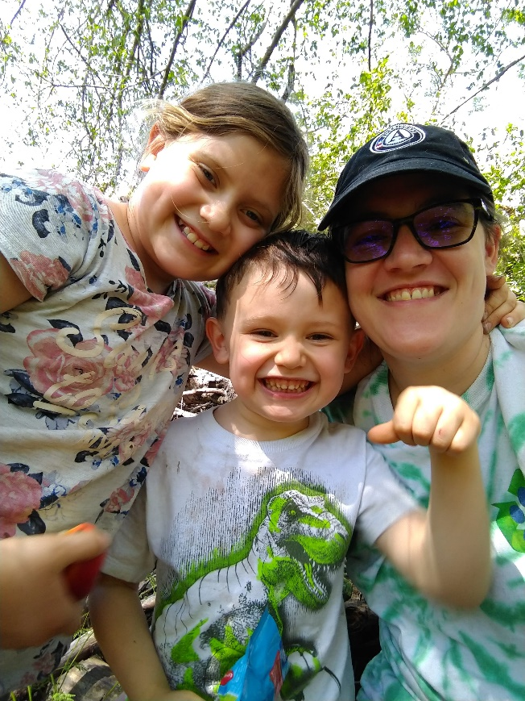
A little about me
Work
  AmeriCorps Alumni
  Environmental Education
  Sustainability
Play
  Outdoors
  Rock hunting
  Reading
  Binge-watching all my favorite shows
Volunteer
  PTA
  Girl Scouts

Slide 24
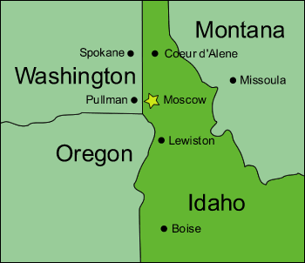
Home Sweet Home
Top 5 employers:
  University of Idaho
  Gritman Medical Center
  Moscow School District
  City of Moscow
  Walmart

Slide 25
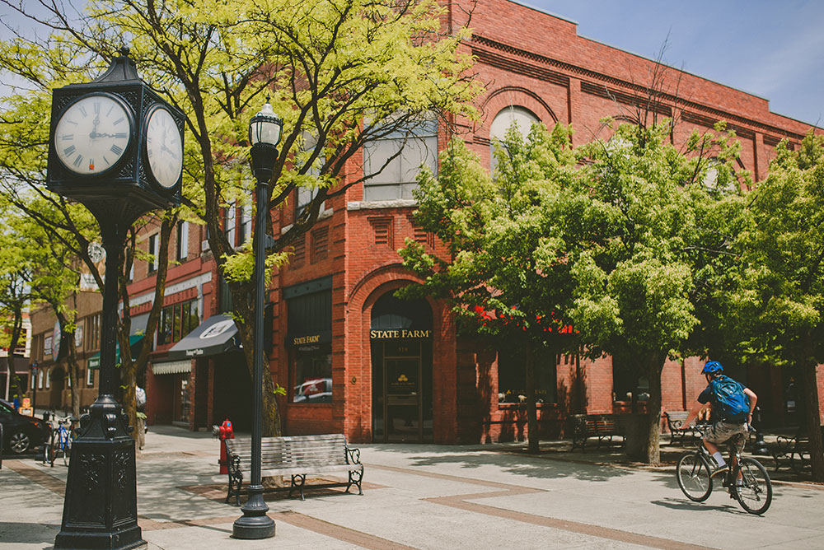
City Snapshot
The City of Moscow delivers quality municipal services while ensuring responsible use of resources. We anticipate and meet the needs of our diverse population in order to build public trust and enhance a sense of community.
Population: 25,766
Annual Budget: 96 million USD

Slide 26

Public Policy
Resolution No. 2007-13: Climate Protection and pledge to join ICLEI
Resolution No. 2010-18: Adoption of the reduction goal of 20% of 2005 Greenhouse Gas levels by 2020
Resolution No. 2013-16: Reconfirmation of reduction goal
Goal Update: Baseline and reduction goal updated by City Council (March 17, 2014); Current reduction target is 20% of 2008 greenhouse gas levels by 2020
Resolution No. 2018-23: Revenue Neutral Carbon Fee Dividend Policy

Slide 27
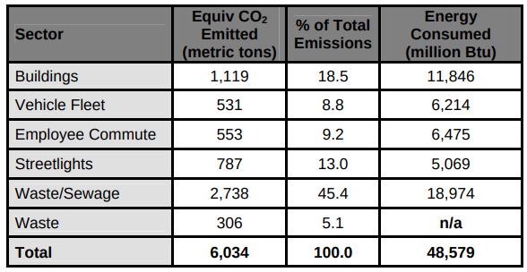
Greenhouse Gas Inventories
Municipal Emissions 2005 from original baseline inventory
Starting in 2007, the City employed a Sustainability Intern
First inventory was completed and adopted in 2010

Slide 28

Internal changes
Green Building Program (2006)
Sustainable Purchasing Policy (2008)
City began contracting with AmeriCorps in 2014
Formation of the Environmental Services Department

Slide 29
Emission Reduction Strategies
Traffic signal and Streetlight upgrades
  Including area lighting at several City Facilities
Water/Wastewater system upgrades
  Variable Frequency Drives
  Boosters
  Operational Changes
  Water Conservation Program
Building and Facility upgrades
  LED lighting upgrades
  HVAC system upgrades
Fleet Reductions
  EcoDriver
  Fleet Replacement program

Slide 30
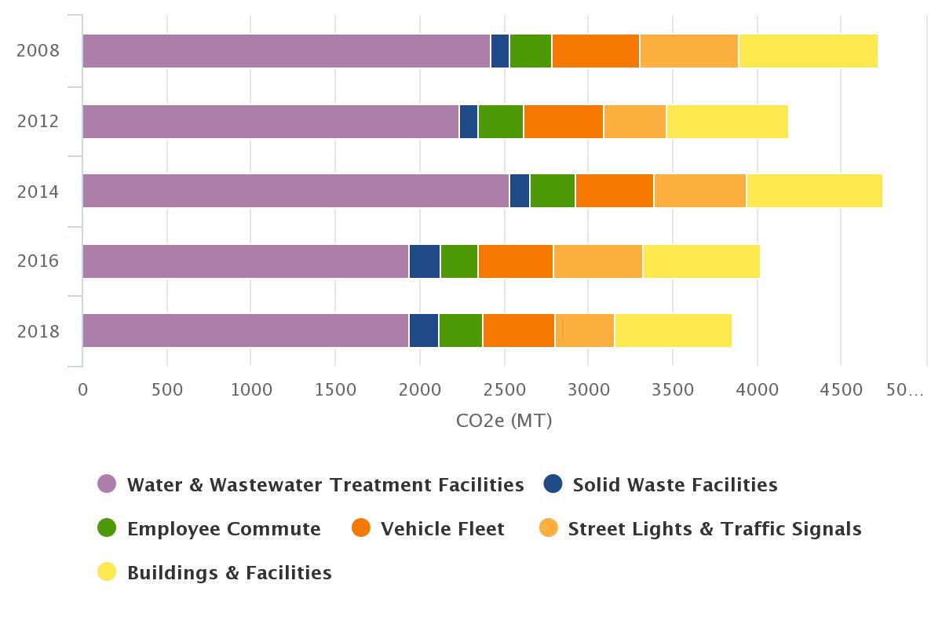
Year | Buildings & Facilities | Streetlights & Traffic Signals | Vehicle Fleet | Employee Commute | Solid Waste Facilities | Water & Wastewater Treatment Facilities | Total | Percent change
2008 | 833 | 579 | 530 | 247 | 116 | 2417 | 4722 | ---
2012 | 725 | 369 | 479 | 267 | 116 | 2233 | 4189 | -11.29
2014 | 807 | 550 | 470 | 271 | 116 | 2534 | 4748 | 0.55
2016 | 695 | 530 | 449 | 224 | 181 | 1939 | 4018 | -14.91
2018 | 696 | 359 | 429 | 256 | 181 | 1935 | 3856 | -18.34

Slide 31
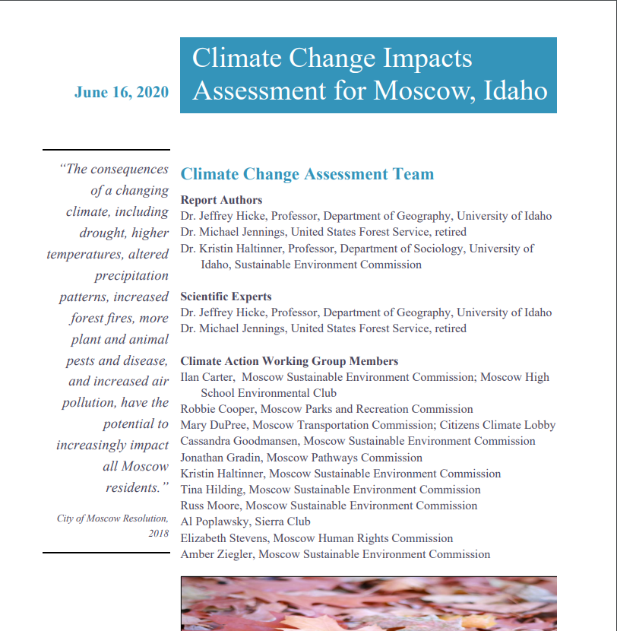
Next Step
Work has begun on an Integrated Climate Action Plan using a combination of City Staff, Sustainable Environment Commission members, University of Idaho Professors, and other members of the community.

Slide 32
City of Boise Climate action Planning
APA Presentation: Local Greenhouse Gas Emissions Inventories and Climate Action Planning in Idaho
October 9, 2020
Amy Parrish and Jami Goldman

Slide 33
TimeLine
GHG Inventories
2000
5-year cadence
Energy Efficiency and Renewables
2014
Municipal building audit
BCAA Analysis
2016
High Climate Risks
2018
2019
6 out of 8 water related
Boise’s Energy Future
2018
Clean Electricity Municipal 2030
Clean Electricity City-wide 2035
New Climate Division
Climate Action
2020
High focus on Climate Initiatives
current
Roadmap to climate goals and action
Solar projects

Slide 34
Greenhouse gas emissions inventory Process
Protocols
  U.S. Community Protocol for Accounting and Reporting of Greenhouse Gas Emissions
  Clearpath Software (developed by ICLEI)
Data Collection can be challenging
  Most important/biggest emitters: Electricity, Natural Gas, Transportation.
  Other data: Wastewater, trash

Slide 35
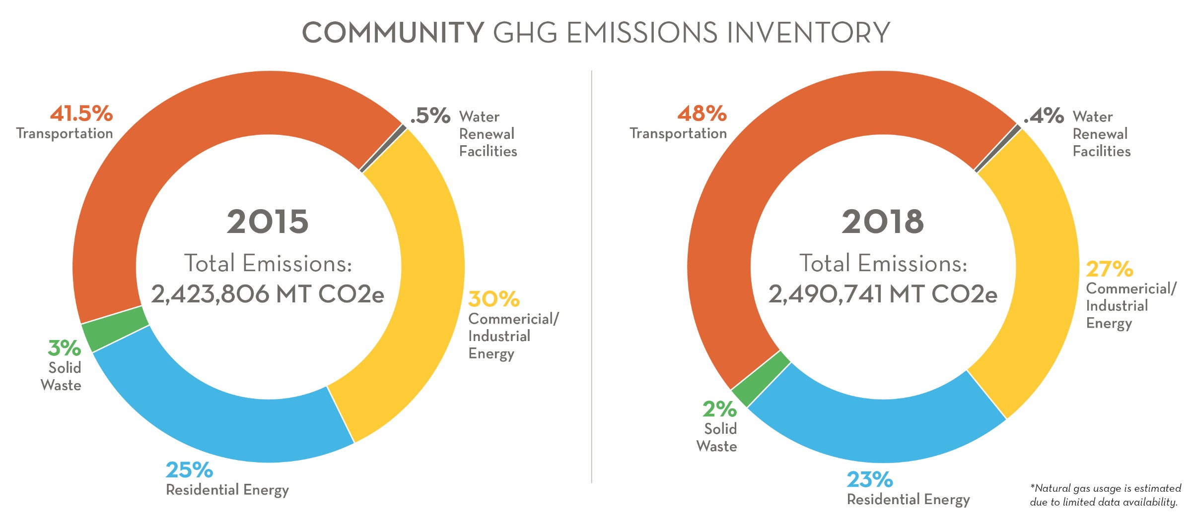
Community Inventory

Slide 36
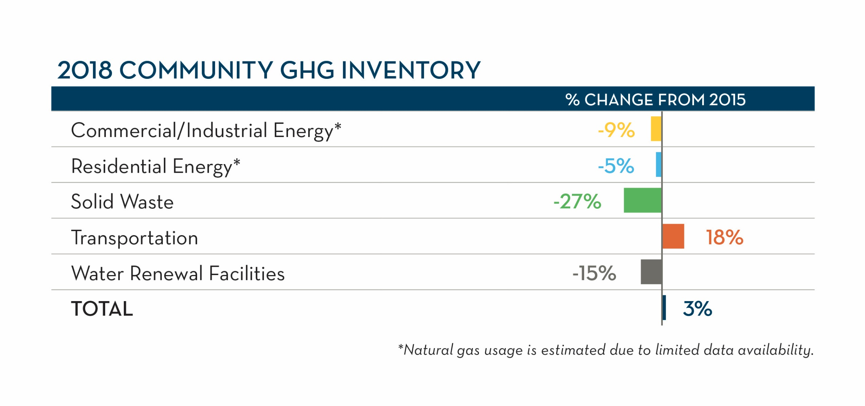
Community GHG Inventory – 2015 to 2018

Slide 37
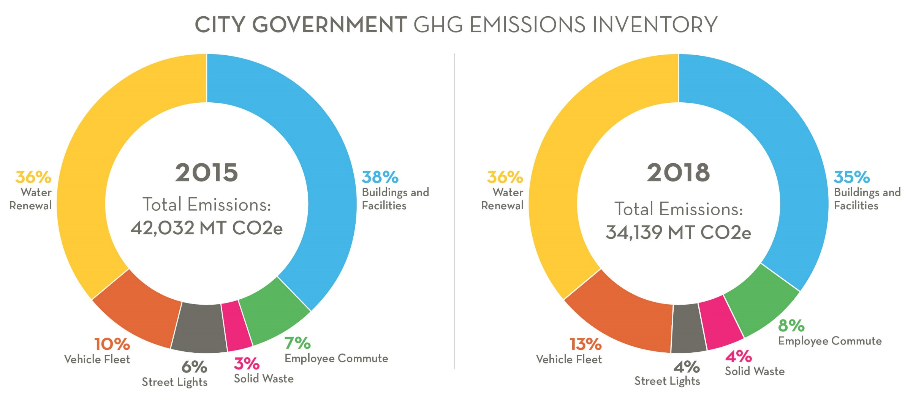
Municipal Inventory

Slide 38
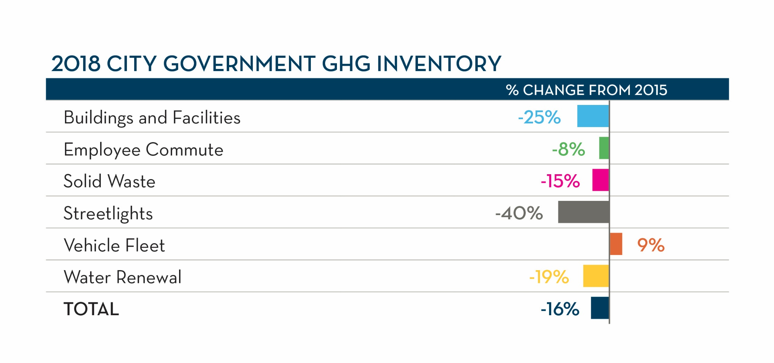
Municipal GHG Inventory – 2015 to 2018

Slide 39
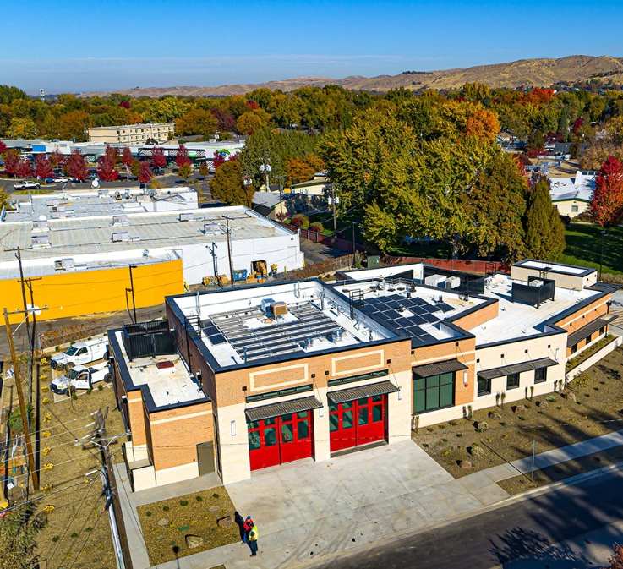
Renewables and Efficiency
Efficiency
  New buildings built with efficiency as a priority
  Energy use tracked in existing buildings
  Streetlights LED Conversion
Renewables
  Solar
  Expanding geothermal

Slide 40
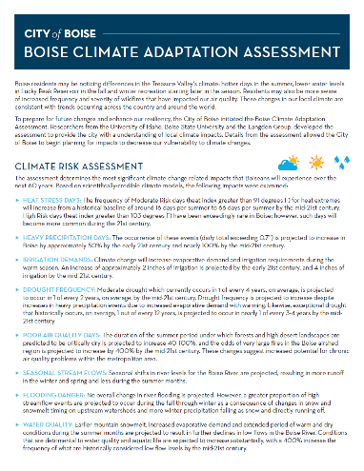
Boise Climate Adaption Assessment
2016 Boise Climate Adaptation Assessment
Top 8 climate impacts
  Heat Stress Days
  Heavy Precipitation Days
  Irrigation Demands
  Drought Frequency
  Poor Air Quality Days
  Seasonal Stream Flows
  Flooding Danger
  Water Quality

Slide 41
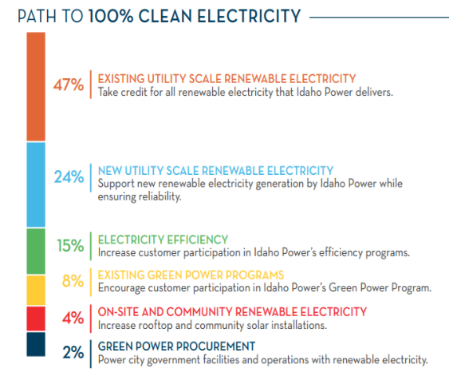
Boise’s Energy Future
Completed 2018
Goals
  100% clean electricity by 2035 with affordability and access for all
  100% clean electricity by 2030 for municipal operations
Actions for electricity and thermal energy (natural gas and geothermal)
Financial analysis/business case evaluation

Slide 42
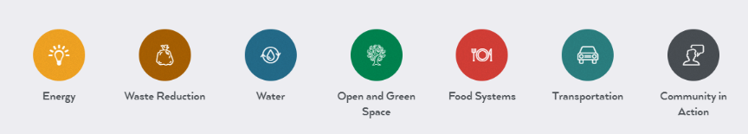








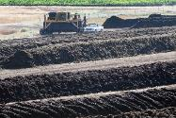
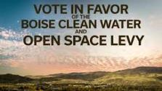

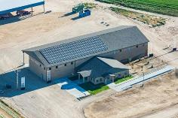

Current State of Climate Work
Current
Focus
Current
Focus
Examples

Slide 43
New Climate Division
Resides in Public Works
Reallocated current resources (4 FTE)
Develop and implement Climate Action Framework
Lead implementation of initiatives:
  Carbon footprint and GHG reduction- tracking/metrics
  Energy (efficiency, renewable, thermal, PUC coordination)
  Other Initiatives
Coordinate across city departments and external stakeholders

Slide 44


Climate Action FrameWork
Climate Economy
Climate and Health
For each focus area: Mitigation, Adaptation and Resilience
Key Outcomes:
Identify specific goals and actions for Community and City Operations
Equity as the foundation
Serve as “umbrella” for all climate work
Engage/promote community action

Slide 45


https://www.cityofboise.org/programs/climate-action/
Amy Parrish abparrish@cityofboise.org
Jami Goldman jgoldman@cityofboise.org

Slide 46

Questions?

