Slide 1
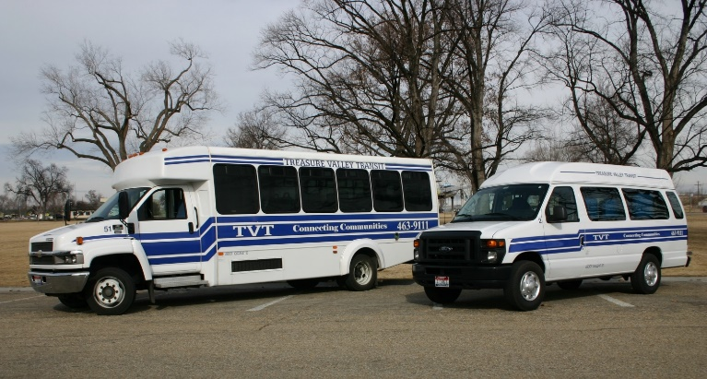
planning for public transportation in rural communities
October 7, 2020
Terri Lindenberg, Executive Director
Treasure Valley Transit, Inc.

Slide 2
Treasure Valley Transit, Inc.
1991: 3 year Grant from the Office of Rural Health Policy
1992: Coordinating Agencies:
Canyon County Head Start – Lead Agency
Canyon County Organization on Aging
Retired Senior Volunteer Program
Terry Reilly Health Services
1995: Secured Ongoing Funding:
Grants from the Idaho Transportation Department
City and County Funding
NEMT Provider
1996: Stand Alone Private Non Profit Corporation

Slide 3
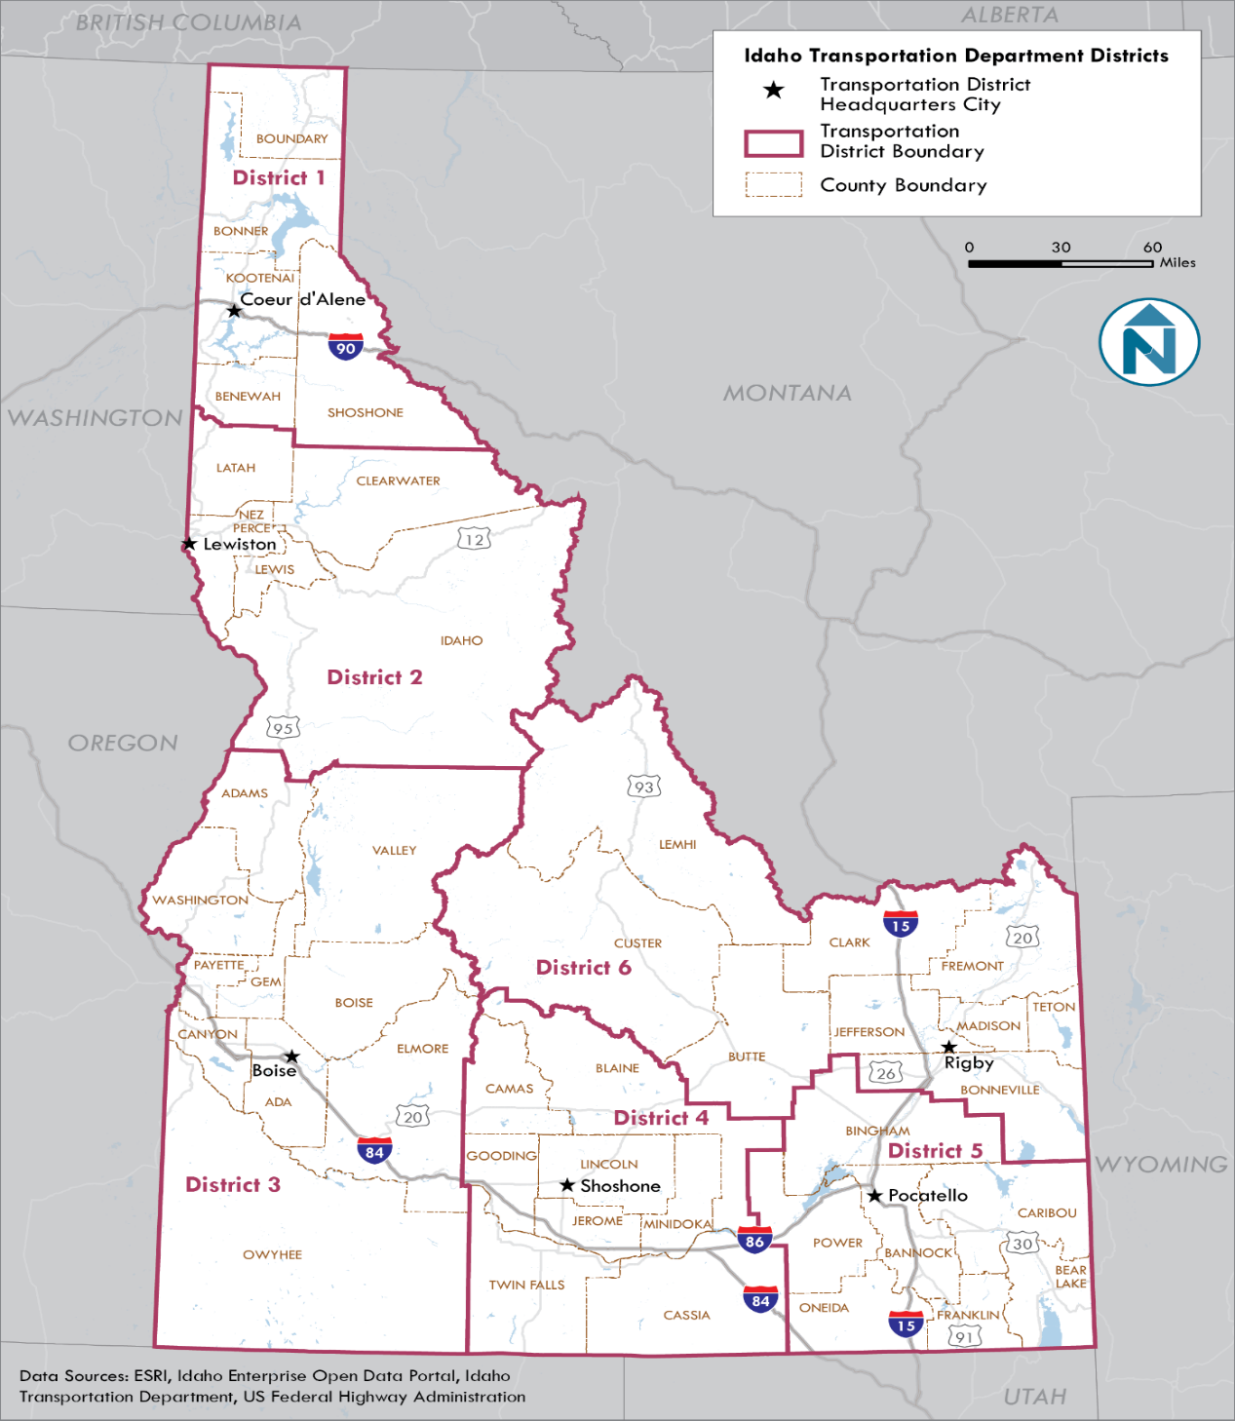
TVT Operates within ITD’s District 3 which is a 10 County Rural Area:
TVT provided 134,296 rides in FY19
Demand Response (NEMT) Transportation within Canyon and Owyhee Counties
Mountain Home Community Transit
Snake River Transit
Mountain Community Transit
Purchase of Service

Slide 4
Planning Components for Rural Public Transportation
Coordinated Transportation Plan
1. Identify Key Stakeholders
Idaho Transportation Department
Local Elected Officials (Transportation Plans)
IDHW and Health and Human Service Agencies
Private and Non-Profit Organizations
Local Business and Chamber of Commerce

Slide 5
2. Identify the Existing Services and Unmet Needs
Stakeholder Interviews/Surveys
Modes of Transportation Options
Demand Response
Fixed Route
Deviated Fixed Route
3. Secure the Funding and Capital Equipment
4. Contract with a Consultant:
Facilitate the Meetings
Produce media (Surveys, Brochures, etc.)
Arrange Open Houses and Print Materials
Promote first day of New Service

Slide 6
TVT Funding Sources
Idaho Transportation Department Rural Grants:
Admin. 80/20% - Operations 57.5/42.5% - PM 92/8% - Capital: 80/20%
City funding to meet % of Local Match
County funding to meet % of Local Match
Medicaid Revenue to fill in Funding Shortfalls
Private Contracts for Service
Advertising on Vehicles

Slide 7
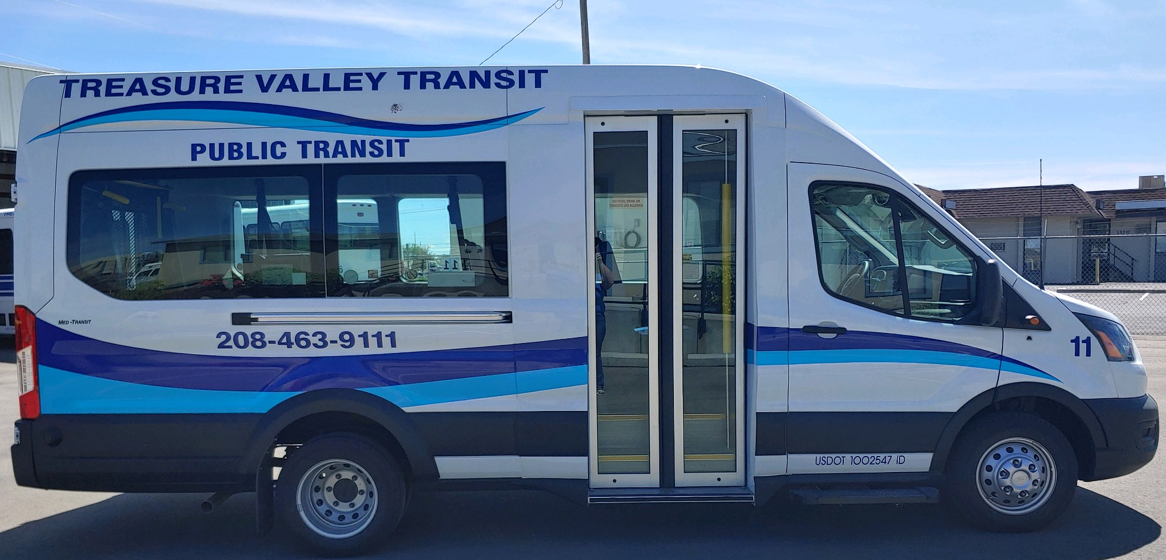
Blue Cross Foundation for Health: $40,000
TVT Van Procurement (4) Cost Per Vehicle: $73,135
$58,508 Federal $14,627 Local Match

Slide 8
Planning for Mountain Home Community Transit
Demonstration Project
Mountain Home Air Force Base
Design of the AFB Route
Department of Defense Passes
Access to AFB
City of Mountain Home
Approval of demonstration project
Approval of funding with success of project
Elmore County
Provided 8,210 Trips for Fiscal Year 2019

Slide 9
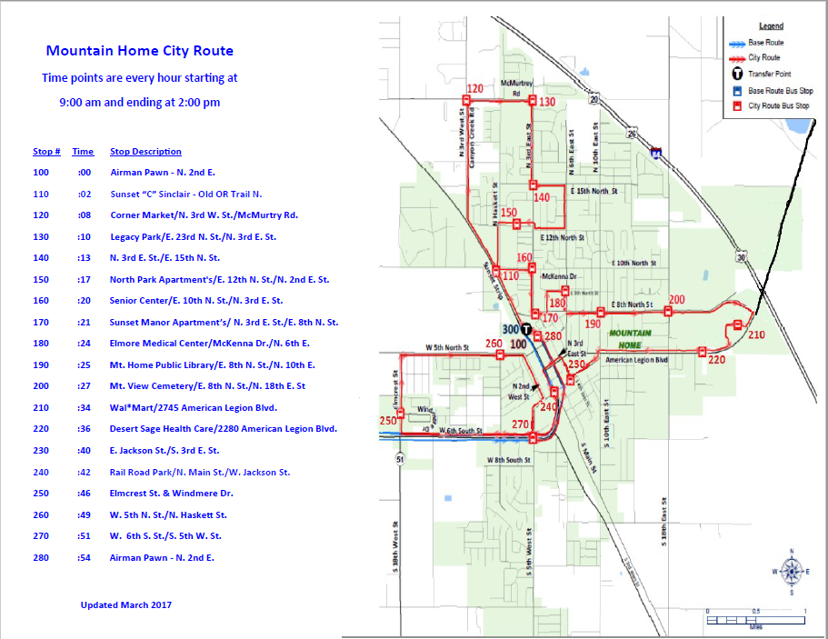

Slide 10
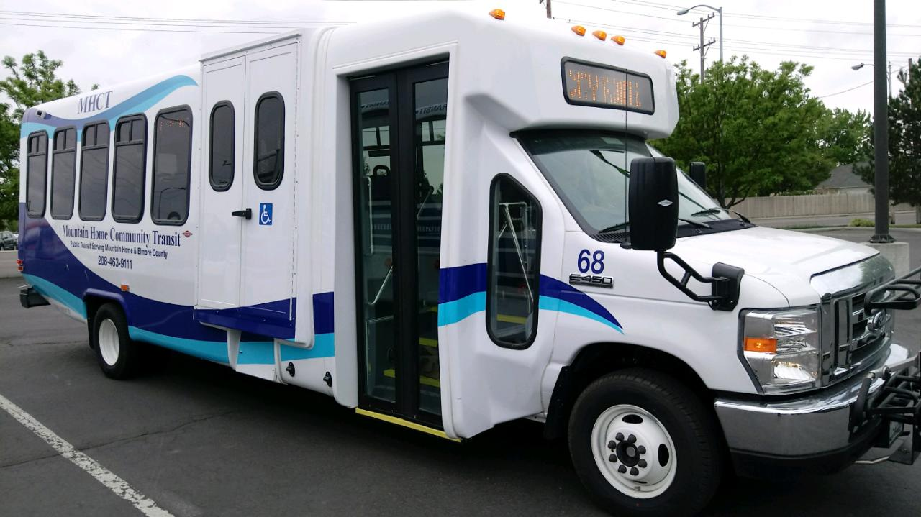
VW Settlement: TVT Received Matching Dollars for 4 Buses
TVT Bus Procurement (7) Cost Per Vehicle: $152,016
$121,613 Federal $30,403 Local Match Per Vehicle

Slide 11
Snake River Transit
This service was a collaborative effort between the following:
The Idaho Transportation Department
The Oregon Department of Transportation
Treasure Valley Transit, Malheur Council on Aging
The Cities of Fruitland, Payette and Ontario
Payette and Malheur Counties
Department of Labor, Health & Welfare
Health & Human Service Agencies
Treasure Valley Community College
The ORBIS Group
Provided 19,468 Trips For Fiscal Year 2019

Slide 12
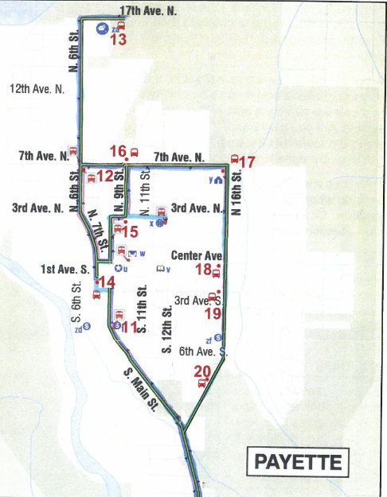
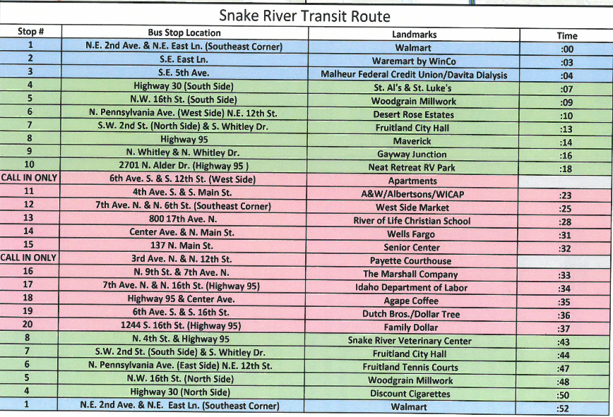
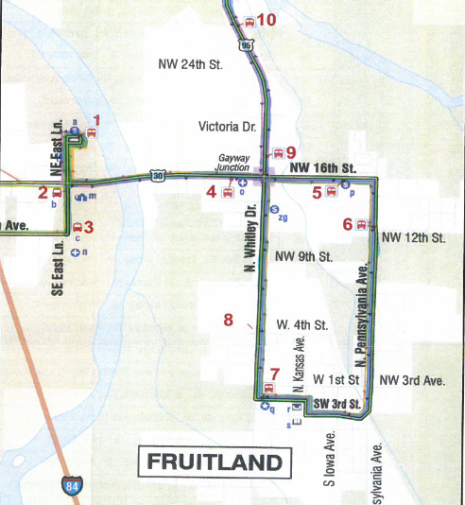
Snake River Transit Route

Slide 13
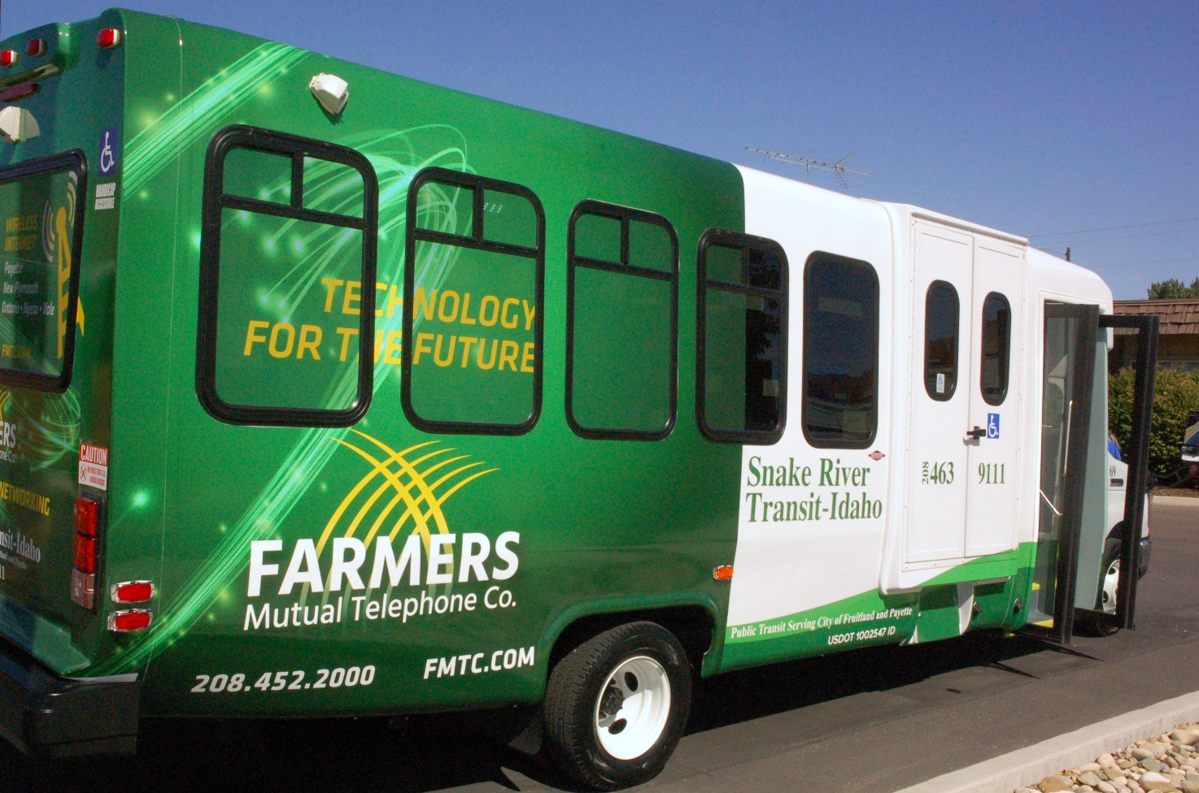
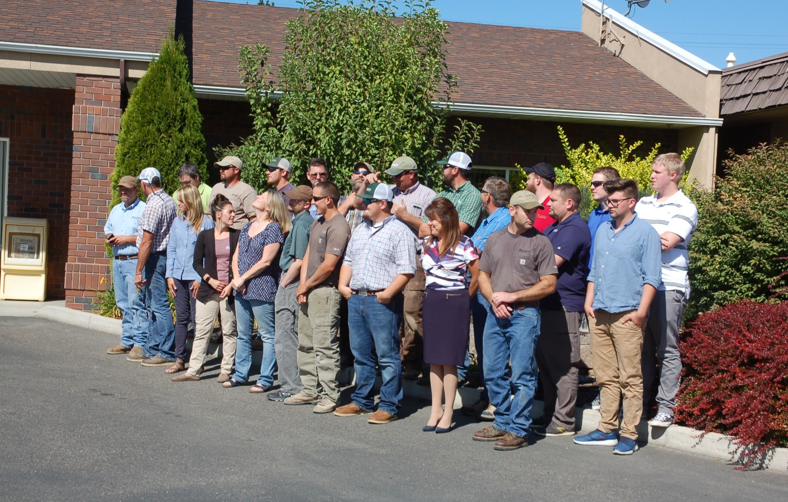
Advertising Revenue
Farmers Mutual Telephone Company
3 Year Contract for $15,000 per year

Slide 14
Mountain Community Transit
The Red Line: Serves the City of McCall
The Green Line: Is a commuter route that serves the Cities of McCall, Lake Fork, Donnelly and Cascade
The Brundage Express: McCall to Brundage Mountain
Extended Service Hours: McCall Winter Carnival, Holiday Weekends and Special Events
Public transportation was a key factor in bringing the Special Olympics and the Nordic Masters to McCall.
Provided 43,759 boarding's for Fiscal Year 2019

Slide 15
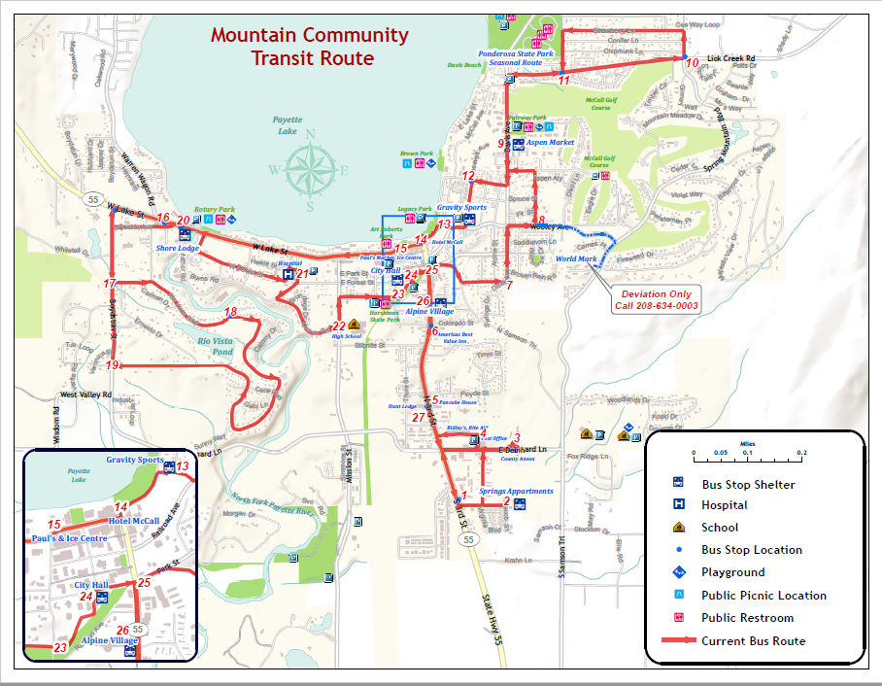

Slide 16
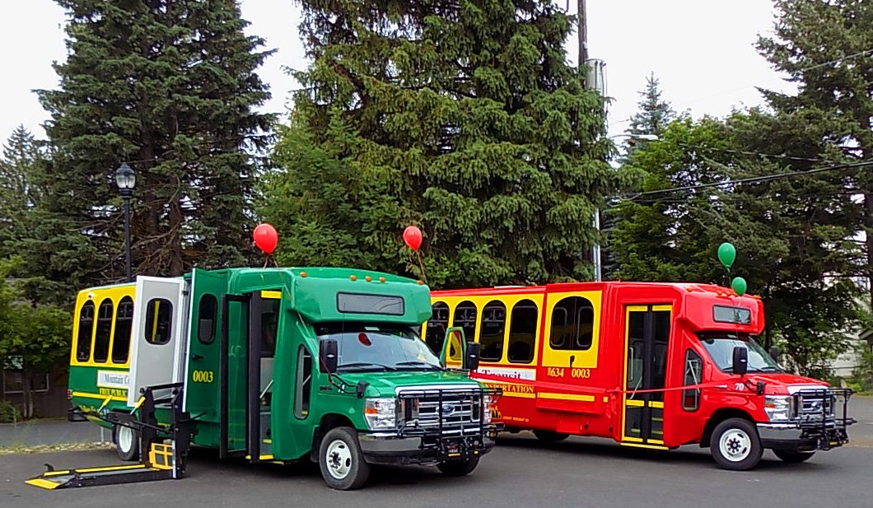

Slide 17
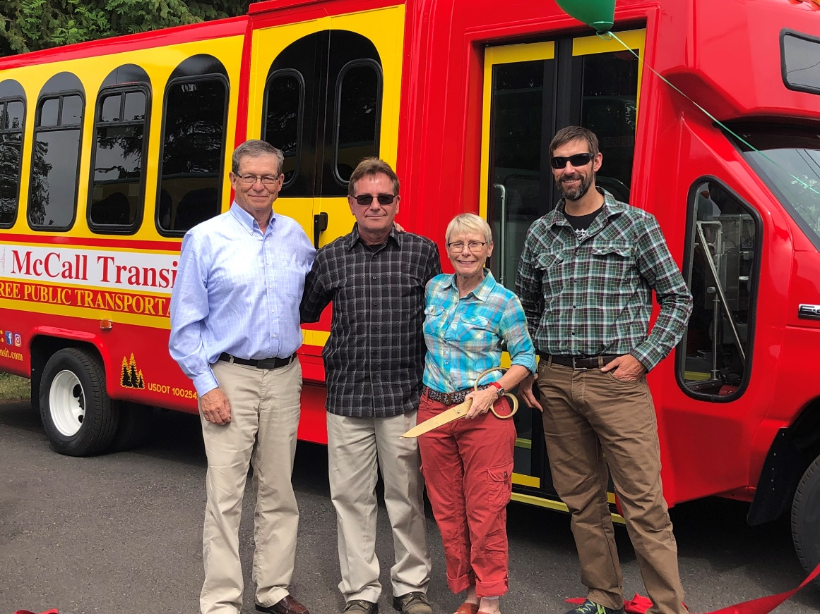
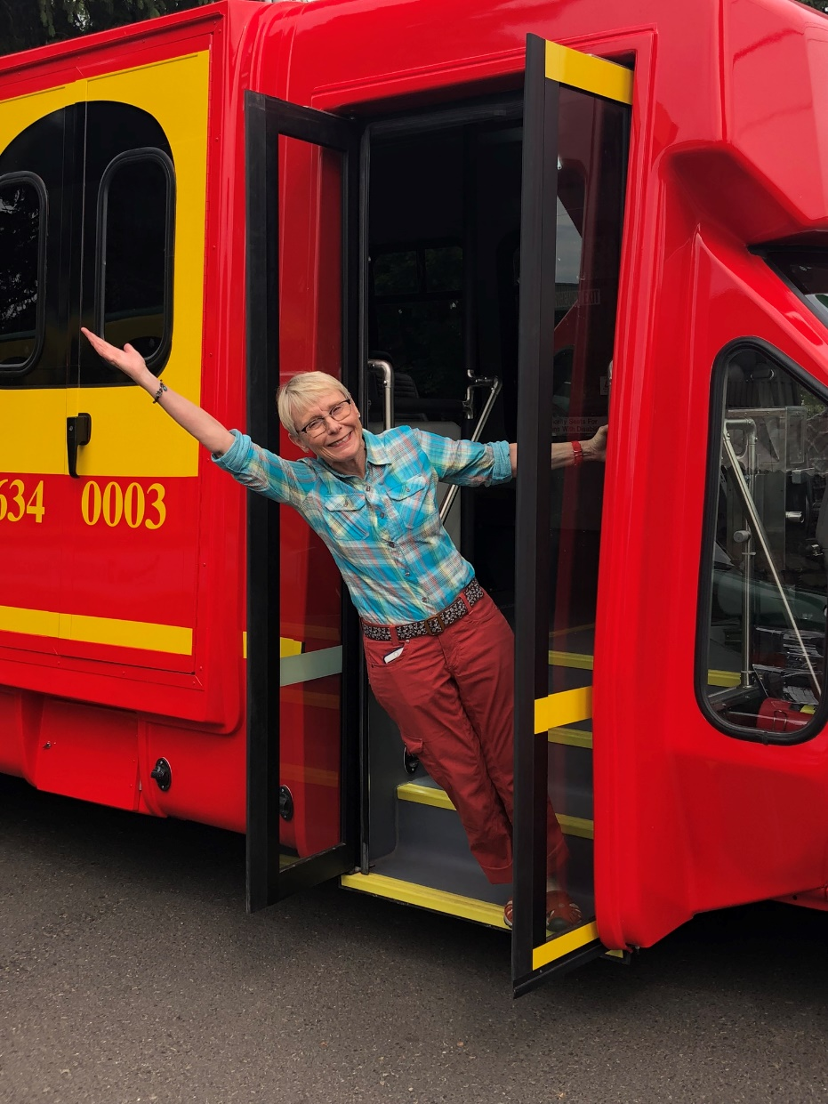
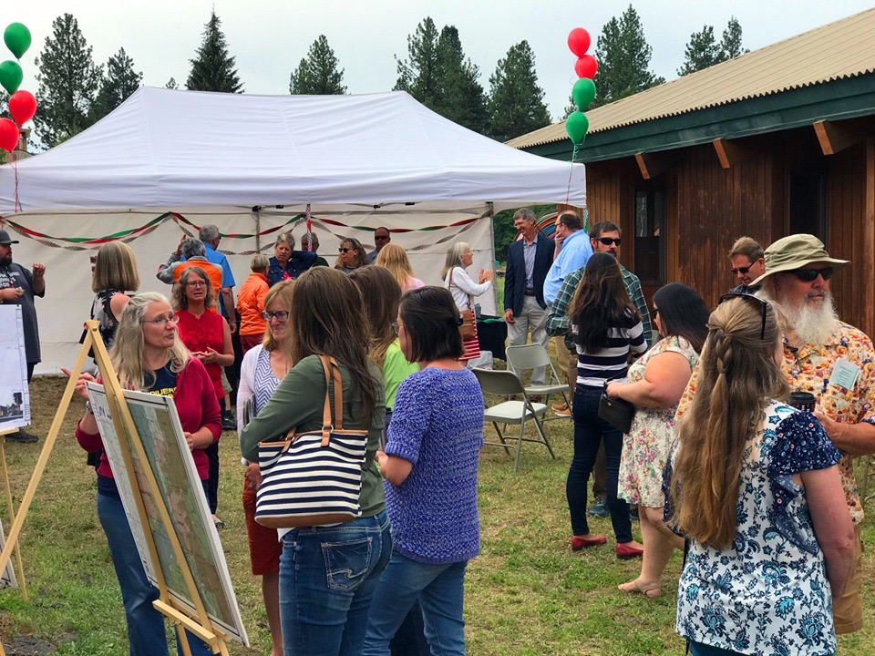

Slide 18
Non Emergency Medical Transportation (NEMT)
TVT is a Medicaid transportation provider in both the rural and small urban areas of Canyon and Owyhee Counties. Currently the Idaho Department of Health and Welfare-Division of Medicaid has used the Statewide Brokerage Model.
1995 -2010 – The NEMT program was run by IDHW
9/2010 - 6/2016 – American Medical Response (Access2Care)
7/2016 – 3/2018 – VEYO
3/2018 – present – Medical Transportation Management (MTM)
Ongoing Communication is Imperative
Dialogue to discuss broker issues
Input into the new RFP to address transportation network
Monthly Meetings with IDHW staff, 5 transportation companies
Bi-weekly Meetings with MTM, IDHW & Transportation Network
Provided 45,719 Trips For Fiscal Year 2019

Slide 19
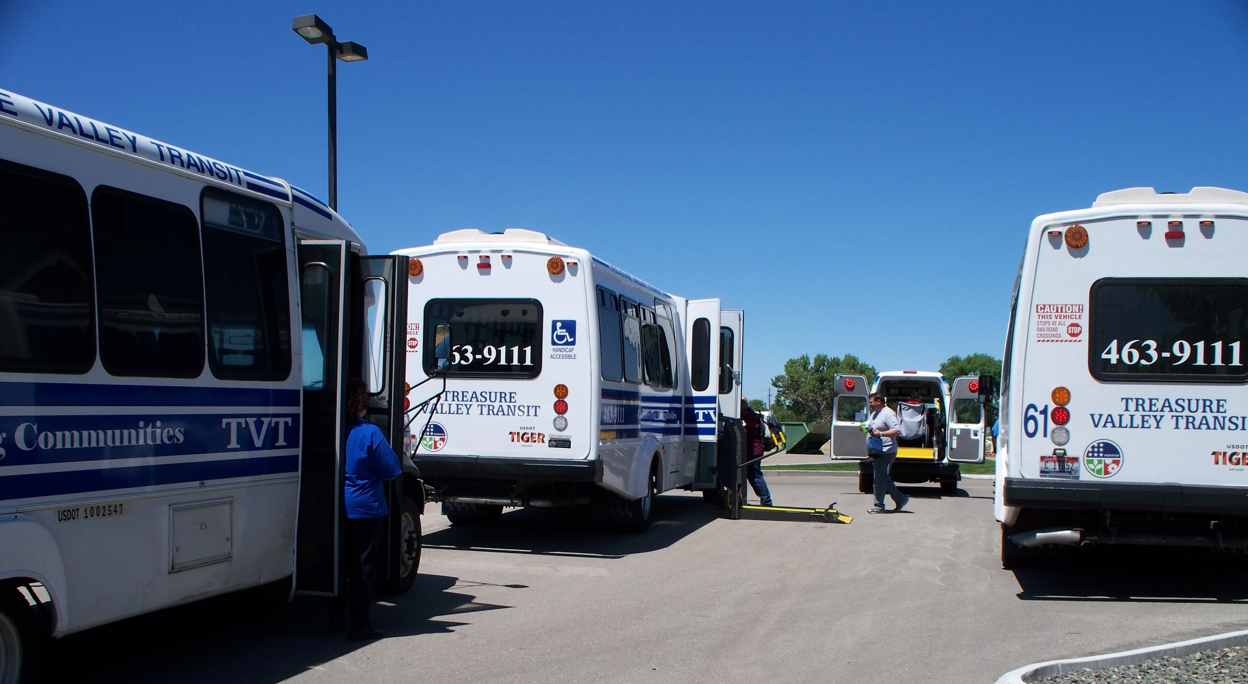
Transporting Passengers from the Western Idaho Training Company

Slide 20
Purchase of Service
This service began in December 2011 serving Seniors and Persons with Disabilities within and connecting the 15 communities of Council, New Meadows, McCall, Cascade, New Plymouth, Payette, Cambridge, Weiser, Idaho City, Horseshoe Bend, Emmett, Homedale, Marsing, Grandview and Melba.
Contract for services
Unit Rate per Trip
Senior Center Transportation
Follow ITD Guidelines
Provided 17,618 Trips For Fiscal Year 2019

Slide 21
Conclusions
Develop a Coordinated Transportation Plan
Identify all the Key Stakeholders in the Community
Identify Existing Services and Unmet Needs
Secure Funding and Capital Equipment

Slide 22
Contact Information:
Treasure Valley Transit, Inc.
Terri Lindenberg, Executive Director
1136 W Finch Drive
Nampa, Idaho 83651
Office: 208-463-9111
Email: terri@treasurevalleytransit.com

