Slide 1
VISION ZERO Visual Communication

Slide 2
Agenda
Why Visually Communicate
Methods for Visual Communication
Cost
What’s Next?

Slide 3
Why Visually Communicate
10% People Remember what they Hear
20% People Remember what they Read

Slide 4
Why Visually Communicate
80% People Remember what they See and Do
93% of Communication is Non-Verbal

Slide 5
Methods for Visual Communication
Infographics

Slide 6
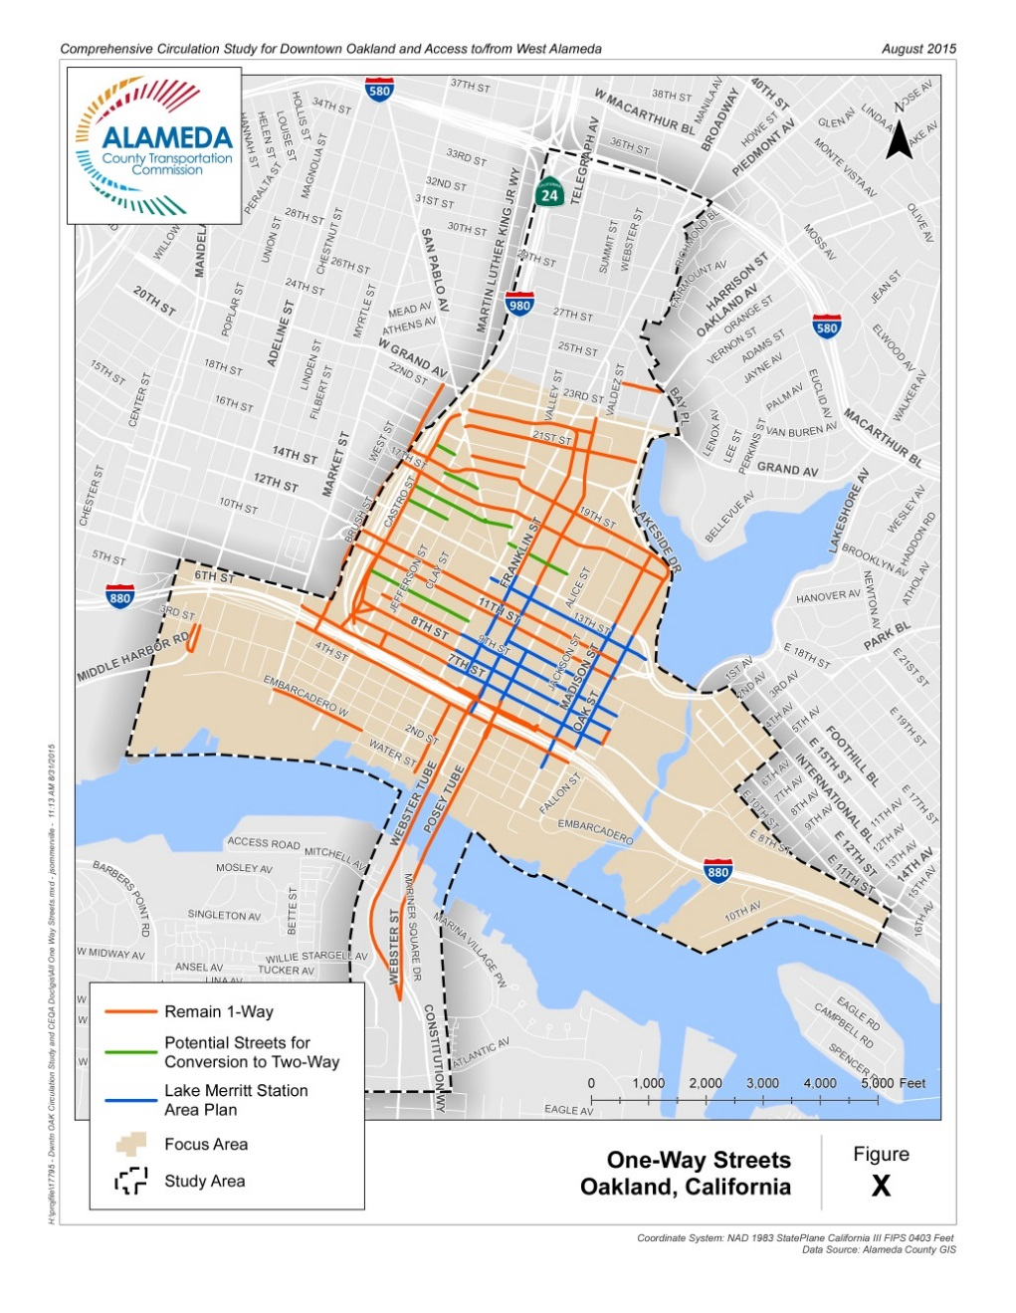
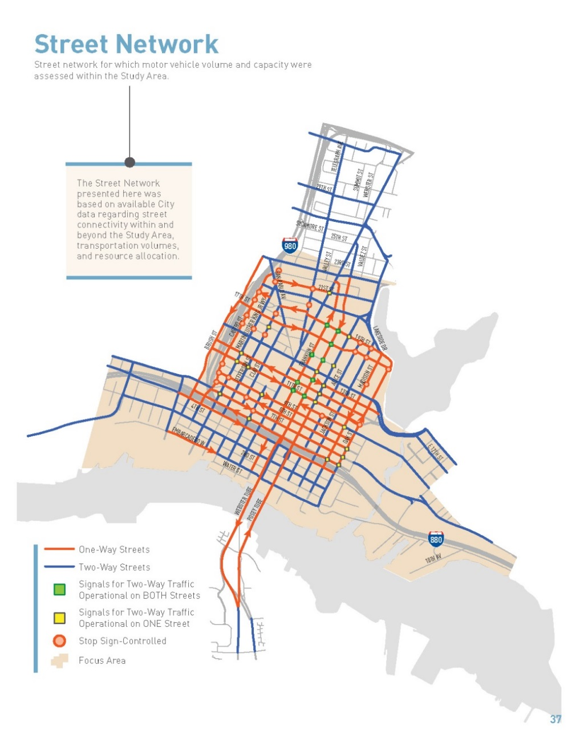
Methods for Visual Communication
GIS
Maps

Slide 7
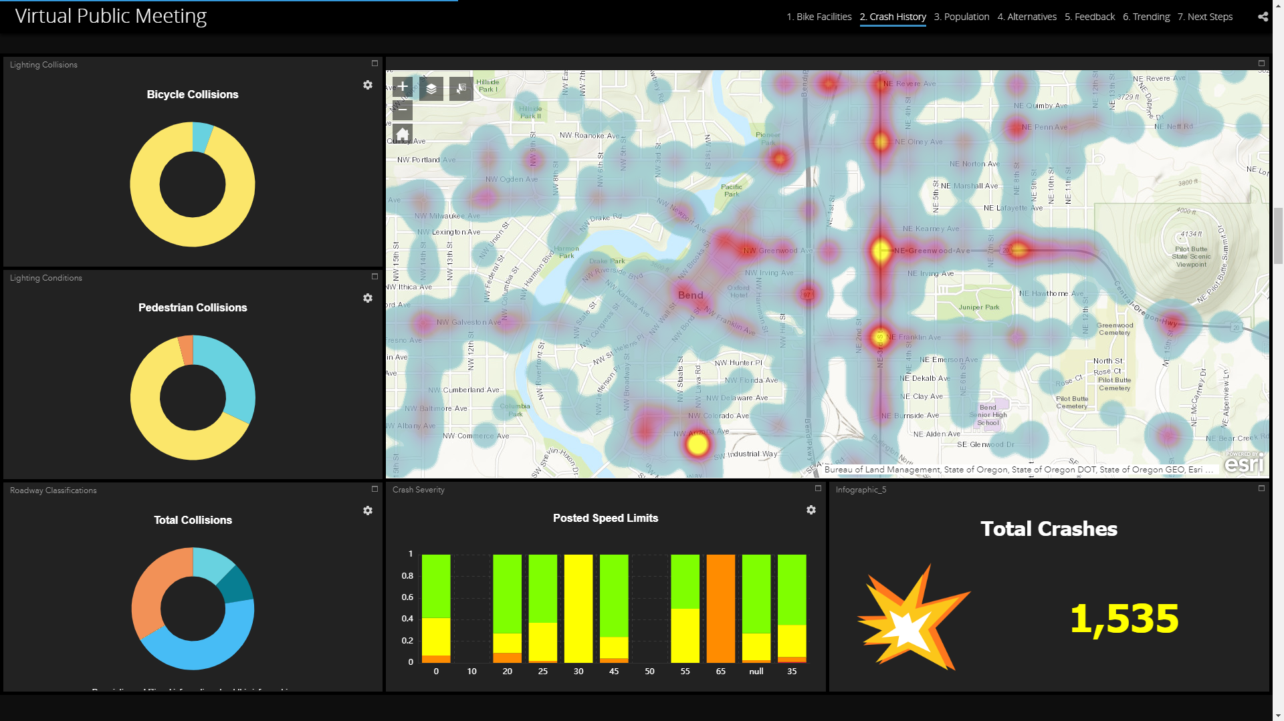
Methods for Visual Communication
GIS
Interactive Maps

Slide 8
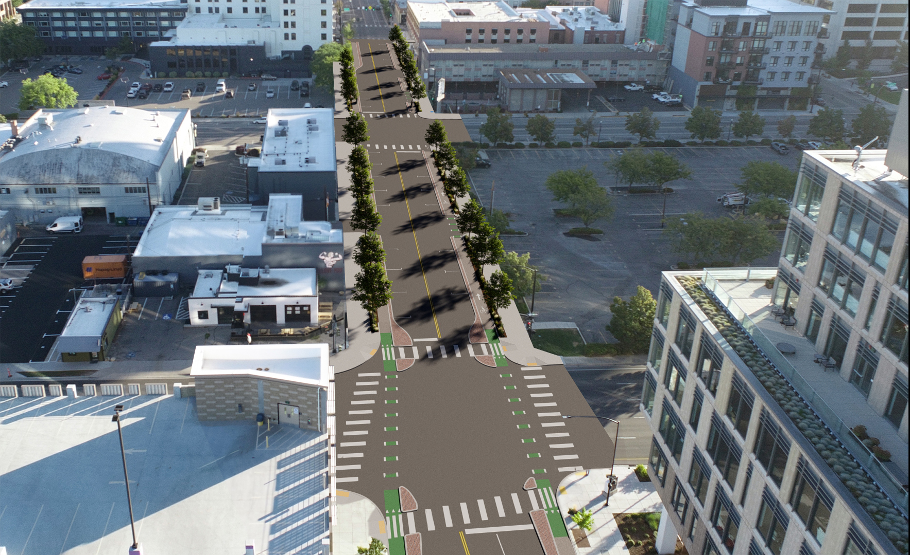
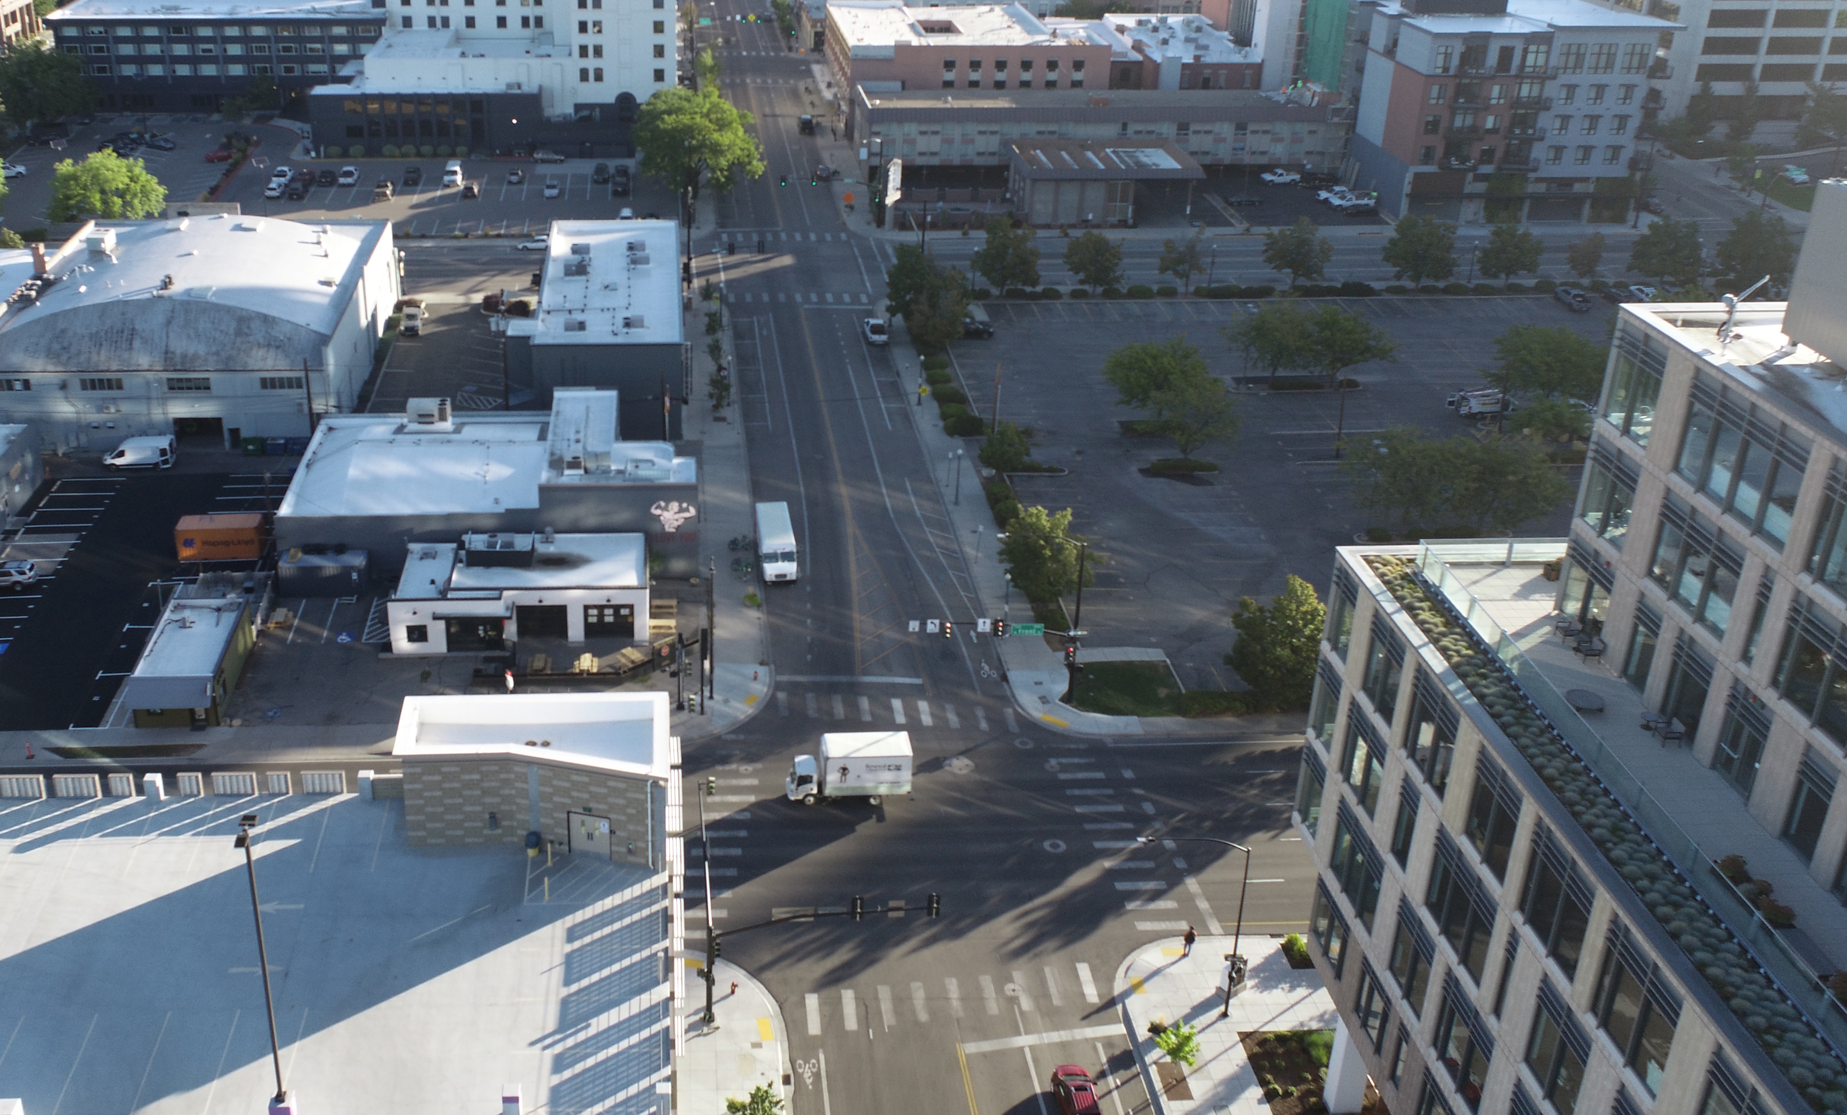
Methods for Visual Communication
3D Visualization
Stills

Slide 9
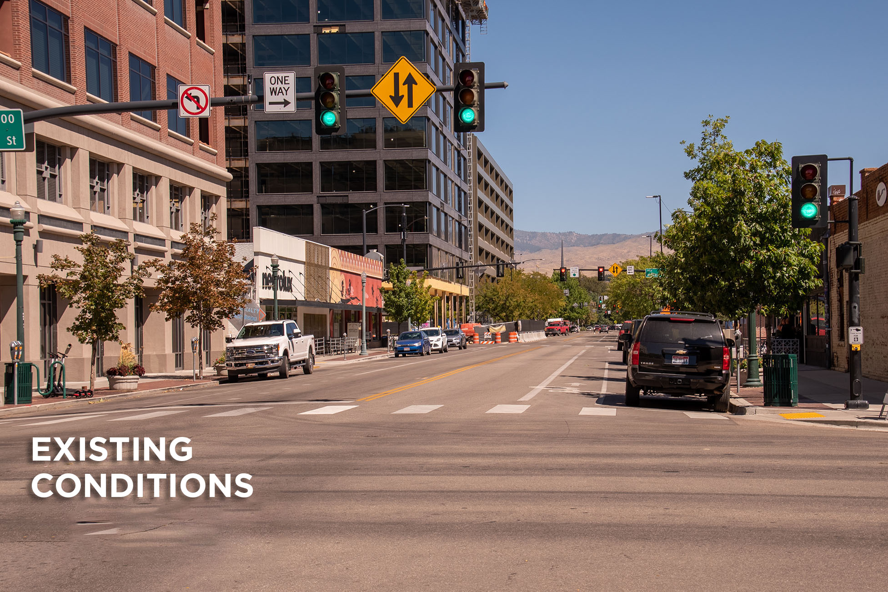
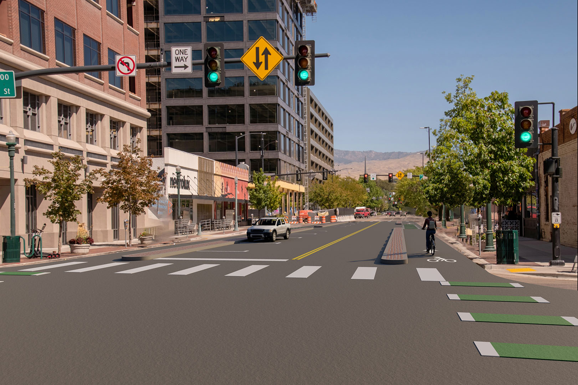
Methods for Visual Communication
3D Visualization
Stills

Slide 10
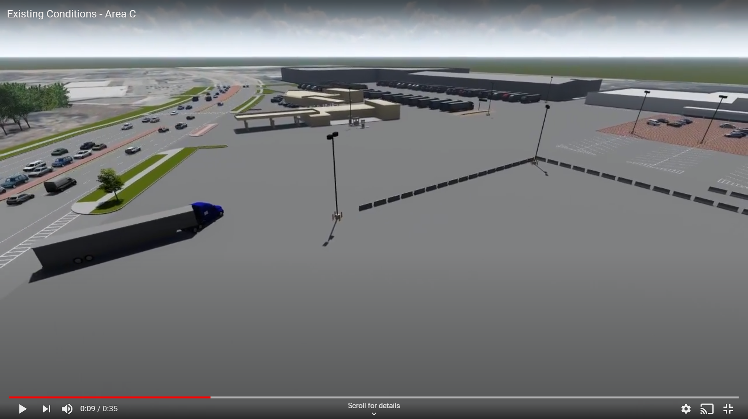
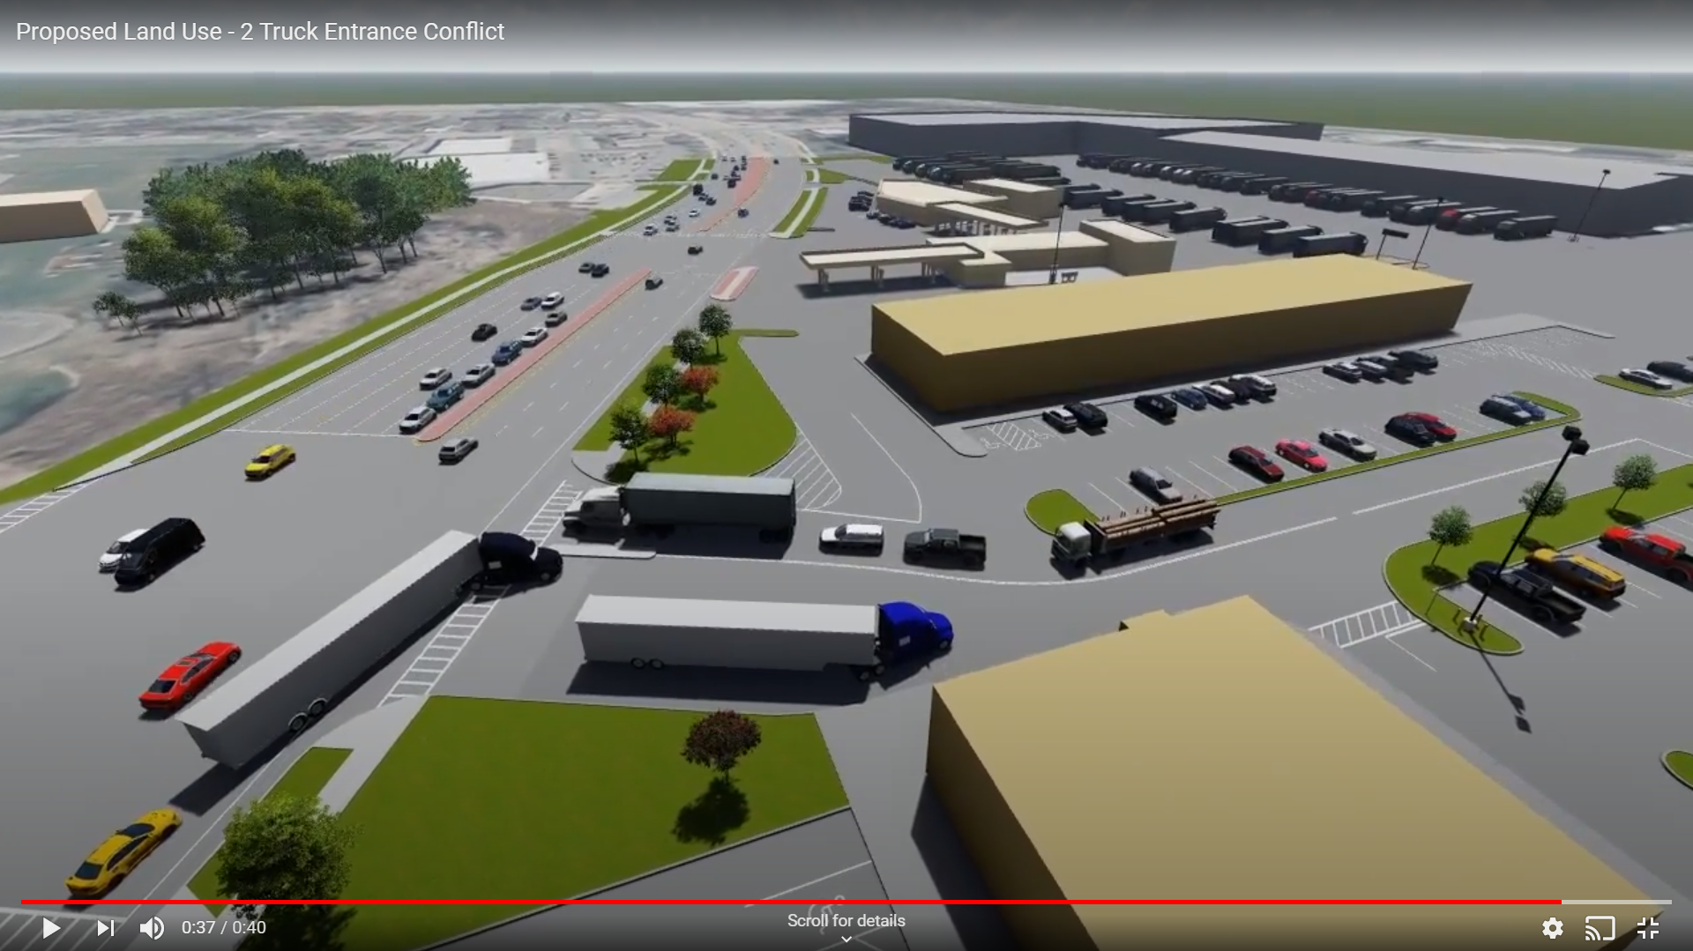
Methods for Visual Communication
3D Visualization
Animation

Slide 11
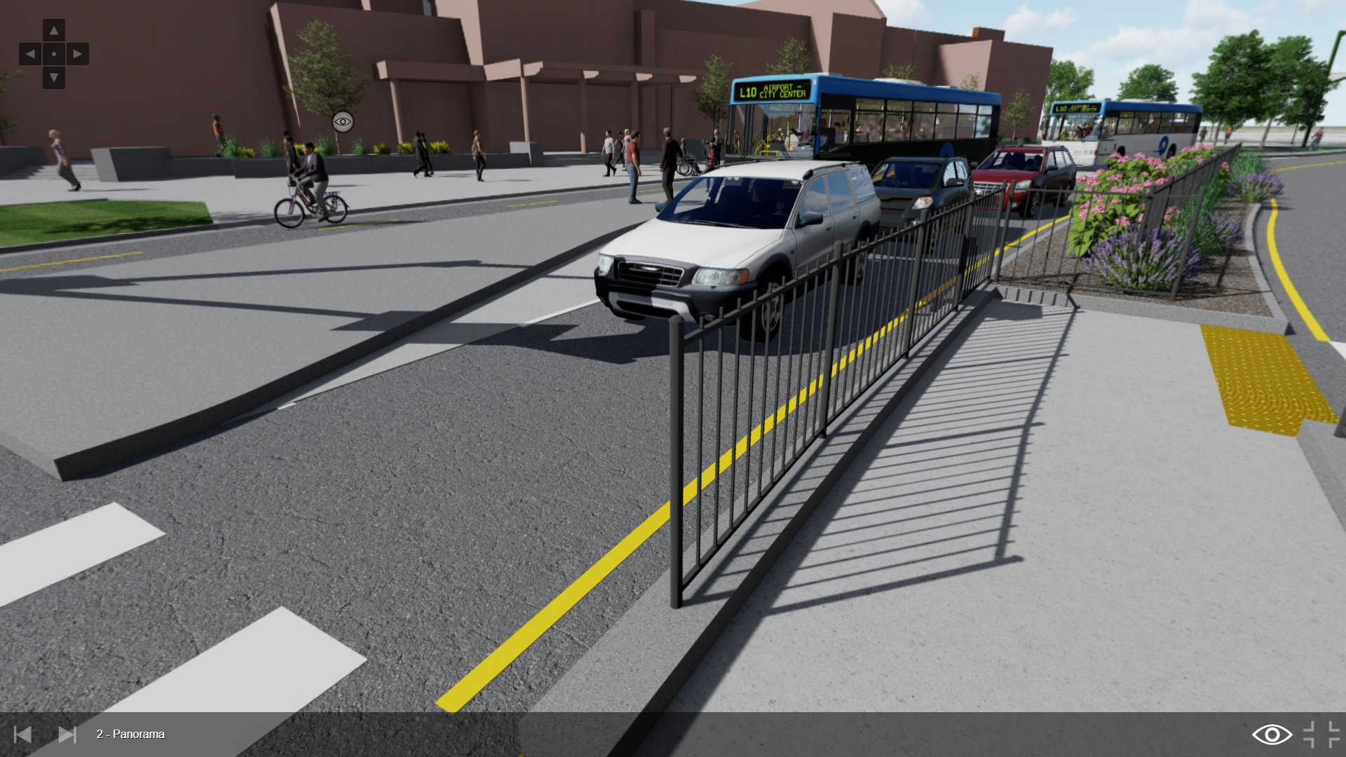
Methods for Visual Communication
Mixed Reality
Virtual Reality

Slide 12
Methods for Visual Communication
Mixed Reality
Virtual Reality

Slide 13
Cost
Cool is Expensive…
Not Really

Slide 14
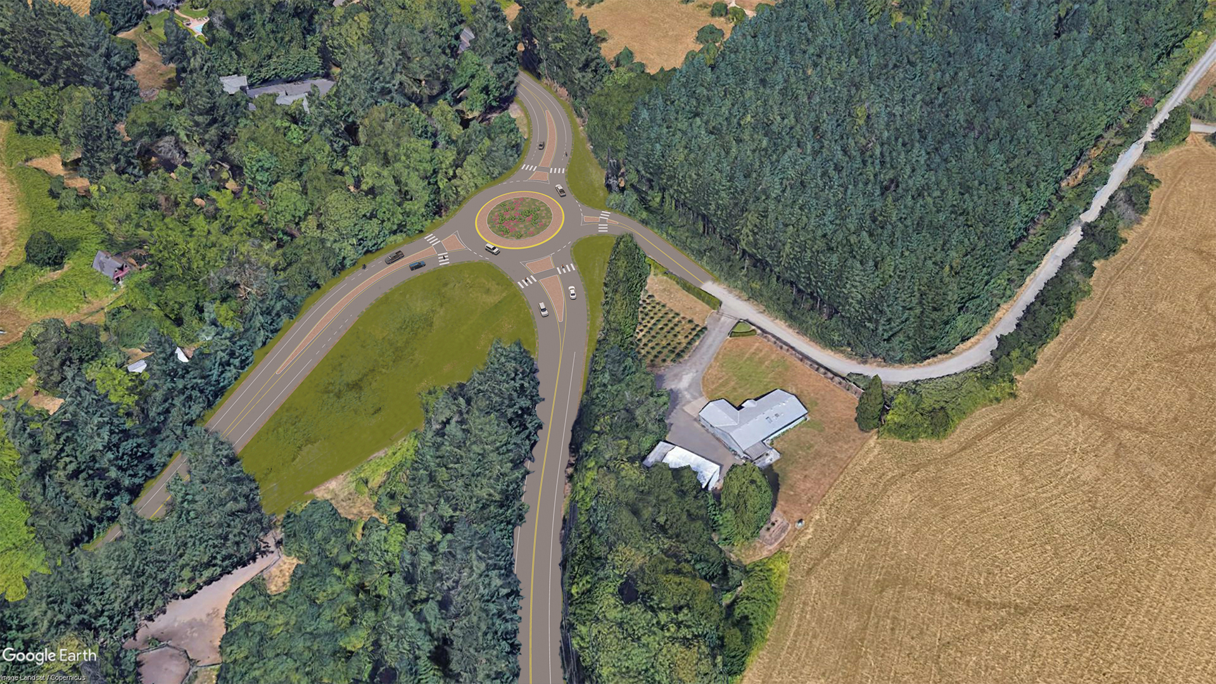
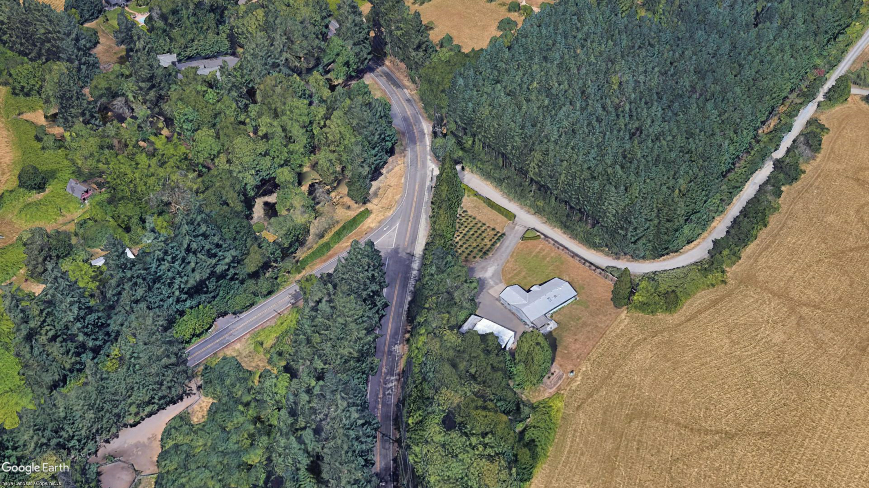
Cost
Cool is Expensive… Not Really
$5K

Slide 15
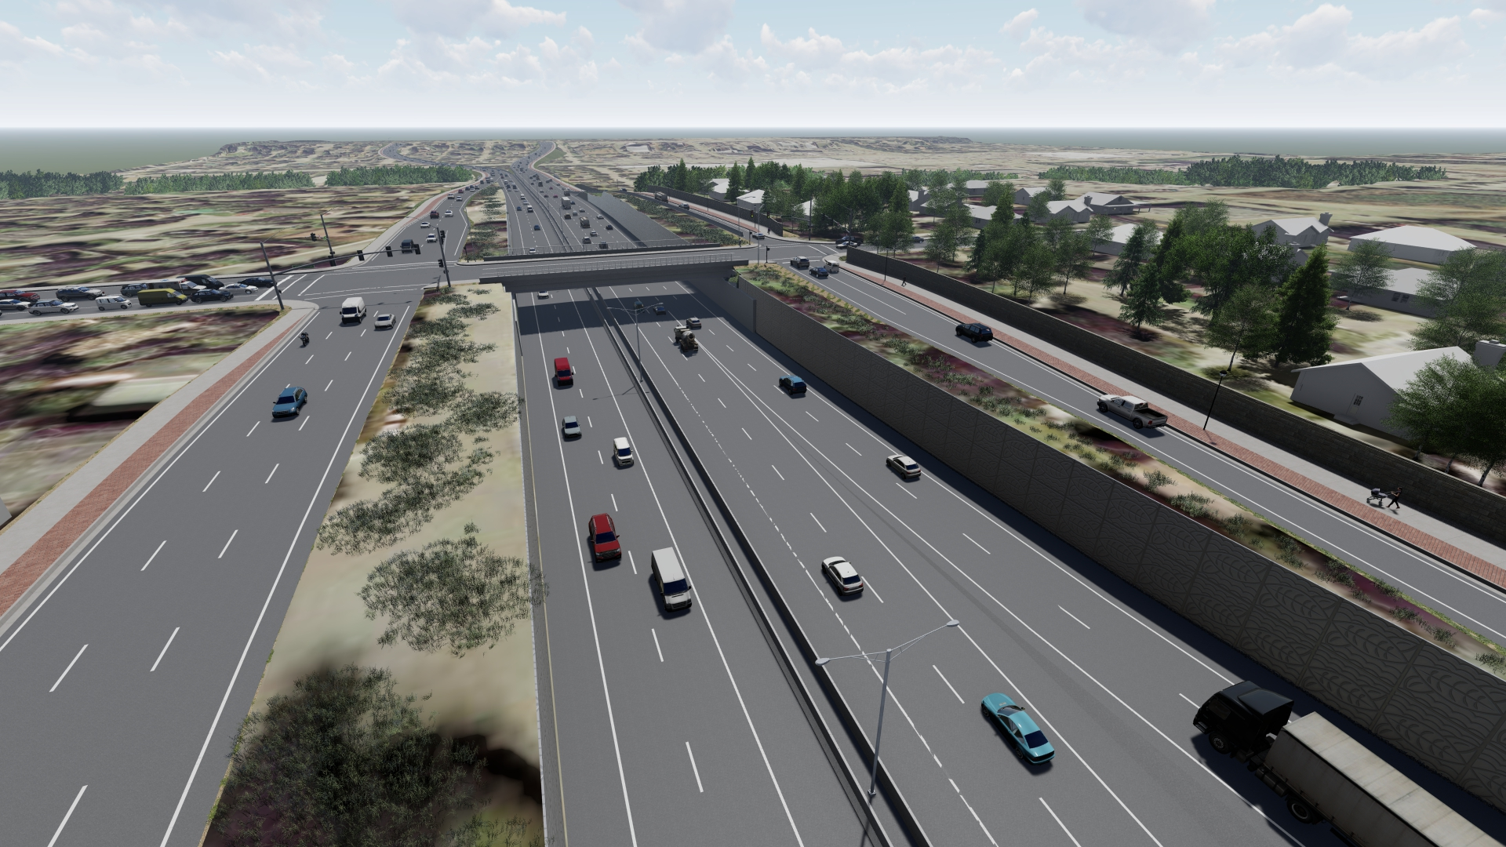
Cost
Cool is Expensive… Not Really
$50K

Slide 16
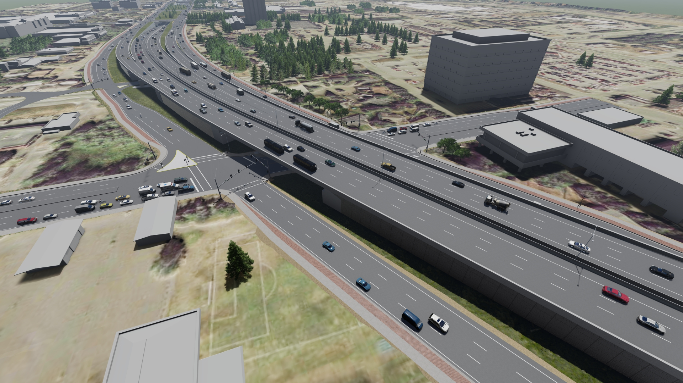
Cost
What is the Cost of Poor Communication?

Slide 17
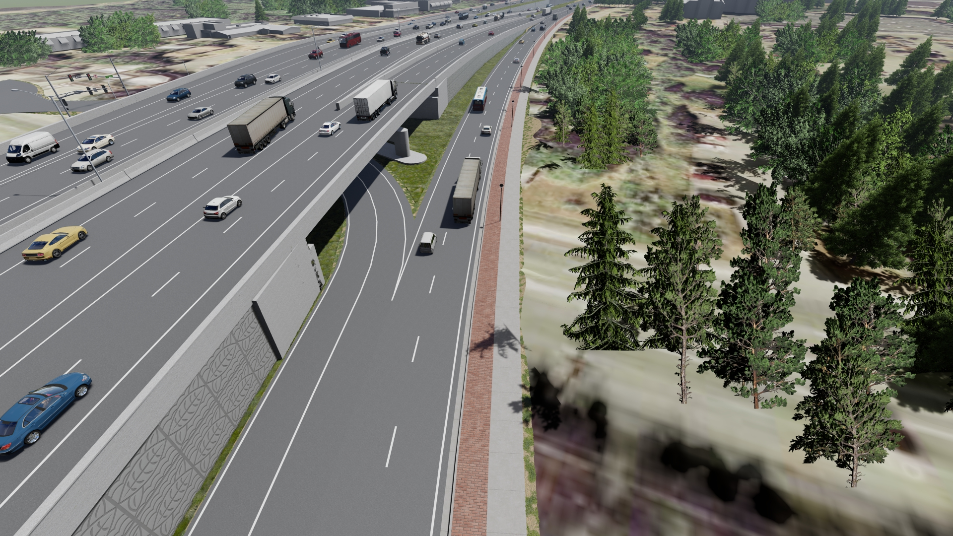
Cost
What is the Cost of Poor Communication?

Slide 18
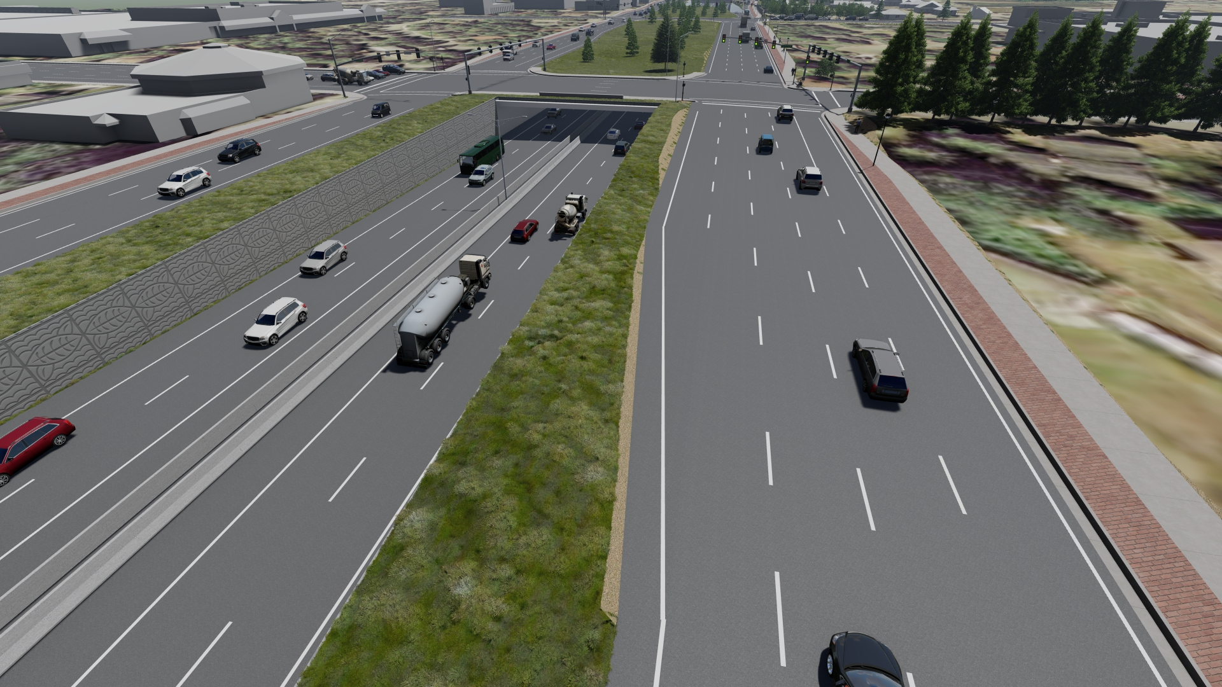
Cost
What is the Cost of Poor Communication?

Slide 19
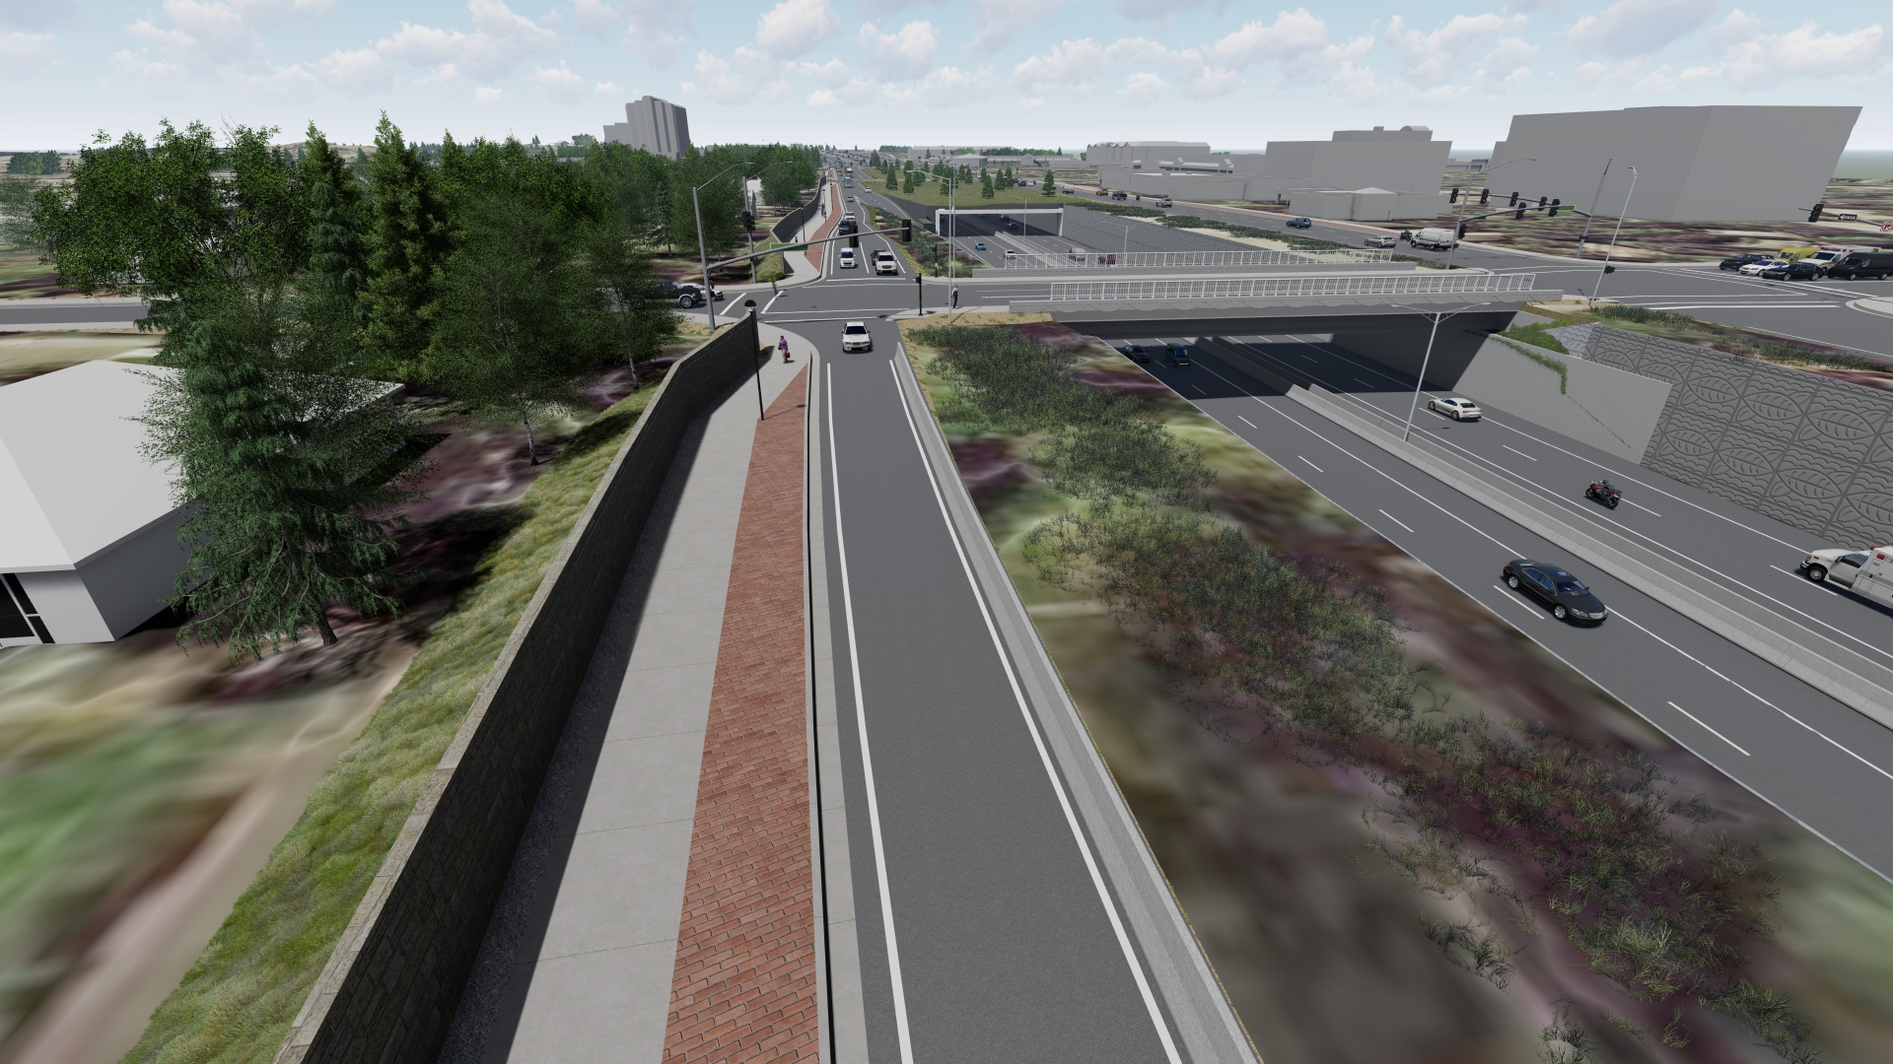
Cost
What is the Cost of Poor Communication?

Slide 20
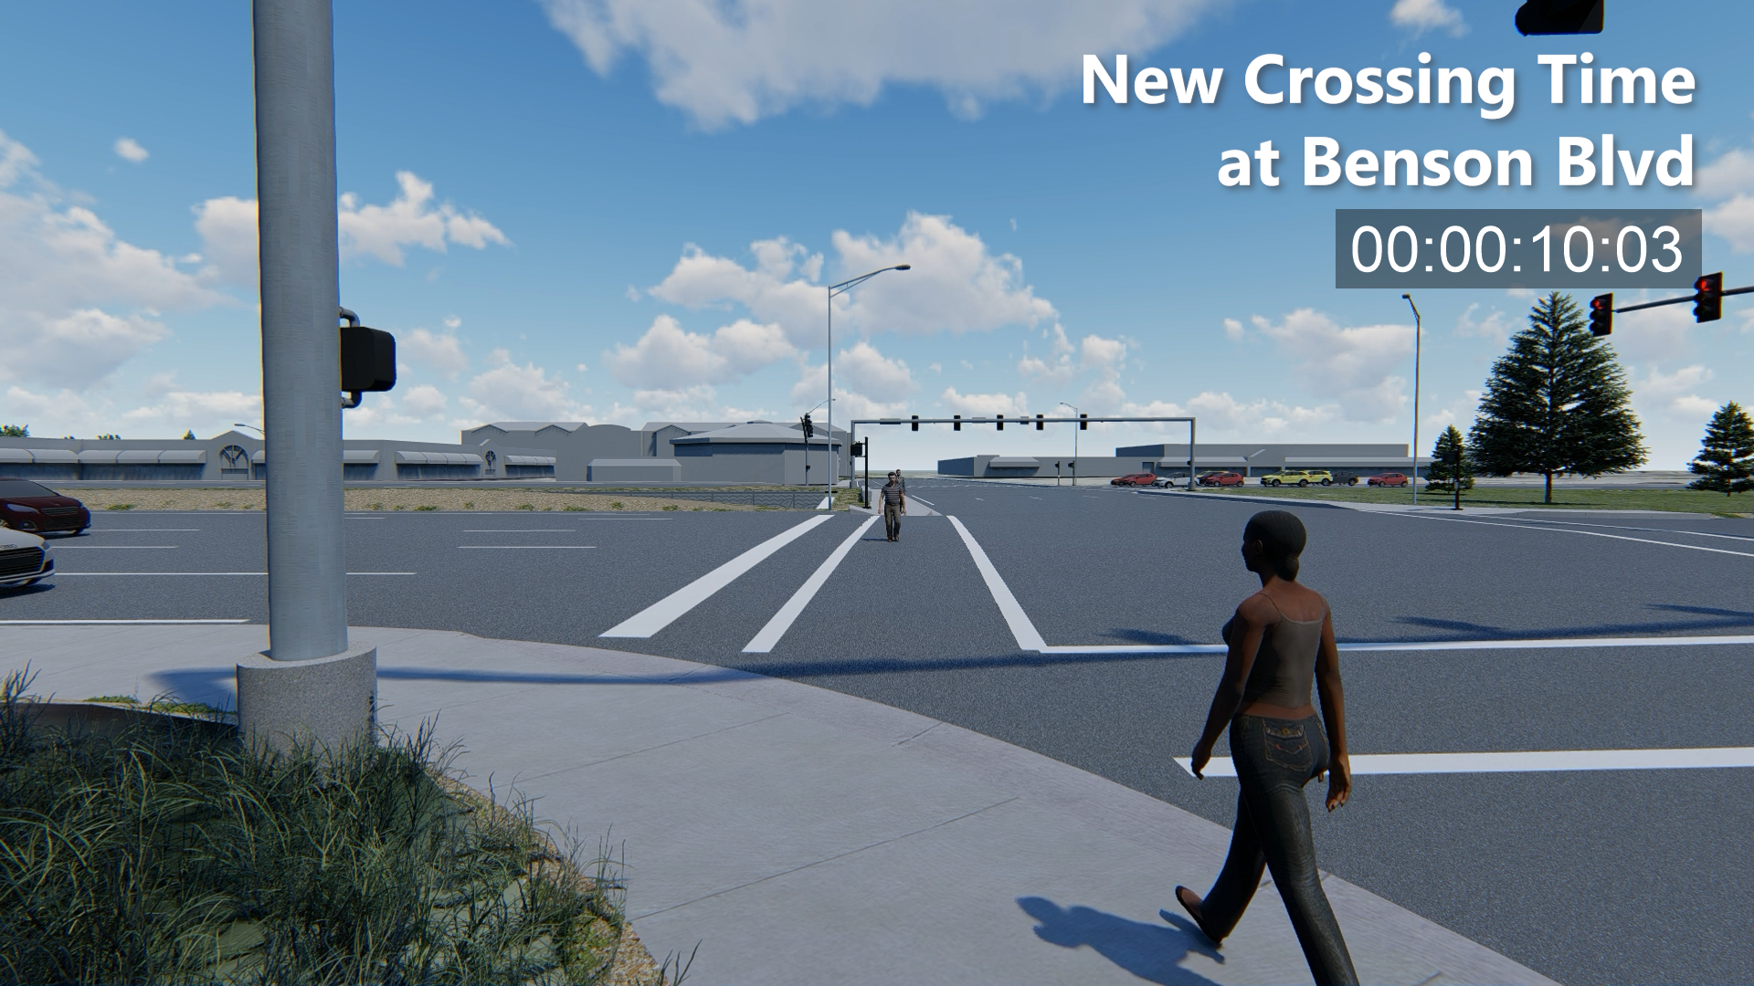
Cost
What is the Cost of Poor Communication?

Slide 21
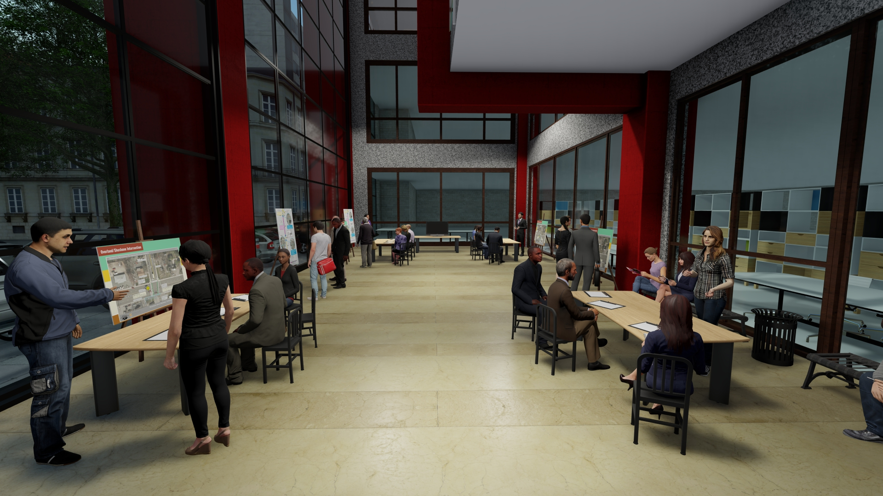
What’s Next?

Slide 22
? Questions

