Slide 1
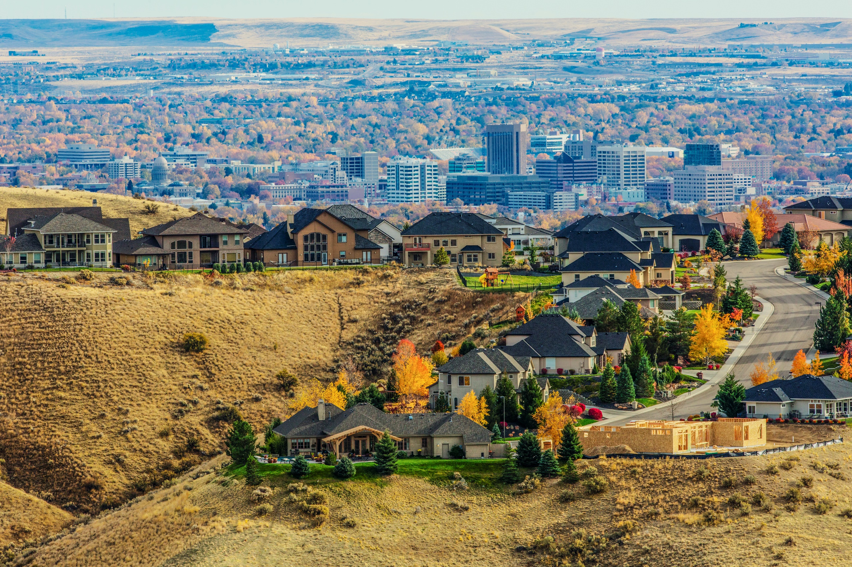
What's This Going to Cost Me?
Fiscal Analysis of Land Use Patterns

Slide 2
What you’ll learn about…
Why COMPASS wanted to do fiscal impact analysis
How using fiscal impact in scenario planning elevated community dialogue
What we learned from this analysis

Slide 3
COMPASS is…
…the forum for regional collaboration in southwest Idaho that helps maintain a healthy and economically vibrant region, offering people choices in how and where they live, work, play, and travel.
Photo by Mike Thueson

Slide 4
Mission
The mission of COMPASS is to conduct regional planning, facilitate coordination and cooperation, serve as a source of information and expertise on issues affecting southwest Idaho, and assist member agencies in accessing funding to accomplish local and regional goals.
Notes:
Our mission it to conduct regional planning, facilitate coordination and cooperation, service as a source of information and expertise on issues affecting southwest Idaho, and assist member agencies in accessing funding to accomplish local and regional goals.

Slide 5
Long-range transportation plan
Multimodal transportation system
Fiscally constrained
Public involvement
20+ years
…Next plan to 2050
Forecasted growth
Communities in Motion (CIM)

Slide 6
Exploratory and Scenario Planning

Slide 8
What Did We Learn and How Did We Use It?
Suburban Housing
Low Traffic Congestion
Commuter Rail
Housing Affordability
Shopping Options
Technology
Great Outdoors
Fiscal Responsibility
Walkability
Changing Workforce
Farmland Preservation
Let It Be
Ticket To Ride
Penny Lane
Come Together

Slide 10
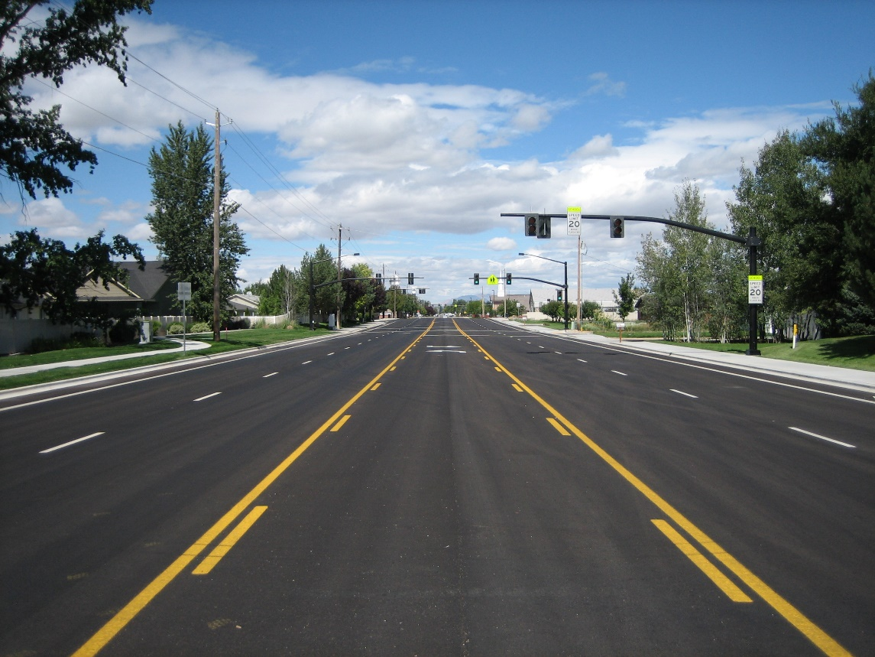
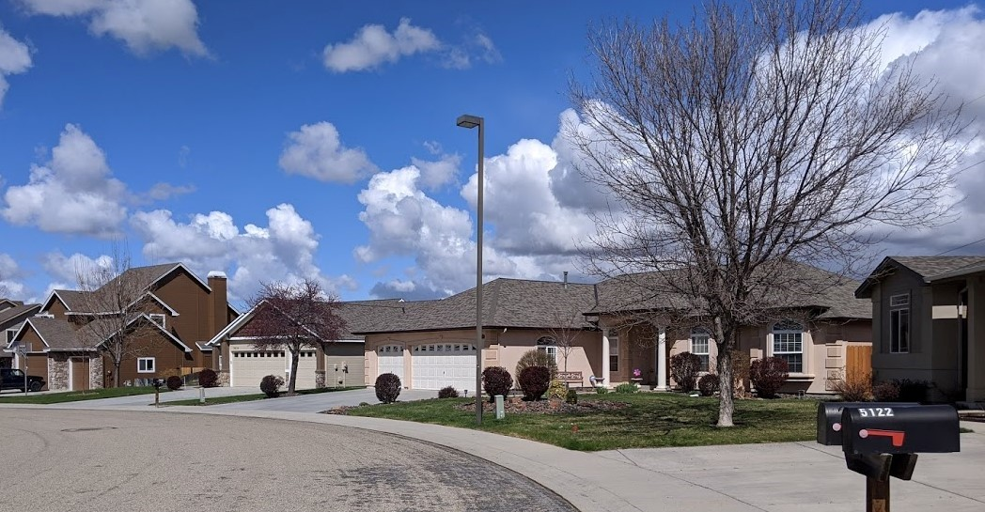
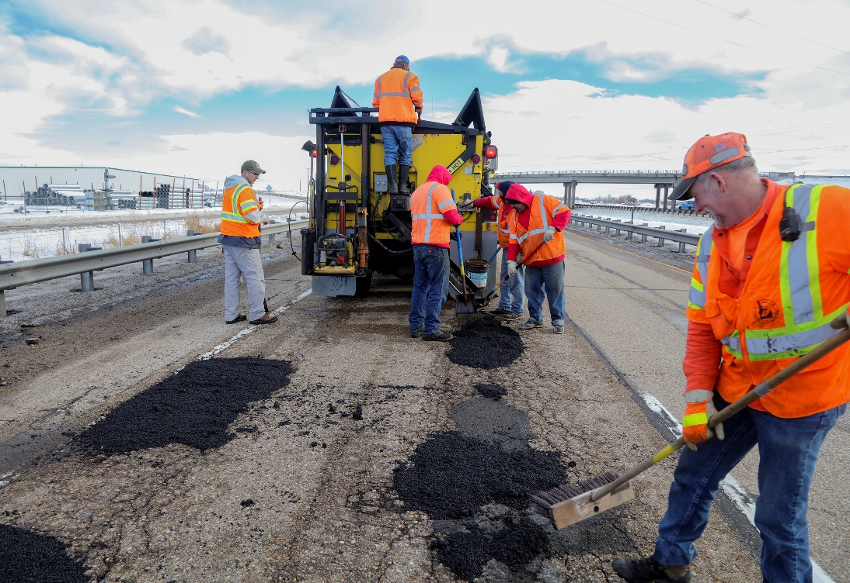
Let It Be

Slide 11
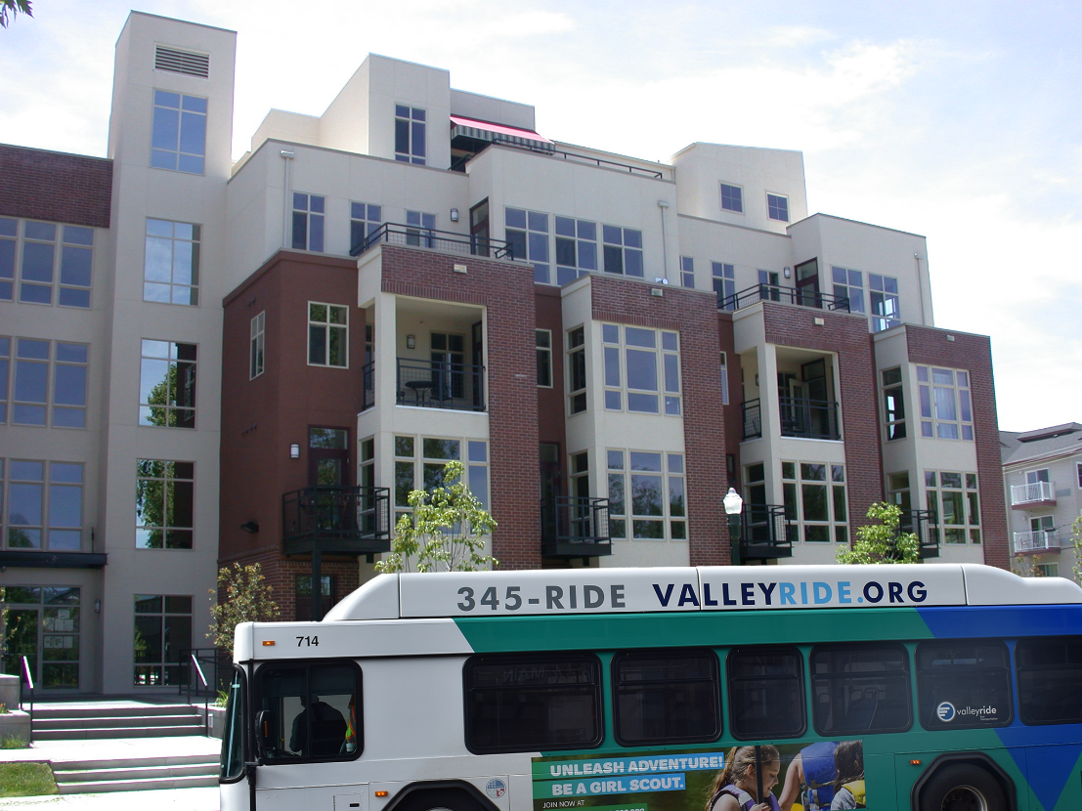
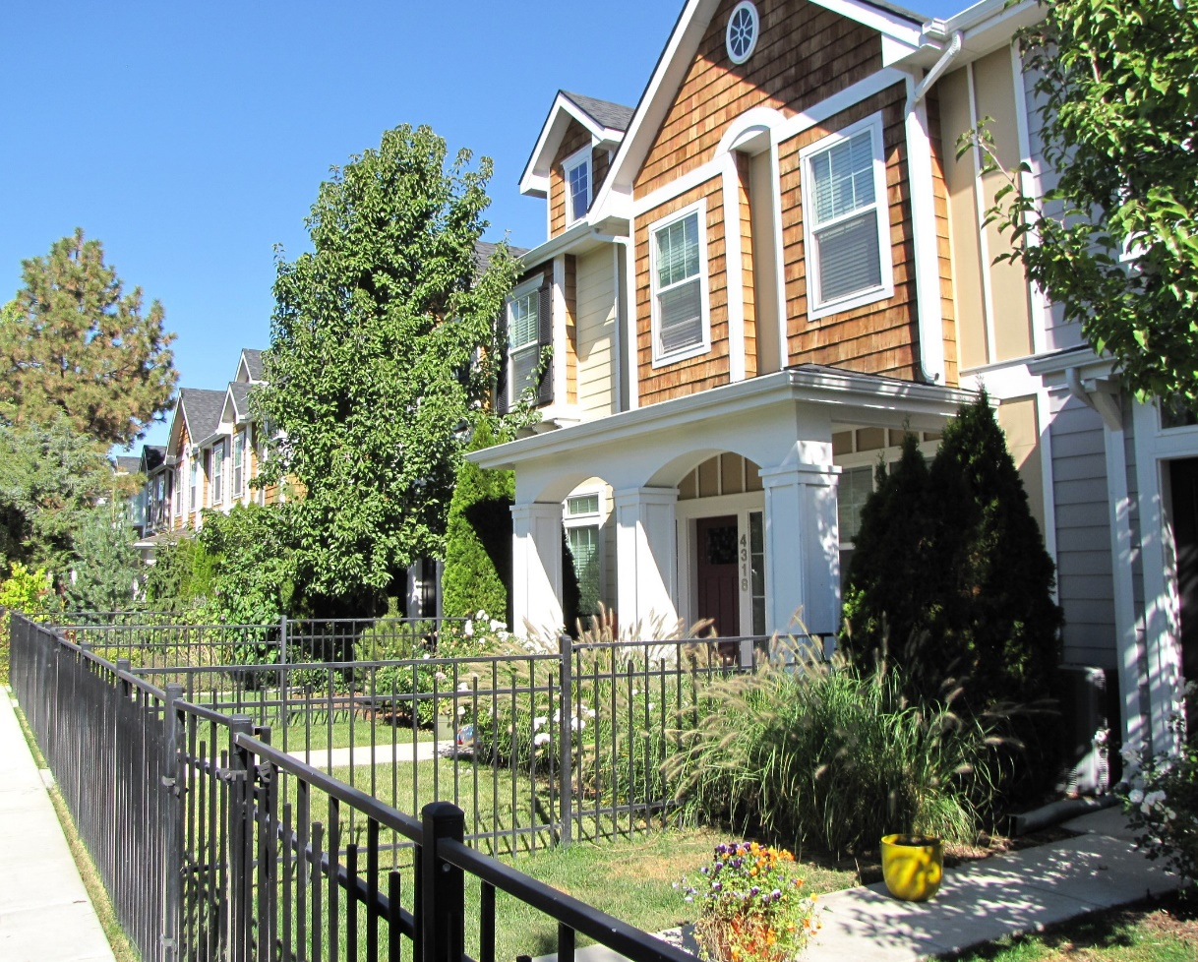
Ticket to Ride

Slide 12
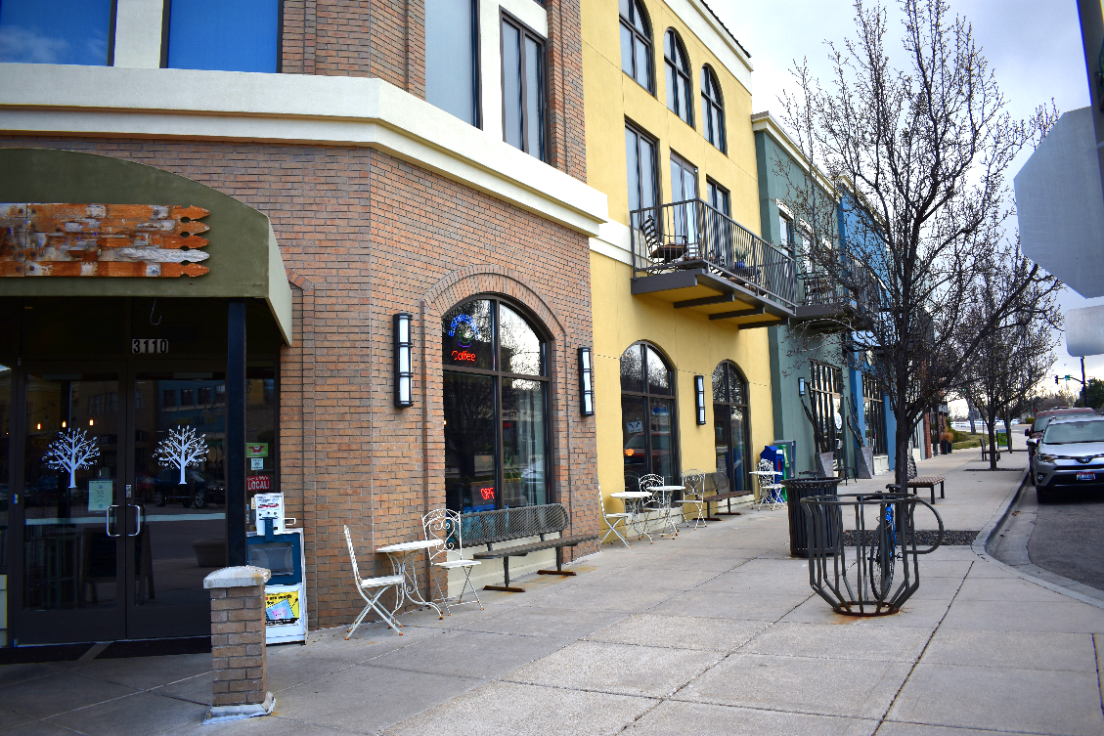
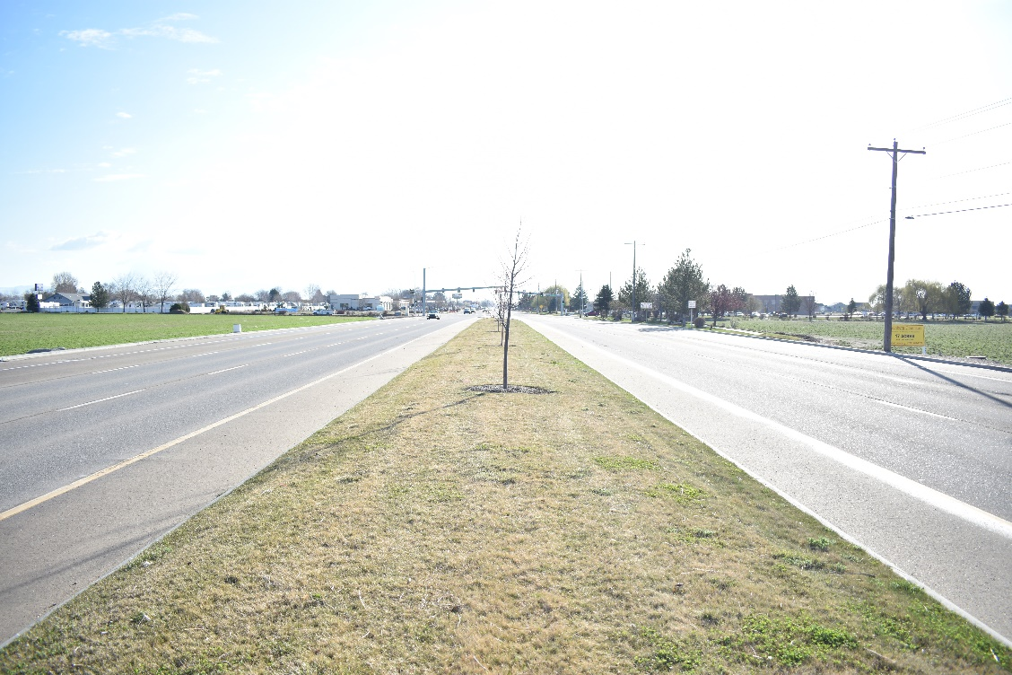
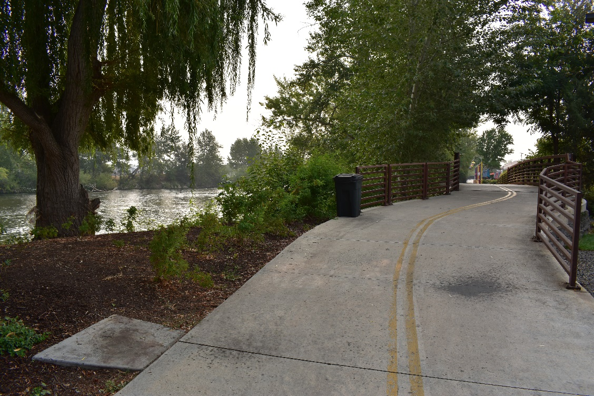
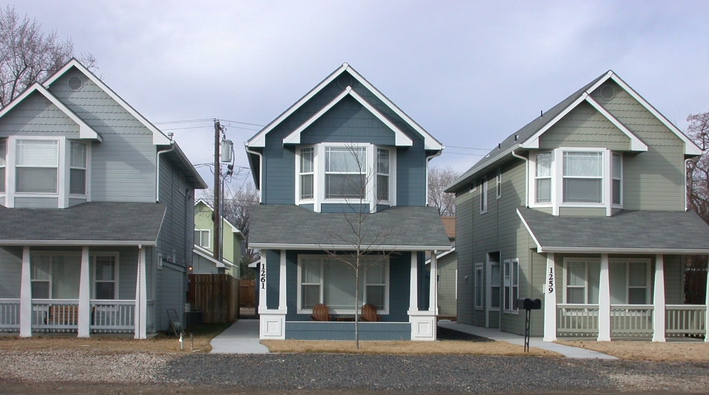
Penny Lane

Slide 13
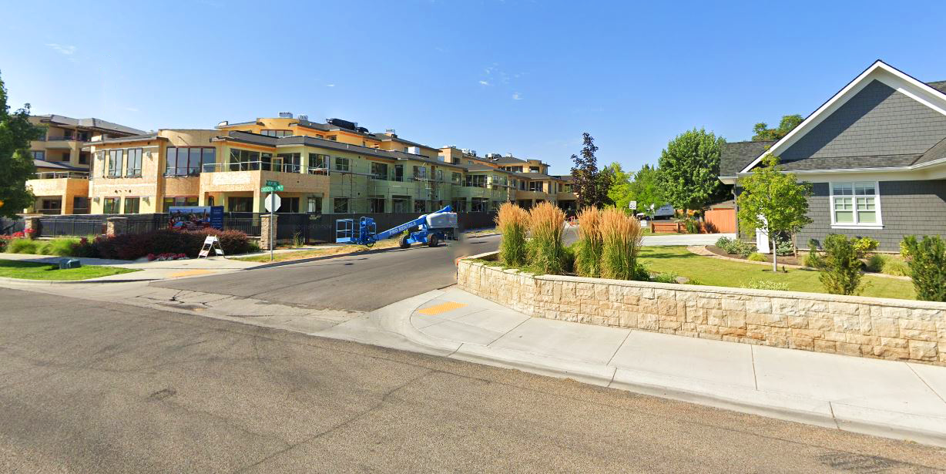
Come Together

Slide 14
What is a Fiscal Impact Analysis?
Infrastructure and service costs
Revenues
Location
Policies and Incentives
Demographic changes
Does growth pay for itself?

Slide 15
Services Evaluated
Transportation
Schools
Safety and Emergency Services
Parks and Recreation
Administration and much more…

Slide 16
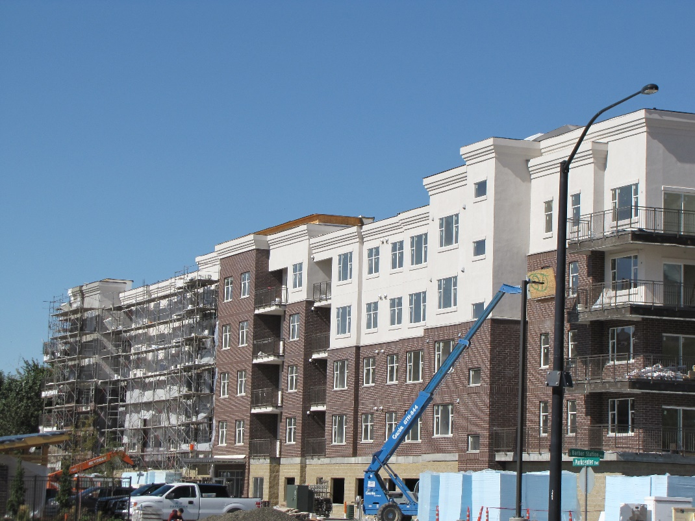
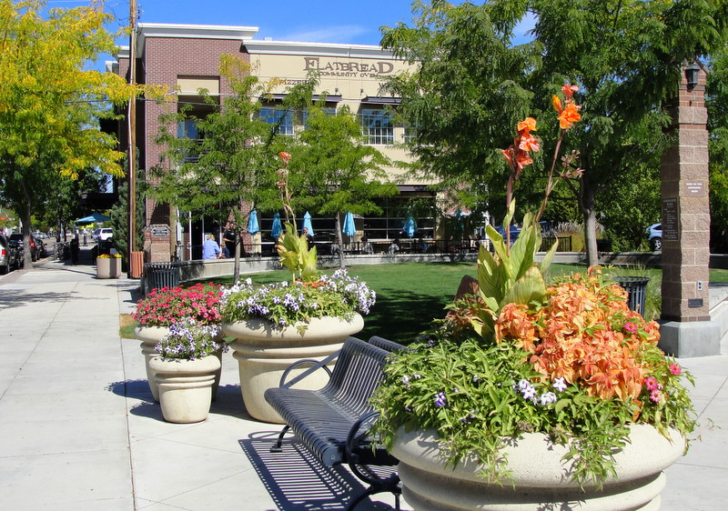
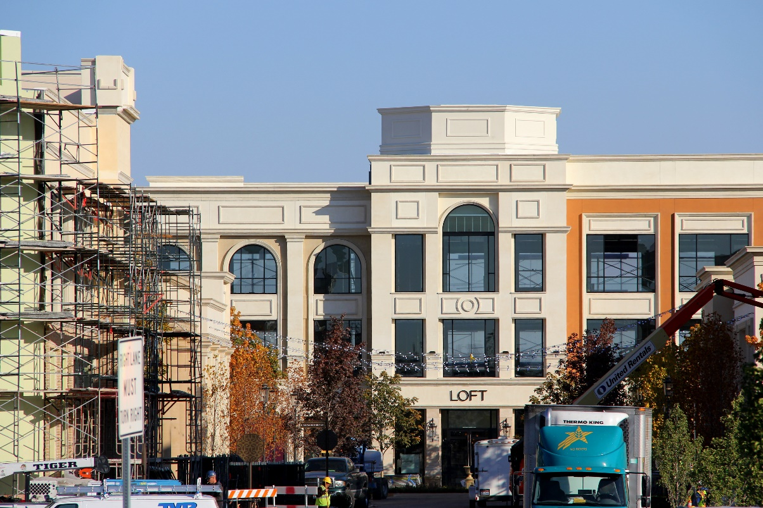
Land Use Prototypes

Slide 17
Data Needs
Revenue Factors
Property taxes
Cost Factors
Trip length
Persons per household
Students per household
School boundary assignment
Impact fees
Jobs per 1,000 square feet
Must be significantly different or it has additional complexity
and room for user error
17
Notes:
Talking Points

Slide 18
Location, Location, Location
Average cost
Average usage
Average per capita/employee
Masks timing
Budget in equilibrium
Marginal cost
Depends on local levels of service
Available capacity triggers capital needs
More sensitive to geography

Slide 19
Average vs. Marginal Cost Methods

Slide 20
Fiscal Impact Analysis

Slide 21
What is important to you?

Slide 22
Fiscal Impact Phases
Regional-level
Broad
Community-level
More specific
Marginal Cost Analysis
6-month
$60,000
Average and Hybrid Cost Analysis
1-year
$150,000

Slide 23
Lessons Learned
Growth Management is important to Idaho

Slide 24
Lessons Learned
Growth Management is important to Idaho
Make money amounts “real”

Slide 25
Lessons Learned
Growth Management is important to Idaho
Make money amounts “real”
Public deserves realistic trade-offs

Slide 26
Lessons Learned
Growth Management is important to Idaho
Make money amounts “real”
Public deserves realistic trade-offs
Marginal and average costs

Slide 27
Contact
Carl Miller, PMP, AICP CTP Principal Planner
cmiller@compassidaho.org
Find us online!
www.compassidaho.org
www.facebook.com/compassidaho
www.instagram.com/compassidaho
www.twitter.com/compassidaho
www.youtube.com/compassidaho
www.linkedin.com/company/compassidaho

